Slide 1
Data Structure
Binary Tree

Slide 2
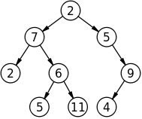

Binary Tree
In computer science, a binary tree is a tree data structure in which each node has at most two child nodes, usually distinguished as "left" and "right".
Nodes with children are parent nodes, and child nodes may contain references to their parents.
In a binary tree, a degree of every node is maximum two. A tree with n nodes has exactly n−1 branches or degree.

Slide 3
Types of Binary Tree
A complete binary tree is a binary tree in which every level, except possibly the last, is completely filled, and all nodes are as far left as possible.(모든 레벨을 내려오면서 왼쪽부터 자식을 순서대로 채움.)
A full binary tree (sometimes proper binary tree or 2-tree or strictly binary tree) is a tree in which every node other than the leaves has two children. Or, perhaps more clearly, every node in a binary tree has exactly (strictly) 0 or 2 children.(자식이 없거나 2개)
A perfect binary tree is a full binary tree in which all leaves are at the same depth or same level, and in which every parent has two children.(모든 레벨에(마지막 제외) 2개의 자식을 가짐. 정삼각형 모양) - 포함관계를 잘 생각하자!

Slide 4


Method for Storing Binary Trees
Nodes and references
In a language with records and references, binary trees are typically constructed by having a tree node structure which contains some data and references to its left child and its right child.
Arrays
Binary trees can also be stored in breadth-first order as an implicit data structure in arrays, and if the tree is a complete binary tree, this method wastes no space.
Perfect 로 만들려면 6개 추가해야
부모가 n방에 있으면 자식은 2n, 2n+1 방에 있다. 부모의 방을 알고 싶으면 2로 나눠보자.

Slide 5
Binary Tree Traverse
Pre-order traverse (전위식)
P – L – R ( P : parent, L : Left sub tree, R : Right sub tree )
In-order traverse (중위식)
L – P - R
Post-order traverse (후위식)
L - R - P

Slide 6
Binary Tree Traverse
Pre-order traverse
2* - 7 - 2 - 6 - 5 - 11 - 5 - 9 - 4
In-order traverse
2 - 7 - 5 - 6 - 11 - 2* - 5 - 4 - 9
Post-order traverse
2 - 5 - 11 - 6 - 7 - 4 - 9 - 5 - 2*

Slide 7
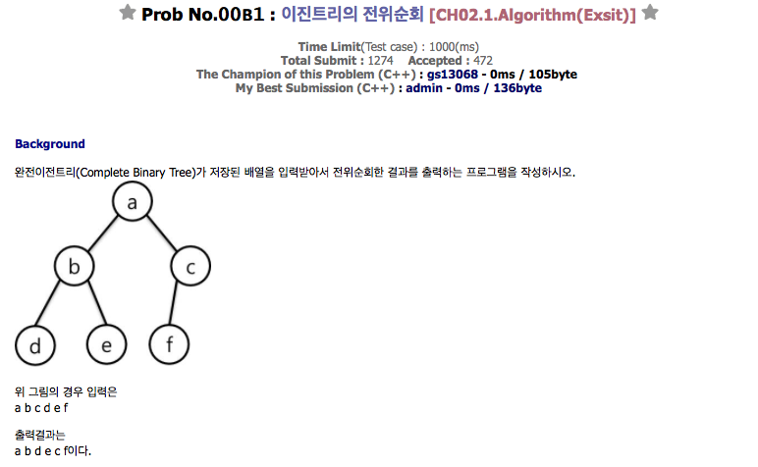
Problems
koistudy.net - 00B1, 00B2, 00B3

Slide 8
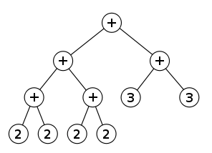
Binary Expression Tree
A binary expression tree is a specific application of a binary tree to evaluate certain expressions.
Two common types of expressions that a binary expression tree can represent are algebraic and boolean.(논리식, 연산식 표현 가능)

Slide 9
Binary Expression Tree
Implementation of expression using stack, structure and pointer
#include <cstdio>
#include <cstdlib>
#include <stack>
using namespace std;
struct NODE{ int v; NODE *l, *r; };
char S[100];
stack<NODE *> st;
NODE *t;
int main()
{
scanf("%s", S); // 후위표현식 입력
for( int i = 0 ; S[i] ; i++ ) // 후위표현식을 수식트리로...
{
if( 'a' <= S[i] && S[i] <= 'z' )
{
t = (NODE *)malloc(sizeof(NODE));
t->v = S[i], t->l = t->r = NULL;
st.push(t);
}
else
{
t = (NODE *)malloc(sizeof(NODE));
t->v = S[i];
t->r = st.top(), st.pop();
t->l = st.top(), st.pop();
st.push(t);
}
}
}

Slide 10
Binary Expression Tree traverse
Pre-order traverse, In-order traverse, Post-order traverse
void post(NODE *v) // 후위순회
{
if( v == NULL ) return;
post(v->l);
post(v->r);
printf("%c",v->v);
}
void in(NODE *v) // 중위순회
{
if( v == NULL ) return;
in(v->l);
printf("%c", v->v);
in(v->r);
}
void pre(NODE *v) // 전위순회
{
if( v == NULL ) return;
printf("%c", v->v);
pre(v->l);
pre(v->r);
}

