Slide 1
Polymath Introduction
Dept. of Chemical Engineering
Catalysis & Energy materials Laboratory (CELab)

Slide 2
Overview
1. Mole balances and Reactors - Chapter 1
2. Conversion and Reactor sizing - Chapter 2
3. Rate Laws, Reaction mechanism and Stoichiometry - Chapter 3
4. Isothermal Reactor Design - Chapter 4
5. Collection and Analysis of Rate Data - Chapter 5
6. Multiple Reactions - Chapter 6
7. Steady State Nonisothermal Reactor Design - Chapter 8
8. Unsteady State Nonisothermal Reactor Design - Chapter 9

Slide 3
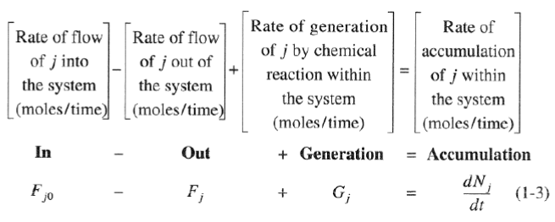
Overview
1. Mole balances and Reactors - Chapter 1

Slide 4
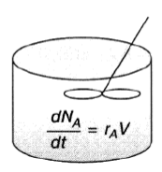
Overview
1. Mole balances and Reactors - Chapter 1

Slide 5
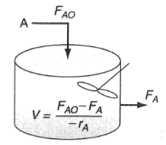
Overview
1. Mole balances and Reactors - Chapter 1

Slide 6
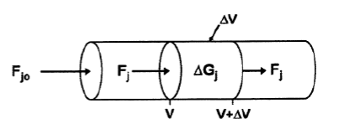
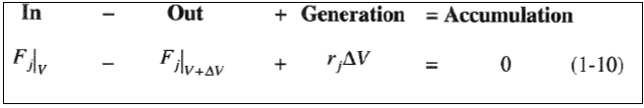
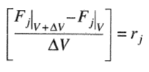

Overview
1. Mole balances and Reactors - Chapter 1

Slide 7

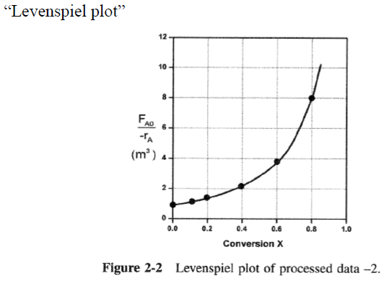
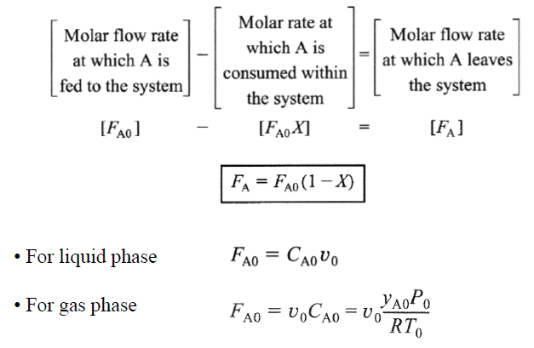
Overview
2. Conversion and Reactor sizing - Chapter 2

Slide 8
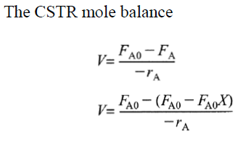
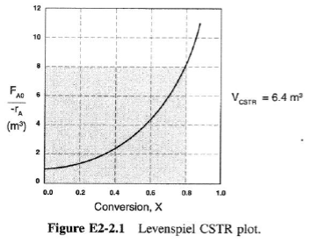

Overview
2. Conversion and Reactor sizing - Chapter 2

Slide 9
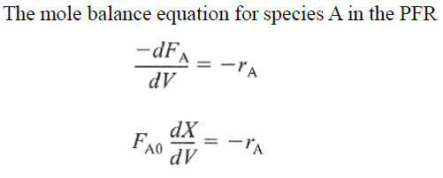
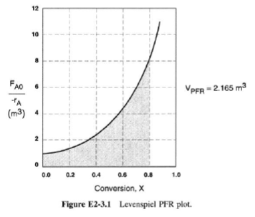

Overview
2. Conversion and Reactor sizing - Chapter 2

Slide 10

Overview
2. Conversion and Reactor sizing - Chapter 2
$$−r_{A}=?$$

Slide 11

Overview
2. Conversion and Reactor sizing - Chapter 2
$$A→P$$
$$−r_{A}=kC_{A} \\ −r_{A}=k[C_{A0}−C_{A0}X] \\ −r_{A}=kC_{A0}\left(1−X\right) \\ V=\int_{0}^{X}{\frac{F_{A0}}{−r_{A}}dX}=\frac{F_{A0}}{kC_{A0}}\int_{0}^{X}{\frac{1}{1−X}dX}$$

Slide 12

Overview
2. Conversion and Reactor sizing - Chapter 2
$$A+2B→P$$
$$−r_{A}=kC_{A}{C_{B}}^{2} \\ −r_{A}=k[C_{A0}−C_{A0}X]{[C_{B0}−2C_{A0}X]}^{2} \\ V=\int_{0}^{X}{\frac{F_{A0}}{−r_{A}}dX}=\int_{0}^{X}{\frac{F_{A0}}{k[C_{A0}−C_{A0}X]{[C_{B0}−2C_{A0}X]}^{2}}dX}$$

Slide 13

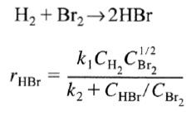


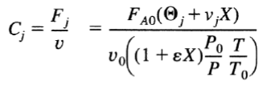


Overview
3. Rate Laws, Reaction mechanism and Stoichiometry - Chapter 3
$$V=\int_{0}^{X}{\frac{F_{A0}}{−r_{A}}dX}$$

Slide 14


Polymath
$$A+2B→P$$
$$C_{A0}=1, C_{B0}=2, C_{P0}=0, v_{0}=100$$ $−r_{A}=kC_{A}{C_{B}}^{2}$
Hand
$$A+2B→P$$
$$−r_{A}=kC_{A}{C_{B}}^{2} \\ δ=−1−2+1=−2, y_{A0}=\frac{1}{3}, ε=−\frac{2}{3} \\ C_{A}=\frac{C_{A0}(1−X)}{1−\frac{2}{3}X},C_{B}=\frac{C_{A0}(2−2X)}{1−\frac{2}{3}X} \\ V=\int_{0}^{X}{\frac{F_{A0}}{−r_{A}}dX}=\int_{0}^{X}{\frac{F_{A0}}{kC_{A}{C_{B}}^{2}}dX}$$

Slide 15
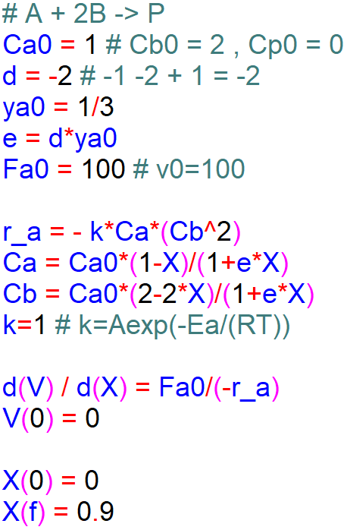

Polymath
$$A+2B→P$$
$$C_{A0}=1, C_{B0}=2, C_{P0}=0, v_{0}=100$$ $−r_{A}=kC_{A}{C_{B}}^{2}$
Program
$$A+2B→P$$
$$−r_{A}=kC_{A}{C_{B}}^{2} \\ δ=−2, y_{A0}=\frac{1}{3}, ε=δy_{A0} \\ C_{A}=\frac{C_{A0}(1−X)}{1+εX},C_{B}=\frac{C_{A0}(2−2X)}{1+εX} \\ \frac{dV}{dX}=\frac{F_{A0}}{−r_{A}} , V\left(0\right)=0, X=0\sim 0.9$$

Slide 16
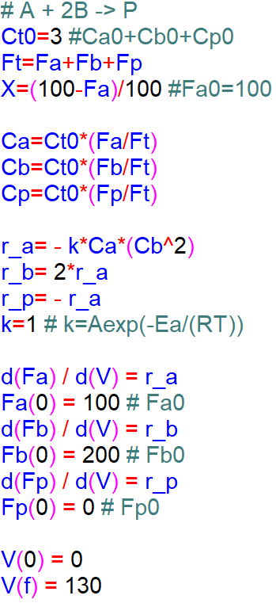




Polymath
$$A+2B→P$$
$$C_{A0}=1, C_{B0}=2, C_{P0}=0, v_{0}=100$$ $−r_{A}=kC_{A}{C_{B}}^{2}$
Program

Slide 17
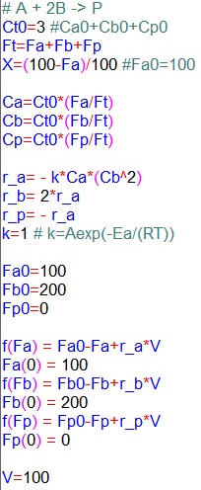
Polymath
$$A+2B→P$$
$$C_{A0}=1, C_{B0}=2, C_{P0}=0, v_{0}=100$$ $−r_{A}=kC_{A}{C_{B}}^{2}$
Program
PFR-ODE
CSTR-Nonlinear

Slide 18
Polymath
$$A+2B→P$$
$$C_{A0}=1, C_{B0}=2, C_{P0}=0, v_{0}=100$$ $−r_{A}=kC_{A}{C_{B}}^{2}$
Program
-Table
-Graph
-Report

Slide 19
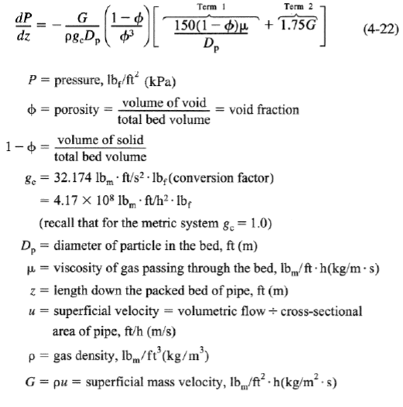
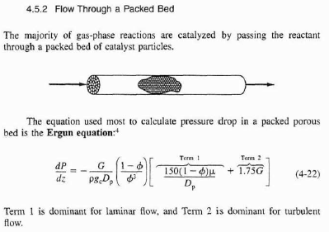
Overview
PBR (Pressure drop / text 175~181p)
4. Isothermal Reactor Design - Chapter 4

Slide 20
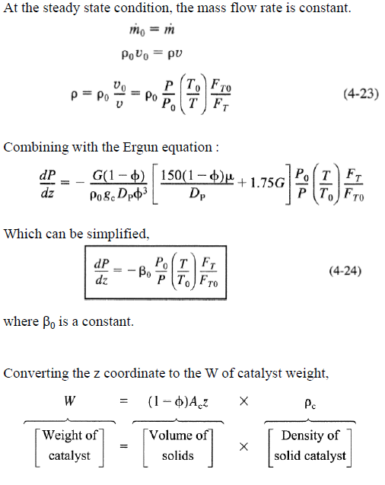
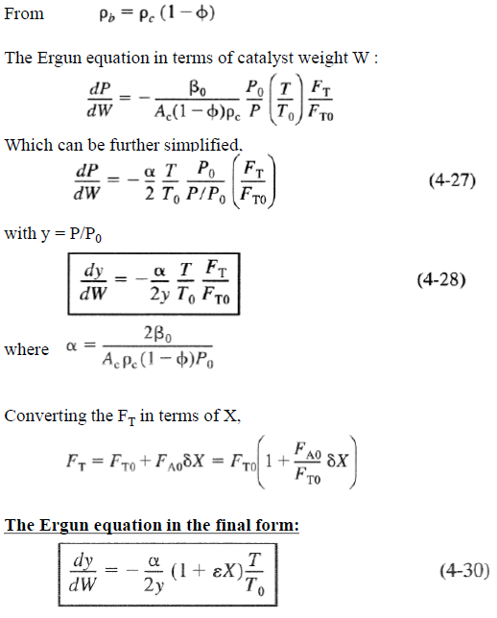
Overview
PBR (Pressure drop / text 175~181p)
4. Isothermal Reactor Design - Chapter 4

Slide 21

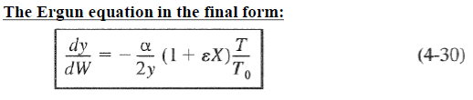


Overview
PBR (Pressure drop / text 175~181p)
4. Isothermal Reactor Design - Chapter 4
$$C_{j}=C_{T0}\frac{F_{j}}{F_{T}}$$
$$C_{j}=C_{T0}\frac{F_{j}}{F_{T}}\frac{T_{0}}{T}y$$

Slide 22
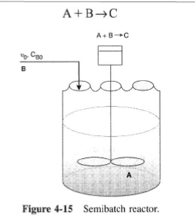
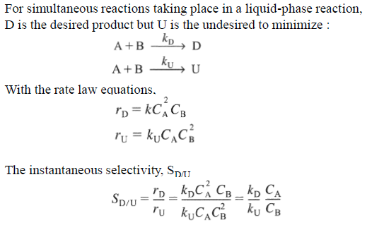
Overview
Semi-batch
4. Isothermal Reactor Design - Chapter 4

Slide 23

Overview
Semi-batch reactor
4. Isothermal Reactor Design - Chapter 4
$\frac{dN_{j}}{dt}=F_{j0}−F_{j}+r_{j}V (F_{j}=0 at Batch reactor,F_{j0}:j inlet)$
$\frac{d(C_{j}V)}{dt}=C_{j}\frac{dV}{dt}+V\frac{dC_{j}}{dt}=F_{j0}+r_{j}V$
$\frac{dC_{j}}{dt}=r_{j}+\frac{F_{j0}}{V}−\frac{C_{j}}{V}\frac{dV}{dt}$
$\frac{dC_{j}}{dt}=r_{j}+\frac{C_{j0}v_{0}}{V}−\frac{C_{j}}{V}v_{0}=r_{j}+\frac{\left(C_{j0}−C_{j}\right)v_{0}}{V} (if V=V_{0}+v_{0}t)$
$\frac{dC_{j}}{dt}=r_{j}−\frac{C_{j}v_{0}}{V}$ (if $F_{j0}$=0)
$\frac{dC_{j}}{dt}=r_{j}$ (if $v_{0}$=0)

Slide 24
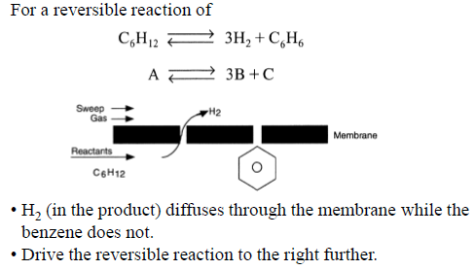
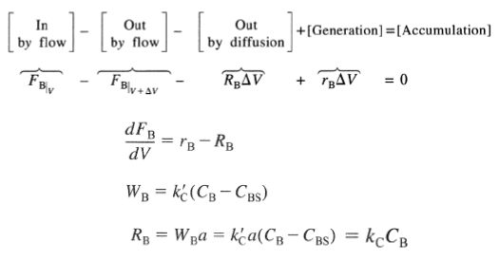
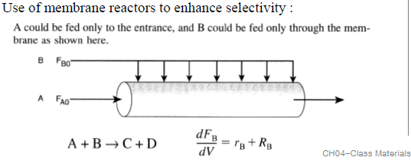
Overview
Membrane reactor
4. Isothermal Reactor Design - Chapter 4

Slide 25
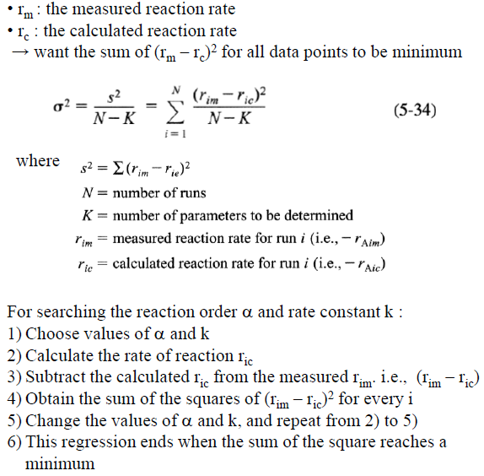
Overview
Regression
5. Collection and Analysis of Rate Data - Chapter 5
-Differential method -Integral method
-Regression
-Initial rate method
-Half-lives method

Slide 26
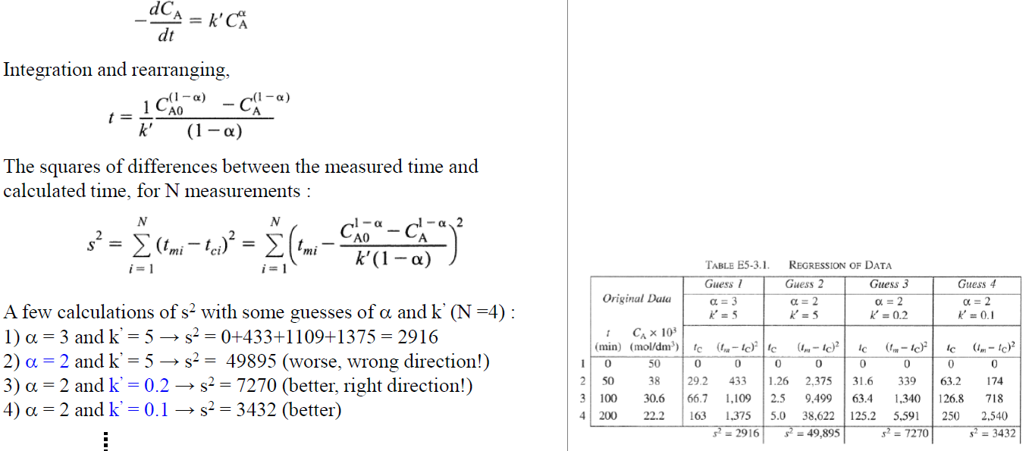
Overview
Regression
5. Collection and Analysis of Rate Data - Chapter 5

Slide 27

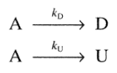
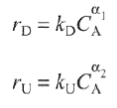



Overview
6. Multiple Reactions - Chapter 6
-Series reactions
-Parallel reactions
-Independent reactions
-Complex reactions

Slide 28


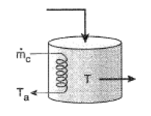

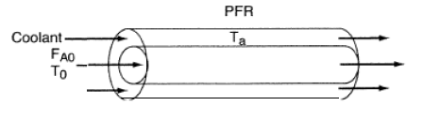

Overview
7. Steady State Nonisothermal Reactor Design - Chapter 8

Slide 29


Overview
7. Steady State Nonisothermal Reactor Design - Chapter 8

Slide 30
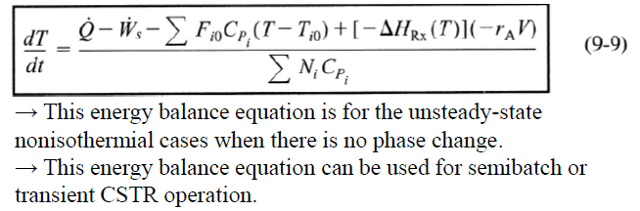
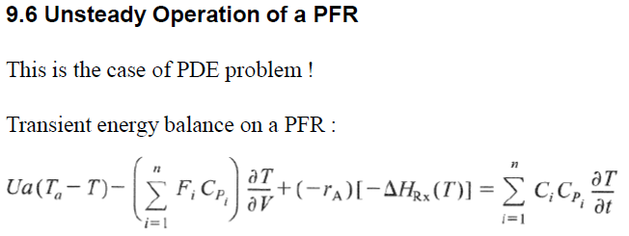
Overview
8. Unsteady State Nonisothermal Reactor Design - Chapter 9

