Slide 1
Happiness Score
vs
Suicide Rate
Alejandra Zapata, Jinming Chen, Xiaolan Li
Professor Topor
Notes:
Jinming

Slide 2
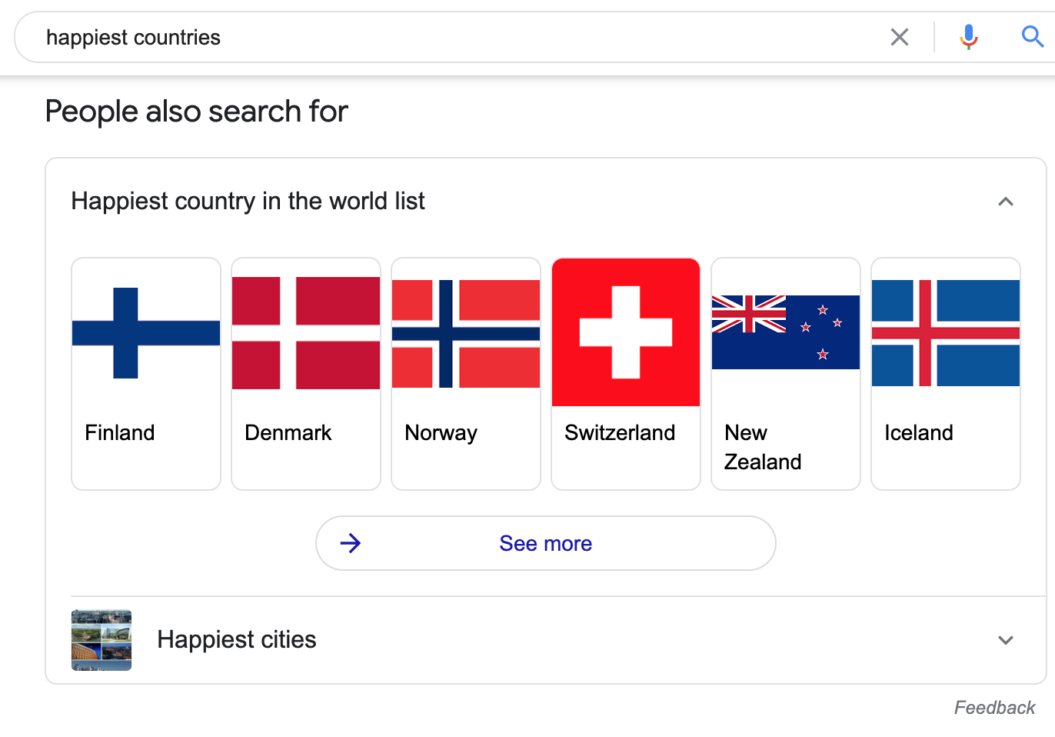
Introduction
Why have these countries been considered to remain at the top of the list in the world happiness report ?
How has the social environment of countries acted as a factor of happiness score?
Notes:
It might seem an odd time to analyze a report ranking which countries are happiest.
After all, who can really be happy during a global pandemic?
But according to the authors of the annual World Happiness Report, an annual survey of how satisfied people worldwide are with their lives, this is precisely the right moment to consider what the top countries in the list have been considering to remain at the top.
In our research, we plan to explore further how the context plays a role in this score and by looking at the second dataset of Suicide Rates per Country dig deeper on how the social environment of cities could be a factor in “happiness” and suicide rates.

Slide 3
Data Sources
World Happiness Report (Kaggle)
Link: https://www.kaggle.com/unsdsn/world-happiness?select=2016.csv
Suicide Rate(Kaggle Web Api token download)
Link: https://www.kaggle.com/twinkle0705/mental-health-and-suicide-rates?select=Crude+suicide+rates.csv
Country Status (Kaggle)
Link: https://www.kaggle.com/kumarajarshi/life-expectancy-who
Country Population (Rapid Web Api request json file)
Link: https://rapidapi.com/ajayakv/api/rest-countries/endpoints

Slide 4




Research Question
1. What attributes could be the factors that influence the happiness score?
2. Based on GDP per capita, does a developing country have a higher suicide rate or a developed country has a higher suicide rate?
3. Can family(social support) decreases the suicide rate?
4. Can high happiness score increase the population?

Slide 5
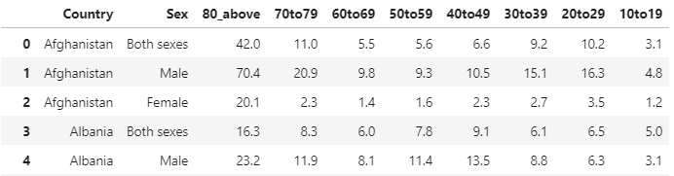
Data Acquisition
Happiness Score
Suicide Rate
Total Rate
Country Status

Slide 6
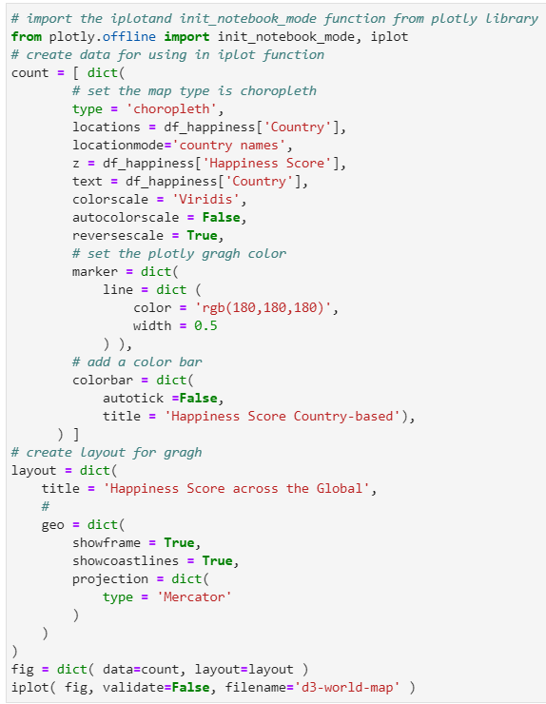
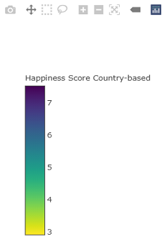
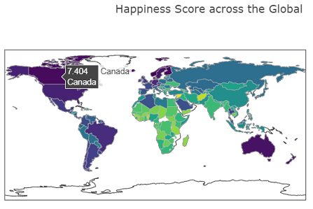
Happiness Dataset Exploratory Data Analysis

Slide 7
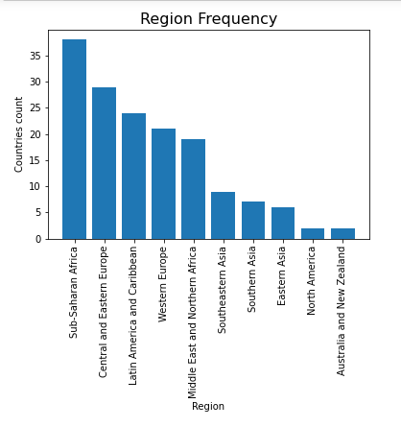
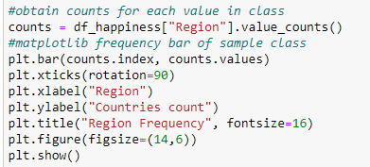
Countries per Region

Slide 8
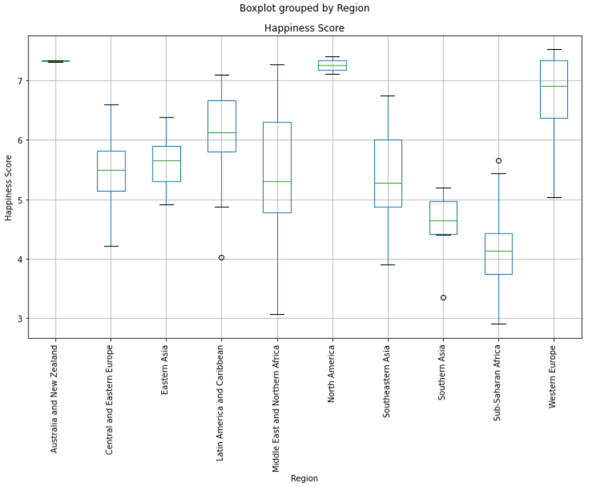

Happiness Score per Region

Slide 9
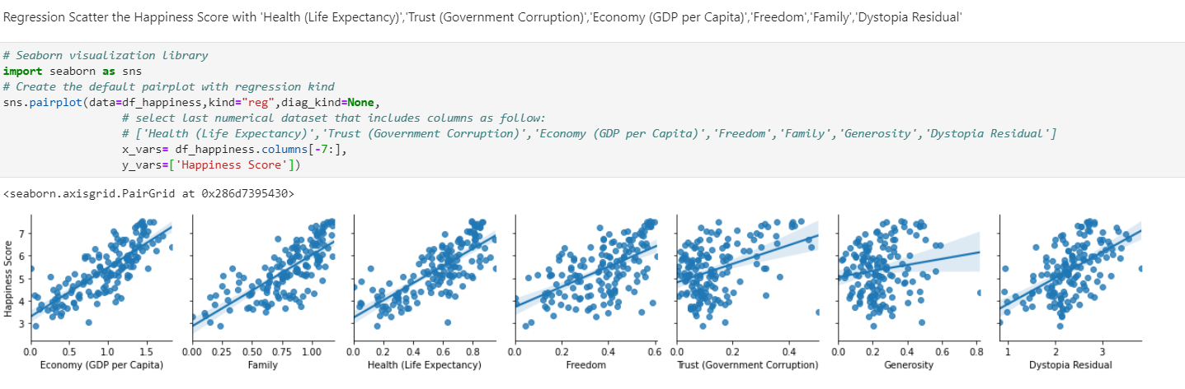
Relationship between Happiness Score and other Attributes

Slide 10
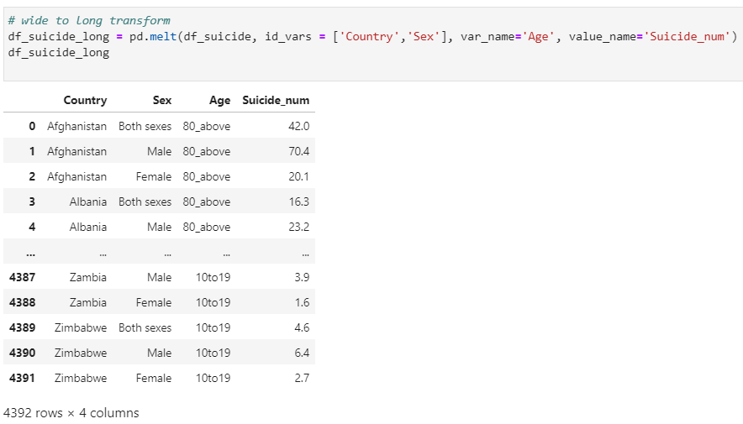
Suicide Dataset Exploratory Data Analysis
Transformation- Wide to Long
Notes:
Cara

Slide 11
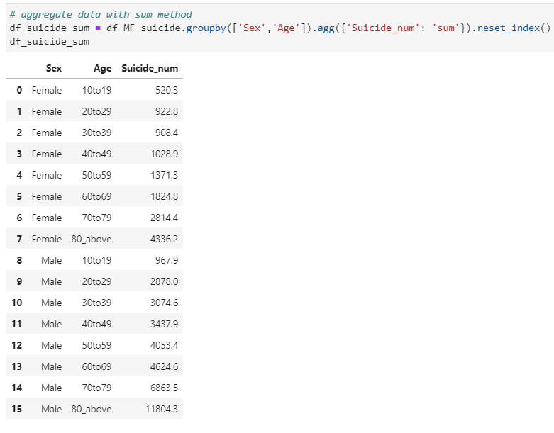
Aggregation- Sum

Slide 12
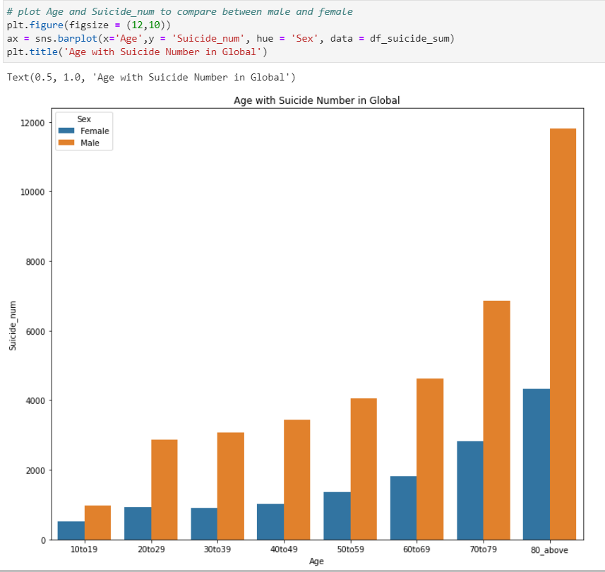
Sucide rate distribution per gender

Slide 13
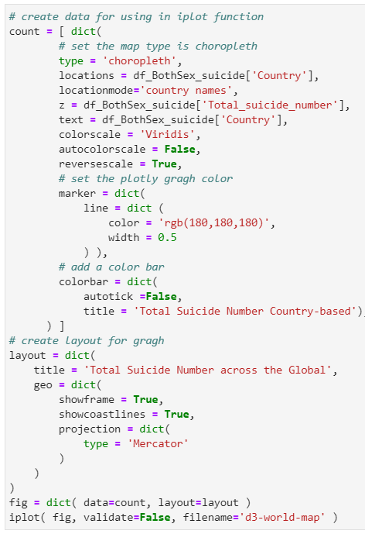
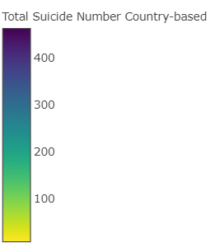
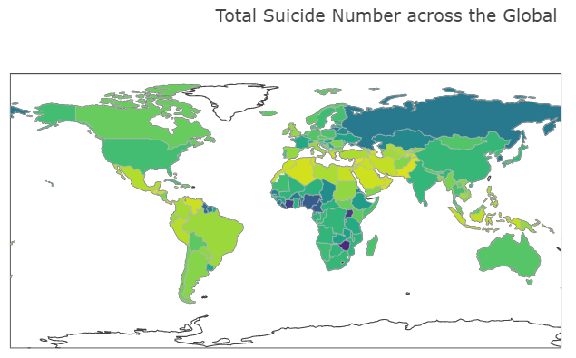
Total Number of suicides across the world

Slide 14
Challenge- plotly graph

Slide 15
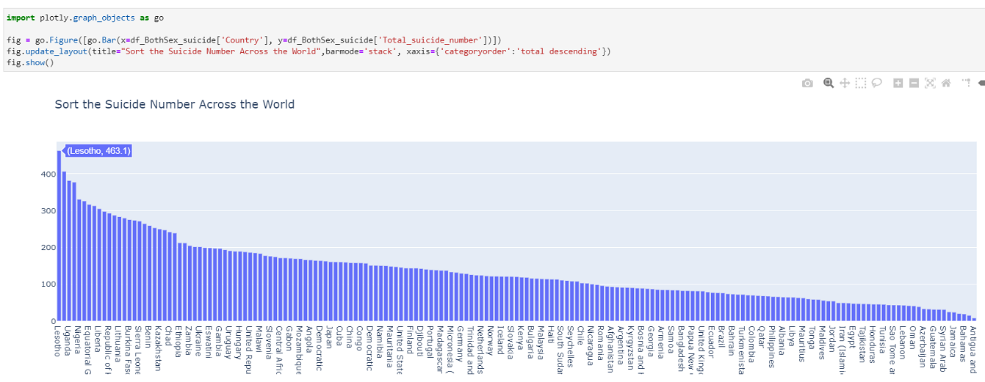
Total suicides Number around the World

Slide 16
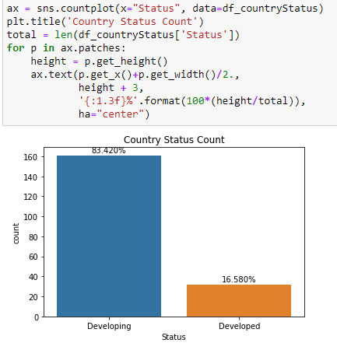
Country Status Dataset Exploratory Data Analysis

Slide 17
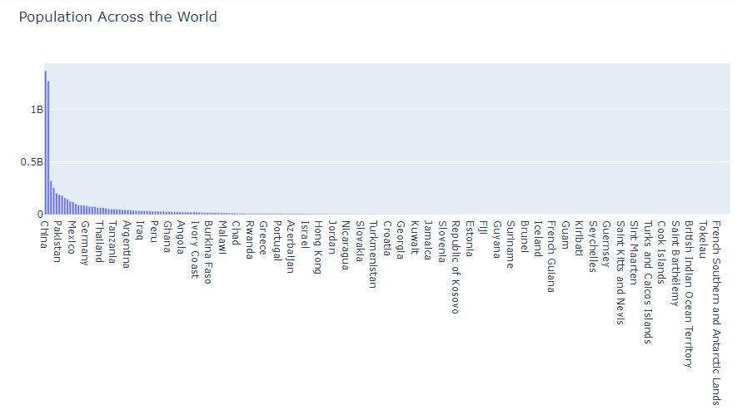
Population Dataset Exploratory Data Analysis

Slide 18
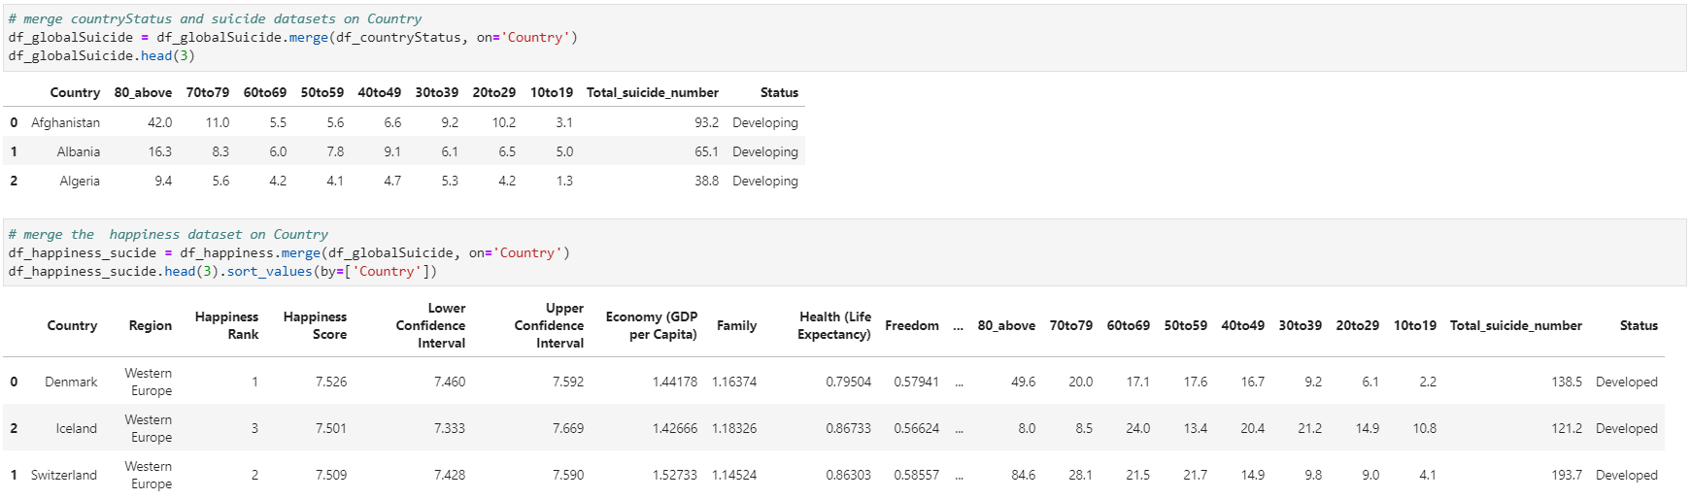
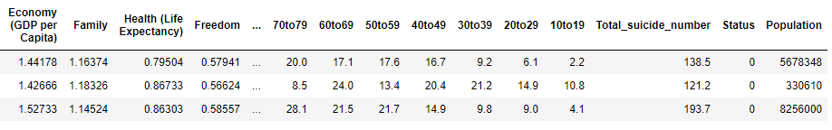
Data Preparation
Notes:
Jinming

Slide 19
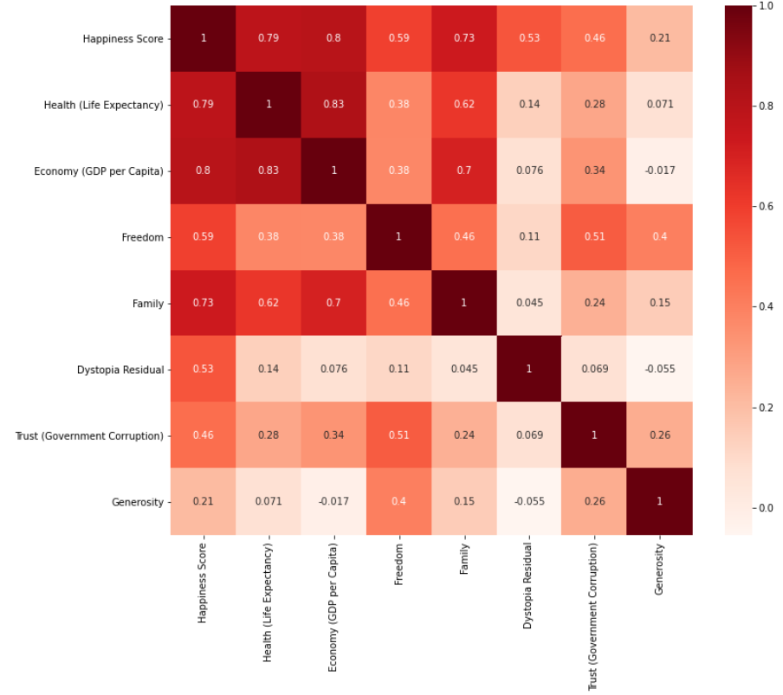
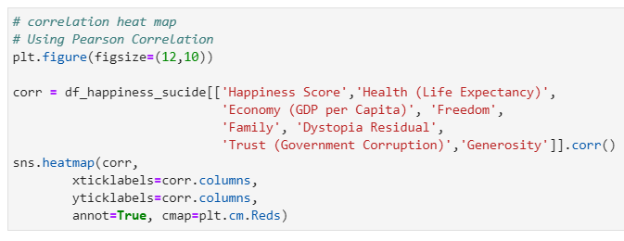
1. What attributes could be the factors that influence the happiness score?
'Health (Life Expectancy)',
'Economy (GDP per Capita)',
'Family'

Slide 20
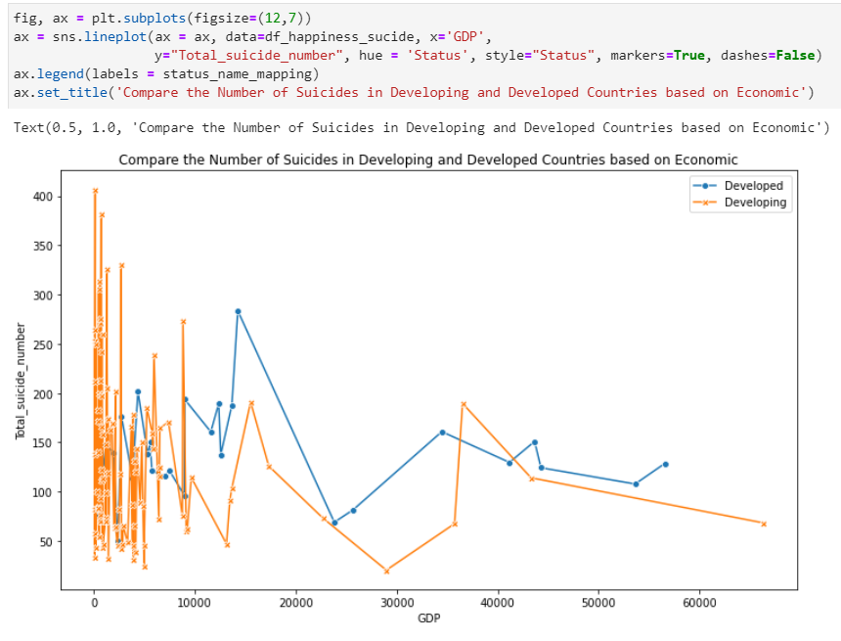
2. Based on GDP per capita, does a developing country have a higher suicide rate or a developed country has a higher suicide rate?
Gross Domestic Product per capita
(in USD)
Suicide rates per 100, 000 population

Slide 21
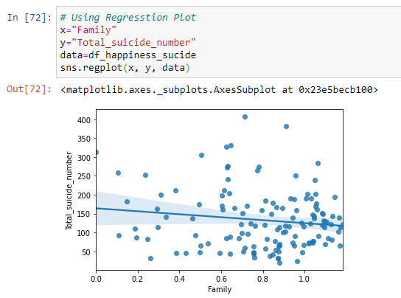
3. Can family(social support) decreases the suicide rate?

Slide 22
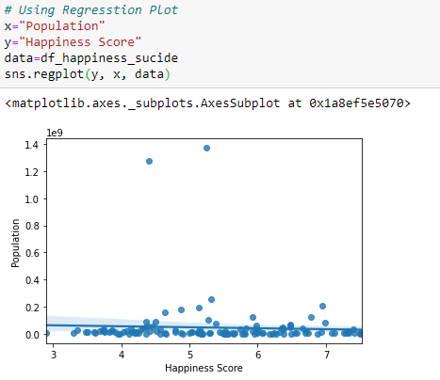

4. Can higher happiness score increase the population?

Slide 23
Conclusion
Factors that influence the suicide rates and happiness scores
Difference between age group and gender in suicide rates
Improve people’s happiness and decrease suicide rates
Notes:
The regions that have countries with a higher Happiness Score are Australia, North America, and Western Europe. Followed by Latin American and Caribbean countries. The regions with the lowest score are within the Sub-Saharan countries and Southern Asia.
Happiness Score and Health (Life Expectancy), Family and Economy(GDP per Capita) have a high correlation whereas Freedom, Dystopia Residual and Trust have a moderate relationship. This means that in this study people throughout all countries said that health, family structure and their country's wealth affected their happiness.
Also from the EDA, we understood that most countries had a low score to the extent in which Generosity and Trust affect their happiness throught the histogram's distribution. Out of 157 countries the majority had happiness score aroun 5 in a scale from 0-8. The lowest score was 2.90 and the highest 7.5.
Moreover, suicide rates througout the world are higher for male and lower for female and they both increase as the age group increases. Age would be a layer to make more granular the explanation for the happiness score as we see there is a trend regarding age increase and suicide rates.
Question 1From our research questions we confirmed that the extent to which health, family and economy affect a countries happines has a positive relationship. Some of the less important factors include Government Trust and Generosity.
Question 2
Question 3 Although we saw that family has a high correlation to Happiness Score it did not have a positive coefficient with suicide rates. Further analysis would lead us to calculate the coefficient for Health or Economy which are also some of the more strongly connected attributes to Happiness Score, but family was not the best performer.
Through this project we understood the three most impactful factors to our happiness throughout the wolrd. They may not necessarily be the most impactful to decrease suicide rate's but we would need to further our research to see the impact.
From looking at the original study we were not able to gather information to see if health includes mental health but it would be interesting to look more into this.
Developing countries blah blah blah

Slide 24
Reference
1. https://worldhappiness.report/ed/2016/
2. https://www.who.int/bulletin/volumes/88/10/09-070821/en/
3. https://www.who.int/teams/mental-health-and-substance-use/suicide-data
4. https://s3.amazonaws.com/happiness-report/2016/FAQ_2016.pdf
5. https://plotly.com/python/maps/
6. https://www.nytimes.com/2020/03/20/world/europe/world-happiness-report.html
7. https://rapidapi.com/blog/how-to-use-an-api-with-python/
8. https://github.com/Kaggle/kaggle-api

Slide 25
Thank you!

