Slide 1




MedInsight
TURNAMEN SAINS DATA NASIONAL 2024
BoyWithLuv
Ketua Pelaksana Turnamen Sains Data Nasional 2024

Slide 2
MedInsight
TURNAMEN SAINS DATA NASIONAL 2024
BoyWithLuv
Ketua Pelaksana Turnamen Sains Data Nasional 2024

Slide 3
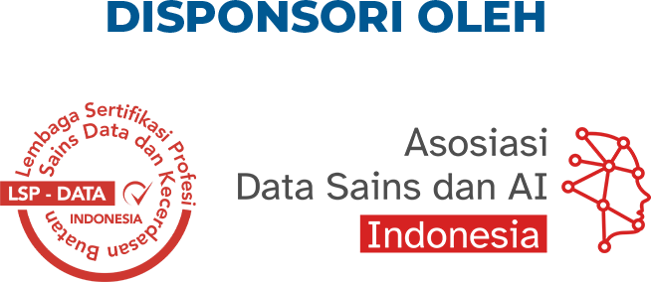

Slide 4
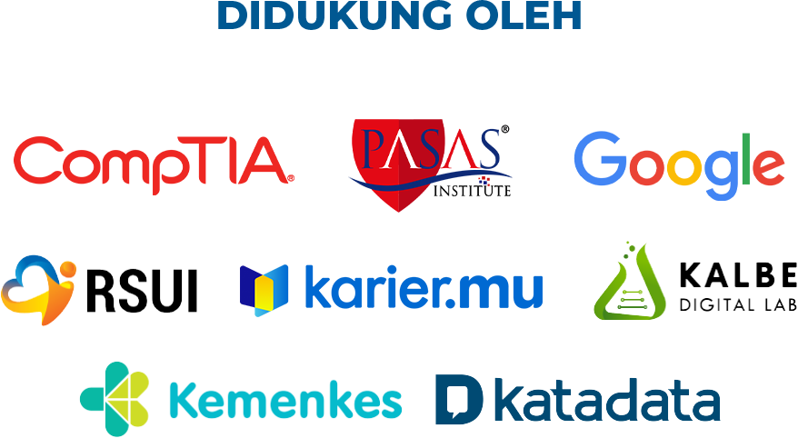


Slide 5
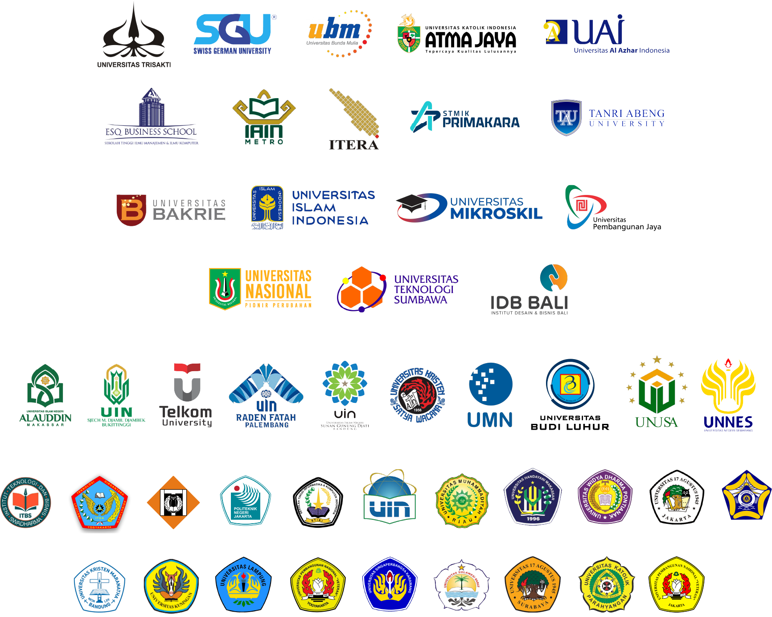

Slide 7

Daftar Isi
Isi daftar isi
Informasi Tim
Pendahuluan
Latar Belakang
Analisa Data
Proses Flow
Model Seleksi
Dokumentasi
Kesimpulan
Daftar Pusaka
TSDN 2024

Slide 8

Informasi Tim
Eugene Winata
Steven Yenardi

Slide 9
Laporan
Hasil Pekerjaan

Slide 10
Pendahuluan
Indonesia, with its rapidly growing population, faces significant challenges in healthcare, particularly due to the increasing burden of non-communicable diseases (NCDs) and rising hospitalization costs. While the government’s Jaminan Kesehatan Nasional (JKN) program has expanded healthcare access, issues like regional disparities, a shortage of medical professionals, and the escalating costs of chronic disease management remain pressing.
This project aims to utilize predictive analytics to forecast disease risks and provide insights into hospitalization outcomes. The disease prediction models will focus on conditions such as heart attack, stroke, angina, depressive disorders, arthritis, and skin cancer—all of which are major contributors to mortality and healthcare expenditure in Indonesia. Additionally, the project will develop models to predict hospitalization insights like survival rates, surgery risks, hospitalization costs, and admission durations, thereby enabling healthcare providers to make data-driven decisions and optimize patient care and hospital resource allocation.

Slide 11
Latar Belakang
Indonesia is facing a rising prevalence of non-communicable diseases (NCDs), such as heart attack, stroke, angina, depressive disorders, arthritis, and skin cancer, which significantly contribute to mortality and healthcare costs. Cardiovascular diseases, including heart attacks and strokes, are especially common due to factors like poor diet and smoking. Early disease prediction and intervention can reduce mortality and healthcare burdens (WHO, 2018).
Alongside these diseases, the aging population and lifestyle changes have led to an increase in arthritis and skin cancer cases. Predictive analytics can help identify individuals at risk, enabling proactive treatment and improving outcomes (Jarman & McDonald, 2019).
Moreover, hospitalization insights such as survival rates, surgery risks, hospitalization costs, and admission durations are crucial for optimizing healthcare services. Predicting these factors helps hospitals improve resource allocation, reduce costs, and enhance patient care (Sismanto & Arifin, 2020).
By integrating disease prediction and hospitalization insights, this project aims to support Indonesia's healthcare system in addressing these challenges and improving both patient outcomes and hospital efficiency.

Slide 12
Analisa Data
Penjabaran proses telaah data

Slide 13
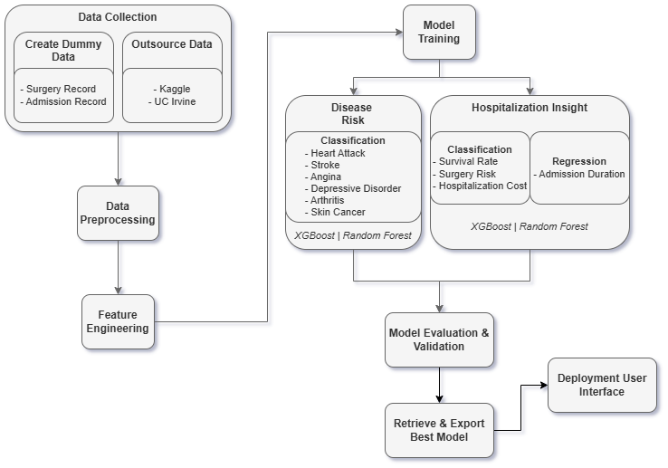
Proses Flow

Slide 14
Model Seleksi
For this project, we aim to predict various health-related outcomes such as heart attack, stroke, arthritis, surgery risks, hospitalization costs, and stay duration. To address these diverse prediction tasks, we have selected XGBoost and Random Forest as our primary machine learning models due to their robustness, interpretability, and proven effectiveness across both classification and regression tasks.
XGBoost:
XGBoost (Extreme Gradient Boosting) is an advanced gradient boosting algorithm known for its efficiency and high performance in both classification and regression problems. It is particularly advantageous for handling large datasets and can model complex, non-linear relationships in the data. In this project, XGBoost is ideal for disease prediction tasks such as heart attack, stroke, and arthritis classification, as it can handle unbalanced datasets effectively by adjusting class weights and using boosting techniques to improve prediction accuracy. Additionally, XGBoost's feature importance capabilities allow for better interpretation of the model, enabling healthcare professionals to understand the key factors contributing to disease risks. XGBoost also performs well in scenarios where hyperparameter tuning is crucial for achieving the best model performance (Chen & Guestrin, 2016).
Random Forest:
Random Forest is an ensemble learning method that constructs multiple decision trees during training and outputs the class or prediction based on majority voting (for classification) or averaging (for regression). Random Forest is particularly useful in healthcare-related tasks due to its ability to handle high-dimensional data with missing values, which is common in medical datasets. For tasks like predicting hospitalization costs, stay duration, and surgery risk, Random Forest is a strong candidate because of its robustness to overfitting and ability to model complex relationships with less effort in hyperparameter tuning. It provides a good balance between interpretability and performance, making it suitable for understanding the factors affecting patient outcomes. Additionally, Random Forest is less sensitive to noisy data compared to some other models, which is important in healthcare settings where data quality can vary (Breiman, 2001).

Slide 15
Dokumentasi
Screen Capture hasil capaian

Slide 16
Kesimpulan
Penjabaran kesimpulan

Slide 17
Chen, T., & Guestrin, C. (2016). XGBoost: A Scalable Tree Boosting System. Proceedings of the 22nd ACM SIGKDD International Conference on Knowledge Discovery and Data Mining, 785-794. Retrieved from https://dl.acm.org/doi/10.1145/2939672.2939785
Breiman, L. (2001). Random Forests. Machine Learning, 45(1), 5-32. Retrieved from https://link.springer.com/article/10.1023/A:1010933404324
World Health Organization (WHO). (2018). Noncommunicable diseases country profiles 2018. Retrieved from https://www.who.int/nmh/countries/idn_en.pdf
Jarman, H., & McDonald, M. (2019). Healthcare in Indonesia: Challenges and Prospects. Asian Journal of Health Policy, 7(3), 45-60.
Sismanto, S., & Arifin, Z. (2020). Universal Health Coverage in Indonesia: Progress and Challenges. Journal of Global Health, 10(2), 112-118.
Kaggle Dataset. (2021). Patients Data for Medical Field. Retrieved from https://www.kaggle.com/datasets/tarekmuhammed/patients-data-for-medical-field/data
Kaggle Dataset. (2021). Healthcare Dataset. Retrieved from https://www.kaggle.com/datasets/prasad22/healthcare-dataset/data
UCI Machine Learning Repository. (2021). Support2 Dataset. Retrieved from https://archive.ics.uci.edu/dataset/880/support2
Daftar Pustaka

Slide 18
Terima Kasih

