Slide 1
READY · STOCKED · ACCOUNTABLE
CLOUD ENGINEERING PORTFOLIO
EMS ReadyKit Demos
Shift-ready ambulances, verified before every call.
Administrator demonstration

Slide 2
OVERVIEW
What is EMS ReadyKit?
EMS ReadyKit gives crews and supervisors a structured, accountable way to verify that every ambulance is stocked, nothing is expired, and critical equipment is ready — before every shift goes out the door.
01
02
03
Responders
Supervisors
Administrators
Fast, easy and available inventory updates on demand
Compliance dashboards – know your status immediately
Complete access with easy station setup
EMS ReadyKit
02

Slide 3
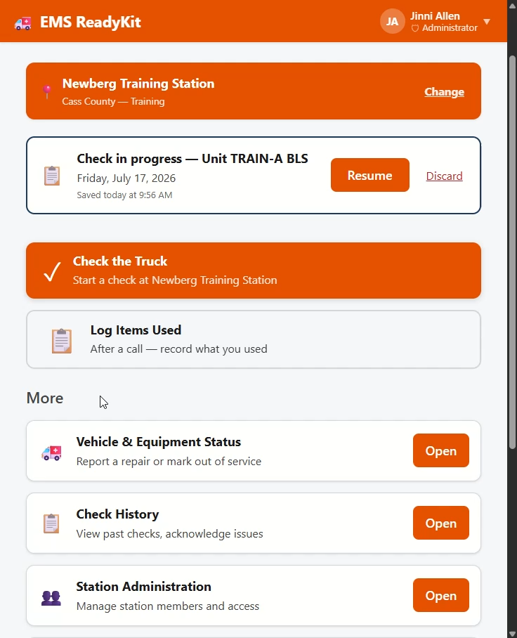
ADMINISTATOR
Daily Tasks
Administrators can set up stations, seed vehicles and items. They can also step in and help supervisors when requested.
Settings
Station Administration
Check History hard delete
EMS ReadyKit
09
Notes:
Administration is meant to be a supportive role and help bring in new stations or pre-load data for users.

Slide 4
EMS READYKIT
Crews ready before every call.
A structured, accountable readiness check — stocked, in-date, and equipment-tested — built and deployed as a cloud web application.
EMAIL
GITHUB
jinniyah@gmail.com
https://github.com/Jinniyah/EMS_ReadyKit

