Slide 1

AZURE TECHNICAL EVIDENCE
EMS ReadyKit
Backend Engineering & Deployment Evidence
Azure Cloud
REST API
PostgreSQL
AZURE CLOUD ARCHITECTURE

Slide 2
Backend Architecture Overview
Four core Azure services powering EMS ReadyKit in production
FEATURE-01
FEATURE-02
FEATURE-03
FEATURE-04
Azure App Service
PostgreSQL Flexible Server
Static Web Apps
Azure AD
Node.js/Python REST API hosted on PaaS with auto-scaling enabled. Standard B1 plan
Global CDN delivery across Azure PoPs worldwide. CI/CD via GitHub Actions, custom domain ready with managed TLS
OAuth2 / OIDC app registration with token-based auth enforced on all API routes. Role-based access control enabled
Managed relational DB with private VNet integration. Automated backups, SSL enforcement, geo-redundant retention
Node.js 20 LTS
Python 3.11
PostgreSQL 16
VNet Private
Azure CDN
GitHub Actions
OAuth2
OIDC
RBAC
PaaS
128 GB
HTTPS

Slide 3
FEATURE-01 · Azure App Service
REST API host — Platform-as-a-Service
01
Runtime Environment
Node.js 20 LTS / Python 3.11 on Linux App Service Plan
02
Service Tier
Basic B1 with auto-scale rules
03
Deployment Method
GitHub Actions CI/CD pipeline, ZIP deploy on push to main
04
Networking
HTTPS enforced, TLS 1.2 minimum, outbound VNet integration
05
Health & Monitoring
Application Insights connected, /health endpoint active, alert rules configured
Resource Group: rg-ems-readykit-dev · Region: North Central US · Plan: Basic B1 · OS: Linux

Slide 4
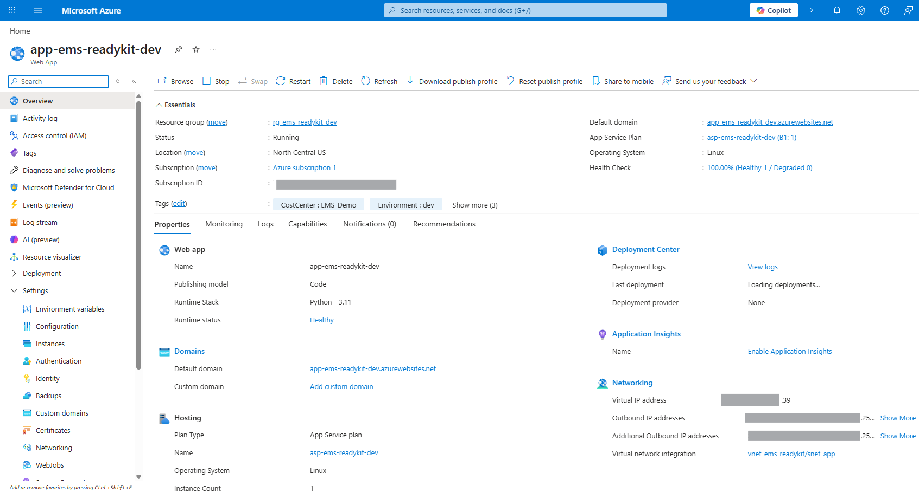
Azure App Service
FEATURE-01

Slide 5
FEATURE-02 · PostgreSQL Flexible Server
Managed relational database — private VNet integrated
SERVER CONFIGURATION
SECURITY & CONNECTIVITY
Engine
Endpoint Access
PostgreSQL 16.x Flexible Server
Private endpoint · no public access
SKU
VNet Integration
Standard_B1ms · 1 vCore · 2 GB memory
vnet-ems-readykit / snet-db
Storage
SSL Enforcement
32 GB · auto-grow enabled
ON · require_secure_transport enabled
Backup
Authentication
7-day retention · geo-redundant
Azure AD authentication enabled
Availability Zone
Firewall Rules
Zone 1 · North Central US
No public rules — VNet only
RESOURCE GROUP: rg-ems-readykit-dev
REGION: North Central US
POSTGRESQL 16.X · FLEXIBLE SERVER · VNET ISOLATED

Slide 6
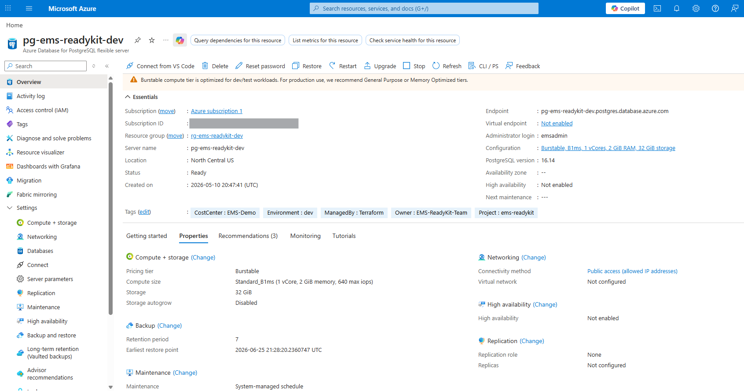
PostgreSQL Flexible Server
FEATURE-02

Slide 7
FEATURE-03 · Azure Static Web Apps
Global CDN delivery with integrated CI/CD — frontend hosting evidence
Global CDN
Content distributed across Azure CDN PoPs worldwide, sub-100ms TTFB
01
CI/CD Integration
GitHub Actions workflow auto-triggered on PR merge to main branch
02
Default Domains & TLS
Default domain mapped, free managed TLS certificate, HTTPS-only
03
Linked Backend API
CORS configured, API base URL bound to App Service endpoint
04
Staging Environments
Pull request preview environments auto-provisioned per branch
05

Slide 8
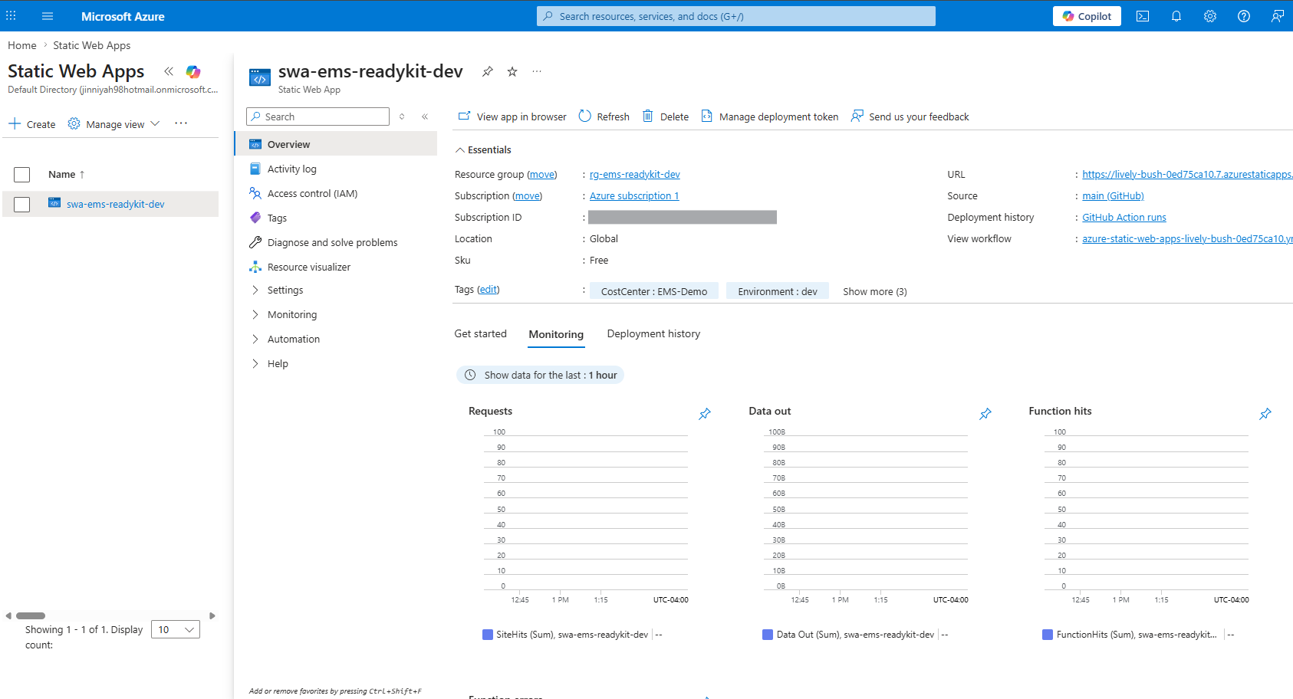
Static Web Apps
FEATURE-03

Slide 9
ENTRA ID
FEATURE-04 · Azure AD App Registration
App Registration
Identity platform integration — OAuth2 & OIDC authentication
Client Credentials
Redirect URIs
Application (client) ID registered in tenant directory; client secret generated and stored as a Key Vault reference — never in source code.
Production and staging callback URIs registered; SPA implicit grant flow disabled. Auth code + PKCE enforced for all token requests.
API Permissions
Token Configuration
Microsoft Graph: User.Read delegated scope. Custom API scope emsreadykit-api/.default exposed and consented at tenant level.
Access token lifetime: 1 hour; refresh token: 24 hours. Optional claims enabled: upn, email, roles mapped to JWT payload.
OAuth2
OIDC
PKCE
Entra ID

Slide 10
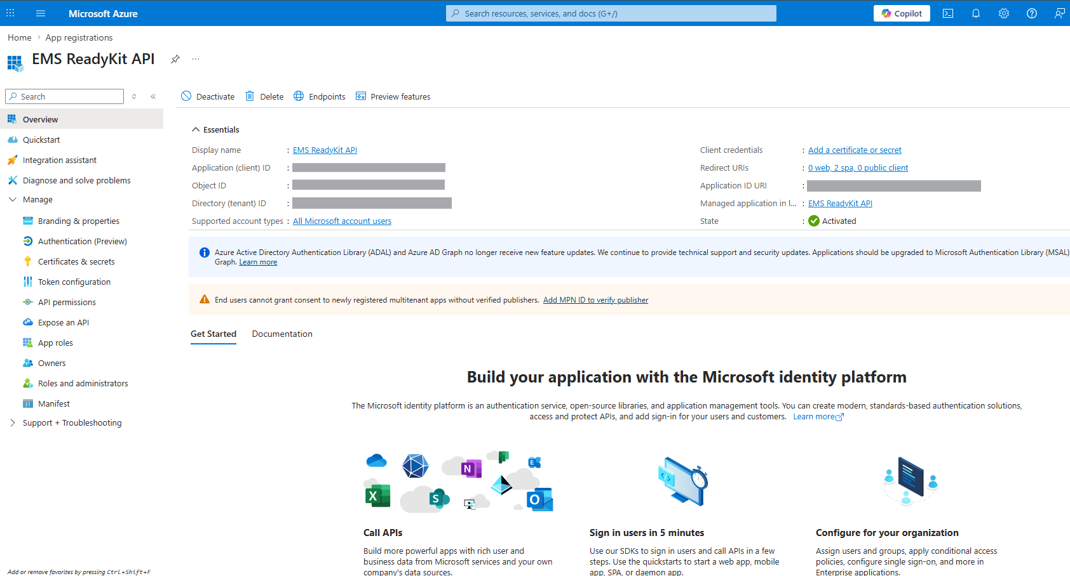
Azure AD App Registration
FEATURE-04

Slide 11
CLOSING SUMMARY
Backend Delivery — Key Takeaways
EMS ReadyKit is fully deployed, secured, and production-ready
01
4 Live Azure Resources Verified
AZURE · NORTH CENTRAL US
FEATURE-01 through 04 all provisioned and active in North Central US
02
Secure-by-Default Architecture
ZERO TRUST · OAUTH2
Private VNet, HTTPS-only, Azure AD authentication, Key Vault secrets on every resource
03
Scalable API Backend
REST · NODE.JS
Versioned REST API, auto-scaling App Service, structured error handling and correlation IDs
04
Robust Data Layer
POSTGRESQL · PAAS
PostgreSQL Flexible Server with VNet isolation, SSL enforcement, automated backups, and versioned migrations
05
Full CI/CD Observability
GH ACTIONS · INSIGHTS
GitHub Actions pipeline, Application Insights, Azure Monitor alerts, and zero-downtime deploy slots
EMS READYKIT
BACKEND ENGINEERING EVIDENCE
JULY 2026

