Slide 1
READY · STOCKED · ACCOUNTABLE
CLOUD ENGINEERING PORTFOLIO
EMS ReadyKit
Shift-ready ambulances, verified before every call.
A web application built, deployed, and operated on the cloud
Product walkthrough · Architecture · Engineering highlights

Slide 2
OVERVIEW
What is EMS ReadyKit?
EMS ReadyKit gives crews and supervisors a structured, accountable way to verify that every ambulance is stocked, nothing is expired, and critical equipment is ready — before every shift goes out the door.
01
02
03
Easy to use
Easy to access
Easy to get it done
The tool is designed to be easy to use, even when tired
Web app supported by Microsoft Entra
Step by step wizards to keep the user oriented
EMS ReadyKit
02

Slide 3
WHY IT MATTERS
From paper checklists to accountable readiness
THE PROBLEM
THE SOLUTION
Manual paper checks can be slow
They can be hard to verify and find
No notification of low or expired stock
Missing equipment found mid-call, not before
Guided digital checklists for every unit
Digital storage and recall
Automatic expiry tracking and alerts
Accountable sign-off with a full audit trail
Real-time readiness visible to responders and supervisors for increased accountability
EMS ReadyKit
03

Slide 4
THE WORKFLOW
How a readiness check works
›
›
›
1
2
3
4
Sign in & pick a unit
Check the truck
Flag & restock
Submit & report
Crew member logs in and selects the station and ambulance for their shift.
Step through supplies, and equipment item by item. Custom categorized for the selected vehicle
Mark anything missing, low, damaged or expired and resolve it.
Confirm inventory; the result is logged and findings are shared with supervisors.
EMS ReadyKit
04

Slide 5
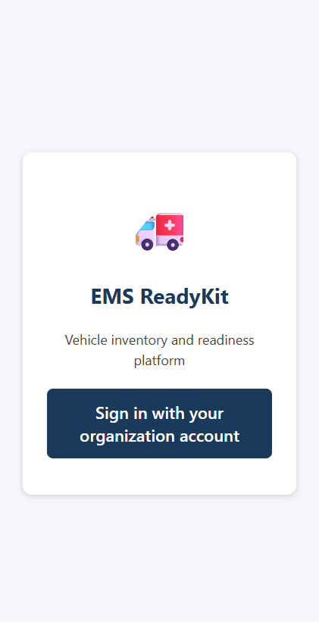
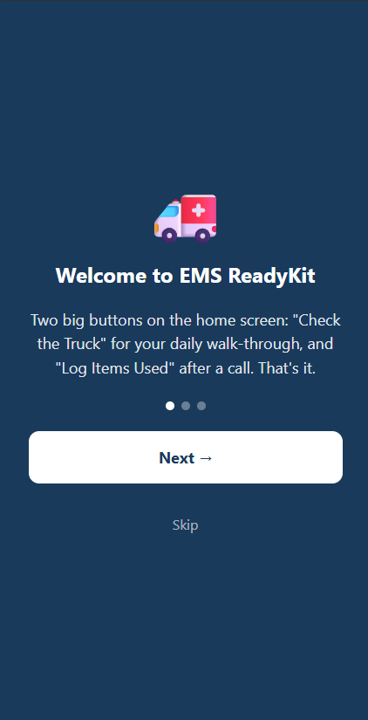
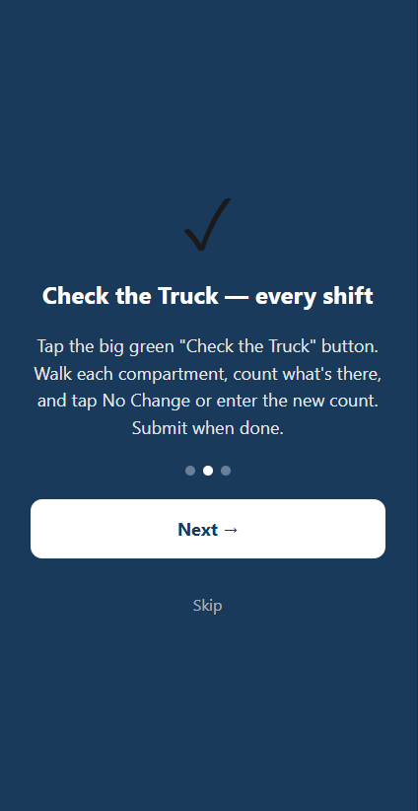
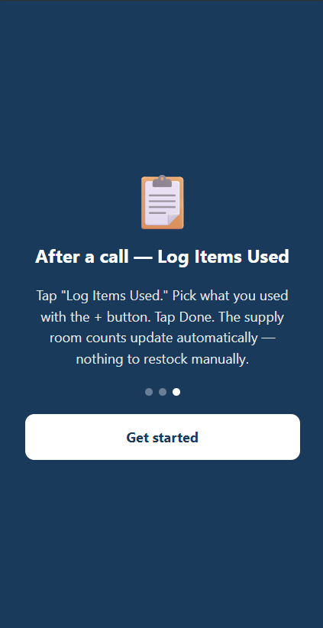
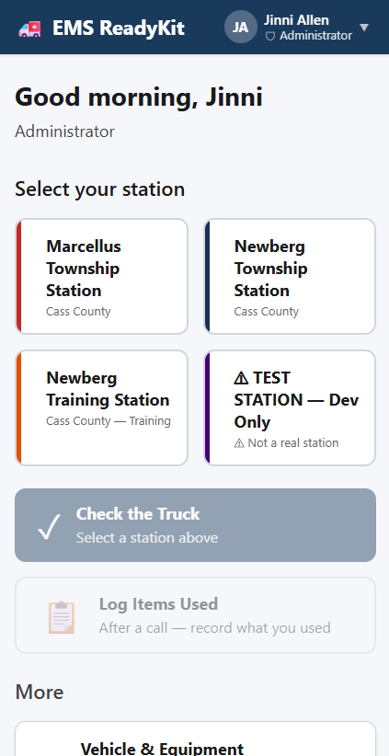
FEATURE 01
Login & Stations
All Roles
All Roles
All Roles
All Roles
All Roles
Login
Introductory tutorial
Dashboard
EMS ReadyKit
05
Notes:
Users are greeted with log in. After logging in, first time users are greeted with a three-screen introductory tutorial and then delivered to the dashboard. Users who are a part of more than one station can select the station they are working on right now. Stations are assigned their own colors, and the screens and buttons are updated to reflect the selected station.

Slide 6
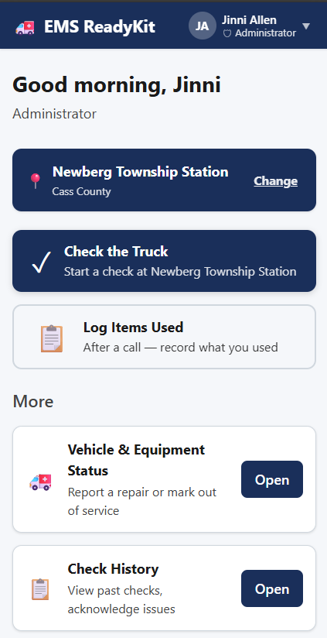
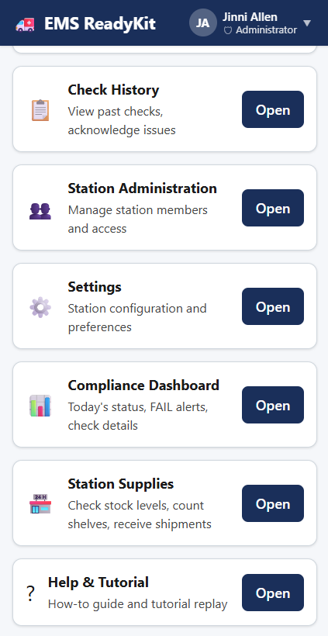
All Roles
Supervisor
FEATURE 01
Shift readiness dashboard
The home view makes it easy for responders and supervisors to access what they need.
Check the truck – daily inventory
Log Items Used – easy decrement after a run
Color-coded to identify station and most important tasks
Organized for ease of use
EMS ReadyKit
05
Notes:
Buttons are based on importance. Responders see all the buttons except Station Administration, Settings and Compliance Dashboard.

Slide 7
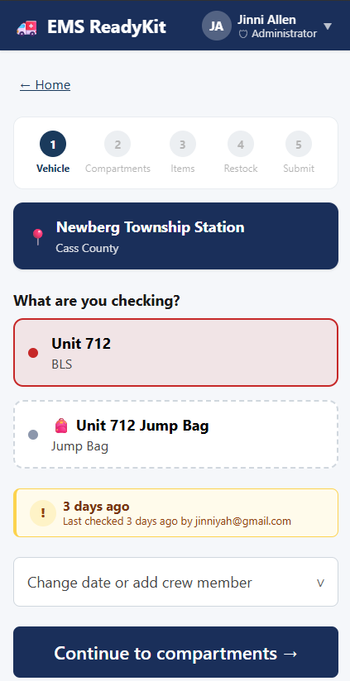
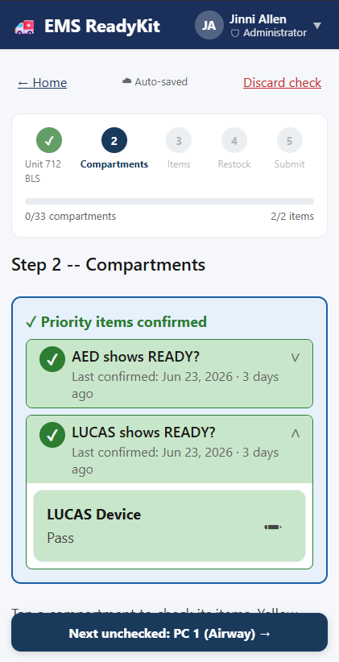
All Roles
All Roles
FEATURE 02
Ambulance Daily Check
Guided, item-by-item checklists confirm every required supply is present and counted.
Checklists tailored to each unit type
Tap to confirm, flag, or note a shortage or damaged item
Progress saved as the crew works through it
EMS ReadyKit
06
Notes:
Click Check the Truck to access the ambulance daily check.
Select the ambulance or jump bag that you are checking.
Update the priority items – the AED and LUCAS

Slide 8
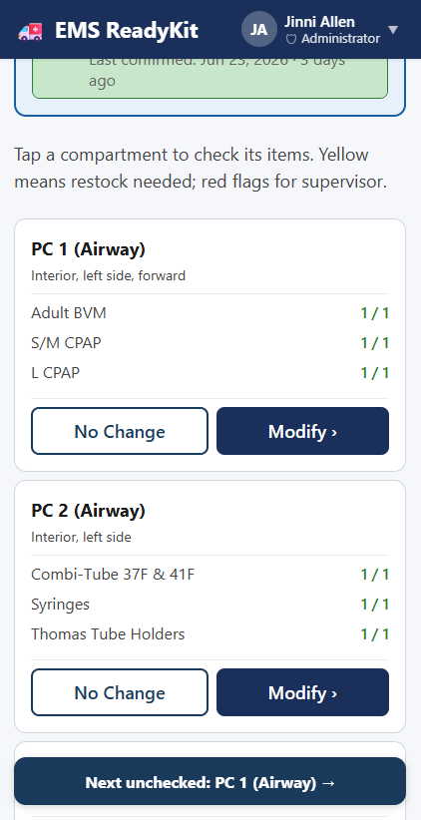
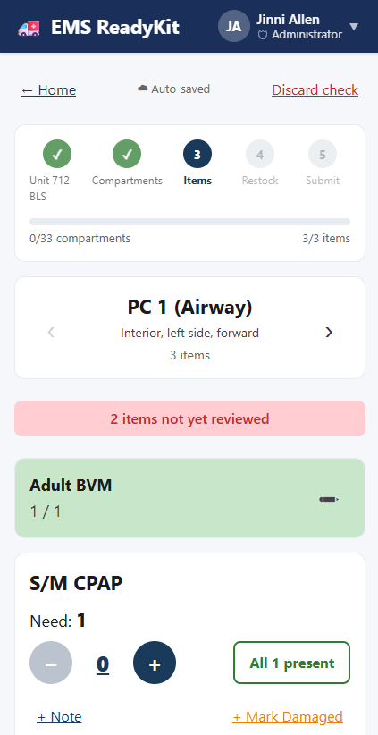
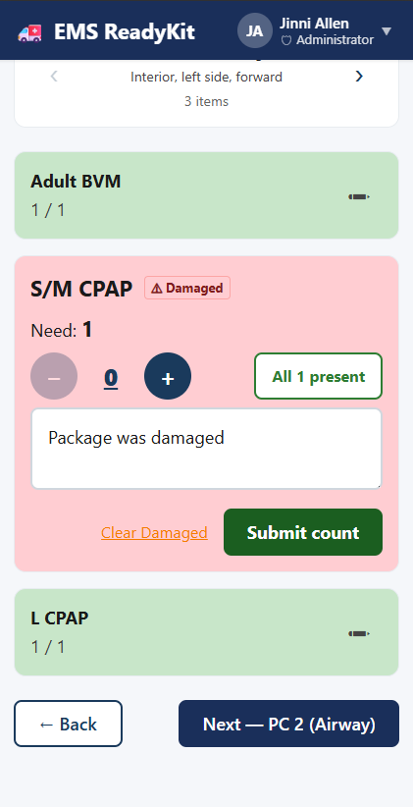
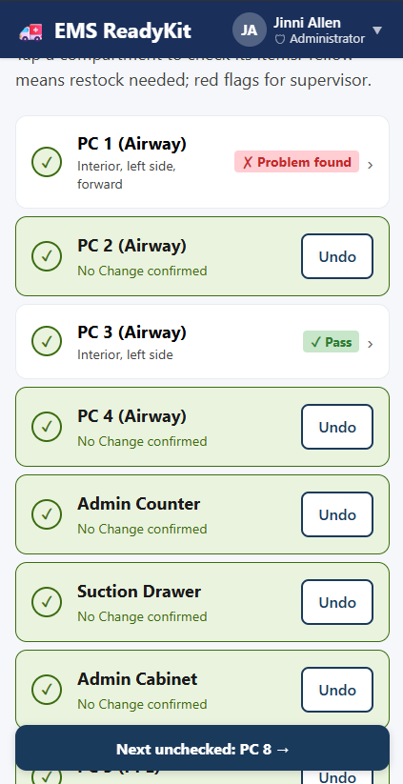
Ambulance Daily Check
All Roles
All Roles
All Roles
All Roles
EMS ReadyKit
06
Notes:
Click the modify button to make changes to the items in the compartment.
Or click No Change if the compartment was not accessed previously.
If modifying the compartment, you can update the number using
The – or + buttons
Clicking the 0 – it opens a number interface
Or clicking the “All # present” button to verify that the expected number is there.
Once the item has been validated it will shrink to aid in scrolling.
Once all items in the compartment have been validated click on the next button to navigate to the next compartment.

Slide 9
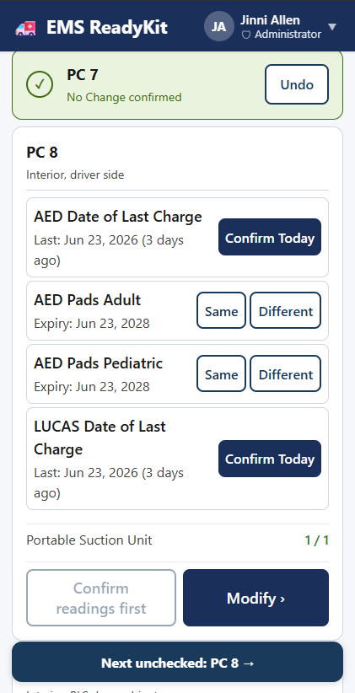
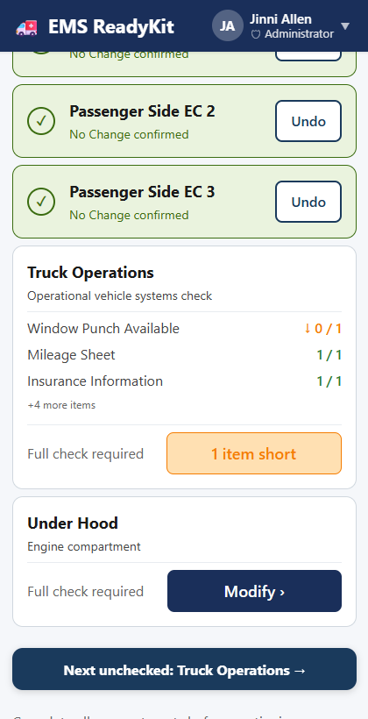
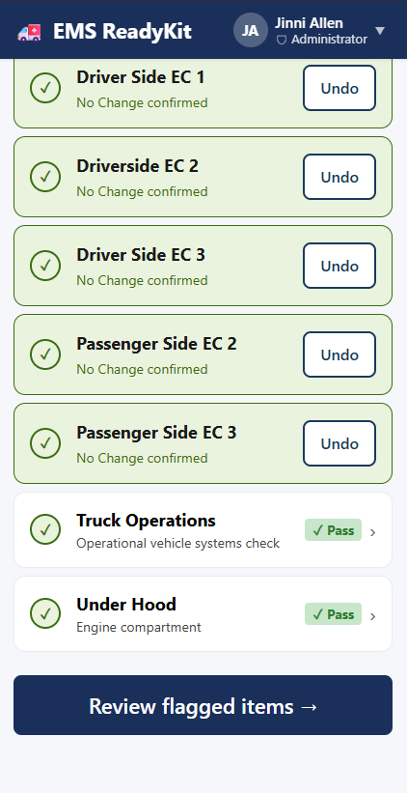
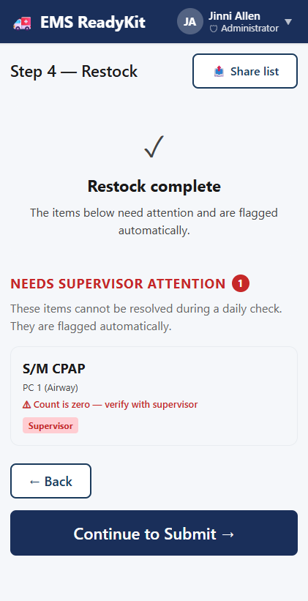
Ambulance Daily Check
All Roles
All Roles
All Roles
All Roles
EMS ReadyKit
06
Notes:
Compartments like PC 8 have special settings where you can show items in the Compartment to make it faster and easier to update important items.
If something was marked used in Log Items Used, it’ll show up as something “short” in the current inventory.
When all completed, you can click Review flagged items to review items that were marked damaged or short. During the restock stage, you can add refill the item from station stock.
When done, if there’s still an item it will report the finding to the supervisor when you click Continue to Submit.

Slide 10
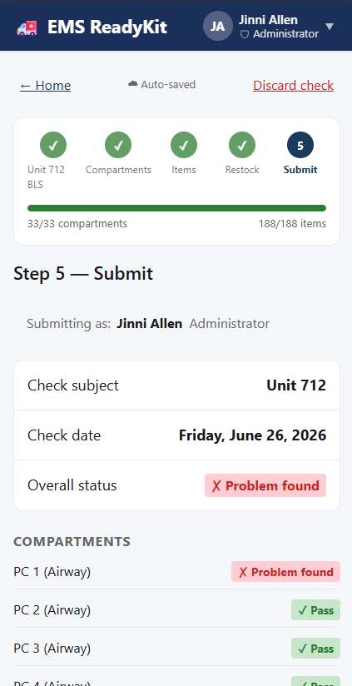
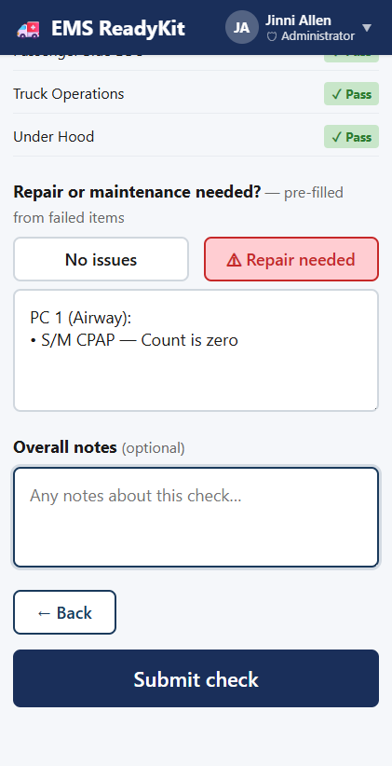
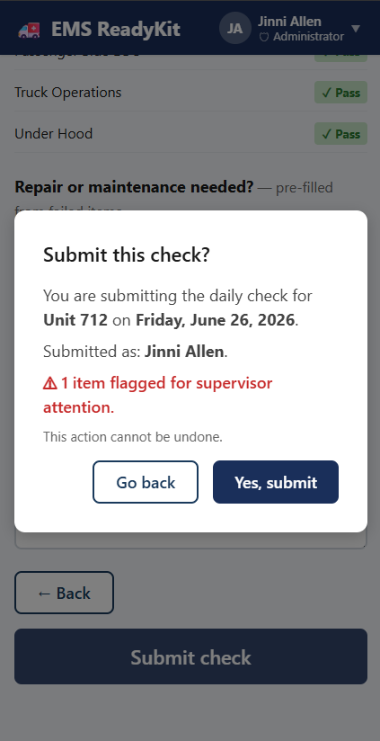
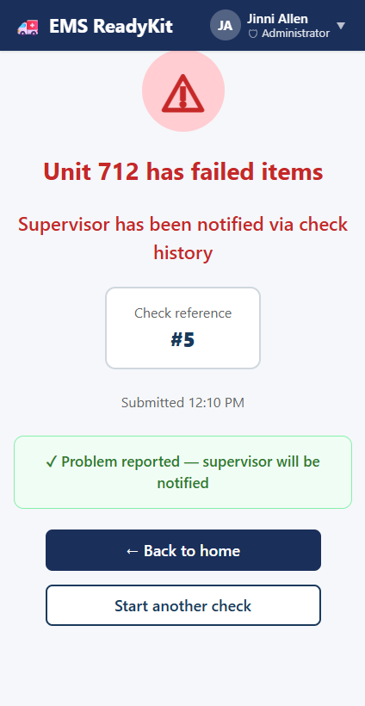
Ambulance Daily Check
All Roles
All Roles
All Roles
All Roles
EMS ReadyKit
06
Notes:
As part of the Submit process, you can review items, note if there are issues or a repair is needed and then submit the daily check.
Once submitted the app will give you feedback that it was saved. You can start another check or return to the home dashboard.

Slide 11
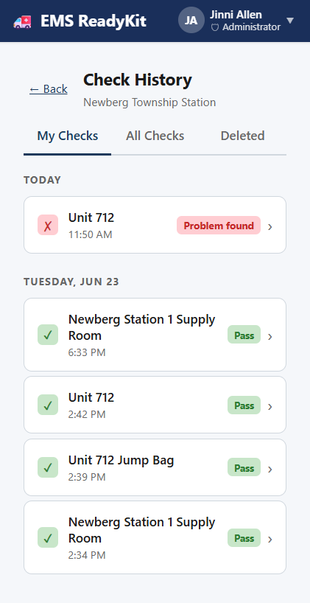
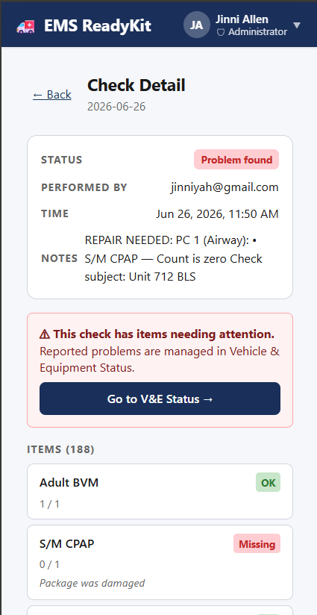
Supervisor
Supervisor
FEATURE 03
Check History
EMS ReadyKit allows responders to see what they’ve done.
Daily checks
Jump bag checks
Station checks
Note:
Responders do not see All Checks or Deleted.
Responders can see the Check Details information, but not the V&E Status
EMS ReadyKit
07
Notes:
Responders
Can see their own truck checks
Can add notes to their checks
If setup, can delete a truck check
Supervisors
Can see everyone’s truck checks
Can resolve missing or damaged items
Can soft delete checks that had issues
Administrators
Can hard delete truck checks that have been soft deleted

Slide 12
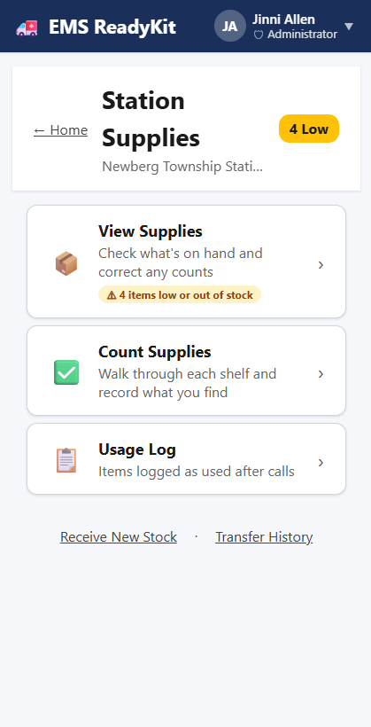
All Roles
FEATURE 04
Station Inventory
EMS ReadyKit tracks inventory end to end — station supply room to ambulance and jump bags — so crews never run short.
Items used from the ambulance are reduced from ambulance stock
Items used from the jump bag are reduced from the current jump bag stock
Items are pulled from station supply to restock ambulance and jump bags
Usage Log tracks items decremented after using Log Items Used
EMS ReadyKit
08
Notes:
Station Supplies allows users to set up and manage the station stock.
View Supplies – see what’s on hand. Update it with a note to reconcile differences.
Count Supplies – the equivalent of a “Check the Truck” but for the station.
Usage Log – the visible log of “Log Items Used”
Supervisor Only
Receive New Stock – allows for CSV upload and individual stock to be added to the station
Transfer History – The list of items that get moved from the station to the ambulance. See what’s used and where it goes

Slide 13
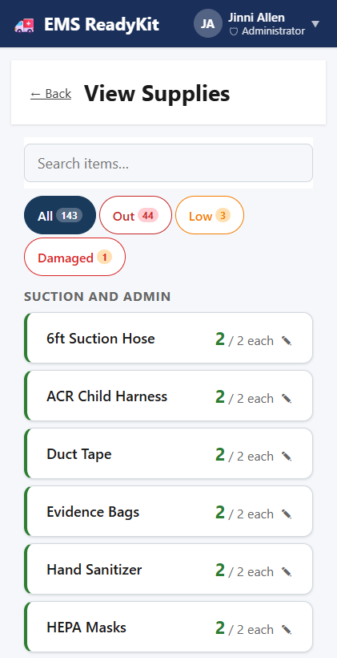
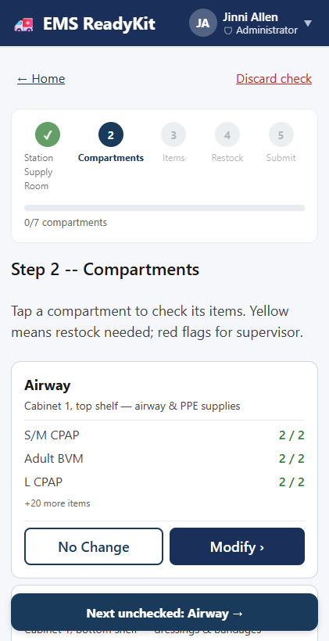
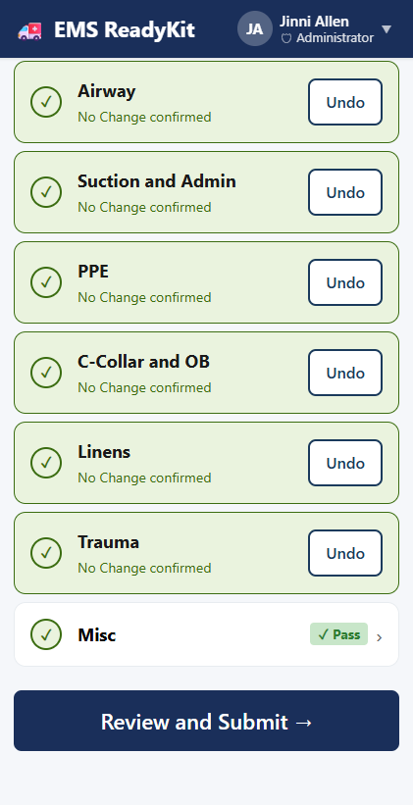
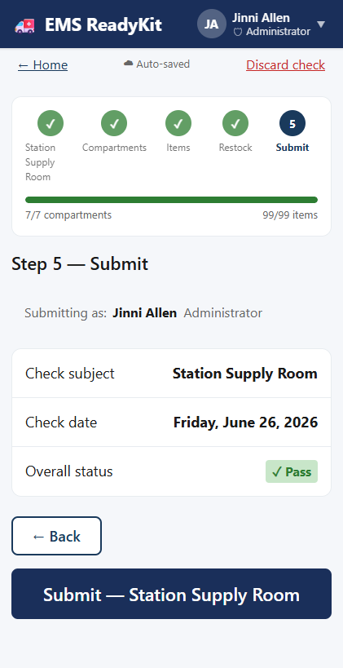
Tracking Inventory
All Roles
All Roles
All Roles
All Roles
Count Supplies
EMS ReadyKit
08
Notes:
View Supplies
This is where users can update items that are in the station.
Count Supplies (Pictures 2 – 4)
Same interface as Check the Truck – familiar and easy to use.
Same compartment interactions
Same submission process.

Slide 14
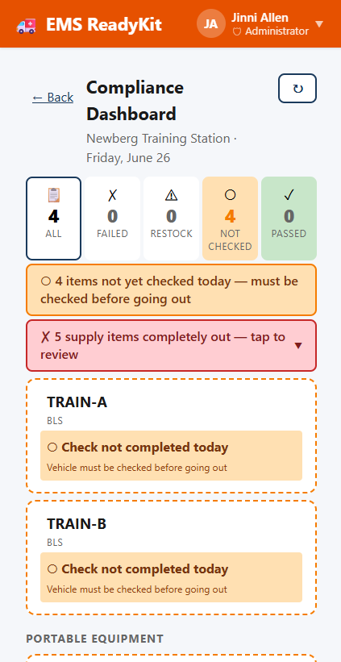
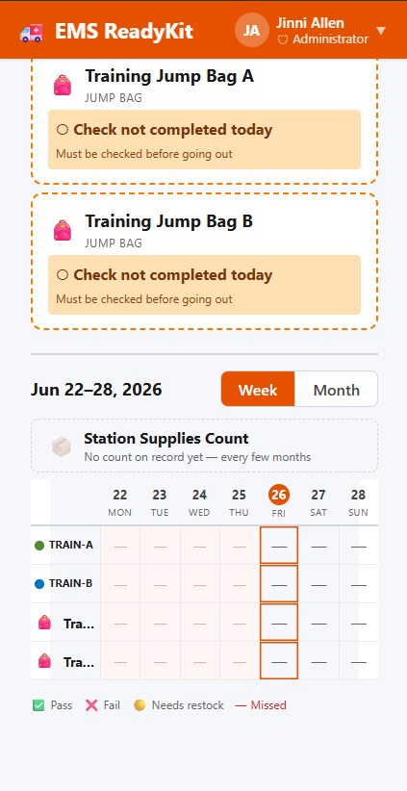
FEATURE 05
Supervisor
Supervisor
Supervisor’s Compliance Dashboard
Easy visibility into all the important stuff.
Ambulances and jump bags checked – pass and fail
Weekly and monthly views
Damaged and low items
Vehicle concerns surfaced first.
EMS ReadyKit
09
Notes:
NOTE: Pictures taken from the training station (orange) not Newberg Township (dark blue)
Compliance Dashboard (Image 1)
Clicking on the icons on the top will filter All, Failed, Restock, Not Checked and Passed for easy viewing
Vehicles filtered by the view are show with status at the top
Portable equipment is shown below the vehicles
Station supply count – Shows the last time it was done
Weekly view for easy understanding (Image 2)
Pass
Fail
Needs Restock
Missed
Monthly status, filtered by vehicle and portable equipment

Slide 15
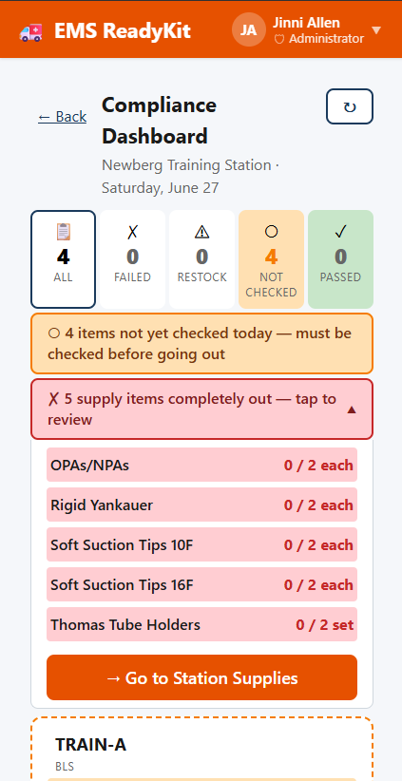
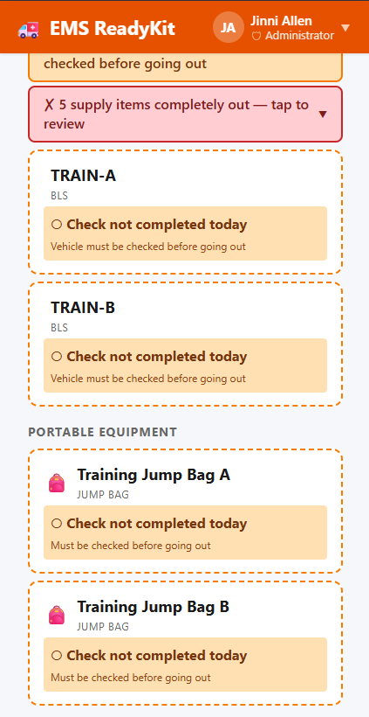
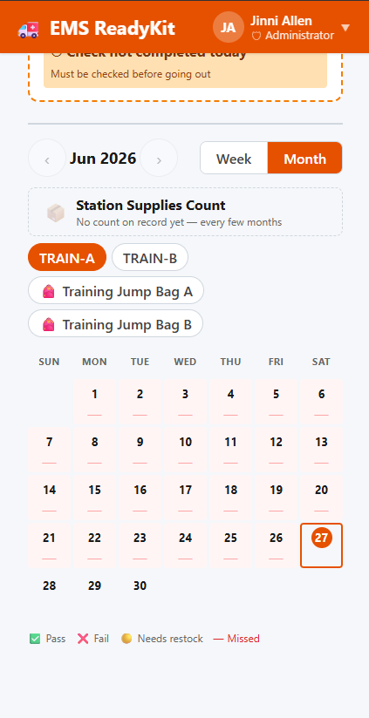
Supervisor’s Compliance Dashboard
Supervisor
Supervisor
Supervisor
Supply alert
Notification of daily checks
Monthly View
EMS ReadyKit
09
Notes:
(Image 1) Damaged and short items are surfaced at the top, with buttons to take you to the relevant screen to remedy the situation.
(Image 2) Up-to-date vehicle status
(Image 3) Monthly views to track trends

Slide 16
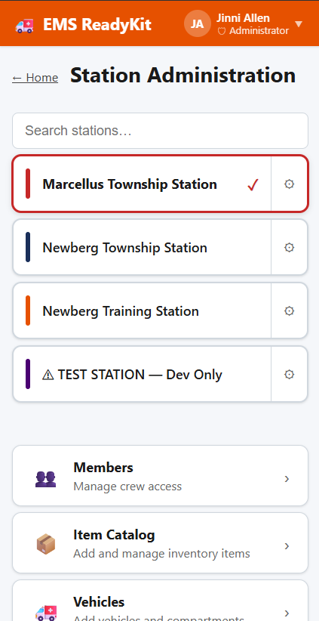
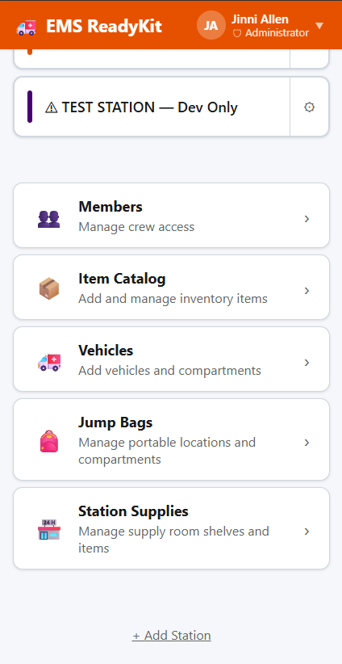
Supervisor
Supervisor
FEATURE 06
Station Administration
Supervisors can add members, items, vehicles, jump bags and station supplies in one location.
Central dashboard for setting up a station
Unique members, items, vehicles and jump bags per station
Items Catalog shows where items are stored in the station, vehicles and jump bags.
EMS ReadyKit
10
Notes:
NOTE: Station Administration is bound by ROLE – if you are not a supervisor of that station, it will not show in the screen. Only Administrators can add stations.

Slide 17
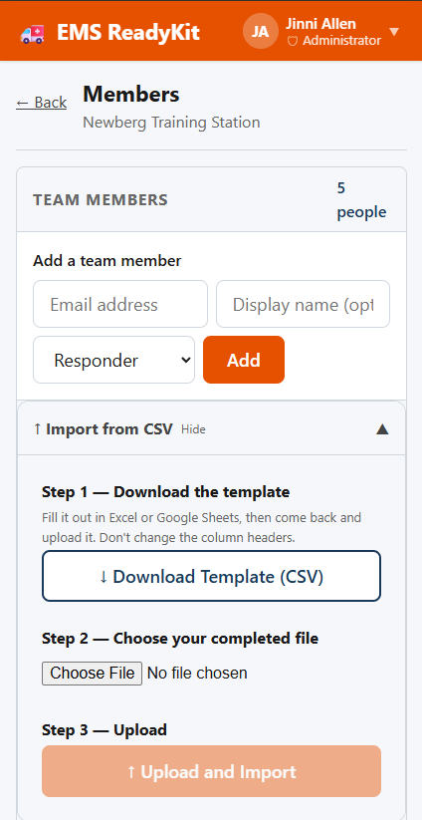
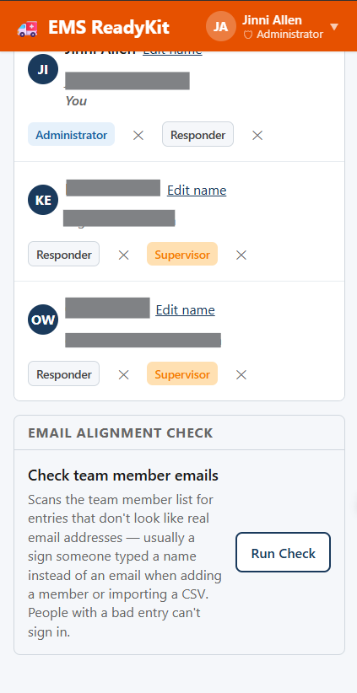
Supervisor
Supervisor
Members
Members can be added individually or using a CSV template when setting up a station.
Individual Add
Central dashboard for member management
Can assign multiple roles per user
Emails must be unique per user.
CSV Add
EMS ReadyKit
10
Notes:
Members can be added individually or using a template. Use Run Check after using the template to ensure that there are valid emails for login.

Slide 18
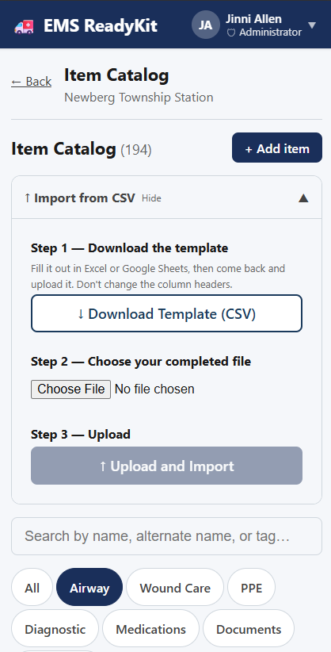
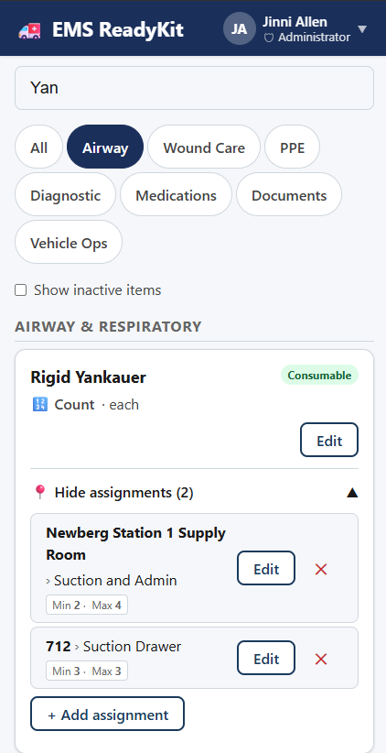
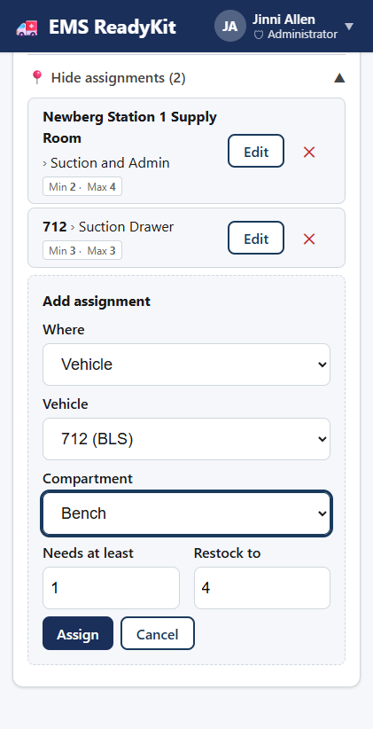
Station Administration – Item Catalog
Supervisor
Supervisor
Filter
Item
Location assignment
Location
EMS ReadyKit
10
Notes:
(Newberg Township Station)
Item Catalog
Items can be individually added
Items can be mass uploaded. Makes it easier to set up a new station
Items can be searched and filtered
Filters include Airway, Wound Care, PPE, Diagnostic, Medications, Documents, Vehicle Ops
Items can be marked inactive – and they are filtered out for normal operations
Individual items show where they are used.
You can assign items from the inventory catalog for easy of use.

Slide 19
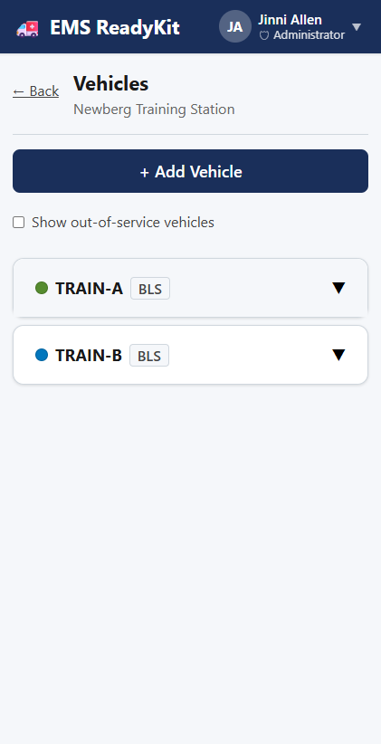
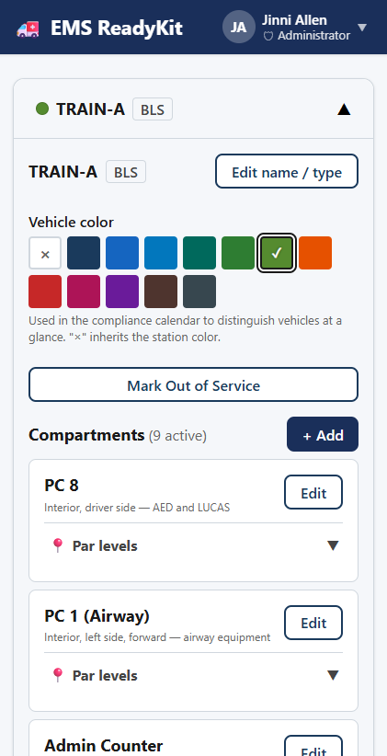
Supervisor
Supervisor
Vehicles
Supervisors can add vehicles and update the items stored in them from a central interface
Vehicles details can be added or edited
Basic colors assigned
Custom compartments created and edited
Items added to compartments with custom par levels
Marked out of service and returned to service
EMS ReadyKit
10
Notes:
Vehicles can be managed from this view.

Slide 20
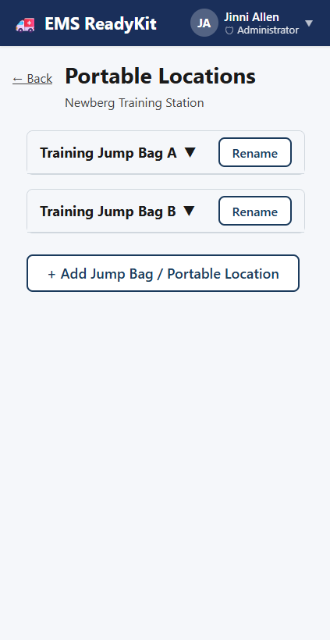
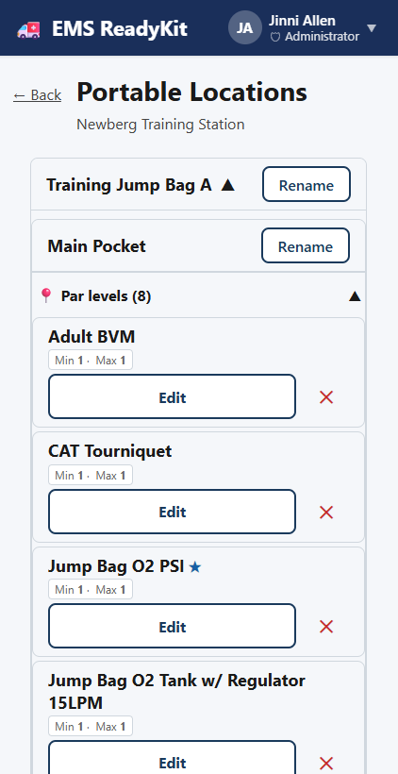
Supervisor
Supervisor
Portable Locations
Supervisors can add portable locations, such as jump bags from this view.
Bag details can be added or edited
Basic colors assigned
Custom compartments created and edited
Items added to compartments with custom par levels
EMS ReadyKit
10
Notes:
Jump bags can be managed from this view. This includes Ambulance jump bags, pediatrics and medical first responder bags.

Slide 21
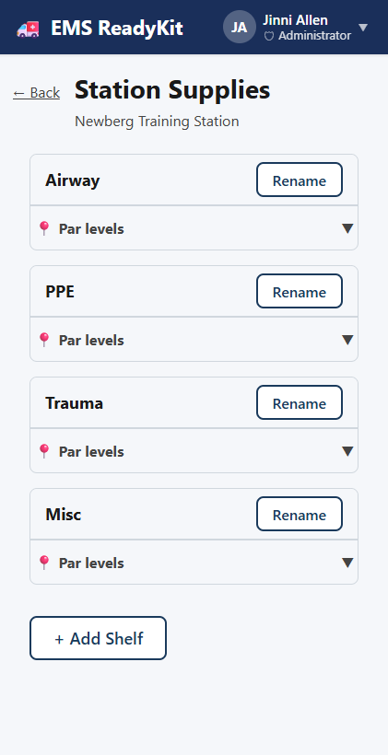
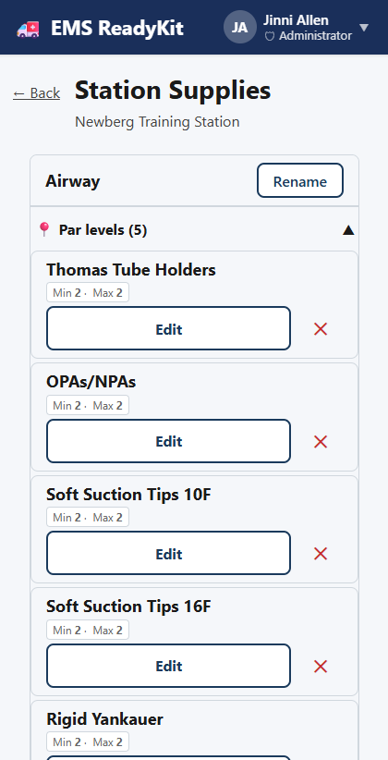
Supervisor
Supervisor
Station Supplies
Supervisors can setup the station supply room from here
Custom shelves can be added
Items can be assigned
Custom par levels can be assigned.
This data feed the Station Supply interface that is on the homepage
EMS ReadyKit
10
Notes:
Station Supplies in the Station Administration sets up the inventory to be fed from the station to the ambulances and jump bags.

Slide 22
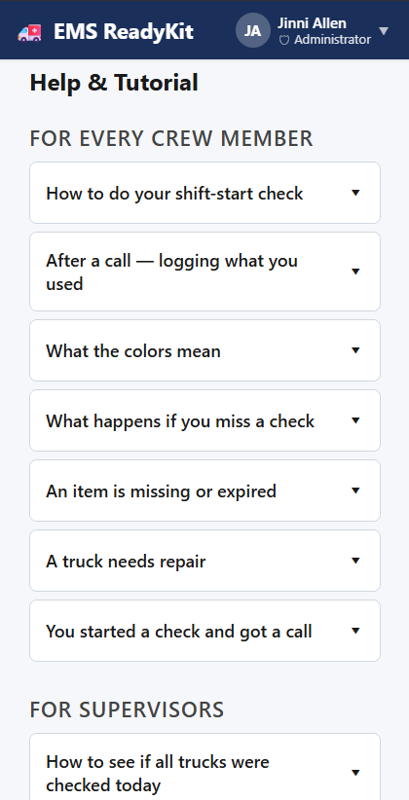
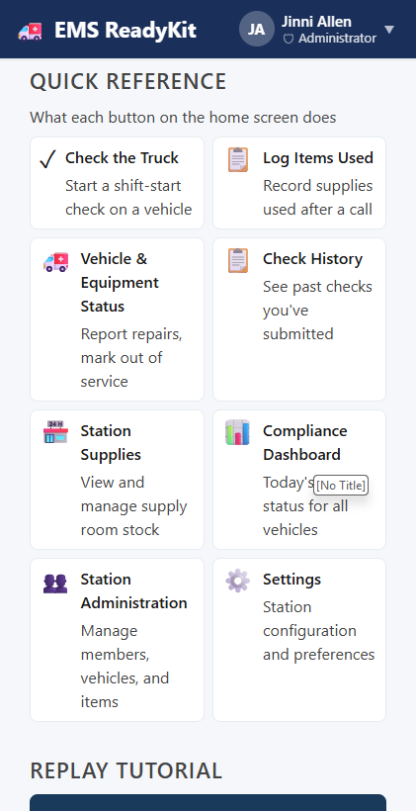
Supervisor
Supervisor
FEATURE 07
Help & Tutorial
Quick and easy help file for the most common questions
Help focused by role
Quick reference for buttons
EMS ReadyKit
10

Slide 23
UNDER THE HOOD
Cloud architecture
Representative architecture for a secure, multi-user web app.
→
→
→
Crews & supervisors
Frontend
API service
Database
Browser / mobile web
Single-page web app
Application & business logic
Managed relational store
Authentication
Storage
CI/CD pipeline
User identity & role-based access
Daily check, items and relationships
Automated build, test & deploy
EMS ReadyKit
11

Slide 24
WHAT IT DEMONSTRATES
Engineering highlights
Representative stack and practices behind the build.
Frontend
Backend & API
Data layer
Responsive single-page web app built for crews on tablets and phones.
Service exposing a clean REST API for checklists, units, and sign-offs.
Relational schema modeling units, items, expirations, and audit records.
Cloud & infra
CI/CD & automation
Security & access
Containerized services deployed to managed cloud compute.
Automated pipeline for build, test, and zero-touch deploys.
Role-based auth separating crew, supervisor, and admin views.
EMS ReadyKit
12

Slide 25
EMS READYKIT
Crews ready before every call.
A structured, accountable readiness check — stocked, in-date, and equipment-tested — built and deployed as a cloud web application.
EMAIL
GITHUB
jinniyah@gmail.com
https://github.com/Jinniyah/EMS_ReadyKit

