Slide 1
CAD/CAM

Slide 2
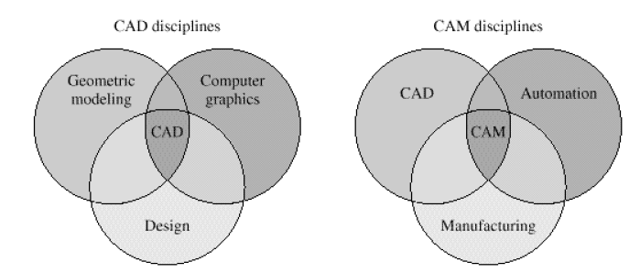
Scope of CAD/CAM

Slide 3
CAD/CAM system
Today, almost all the CAD/CAM software systems are interactive. To use this kind of system well, one, as a designer or user, should know of how these systems work and how to set or get information with CAD/CAM system through GUI(Graphics User Interface)

Slide 4
CAD

Slide 5
Instruction to computer graphics
Computer graphics focuses mainly on displays of any digital image by a computer.
There are bunch of hardware and software developed for fast and correct displays of graphics on terminals.
The core techniques of computer graphics are based on geometry, optics, physics, and perception.

Slide 6
Coordinate system

Slide 7
Three types of coordinate system
Coordinate systems are the most important concept in a CAD system. They are used to input, store, and display geometric model. There are three kinds of coordinate systems, that is
Model coordinate system (MCS)
Working coordinate system (WCS)
Screen coordinate system (SCS)

Slide 8
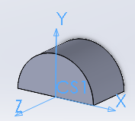
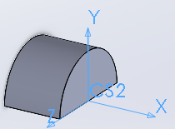
Model Coordinate System (MCS)
MCS is a 3D Cartesian coordinate system used by most of CAD softwares to perform internal geometrical data operations, such as record, storage and calculation.
MCS is the only coordinate system CAD software can identify. Even users define another type of coordinate system during the process of creating models, the model will still be convert to data under MCS to store.
Sometime MCS is also called Absolute Coordinate System(ACS).

Slide 9
Working Coordinate System(WCS)
A modelling processing of a 3D body is usually a result of combining many steps of creating some simple structure bodies. WCS is an user defined local coordinate system, with which user can generate some basic structures easily.
WCS has different appearances in different CAD systems. One of the most useful one is a sketch plane.
As we mentioned, whatever was chosen to be a coordinate system , the stored data should be represented with MCS. To satisfy this requirement, a homogenous transform matrix will play an very important role.

Slide 10
Working Coordinate System(WCS)
Given a vector under WCS, , and let is the stored point represented with MCS. Supposing T is the transformation matrix, we have

Slide 11
Homogenous transformation matrix
Since we still need consider translation and project operation meanwhile. The matrix to finish all the transformations from WCS to MCS looks like as follows.

Slide 12
Homogenous transformation matrix
Let
The above matrix become
T is to transform coordinate components, o means origin point shifting,
p is perspective vector, s means perspective shifting

Slide 13
Homogenous transformation
Actually, for any point under WCS should be transformed to MCS, the final forms looks like

Slide 14
Some useful HT matrices
Matrix without perspective involved

Slide 15
Some useful HT matrices
Matrix pure shearing involved
At the same time, T part of this matrix is symmetric. Which means t₂₁=t₁₂, t₃₁=t₁₃, t₃₂=t₂₃

Slide 16
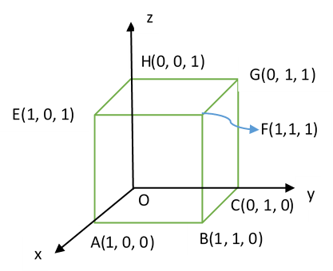
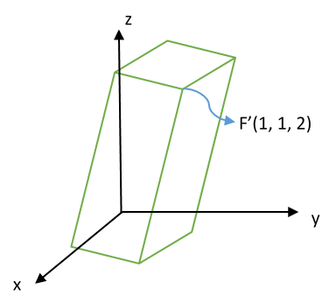
Example: Given a cube with length of edge 1 at the origin O, assume vertex O is fixed, and there is a homogenous transformation which shear vertex F(1,1,1) to F’(1,1,2). Find out the transformation matrix and the new positions of all vertices.

Slide 17
To vertex E, we have the linear equations after taking use of shearing transformation
The solution of homogenous transformation matrix is

Slide 18
Screen coordinate system (SCS)
The coordinate system of screen is a 2D Cartesian coordinate system, which origin (0,0) locates at left-upper corner of the screen. The scale of SCS usually depends on the resolution of screen. For example if the revolution of a screen is 1096x1024, which means the X axis extend to right of screen until scale of 1096, and the Y axis extend to bottom of screen until scale of 1024.
The SCS is mainly used to display correct images on screen device. So it is pixel related.
(0,0)
X
Y

Slide 19
Coordinate system
By default, in most of CAD software, the WCS and MCS are overlapped as you start up the main program.
Definitely, To display correct image of the cad model on screen, we still need some transformation operations to make it sense.
From the view of user, the inputted geometrical elements will firstly transform to uniforms under MCS, then through display converting package developed by CAD software provider, all 3D geometrical items will be shown on the 2D screen.

Slide 20
CAD data exchange and storage

Slide 21
CAD data exchange and storage
Graphic standard
Data storage

Slide 22
Introduction to Geometric Modelling
Usually, geometric modelling is a combination discipline with applied mathematics and computational geometry. In this discipline, people designed varied algorithms to describe all kinds of shapes by computers.
Building two or three dimensional models is crucial content of CAD & CAM.

Slide 23
Geometry of curve
Standard mathematic curves
Bezier curves
B-spline curves
Parameterized curves
Wire frame modelling

Slide 24
Geometry of surface
Ruled surfaces
Other standard mathematical surfaces
NURBS
Surface modelling

Slide 25
Boolean operations in CSG

Slide 26
Constructive solid geometry (CSG)
CSG is one of a fundamental theories of varies 3D modelling CAD system.
Boolean operations of multi-bodies
One of ideas in CSG is that some algebraic calculations can be performed between two bodies.
There are three basic Boolean operations of bodies, which are named unite, difference and intersect, derived from set theory. However, in Solidworks, they are called add, subtract and common, respectively.
Through Boolean operations one can take uses of several bodies to generate a new body.

Slide 27
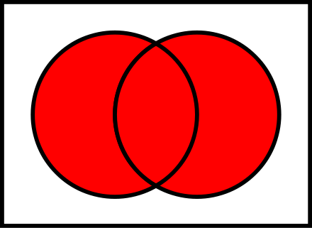
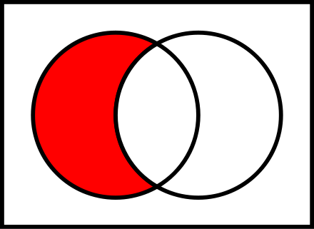
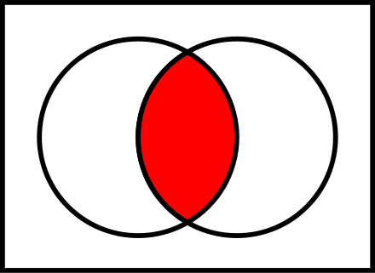
Boolean operations in set theory
In set theory, we have

Slide 28
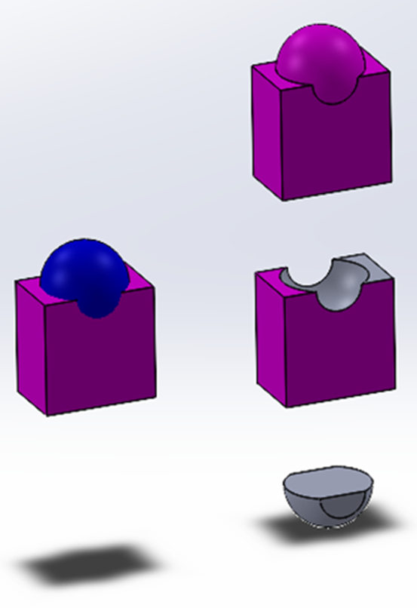
Boolean operations of multi-bodies
Target: The body with the finished geometry is called the target;
Tool: The body used to create or edit the shape is called the tool.

Slide 29
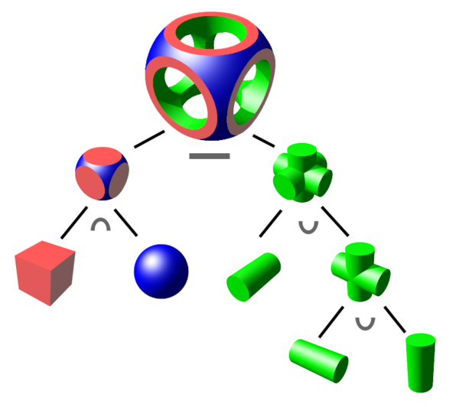
Boolean logic with binary tree
A binary tree structure is usually used to store the basic bodies one lead nodes, the operations on the internal nodes, and the final body on the root node.

Slide 30
Three methods to create 3D models

Slide 31
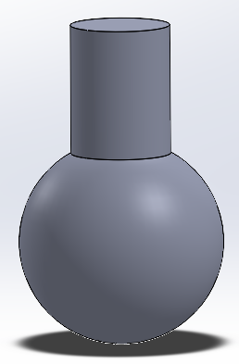
Primitive method
In the method, any 3D model was divided into several simple, basic, standard of items, such as blocks, cylinders, spheres, cones, etc. which usually integrated in CAD system as a standard body. Through these, user can decide how to combine different of them together to construct a new model, then using Boolean operations to get the final result.

Slide 32
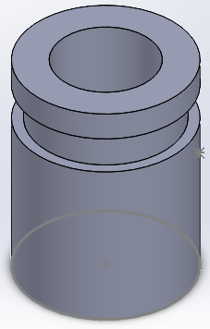
Feature method
Let user to utilize some predefined feature generating instruments, like groove, hole, slot, boss, pad, etc. to simulate a real manufacturing process to create some structure from a simple basic body.

Slide 33
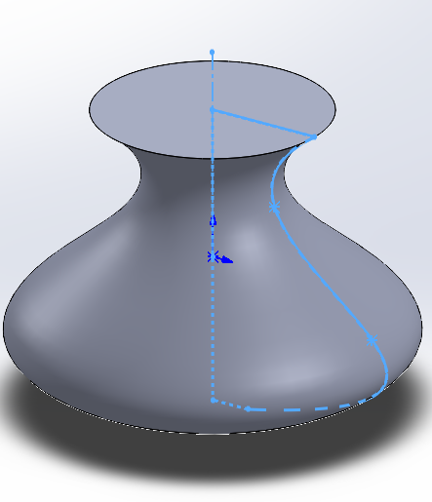
Sketch method
The main idea of this approach is to create 3D body by 2D sketch. Taking use of extrusion, revolution algorithms, in addition some of basic Boolean operations, use can create a very complex 3D structures.
This method is the most popular way used by most of commercial CAD softwares including Solidworks.

Slide 34
Sketch method
The main steps of sketch method to create 3D models are
Define a sketch plane as cross section;
Sketch 2D shapes on the cross section;
Constraint 2D shapes with accurate dimensions;
Perform 2D to 3D operations.

Slide 35
Key disciplines of modelling in Solidworks

Slide 36
Key disciplines of modelling in Solidworks
For basic bodies, generate 3D model by taking use of 2D shapes;
Combine basic bodies to create a complex body;
Repeated bodies can be made through array operations;

Slide 37
Coordinate system
Coordinate systems are the most important concept in a CAD system. They are used to input, store, and display geometric model. There are three kinds of coordinate systems, that is, model coordinate system (MCS), working coordinate system (WCS), and screen coordinate system (SCS).
By default, there are already a coordinates system provided for user by SOLIDWORKS every time you open a new modelling project. Usually, at the lower-left corner of the canvas, you can notice the symbol of coordinate system with three axes.
Whenever user need to carry on some location or orientation related modelling steps, the coordination system should be considered.
For example, in the scenarios of re-oriented a model or two models comparing user should define his own reference coordinate systems.

Slide 38
References objects
Reference points
Reference vectors/axes
Reference plane

Slide 39
Sketch
Plane curves
Two types of Constraint
Dimensional constraints: length and angle
Geometric constraints: parallel, perpendicular, normal, tangent, concentric, etc.

Slide 40
CAM

Slide 41
Brief
Scope and applications
NC in CAM
Principal types of CNC machine

Slide 42
Machine tools
tools and their construction features
tooling for CNC – ISO designation for
tooling
CNC operating system
FANUC, SINUMERIK – LINUMERIK.

Slide 43
Introduction to CAPP
Three main parameters to define a machining process
Principles for process design
Processing planning systems

Slide 44
Programming for CNC machining
Coordinate systems of CNC
Manual part
Computer assisted part programming
CNC part programming with CAD system.

Slide 45
Material handling in CAM environment
Logistic and storage system
AGVS
AS/RS
Swarf handling and disposal of wastes
Assembly lines
Quantitative analysis of assembly systems.

Slide 46
Key disciplines of manufacturing under Solidworks environment
Configuration for a mill or turn machine
Features to machining strategy
Generate operation plan
Generate tool path
Simulation
Post process

Slide 47
The following slides are only for learning purpose

Slide 48
Create a new part
Check the unit setting
Using sketch to create part body
Smart dimension is an import tool to drive the model creatation

Slide 49
Go to the Solidworks CAM module(just perform each of tool button alone the toolbar from left to right, one can finally get the tool path and G-codes)
Define machine
Setup coordinate system
Define stock size using stock manager

Slide 50
Using setup->mill setup to tell the machine which direction is the machining (removing material) direction.
Extract machinable features(which features will be removed)
Generate operation plan(usually have cutting times for the same surface)
Adjust the plan by removing part of operations or changing some parameters for cutting
How to decide the basic cutting parameters(F/S):
Cutting and spindle speed calculations

Slide 51
Feed rate calculatons
Ususlly, we have general start conditons, in which
For HSS(high speed steel tool)

Slide 52
For Carbide
Depth of cut is approximately 10% the diameter of the tool, except with face mills:0.005 inch max. (SFPM=surface feet per minute)
Decide roughing

