Slide 1
CAD/CAM

Slide 2
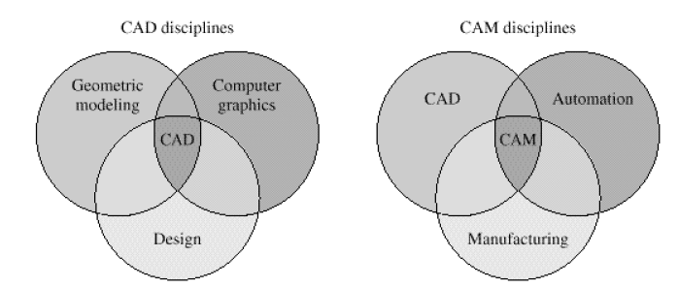
Scope of CAD/CAM

Slide 3
CAD/CAM system
Today, almost all the CAD/CAM software systems are interactive. To use this kind of system well, one, as a designer or user, should know of how these systems work and how to set or get information with CAD/CAM system through GUI(Graphics User Interface)

Slide 4
CAD

Slide 5
Instruction to computer graphics
Computer graphics focuses mainly on displays of any digital image by a computer.
There are bunch of hardware and software developed for fast and correct displays of graphics on terminals.
The core techniques of computer graphics are based on geometry, optics, physics, and perception.

Slide 6
Coordinate system

Slide 7
Three types of coordinate system
Coordinate systems are the most important concept in a CAD system. They are used to input, store, and display geometric model. There are three kinds of coordinate systems,
Model coordinate system (MCS)
Working coordinate system (WCS)
Screen coordinate system (SCS)

Slide 8
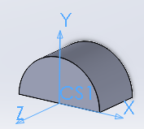
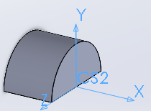
Model Coordinate System (MCS)
MCS is a 3D Cartesian coordinate system used by most of CAD softwares to perform internal geometrical data operations, such as record, storage and calculation.
MCS is the only coordinate system CAD software can identify. Even users define another type of coordinate system during the process of creating models, the model will still be convert to data under MCS to store.
Sometime MCS is also called Absolute Coordinate System(ACS).

Slide 9
Working Coordinate System(WCS)
A modelling processing of a 3D body is usually a result of combining many steps of creating some simple structure bodies. WCS is an user defined local coordinate system, with which user can generate some basic structures easily.
WCS has different appearances in different CAD systems. One of the most useful one is a sketch plane.
As we mentioned, whatever was chosen to be a coordinate system , the stored data should be represented with MCS. To satisfy this requirement, a homogenous transform matrix will play an very important role.

Slide 10
Working Coordinate System(WCS)
Given a vector under WCS, , and let is the stored point represented with MCS. Supposing T is the transformation matrix, we have

Slide 11
Homogenous transformation matrix
Since we still need consider translation and project operation meanwhile. The matrix to finish all the transformations from WCS to MCS looks like as follows.

Slide 12
Homogenous transformation matrix
Let
The above matrix become
T is to transform coordinate components, o means origin point shifting,
p is perspective vector, s means perspective shifting

Slide 13
Homogenous transformation
Actually, for any point under WCS should be transformed to MCS, the final forms looks like

Slide 14
Some useful HT matrices
Matrix without perspective involved

Slide 15
Some useful HT matrices
Matrix pure shearing involved
At the same time, T part of this matrix is symmetric. Which means t₂₁=t₁₂, t₃₁=t₁₃, t₃₂=t₂₃

Slide 16
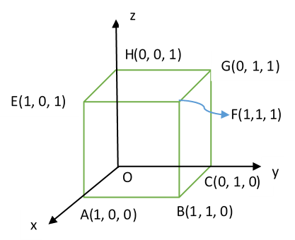
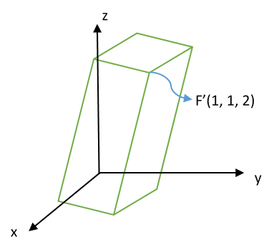
Example: Given a cube with length of edge 1 at the origin O, assume vertex O is fixed, and there is a homogenous transformation which shear vertex F(1,1,1) to F’(1,1,2). Find out the transformation matrix and the new positions of all vertices.

Slide 17
To vertex E, we have the linear equations after taking use of shearing transformation
The solution of homogenous transformation matrix is

Slide 18
Screen coordinate system (SCS)
The coordinate system of screen is a 2D Cartesian coordinate system, which origin (0,0) locates at left-upper corner of the screen. The scale of SCS usually depends on the resolution of screen. For example if the revolution of a screen is 1096x1024, which means the X axis extend to right of screen until scale of 1096, and the Y axis extend to bottom of screen until scale of 1024.
The SCS is mainly used to display correct images on screen device. So it is pixel related.
(0,0)
X
Y

Slide 19
View Generation
The display screen is two-dimensional.
How to present 3D model on the screen.
the orthogonal projection.

Slide 20
Coordinate system
By default, in most of CAD software, the WCS and MCS are overlapped as you start up the main program.
Definitely, To display correct image of the cad model on screen, we still need some transformation operations to make it sense.
From the view of user, the inputted geometrical elements will firstly transform to uniforms under MCS, then through display converting package developed by CAD software provider, all 3D geometrical items will be shown on the 2D screen.

Slide 21
CAD data exchange and storage

Slide 22
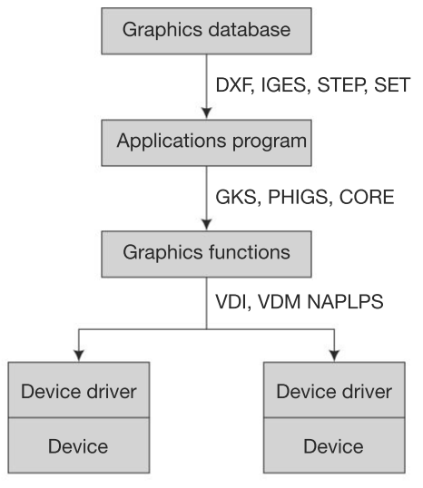
CAD data exchange and storage
Graphic standard
There are various CAD software systems used in different fields. How people could share the same model among these systems? The answer is to share data obeying the same standard. The mainstream data standards are: GKS,STEP, etc.

Slide 23
Data exchange standards
There is increasing application of CAD accompanied by a growth in product variety and the range of companies involved
component suppliers must often match their designs to many variants of different products
a large amount of component and product data must be exchanged
the simplest way is for both companies to used same CADCAM system and software revision number
however, it is more equitable for different CADCAM systems to accurately exchange the same data
too many individual inter-software translator programs would be required
need to convert the data into a neutral file format first
then translate the neutral format into the target system data structure
However, a neutral file format is not straightforward due to
different international CADCAM methods
different CAD representations:
2D draughting; wire frame geometry; surface/solid models
higher order curves → cubic polynomial conversion leads to loss of precision
Ongoing effort to define an internationally accepted standard

Slide 24
IGES(Initial Graphics Exchange Specification)
A standard for the structure and syntax of neutral file in ASCII, compressed ASCII or binary format
the ASCII format is: 80 character records/lines, terminated by semicolons, fields divided with commas
Start section:
– contains data such as the features of the originating system to assist the recipient in translating the file
Global section:
– contains 24 parameter fields which are necessary to translate the file
Directory section:
– contains 18 x 8-character fields on 2 lines as an entry for each entity; codes represent the entity type, subtype, and pointers to entity data in next section
Parameter Data Section:
– contains entity specific data such as coordinates, annotations, spline control points, pointers to directory entries, etc.
the first parameter for each entry identifies the entity type from which the meanings for remaining parameters are derived.
Termination Section:
– marks the end of the data file, contains subtotals of records for data transmission checks

Slide 25
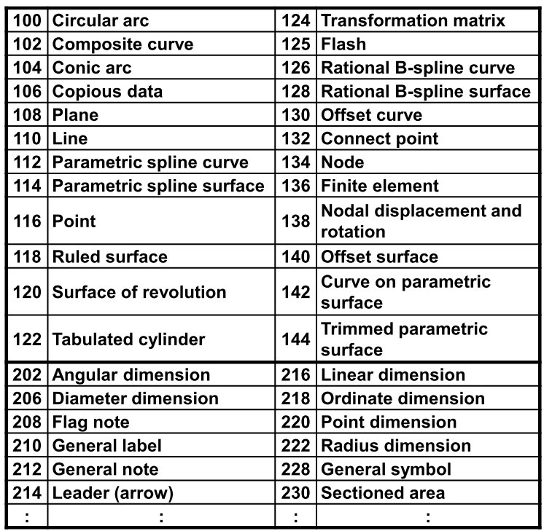
IGES data types
The global section consists of:
delimiter characters (1,2); sender’s identifier (3); filename (4); software ID (5); IGES processor version (6); number precision (7-11); receiver’s identifier (12); model space scale (13); units (14); unit name (15); maximum number of line thicknesses (16); maximum line thickness (17); time file generated (18); smallest distance (19); largest coordinate (20);
Each record line has an identifier in columns 73-80 used as a pointer for cross-referencing between sections
the first character indicates the section (S = Start, G = Global, D = Directory, P = Parameter, T = Termination)

Slide 26
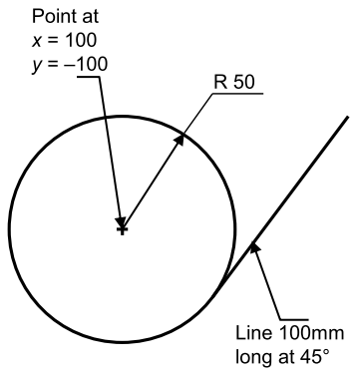
IGES example
EXAMPLE IGES FILE S0000001
1H,,1H;,,,9HMASTERCAM, 1H1,16,8,24,8,56,,1.,1,4HINCH,1,0.01, G0000001
13H850101.0100000,0.,100.,,,,; G0000002
116 1 1 1 1 0 00000000D0000001
116 0 3 1 D0000002
124 2 1 1 1 0 00000000D0000003
124 0 3 1 D0000004
100 3 1 1 1 3 00000000D0000005
100 0 3 1 D0000006
110 4 1 1 1 0 00000000D0000007
110 0 3 1 D0000008
116,100.,-100.,0.; 1P0000001
124,1.,0.,0.,0.,0.,1.,0.,0.,0.,0.,1.,0.; 3P0000002
100,0.,100.,-100.,-150.,-100.,150.,-99.99999; 5P0000003
110,135.3553,-135.3553,0.,206.066,-64.64465,0.; 7P0000004
S0000001G0000002D0000008P0000004 T0000001
• (116) point, (124) transformation matrix, (100) circular arc, (110) line
Note: Parameter entry for line (110) is x1, y1, z1, x2, y2, z2; for arc (100) is z,
x, y of centre, x, y of start point, x, y of end point; for point (116) is x, y, z.

Slide 27
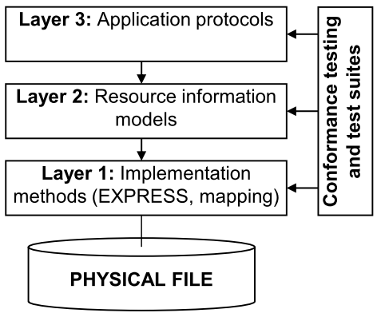
STEP(Standard for the Exchange of Product model data)
Uses a formal model for data exchange, described using an information modelling language called EXPRESS
STEP has a three layer architecture enabling definition of multiple application views and implementations:
techniques for implementing STEP, relations between EXPRESS language, model, and the physical file
resource information models to provide context independent information
description of geometry, topology, product structure
application protocols describing constrained subsets related to specific applications such as geometry, electrical product modelling, etc.

Slide 28
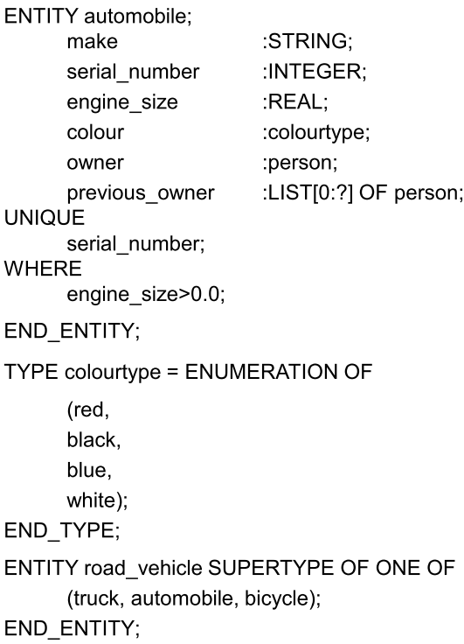
EXPRESS language
IGES defines the file format
STEP uses the EXPRESS language to map the data to the physical file
the EXPRESS language is used to define entities as a collection of attributes
– strings
– real/integer numbers
– logical/Boolean values
– references to other entities, etc.
collections of attributes may be:
– ordered: arrays, lists
– unordered: sets, bags
the collection of entity definitions, data types and associated constraints is a schema

Slide 29
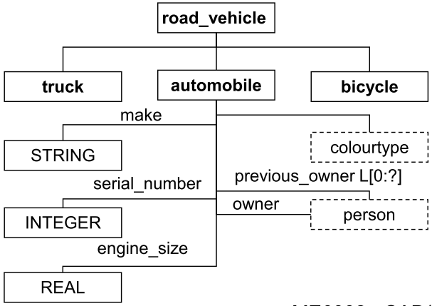
EXPRESS geometric entities
EXPRESS-G is a specific subset of EXPRESS used for graphical notation
– simpler definition of relationships between entities in a class hierarchy
– constraints cannot be specified
– other EXPRESS subsets developed
ENTITY point ;
x-coordinate : REAL ;
y-coordinate : REAL ;
z-coordinate : REAL ;
END_ENTITY ;
ENTITY circle ;
centre : point ;
radius : REAL ;
END_ENTITY ;
#15 = POINT (3.3,4.4,5.5) ;
#16 = POINT (6.6,7.7,8.8) ;
#17 = CIRCLE (#15, 5.0) ;

Slide 30
STEP standard
STEP is being developed incrementally as a series of separate standards (parts) divided into classes:
– Introductory (1-9)
• Part 1: Overview and general Principles
– Description Methods (11-19)
• Parts 11, 12: EXPRESS language
– Implementation Methods (21-29)
• describe how EXPRESS mapped to physical files and other storage mechanisms
– Conformance Testing Methodology and Framework (31-39)
• provide methods for testing implementations, and test suites
– Integrated Resources (41-99, 101-199)
• geometry and structure representation (41-99), and widely used applications such as draughting and FE (101-199)
– Application Protocols (210-299)
• implementation of STEP to specific industrial applications
– Abstract Test Suites (301-399)
• for each of the application protocols
– Application Interpreted Constructs (501-?)
• describe model entity constructs and specific modelling approaches

Slide 31
STEP
Standard for the Exchange of Product Model Data ( STEP), officially the ISO standard 10303, Product Data Representation and Exchange, is a series of international standards with the goal of defining data across the full engineering and manufacturing life cycle. The ability to share data across applications, across vendor platforms and between contractors, suppliers and customers, is the main goal of this standard.

Slide 32
STEP
The broad scope of STEP is as follows.
1. The standard method of representing the information necessary for completely defining a product throughout its entire life, i.e., from the product conception to the end of useful life.
2. Standard methods for exchanging the data electronically between two different systems.
The STEP documentation is split into eight major areas.

Slide 33
The STEP documentation is split into eight major areas.
Overview It gives the general introduction and overview of the standard and forms part one of the ISO standard 10303.
Description Methods The application protocols planned in STEP are far reaching compared to any other existing standard or models. Hence, a new descriptive formal information modelling language called EXPRESS is developed such that the protocols be properly defined
Implementation Methods This provides specifications as to how the STEP information be physically represented for the exchange environment.

Slide 34
Conformance and Tools This part provides the specifications for conformance testing of the processors used for STEP information. They provide information on methods for testing of software-product conformance to the STEP standard, guidance for creating abstract-test suites and the responsibilities of testing laboratories. The STEP standard is unique in that it places a very high emphasis on testing and actually includes these methods in the standard.
Integrated-generic Resources These contain the specifications of the information models that support various application areas that form part of STEP. The topics that form part of this specification are: geometric and topological representation, product structure organisation, materials, visual presentation, tolerances, form features and process structure and properties.

Slide 35
Application Information Models These specify the information models to be used for specific application areas such as draughting, finite element analysis, kinematics, building core model and Engineering analysis core.
Application Protocols These are the main protocols to be used as subsets of STEP information model for exchange of data between specific application systems (such as between two finite element systems or between a CAD and Process Planning system).

Slide 36
Application Interpreted Constructs These relate to the specific resources useful for defining the generic structures useful for applications. These are reusable groups of information resource entities that make it easier to express identical semantics in more than one application protocol. Examples include edge-based wireframe, draughting elements, constructive solid geometry, etc. onwards. Examples include edge-based wireframe, shell-based wireframe, geometry-bounded 2D wireframe, draughting annotation, drawing structure and administration, draughting elements, geometry-bounded surface, non-manifold surface, manifold surface, geometry-bounded wireframe, etc.
Application Protocols These define the context for the use of product data for a specific industrial need. These are more complex data models used to describe specific product-data applications. These parts are known as application protocols and describe not only what data is to be used in describing a product, but how the data is to be used in the model. The application protocols use the integrated information resources in well defined combinations and configurations to represent a particular data model of some phase of product life.

Slide 37
Exporting CAD data
Transferring 3D CAD models between different software packages can be challenging
– fortunately, most CAD packages will directly import files produced in most other packages
• If the file type is not supported, the data must be exported as a neutral format and then imported
– important information may be “lost in translation”
– this applies especially to non-geometric data in 3D models, such as material type
• Sometimes, the geometry could not be properly converted

Slide 38
Introduction to Geometric Modelling
Geometric modelling is a combination discipline with applied mathematics and computational geometry. In this discipline, people designed varied algorithms to describe all kinds of shapes by computers.
Building two or three dimensional models is crucial content of CAD & CAM.
When we were creating a geometric model of a mechanism using a CAD system, what we do is just map real or imaginary structure to a new algorithmic object. This process should be unique and complete. Otherwise, a designer will not be able to restore any of them from start to the end or vice versa. Furthermore, the model could not be manufactured.
This section will tell you what is the theoretical basis of geometric modelling.

Slide 39
Geometry of curve
Representation of curves
Cubic polynomial curves
Bezier curves
Cubic spline curves
B-spline curves
NURBS

Slide 40
Geometry of curve – Representation of curves
Issues in CAD of classical analytic curves
Uneven points
Numerical issue (infinite slope like…)
Multi-valued points
Coordinate system dependent
Solution
Interpolation (pass through all the points)
Approximation (the best fit instead of passing through all points)
Parametrize curve (time-varied trajectory of a moving point)
Composite (piecewise curve)
Ex.

Slide 41

Geometry of curve – cubic polynomial curves
Lagrange/Hermite interpolation
For normalize form, t should belong to interval of [0,1], given two end vectors $r_{0},r_{1}$ and the end vectors of slope $r_{0}^{′},r_{1}^{′}.$We will solve out
Or
We call the functions of t Hermite basis. The above equation means we can use boundary conditions and Hermite basis to define a cubic polynomial curves

Slide 42
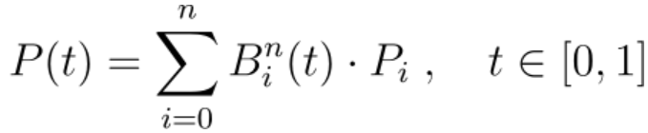
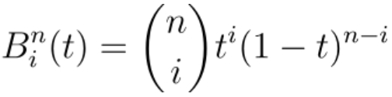
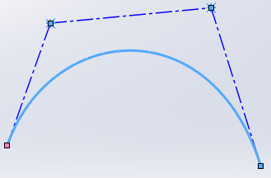

Geometry of curve – Bezier curves
Definition and Control polygon
Bernstein polynomial
for 4 order, the degree of polynomial n=3. we have
$${\text{p}\left(t\right)=(1−t)}^{3}{\text{p}}_{0}+{3t(1−t)}^{2}{\text{p}}_{1}+3t^{2}\left(1−t\right)p_{2}+t^{3}{p }_{3}$$
with matrix representation

Slide 43
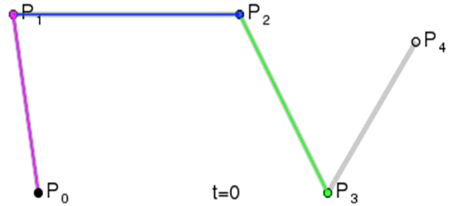
Geometry of curve – Bezier curves
Global control. Changing one of control points affects the shape of whole curve.
The degree of equation depends heavily on the number of control points, which means that the more control points you give, the less efficient it is to generate the curve.

Slide 44
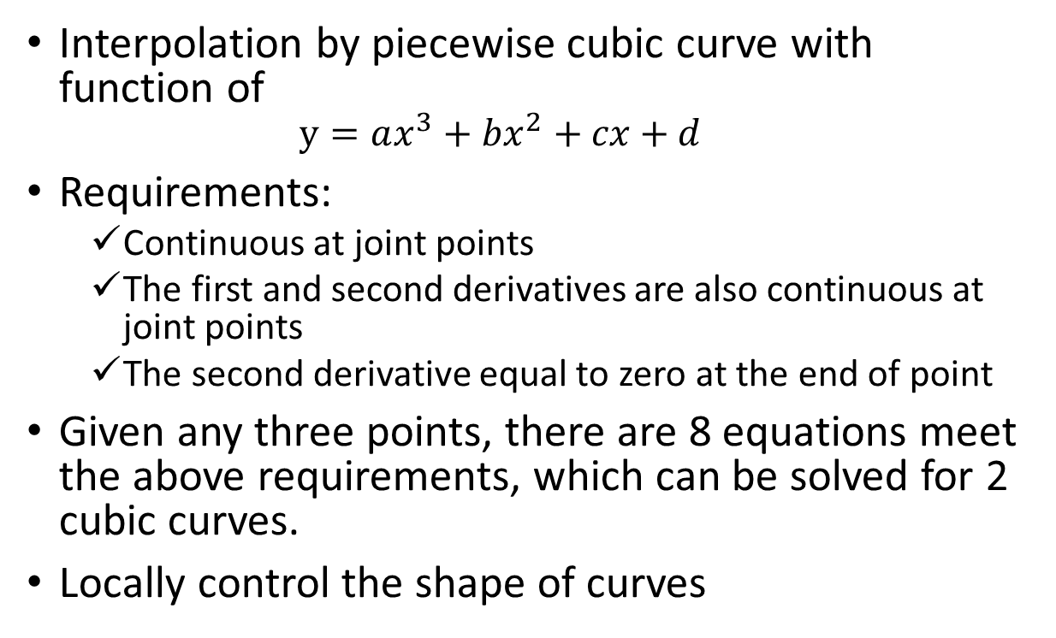
Geometry of curve – Cubic spline curves
Interpolation by piecewise cubic curve with function of
$$y=ax^{3}+bx^{2}+cx+d$$
Requirements:
Continuous at joint points
The first and second derivatives are also continuous at joint points
The second derivative equal to zero at the end of point
Given any three points, there are 8 equations meet the above requirements, which can be solved for 2 cubic curves.
Locally control the shape of curves

Slide 45
Geometry of curve – B-spline curves
B-spline shorted from Basis Spline, is a generalisation of Bezier curve. In other words, a Bezier is a special case of B-spline.
Separate curve degree from the number of given points, which means B-spline curve has the flexibility of choosing the degree of the curve irrespective of the number of control points.
B-splines can be of any degree, but the degrees 2 or 3 is the most useful in computer graphics.
A B-spline is a smoothly joined piecewise parametric polynomial curve
B-spline can be use as both interpolation and approximation.

Slide 46
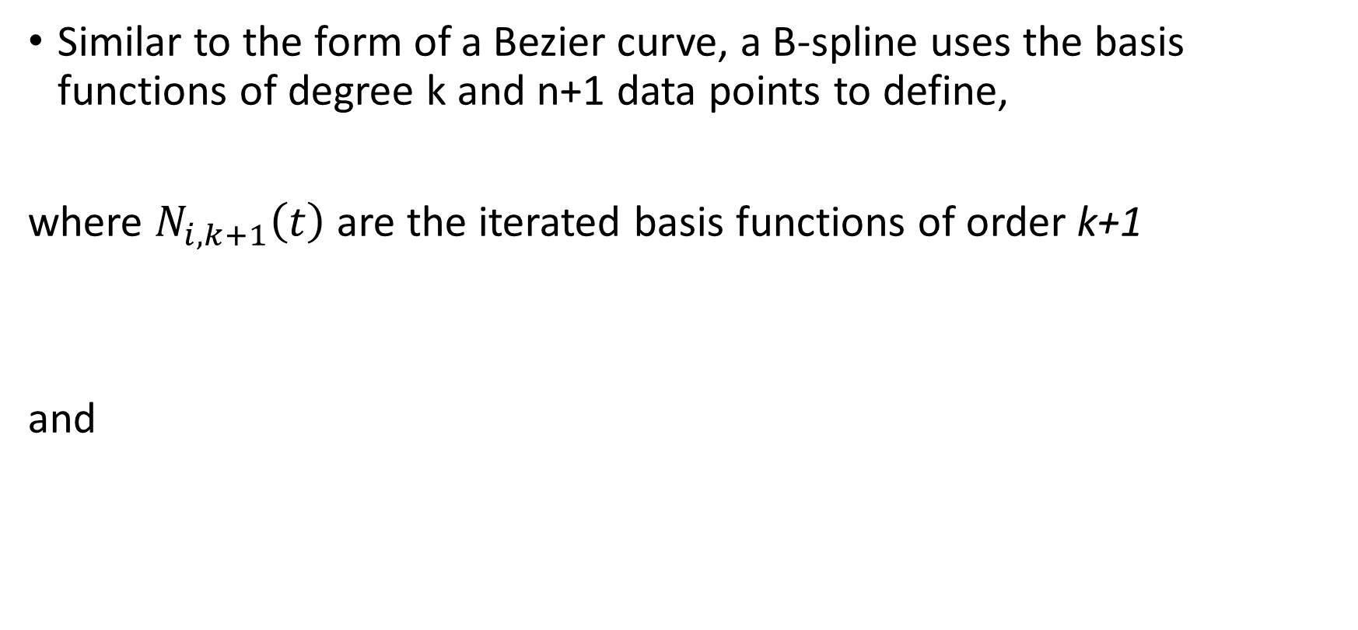
Geometry of curve – B-spline curves
Similar to the form of a Bezier curve, a B-spline uses the basis functions of degree k and n+1 data points to define,
where $N_{i,k+1}\left(t\right)$ are the iterated basis functions of order k+1
and

Slide 47
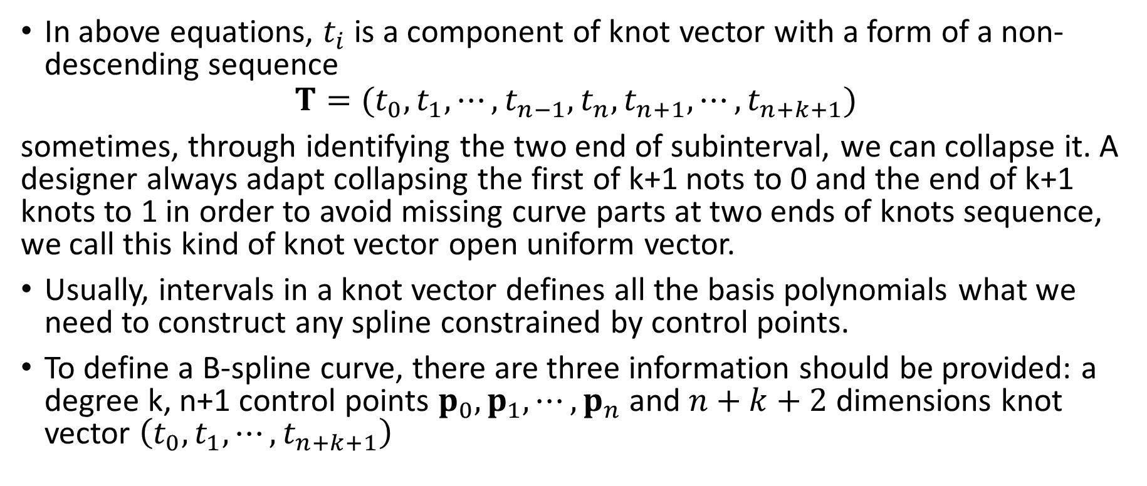
Geometry of curve – B-spline curves
In above equations, $t_{i}$ is a component of knot vector with a form of a non-descending sequence
$$T=(t_{0},t_{1},⋯,t_{n−1},t_{n},t_{n+1},⋯,t_{n+k+1})$$
sometimes, through identifying the two end of subinterval, we can collapse it. A designer always adapt collapsing the first of k+1 nots to 0 and the end of k+1 knots to 1 in order to avoid missing curve parts at two ends of knots sequence, we call this kind of knot vector open uniform vector.
Usually, intervals in a knot vector defines all the basis polynomials what we need to construct any spline constrained by control points.
To define a B-spline curve, there are three information should be provided: a degree k, n+1 control points $p_{0},p_{1},⋯,p_{n}$ and $n+k+2$ dimensions knot vector $\left(t_{0},t_{1},⋯,t_{n+k+1}\right)$

Slide 48
Geometry of curve – B-spline curves
For example, given n=3,k=1, T=(0,0,1/3,2/3,1,1) , we have

Slide 49
Geometry of curve – B-spline curves
p_{i+1}
p_{i-1}
r(u)
p_{i+2}
p_{i}
p_{i-2}
tp_{i}
(1-t)p_{i-1}
0
u_{i-2}
u_{i-1}
u_{i}
u_{i+1}
u_{i+2}
u_{i+3}
u_{i+4}

Slide 50
Geometry of curve – B-spline curves
p_{i+1}
p_{i-1}
p_{i+2}
p_{i}
p_{i-2}
0
u_{i-2}
u_{i-1}
u_{i}
u_{i+1}
u_{i+2}
u_{i+3}
u_{i+4}
Basis functions

Slide 51
Geometry of curve – B-spline curves
Given a knot vector (0,0,0,0,1,2,2,2,2), for 0-degree, there are 8 pieces of basis function. For 1-degree there are 7 pieces of basis function, and for 2-degree there are only 6, and so on.
An order k open uniform B-spline with n+1=k points is the Bezier curve of order k.
For a given degree k, the basis functions are simply shifted versions of one another.
0
0
0
0
1
2
2
2
2

Slide 52
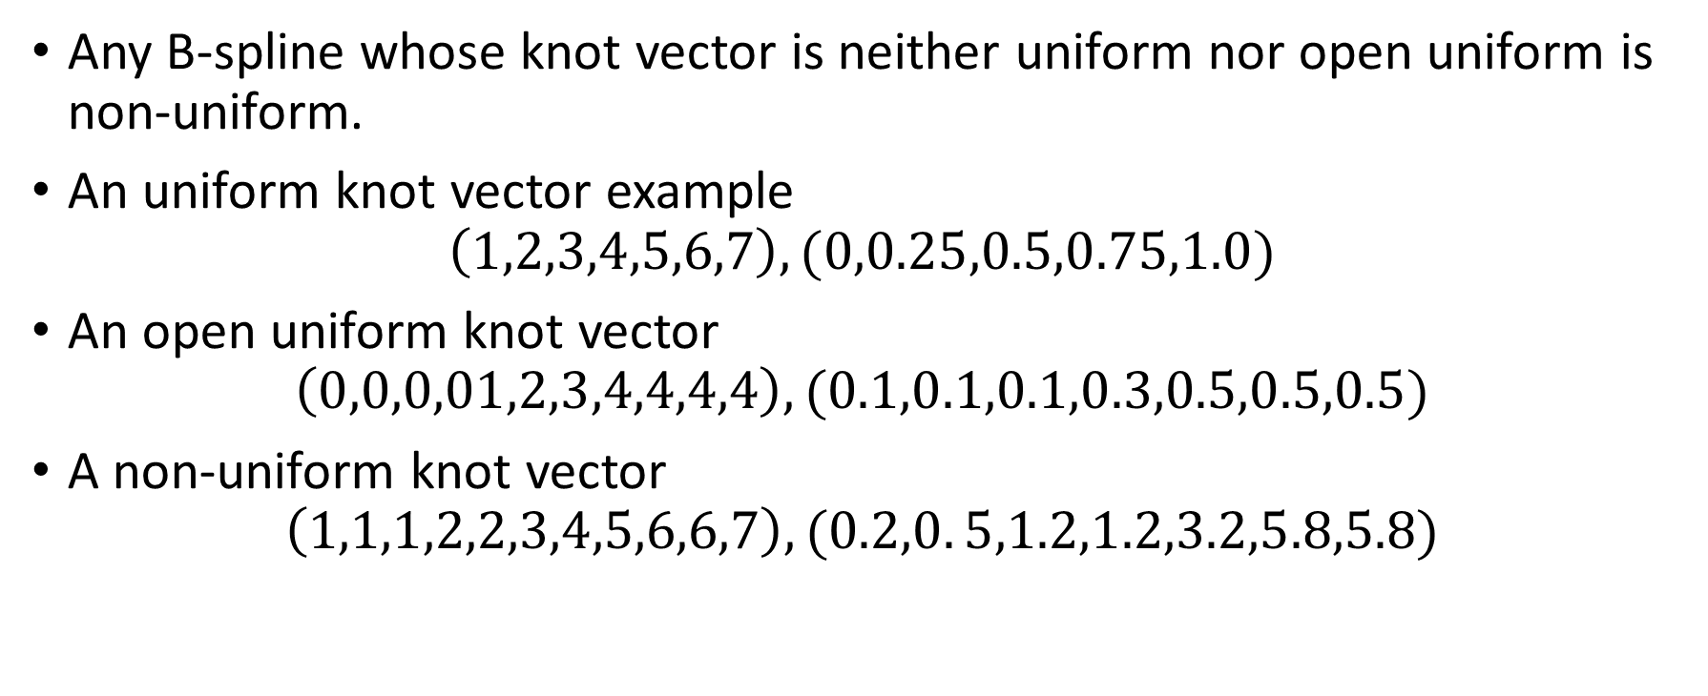
Geometry of curve – NURBS
Any B-spline whose knot vector is neither uniform nor open uniform is non-uniform.
An uniform knot vector example
$$\left(1,2,3,4,5,6,7\right),(0,0.25,0.5,0.75,1.0)$$
An open uniform knot vector
$$\left(0,0,0,01,2,3,4,4,4,4\right),(0.1,0.1,0.1,0.3,0.5,0.5,0.5)$$
A non-uniform knot vector
$$\left(1,1,1,2,2,3,4,5,6,6,7\right),(0.2,0. 5,1.2,1.2,3.2,5.8,5.8)$$

Slide 53
Geometry of curve – NURBS
Any basis function can be represented by algebraic ratio of two polynomials is rational, which has a form like
Based on rational basis functions defined on non-uniform knot vector, we get NURBS. It is short of Non-Uniform Rational Basic Spline.

Slide 54
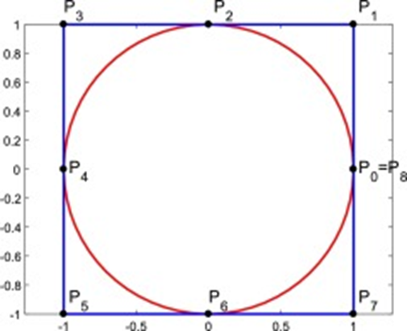
Geometry of curve – NURBS
NURBS is essentially B-spline in homogeneous coordinates, which is more flexible than B-spline through adding another set of (n+1) weights. Today it is actually an industry standard adopted by most of commercial CAD systems.
NURBS is the general form of the B-spline which incorporate open uniform and uniform B-splines as special cases
Even can be used to approximate a circle with knot vector(0,0,0,1/4,1/4,1/2,1/2,3/4,3/4,1,1,1)

Slide 55
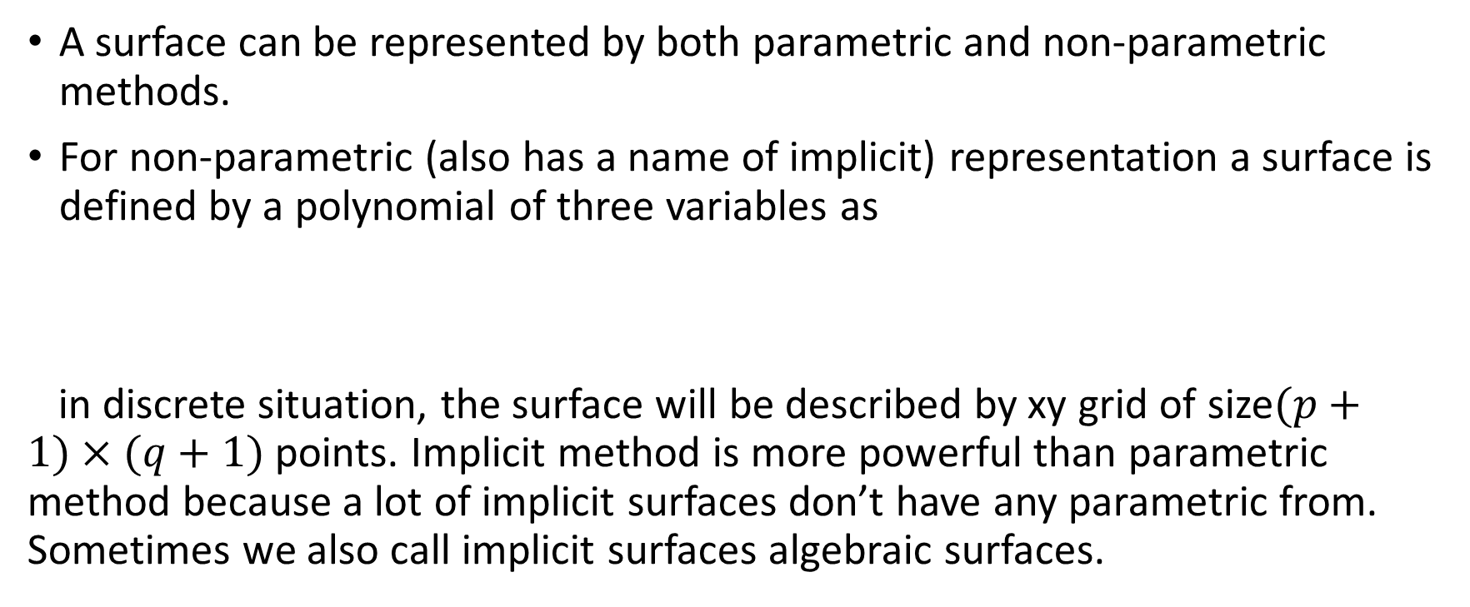
Geometry of surface
A surface can be represented by both parametric and non-parametric methods.
For non-parametric (also has a name of implicit) representation a surface is defined by a polynomial of three variables as
in discrete situation, the surface will be described by xy grid of size$(p+1)×(q+1)$ points. Implicit method is more powerful than parametric method because a lot of implicit surfaces don’t have any parametric from. Sometimes we also call implicit surfaces algebraic surfaces.

Slide 56
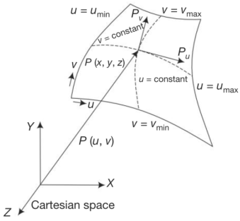
Geometry of surface
For parametric representation, a surface is defined by a set of functions, with the form like
If one parameter is fixed a curve will be got. It means with two spatial curves a surface could be built.

Slide 57
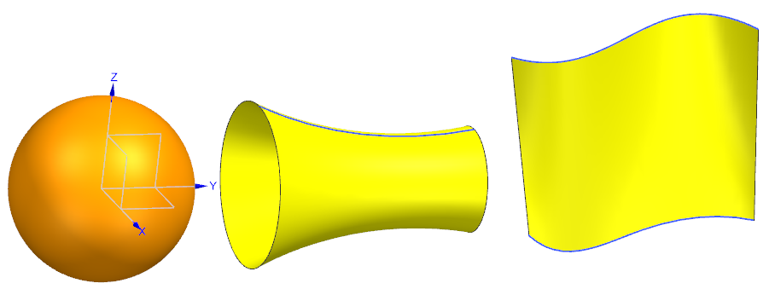
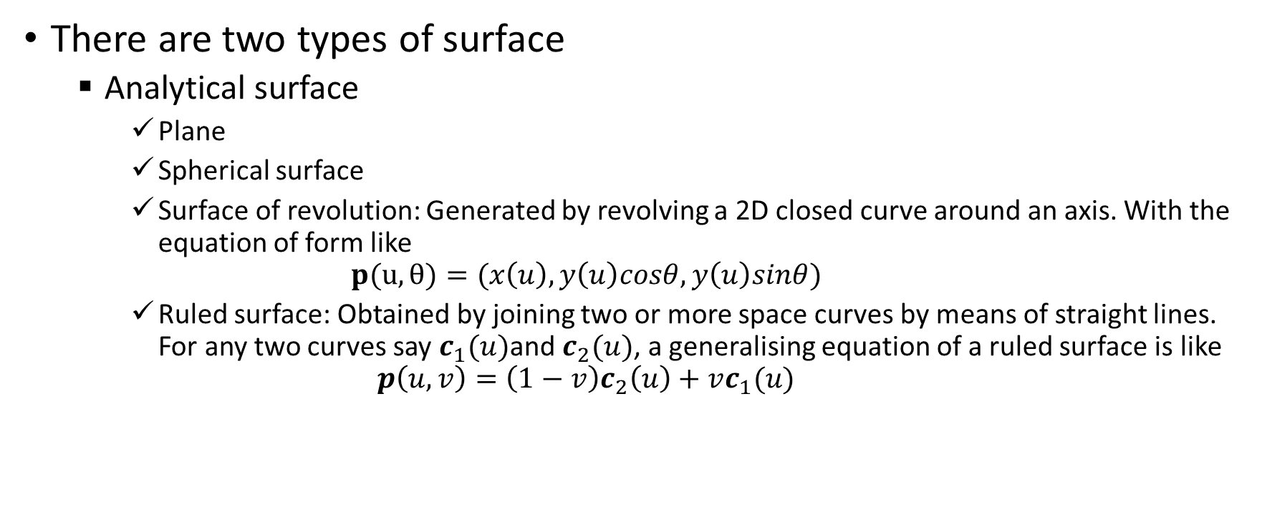
Geometry of surface
There are two types of surface
Analytical surface
Plane
Spherical surface
Surface of revolution: Generated by revolving a 2D closed curve around an axis. With the equation of form like
$$p(u,θ)=(x\left(u\right),y\left(u\right)cosθ,y\left(u\right)sinθ)$$
Ruled surface: Obtained by joining two or more space curves by means of straight lines. For any two curves say $c_{1}(u)$and $c_{2}(u)$, a generalising equation of a ruled surface is like
$$p\left(u,v\right)=\left(1−v\right)c_{2}\left(u\right)+vc_{1}(u)$$

Slide 58
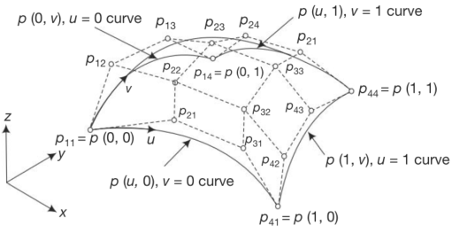

Geometry of surface
Synthetic surface (sculptured surface) is built using many data points or curves
Bezier surface: The Bezier surface is the direct extension of the Bezier curve. Points on a Bezier surface can, therefore, be specified as an extension of the Bezier curve.
where $p_{ij}$ represents the rectangular array of control points (m + 1) × (n + 1) defining the vertices of the characteristic polyhedron of the Bezier patch.

Slide 59
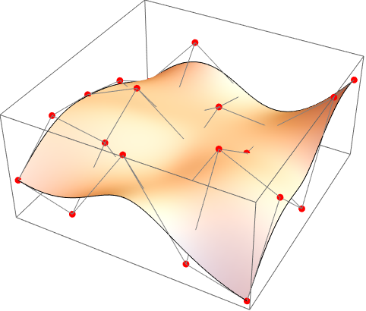
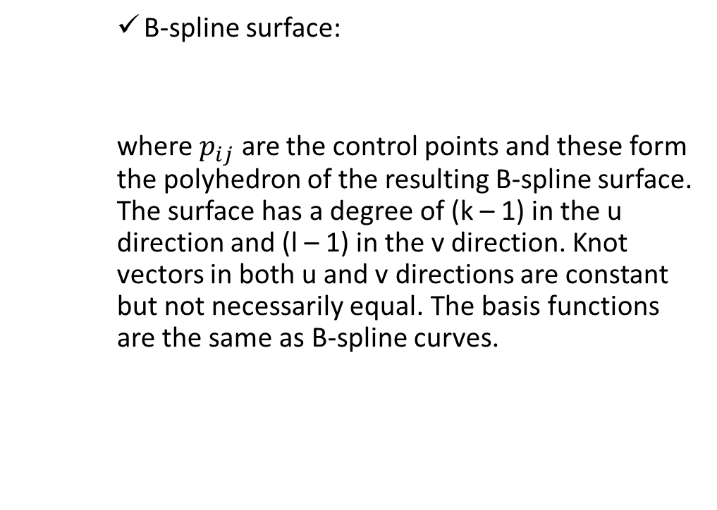
Geometry of surface
B-spline surface:
where $p_{ij}$ are the control points and these form the polyhedron of the resulting B-spline surface. The surface has a degree of (k – 1) in the u direction and (l – 1) in the v direction. Knot vectors in both u and v directions are constant but not necessarily equal. The basis functions are the same as B-spline curves.
https://reference.wolfram.com/language/ref/BSplineSurface.html

Slide 60
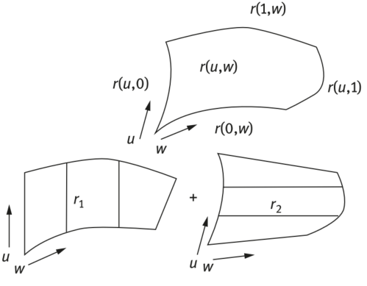
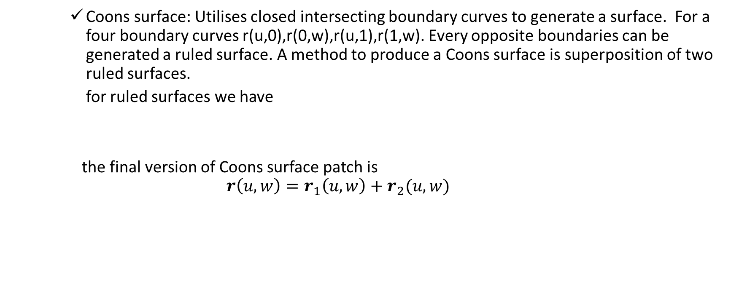
Geometry of surface
Coons surface: Utilises closed intersecting boundary curves to generate a surface. For a four boundary curves r(u,0),r(0,w),r(u,1),r(1,w). Every opposite boundaries can be generated a ruled surface. A method to produce a Coons surface is superposition of two ruled surfaces.
for ruled surfaces we have
the final version of Coons surface patch is
$$r\left(u,w\right)=r_{1}\left(u,w\right)+r_{2}(u,w)$$

Slide 61
Solid Modelling
The most common methods used in commercial CAD system
Boundary representation (B-Rep)
Constructive Solid Geometry (CSG)
Sweeping

Slide 62
Boundary representation (B-Rep)
Any solid occupies a limited space, that is, it has a boundary wrapped itself. By boundary, it can be clearly distinguished wherever is interior or exterior of the solid. Which means a solid can be defined by its boundary.
Usually, a boundary is geometrically described by its vertices, edges loops, faces, genus and bodies.
There are some data structures with maps have been developed for boundary representations.
Modern systems introduced also quadrics and NURBS surfaces as a part of B-Rep.

Slide 63
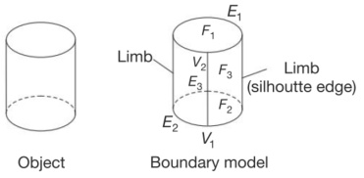
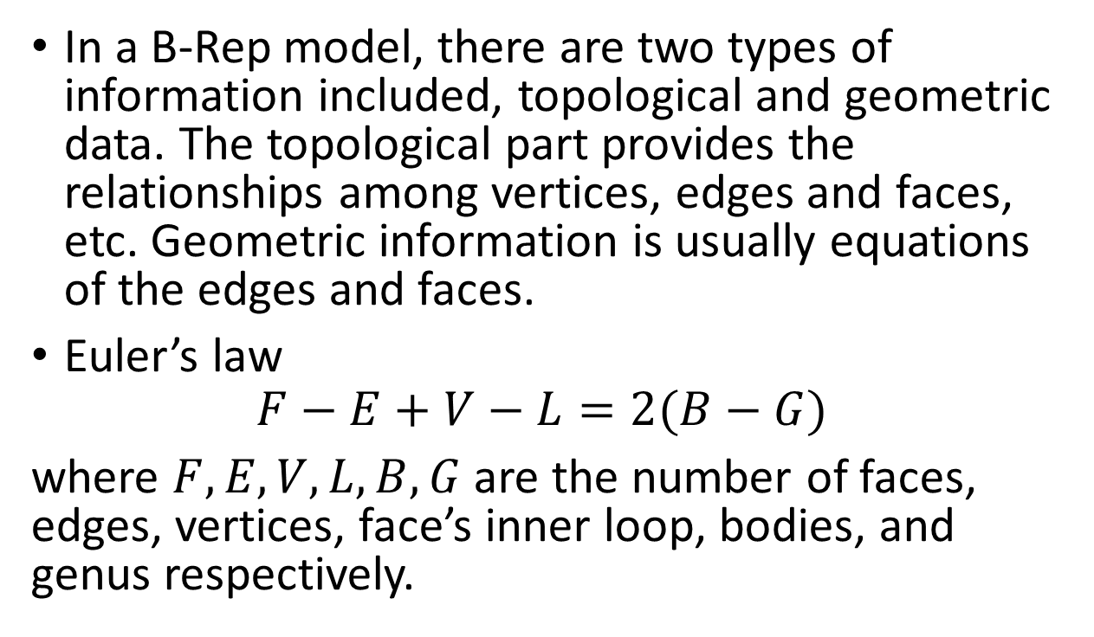
Boundary representation (B-Rep)
In a B-Rep model, there are two types of information included, topological and geometric data. The topological part provides the relationships among vertices, edges and faces, etc. Geometric information is usually equations of the edges and faces.
Euler’s law
$$F−E+V−L=2(B−G)$$
where $F,E,V,L,B,G$ are the number of faces, edges, vertices, face’s inner loop, bodies, and genus respectively.
B-Rep of a cylinder
(P N Rao, CAD/CAM: Principles and Applications,3e)

Slide 64
Constructive solid geometry (CSG)
CSG is one of a fundamental theories of varies 3D modelling CAD system.
Boolean operations of multi-bodies
One of ideas in CSG is that some algebraic calculations can be performed between two bodies.
There are three basic Boolean operations of bodies, which are named union, difference and intersect, derived from set theory. However, in Solidworks, they are called add, subtract and common, respectively.
Through Boolean operations one can take uses of several bodies to generate a new body.

Slide 65
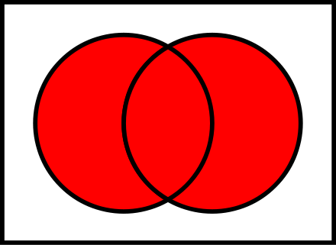

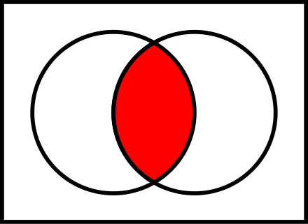
Boolean operations in set theory
In set theory, we have

Slide 66
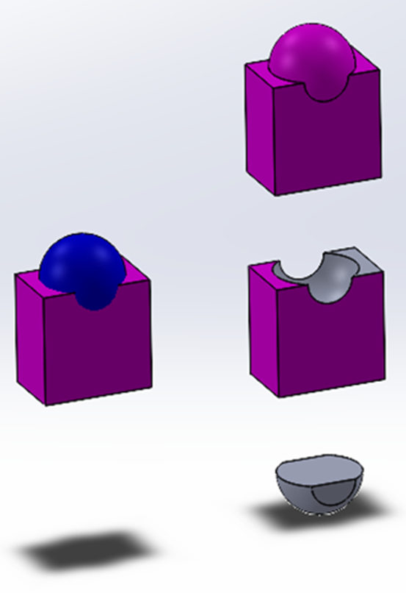
Boolean operations of multi-bodies
Target: The body with the finished geometry is called the target;
Tool: The body used to create or edit the shape is called the tool.

Slide 67
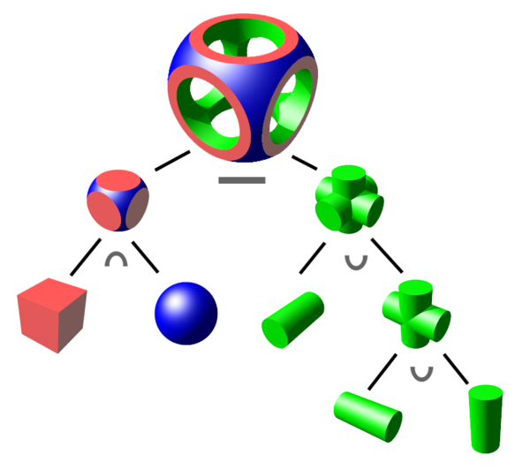
Boolean logic with binary tree
A binary tree structure is usually used to store the basic bodies one lead nodes, the operations on the internal nodes, and the final body on the root node.

Slide 68
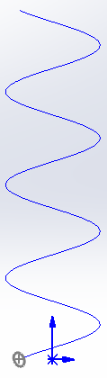
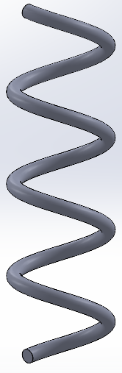
Sweeping
A solid is created by moving a profile shape along a specified path. Most of commercial CAD systems provide the functionality for constructing swept solids in a 2D cross-section moving on a space trajectory.

Slide 69
Three methods to create 3D models

Slide 70
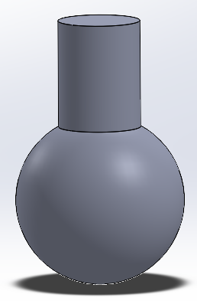
Primitive method
In the method, any 3D model was divided into several simple, basic, standard of items, such as blocks, cylinders, spheres, cones, etc. which usually integrated in CAD system as a standard body. Through these, user can decide how to combine different of them together to construct a new model, then using Boolean operations to get the final result.

Slide 71
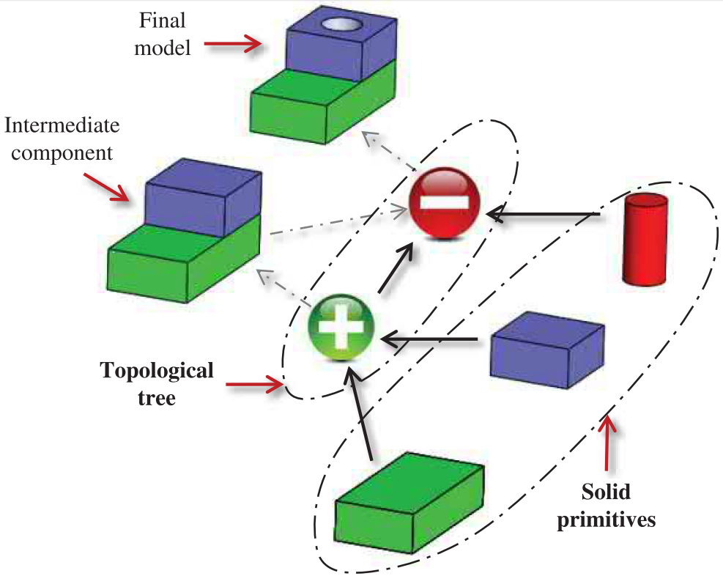

Slide 72
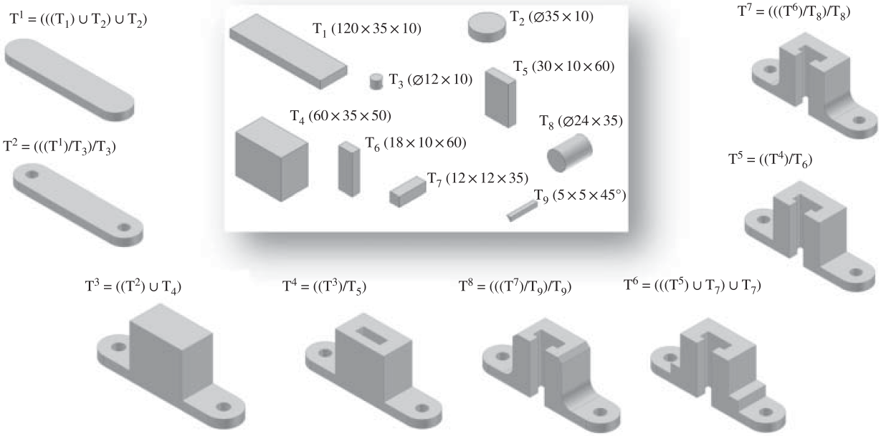

Slide 73
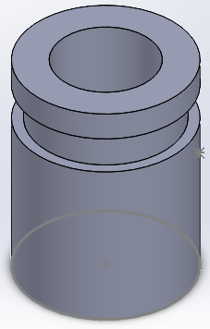
Feature method
Let user to utilize some predefined feature generating instruments, like groove, hole, slot, boss, pad, etc. to simulate a real manufacturing process to create some structure from a simple basic body.

Slide 74
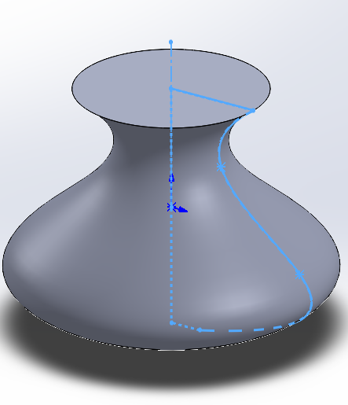
Sketch method
The main idea of this approach is to create 3D body by 2D sketch. Taking use of extrusion, revolution algorithms, in addition some of basic Boolean operations, use can create a very complex 3D structures.
This method is the most popular way used by most of commercial CAD softwares including Solidworks.

Slide 75
Sketch method
The main steps of sketch method to create 3D models are
Define a sketch plane as cross section;
Sketch 2D shapes on the cross section;
Constraint 2D shapes with accurate dimensions;
Perform 2D to 3D operations.

Slide 76
Key disciplines of modelling in Solidworks

Slide 77
Key disciplines of modelling in Solidworks
For basic bodies, generate 3D model by taking use of 2D shapes;
Combine basic bodies to create a complex body;
Repeated bodies can be made through array operations;

Slide 78
Coordinate system
Coordinate systems are the most important concept in a CAD system. They are used to input, store, and display geometric model. There are three kinds of coordinate systems, that is, model coordinate system (MCS), working coordinate system (WCS), and screen coordinate system (SCS).
By default, there are already a coordinates system provided for user by SOLIDWORKS every time you open a new modelling project. Usually, at the lower-left corner of the canvas, you can notice the symbol of coordinate system with three axes.
Whenever user need to carry on some location or orientation related modelling steps, the coordination system should be considered.
For example, in the scenarios of re-oriented a model or two models comparing user should define his own reference coordinate systems.

Slide 79
References objects
Reference points
Reference vectors/axes
Reference plane

Slide 80
Sketch
Plane curves
Two types of Constraint
Dimensional constraints: length and angle
Geometric constraints: parallel, perpendicular, normal, tangent, concentric, etc.

Slide 81
CAM

Slide 82
Brief of NC & CNC
NC in CAM
NC, short of Numerical Control, is introduced into manufacturing field with the rapid development of microelectronics. Bendix Corporation built the first commercial production-based NC unit using MIT patents in 1954.
Basically, a NC machine runs on a program fed to it. The program consists of precise instructions with geometric and process information, such as what tool to be used, at what speed, at what feed and to move from which point to which point in what path.
To make the soft instructions sense, some hard part should be driven
starting and stopping of machine-tool spindle
controlling the spindle speed
positioning the tool tip at desired locations and guiding it along desired paths by automatic control of the motion of slides
controlling the rate of movement of the tool tip
changing of tools in the spindle

Slide 83
Principle of numerical control
The basic information that has to be input into the system consists of the part geometry, cutting-process parameters followed by the cutting tools used.
The part program is then entered into the controller of the machine, which in turn runs the machine tool to make the part.
Each of the machine axes is connected to a servomotor/stepmotor which works under the control of the Machine Control Unit (MCU).
The movement of the cutting tool with respect to the workpiece is given in terms of the coordinates, which are used to control the motion of the servomotor/stepmotor which drives the individual axes.

Slide 84
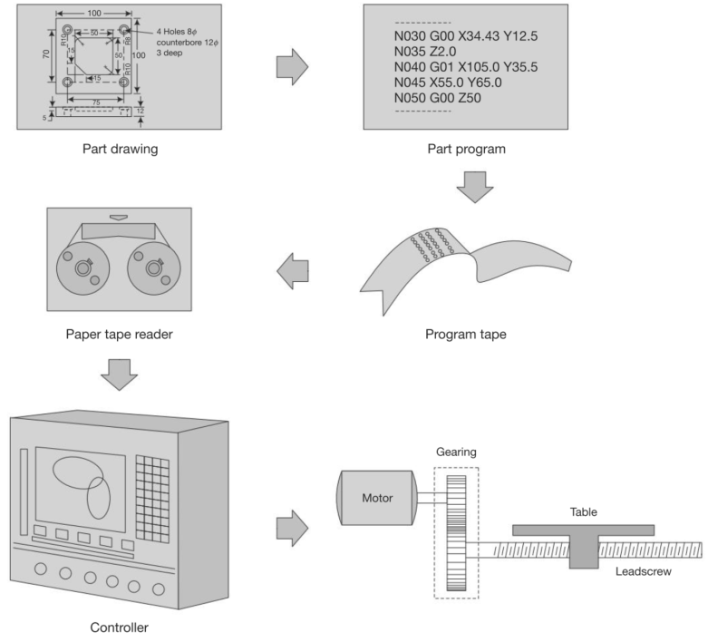

Slide 85
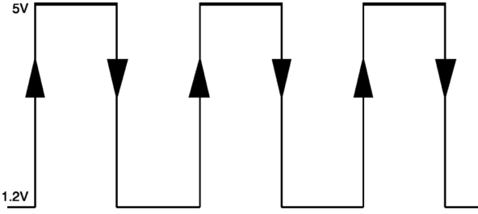
Principles of a CNC Servo System
Usually, a CNC servo system works in the digital mode, which means its control signal is with the form of electrical pulses.

Slide 86
Main types of CNC machine
Computer Numerical Control (CNC) integrated a computer type controller into the machine tools, which is a big step from NC to CNC. NC focuses mainly on the hardware techniques, and on the other hand, CNC mainly concerns of software techniques, which means more flexibilities, huge data throughput, standard OS. Sometimes it is also termed software numerical control.
There are four numerical control modes:
Point-to-point mode; the machine tool can be moved to any point along X and Y axes, then to perform machining in Z axis at that point, such as drilling machines.
Point-to-point straight line mode; Improved the point-to-point mode, in which the machine tool can carry out a continuous motion in each of the axis direction.
2-axis contouring, with switchable plane; Based on the previous two modes, in this mode, the machine tool can be moved simultaneously in any 2 axes. Based on this mode, the remained one axis can only carry out motion after the 2-axis motion finished, usually we call this situation 2.5D mode.
3-axis contouring continuous path. This mode can be found in most of current-day control systems. In this mode, the machine tool is supposed have the capability of simultaneous 3 or more axes motion.

Slide 87
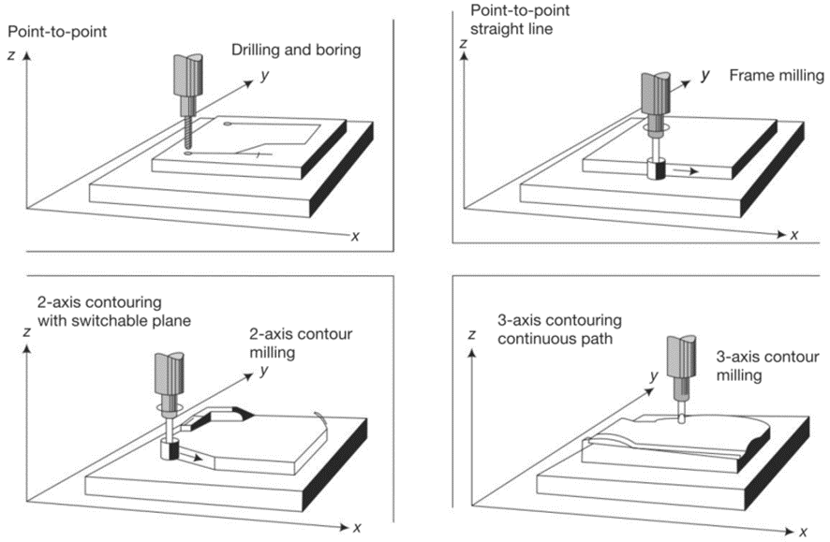
Main types of CNC machine

Slide 88
CNC Hardware
Spindle
Spindle is the most import performing mechanism in a CNC machine-tool
Since during working, a spindle usually suffers axial and radial forces which transmitted from the machining force. The accuracy of spindle should be taken care of to ensure the proper designed tolerance could be achieved.
Methods to keep spindle working in a best status in order to get the needed surface finish.
Avoid large power used
Avoid high spindle speed
Avoid temperature of spindle increasing too high. (e.g. introducing temperature compensation system)

Slide 89
CNC Hardware
Drives
Spindle Drives: supply power for spindle to cut.
Dc motor, controlled by varying the voltage
Ac motor, controlled by varying the frequency. For positioning the spindle axis, ac drive is a good choice like in turn mill centres.
Feed Drives: supply power for the motion along different axis.
DC Servomotor
Brushless dc servomotor
Stepper motor
Permanent-magnet step motor
Micro-step motor
Linear motor

Slide 90
CNC Hardware
Actuation Systems
Lead Screws
Slideways
Linear-Motion Systems
Feedback Devices
Optical Rotary Encoder
Linear Scale
Axes
Z axis
X axis
Y axis

Slide 91
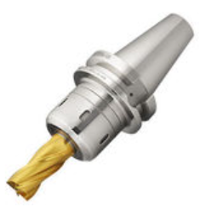
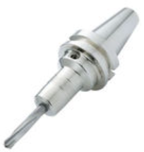
CNC Tooling
tools and their construction features
The main difference between the NC tooling and the conventional one is that NC cutting tool is usually set in an adapter. And most of configurations of them are following ISO standard. Statistically, the 20-30% of total budget was spent on tooling for a NC machine tools. It is always a key to get the exactly position of a tool tip at any time in any machining process.
Origin: https://en.nttool.com/products/nc/

Slide 92
CNC Tooling
tooling
CNC operating system
FANUC, SINUMERIK – LINUMERIK.

Slide 93
Introduction to CAPP
Three main parameters to define a machining process
Principles for process design
Processing planning systems

Slide 94
Programming for CNC machining
Coordinate systems of CNC
Manual part
Computer assisted part programming
CNC part programming with CAD system.

Slide 95

Programming for CNC machining
CNC part programming with CAD system.

Slide 96
Programming for CNC machining
The CNC machine receives MCD blocks containing:
– Sequence Number (identifier N): ascending numerical order but not necessarily a continuous sequence
– Preparatory function (identifier G)
– Dimensional data (identifiers X,Y, Z, A or B): location and axis orientation data for a cutter move
– Feed functions (identifier F): cutter feedrates
– Spindle functions (identifier S): spindle speed or parameters for constant surface speed (CSS) operation
– Tool functions (identifier T): specify the cutter and its offsets
– Miscellaneous functions (identifier M): specify mode of operation or switch feature on and off
– end of block (eob) character

Slide 97
Programming for CNC machining
The CNC data sequence convention is:
N G XYZAB F S T M eob
– Fixed sequential / tab sequential formats use the sequence order and spacing to identify the data items
– Word address form uses identifier letter
• only enter the required data, so it’s a more compact form
– Further variations due to:
• decimal places (e.g. metric 3, imperial 4); omission of trailing zeroes or decimal places
001 01 45.000 75.125 150.000 0.750 3000 eob
N001 G01 X45. Y75.125 Z150. F.75 S3000 eob
N001 G01 X045000 Y075125 Z150000 F075 S3000 eob
N001 G01 X1.7717 Y2.9577 Z5.9055 F0.0295 S3000 eob
– are all equivalent

Slide 98

Basic CNC Commands

Slide 99

CNC operations
Absolute programming:
– absolute coordinates are given in the machine’s coordinate space
– the origin may be redefined
Incremental programming:
– each move is specified as an increment from the previous position
– the encoders must be moved to a known position at start-up
Cutter compensation (Tool Nose Radius Compensation):
– most tools cut on a curved edge rather than single point
– the cutter path must be offset by the tool radius; the path defines the tool side of profile
– using a different tool should not affect the program
Constant surface speed (CSS)
– this automatically adjusts the spindle speed to maintain the cutter speed with respect to workpiece

Slide 100
Machining from 3D models

Slide 101
Material handling in CAM environment
Logistic and storage system
AGVS
AS/RS
Swarf handling and disposal of wastes
Assembly lines
Quantitative analysis of assembly systems.

Slide 102
Key disciplines of manufacturing under Solidworks environment
Configuration for a mill or turn machine
Features to machining strategy
Generate operation plan
Generate tool path
Simulation
Post process

Slide 103
The following slides are only for learning purpose

Slide 104
Create a new part
Check the unit setting
Using sketch to create part body
Smart dimension is an import tool to drive the model creatation

Slide 105
Go to the Solidworks CAM module(just perform each of tool button alone the toolbar from left to right, one can finally get the tool path and G-codes)
Define machine
Setup coordinate system
Define stock size using stock manager

Slide 106
Using setup->mill setup to tell the machine which direction is the machining (removing material) direction.
Extract machinable features(which features will be removed)
Generate operation plan(usually have cutting times for the same surface)
Adjust the plan by removing part of operations or changing some parameters for cutting
How to decide the basic cutting parameters(F/S):
Cutting and spindle speed calculations

Slide 107
Feed rate calculatons
Ususlly, we have general start conditons, in which
For HSS(high speed steel tool)

Slide 108
For Carbide
Depth of cut is approximately 10% the diameter of the tool, except with face mills:0.005 inch max. (SFPM=surface feet per minute)
Decide roughing

