Slide 1
Travelling Salesman Problem
Author: Jinglong Wu
Juncheng Li
Xintong Yan

Slide 2
Outline
1. Introduction
2. Description of Algorithms
A. Brute-Force
B. Dynamic Programming
C. Greedy
D. Lin-Kernighan Heuristic (2-Opt)
3. Improvement of Algorithms
4. Results and Analysis
5. Conclusion
6. Reference

Slide 3
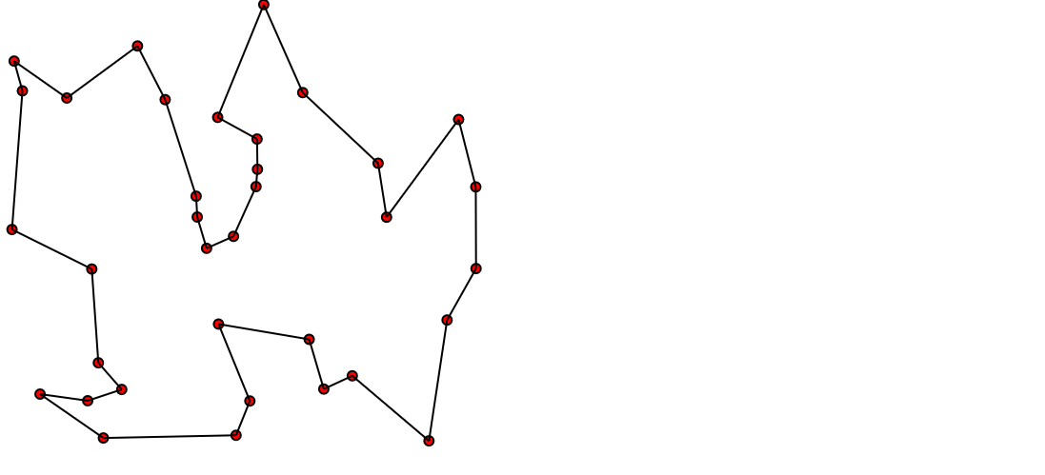
Introduction
The travelling salesman problem (TSP) can be stated as follows:
Given:
Complete undirected graph G(V, E)
Metric edge cost Ce >=0
Problem:
Find a hamiltonian cycle with minimal cost.

Slide 4
2.A Brute-Force
When one thinks of solving TSP, the first method that might come to mind is a brute-force method. The brute-force method is to simply generate all possible tours and compute their distances. The shortest tour is thus the optimal tour. To solve TSP using Brute-force method we can use the following steps:
Step 1. calculate the total number of tours.
Step 2. draw and list all the possible tours.
Step 3. calculate the distance of each tour.
Step 4. choose the shortest tour, this is the optimal solution.

Slide 5
2.B Dynamic Programming
Why DP can works?
Assume that {s, s1 ,s2 , … , sp, s} is a optimal circle. if dist(s,s1) is known, then problem becomes to find optimal circle from s1 to s. If dist(s1,s2) is known, then problem becomes to find optimal circle from s2 to s. Obviously, it’s a optimal substructure problem.

Slide 6
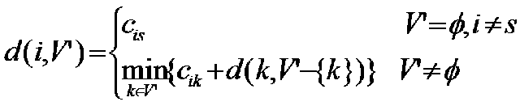
2.B Dynamic Programming
DP equation
Assume start from s，d(i, V’) represent the optimal weight of the circle, which go from vertex i, go through all vertice in V’ (a set) once and only once, then go back to s.
①if V’ is empty，d(i, V’)=C(i,s) (distance between i and s)、
②if V’ is not empty， d(i, V’)=min{C(i,k) + d(k, V’-{k})}
Ps : d(k, V’-{k}) is a subproblem

Slide 7
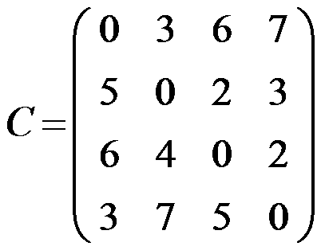
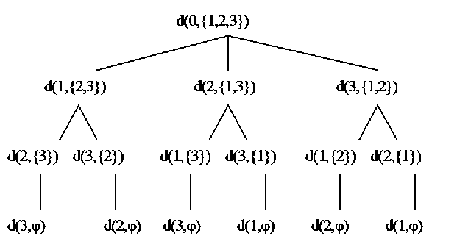
2.B Dynamic Programming
5
3
6
4
7
2
5
3
2
5
2
7
3
4
2
3
7
6
3
6
7

Slide 8
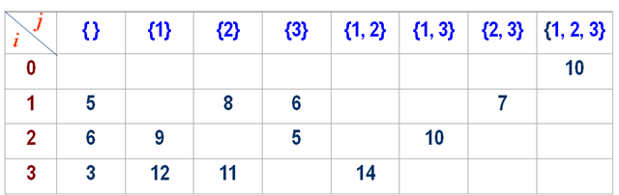
Example

Slide 9
2.C Greedy Algorithm
----Nearest Neighbor
In common, we always need a fast way to solve this kind of problems. One of the solutions is greedy algorithm.
Non-optimal
1. Start at home (of course)
2. Next city will be the closest as-yet-unvisited one (if there are two or more at the same closest distance, just pick any one of them)
3. Go there
4. Repeat 2. and 3. until no more unvisited cities
5. Go home

Slide 10
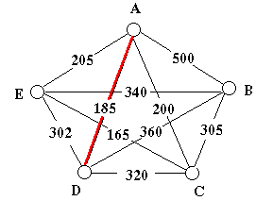
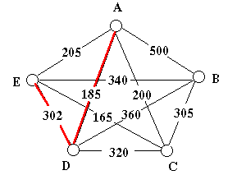
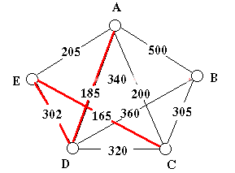
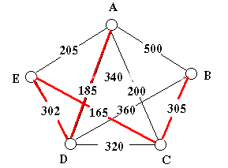
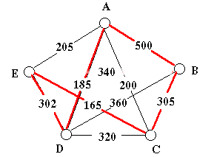
2.C Greedy Algorithm
----Nearest Neighbor

Slide 11
2.D Lin-Kernighan Heuristic
K-opt neighborhood for tour x:
N_{k}(x) consists of all tours, which can be constructed from X by deleting and adding K edges.
Observation:
Two hamiltonian cycles only differ in K edges (2<= k <= n)
Problem 1: k-optimality in N_{k}can only be tested in O(n^{k})
Problem 2: K is unknown.
Approach: Choose an efficient searchable neighborhood such that K can be chosen dynamically.
Sequential K-opt moves

Slide 12
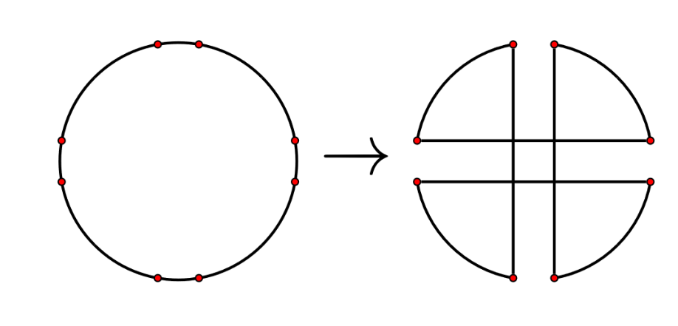
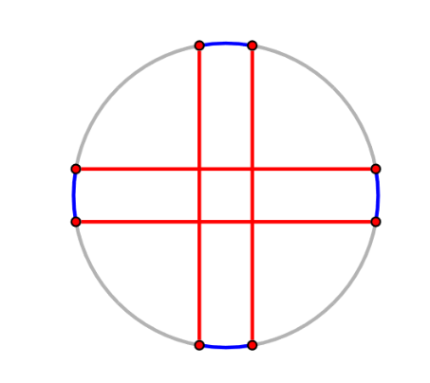
2.D Lin-Kernighan Heuristic
Double Bridge Move (4-opt):

Slide 13
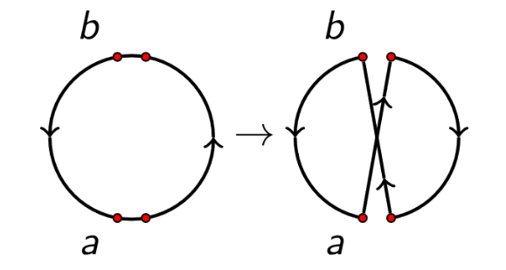
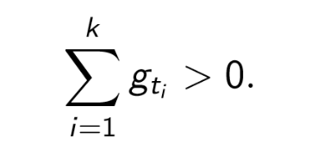
2.D Lin-Kernighan Heuristic
Flip Operations:
Flip operation: flip(next(a), prev(b))
Gain g_{t} of flip t:
g_{t} = C(a,next(a)) + C(prev(b), b) - C(next(a),b) - C(a, prev(b))
Lin-Kernighan:
Choose a fixing start node a and construct the alternating path by a sequence of flip operations of the form flip(next(a), prev(b))
The goal within this construction is to obtain

Slide 14
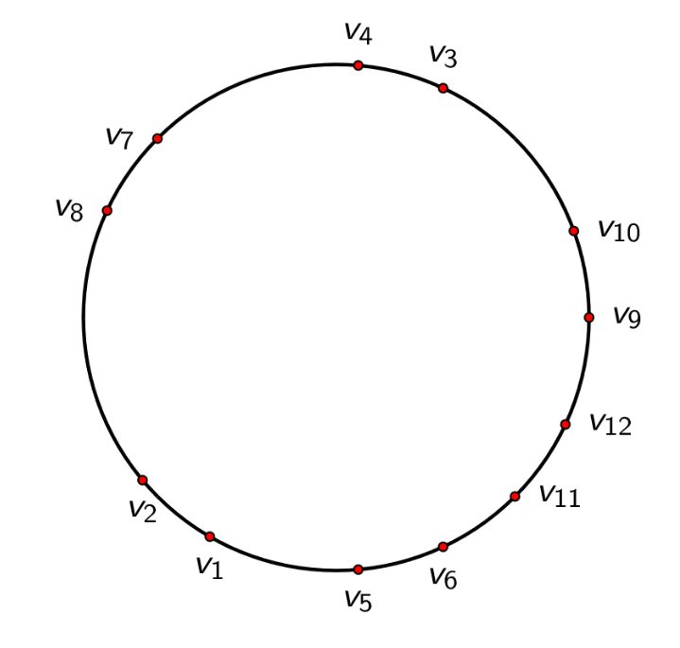
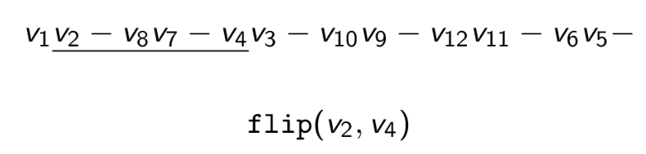
Example

Slide 15
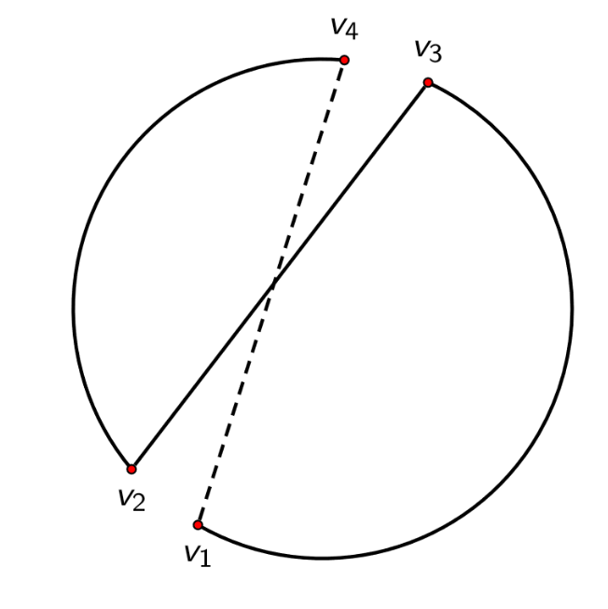
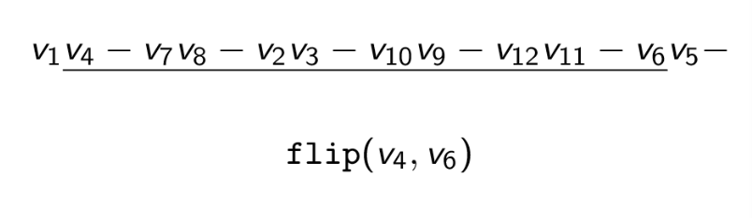
Example

Slide 16
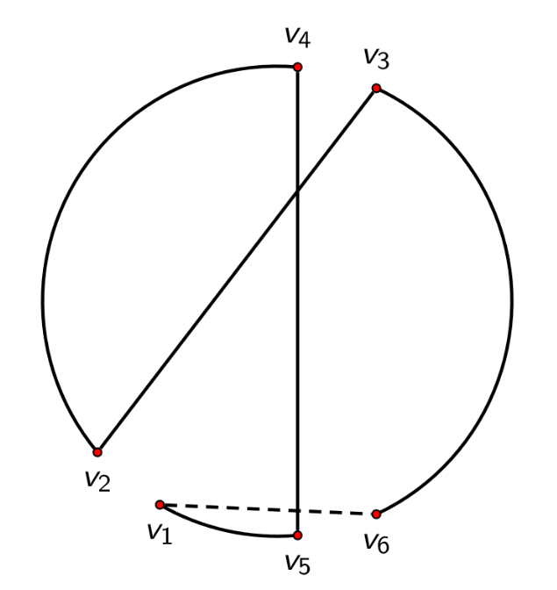
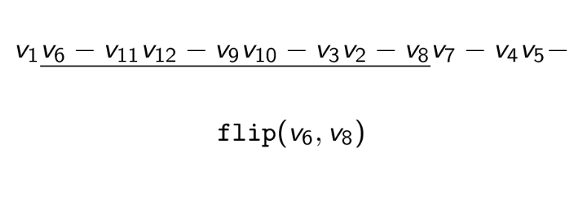
Example

Slide 17
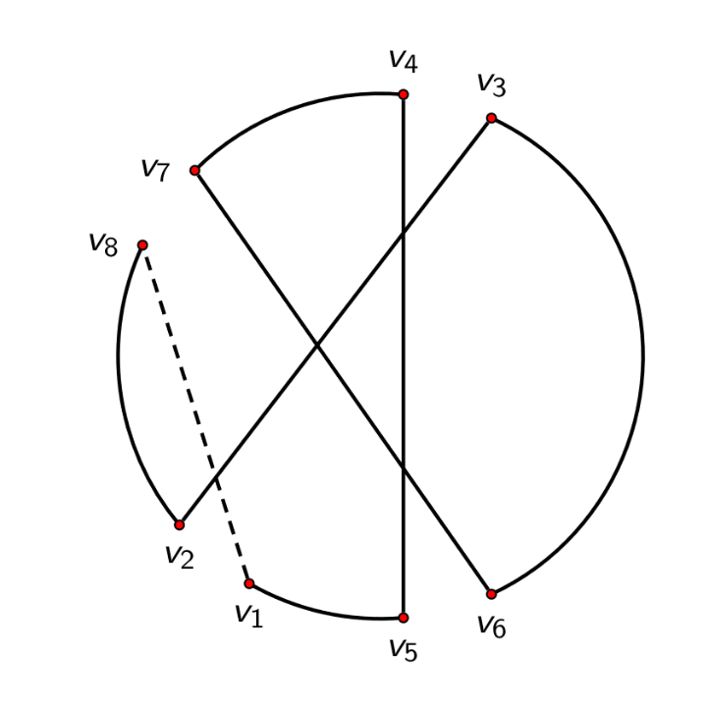
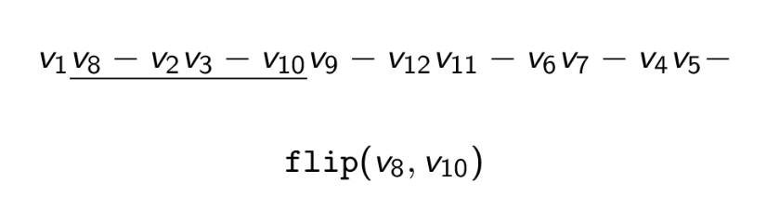
Example

Slide 18
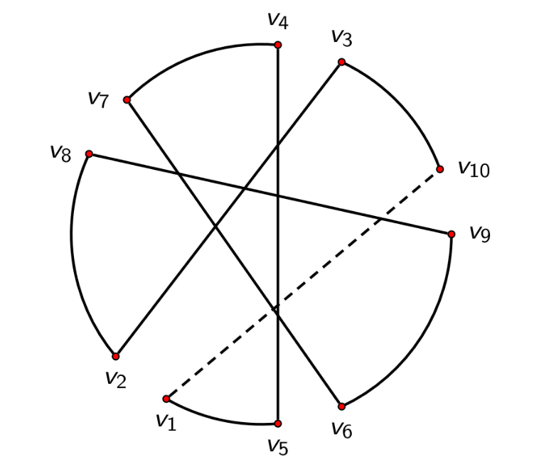
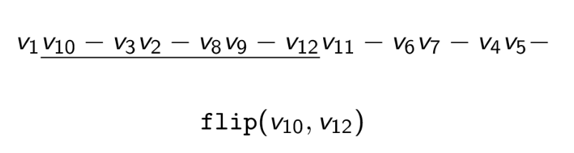
Example

Slide 19
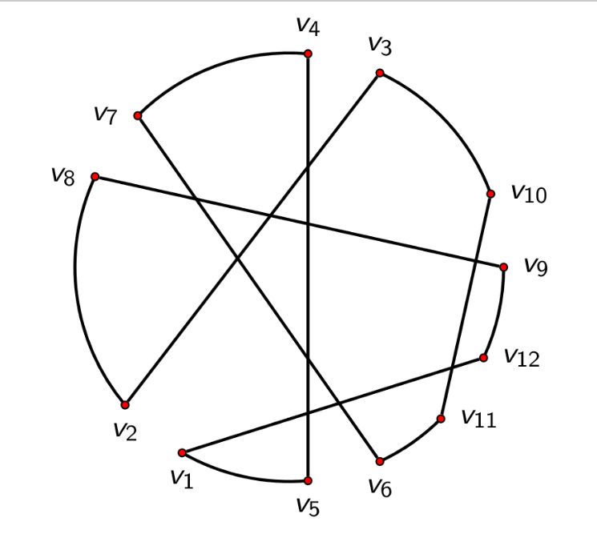
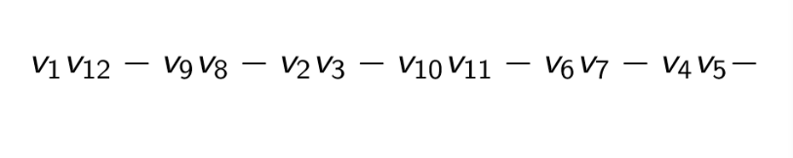
Example

Slide 20
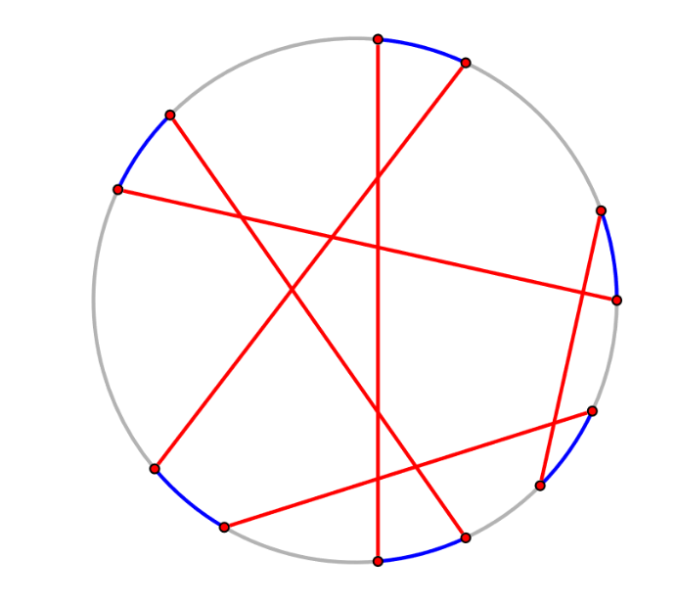
Example

Slide 21
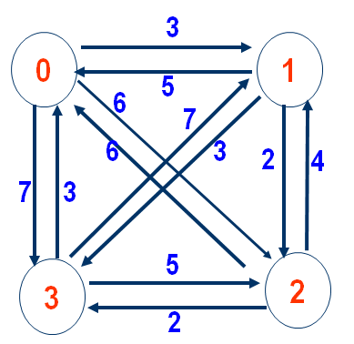
Representation of Graph
Labeled graph
Adjacency matrix
Coordinator
Vertex 1 ： (0,1)
Vertex 2 ： (3,7)
Vertex 3 ： (30,12)
Vertex 4 ： (22,9)
Vertex 5 ： (73,66)
.
.
.
Vertex n ： (Xn,Yn)

Slide 22
Assumption of Our TSP Input
Dist(i,i)=0; // Distance to itself is 0
Dist(i,j)=Dist(j,i) // Diagonal symmetry
Dist(i,j)>0 , ( i != j ) // All vertice linked and weight of edges >0
A positive, complete undirected graph

Slide 23
Improvement of Algorithms - Eliminate crossover
Require coordinator graph representation
The current 2 segments are i⇾i+1, j⇾j+1 (1 < i < i+1 < j< j+1 < n).
For i⇾i+1 : x=xi+(xi-1 - xi)*t, y= yi +(yi+1 - yi)*t
For j⇾j+1 : x=xj+(xj-1 - xj)*s, y= yj +(yj+1 -yj)*s
If 0 < t < 1 and 0 < s < 1, two segments are intersected.

Slide 24
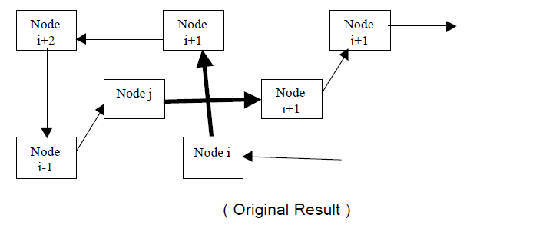
Eliminate crossover

Slide 25
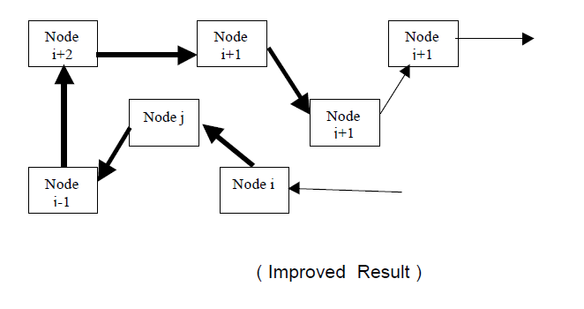
Eliminate crossover

Slide 26
Results and Analysis
Length Comparison
 | 9 | 12 | 30 | 100 | 300
Brute Force | 1070 | 1493 | Unknown | Unknown | Unknown
Dynamic Programming | 1070 | 1493 | Unknown | Unknown | Unknown
Greedy | 1099 | 1815 | 3444 | 7215 | 17286
2-Opt (Based on Greedy) | 1099 | 1493 | 2442 | 6430 | 16156
N
Algo.

Slide 27
Results and Analysis
Time Comparison
 | 9 | 12 | 30 | 100 | 300
Brute Force | 263 ms | 440670 ms | >20 min | Unknown | Unknown
Dynamic Programming | 355 ms | 62311 ms | Unknown | Unknown | Unknown
Greedy (JAVA) | 22 ms | 24 ms | 31 ms | 63 ms | 146 ms
2-Opt (Based on Greedy) | 0 ms | 0 ms | 1 ms | 21 ms | 169 ms
N
Algo.

Slide 28
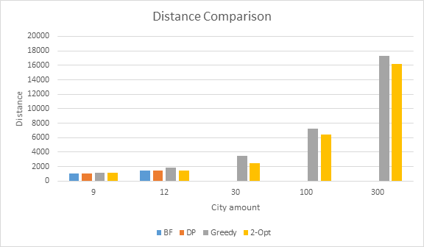

Slide 29
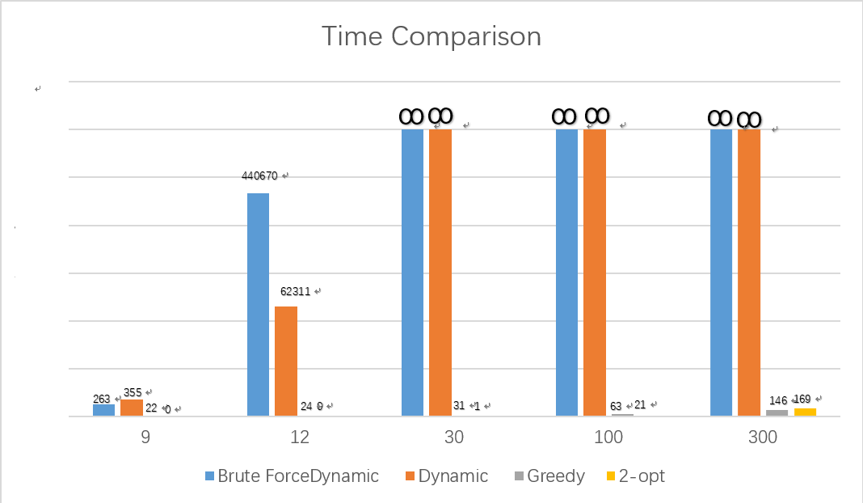

Slide 30
Conclusion
1.Brute Force will output the accurate shortest path and distance. But it takes too long time to compute, we can’t get a solution when more than 12 cities. Because it has a complexity O(n*(n-1)*(n-2)*...*2*1)
2. Dynamic Programming is a better way than Brute Force to get an accurate solution. It cost much less time than Brute Force, but still perform bad when you have more than 12 cities. Sometimes, if N is very small, it even performs worse than BF.
3.Greedy is the fastest way to get an approximate solution because of its complexity is O(n)
,and most of time it is too inaccurate to satisfy our request..
4. LK is a practical and efficient way to improve algorithms. But after optimizing, it still could be an inaccurate solution.
5. Coordinator representation is most practical way to represent TSP problem, and Eliminate crossover is useful improvement, we’ll implement them in the future.

