Slide 1
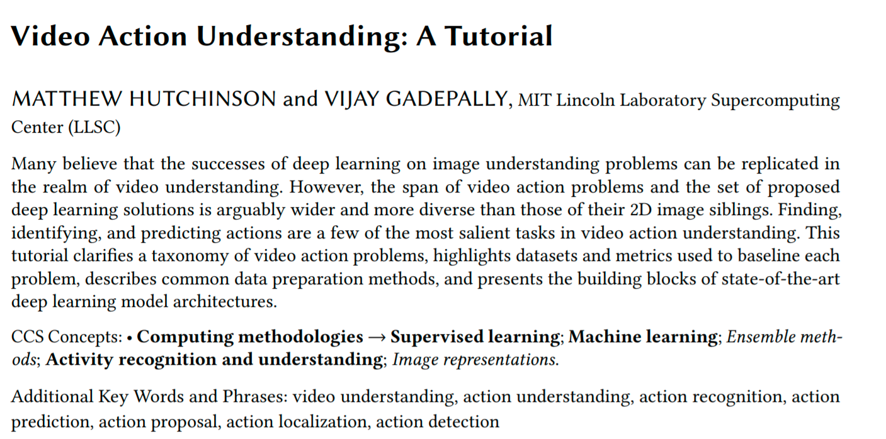
Wen Liu
2021/3/28
http://xxx.itp.ac.cn/pdf/2010.06647.pdf

Slide 2
