Slide 1
DetNet: A Backbone network for Object Detection
Zeming Li, Chao Peng, Gang Yu, Xiangyu Zhang, Yangdong Deng, Jian Sun

Slide 2
There are two problems using the classification backbone for object detection tasks
Recent detectors, e.g., FPN, involve extra stages compared with the backbone network for ImageNet classication in order to detect objects with various sizes.
large downsampling factor causes compromised spatial resolution which will fail to accurately localize the large objects and recognize the small objects.

Slide 3
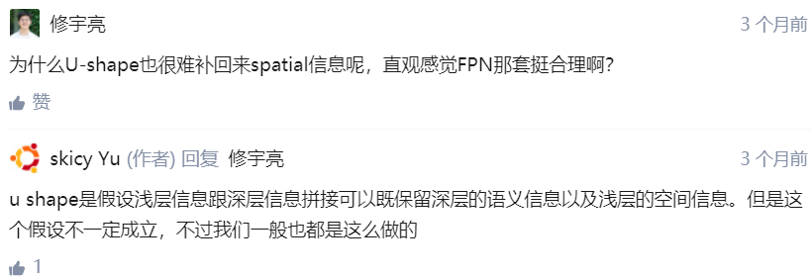
Three problems in FPN
The number of network stages is different. Extra stages like P6 are not pre-trained in ImageNet dataset.
Weak visibility of large objects. The boundary of large object may be too blurry to get an accurate regression.
Invisibility of small objects.
The information from the small objects will be easily weaken as the spatial resolution of the feature maps is decreased.
Shallow layers usually only have low semantic information which may be not sucient to recognizethe category of the object instances.
In FPN, if the small objects is missing in deeper layers, these context cues will miss simultaneously.

Slide 4
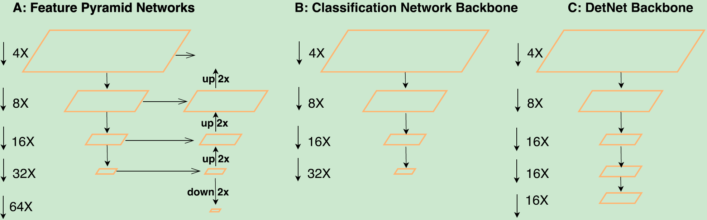
DetNet More stages for object detection with high spatial resolution of the feature maps, and large receptive field
Extra stages like P6 can be pre-trained in ImageNet dataset.
Benefited by high resolution feature maps in last stage, DetNet is more powerful in locating the boundary of large objects and finding the missing small objects.

Slide 5
Design
keep stage1,2,3,4 the same as original ResNet-50
fix the spatial resolution as 16x downsampling even after stage 4.
after stage 4, employ a dilated bottleneck with 1x1 convolution projection to introduce a later stage.
stage 5 and stage 6 keep the same channels as stage 4.(Traditional backbone design will double channels in a later stage.)

Slide 6
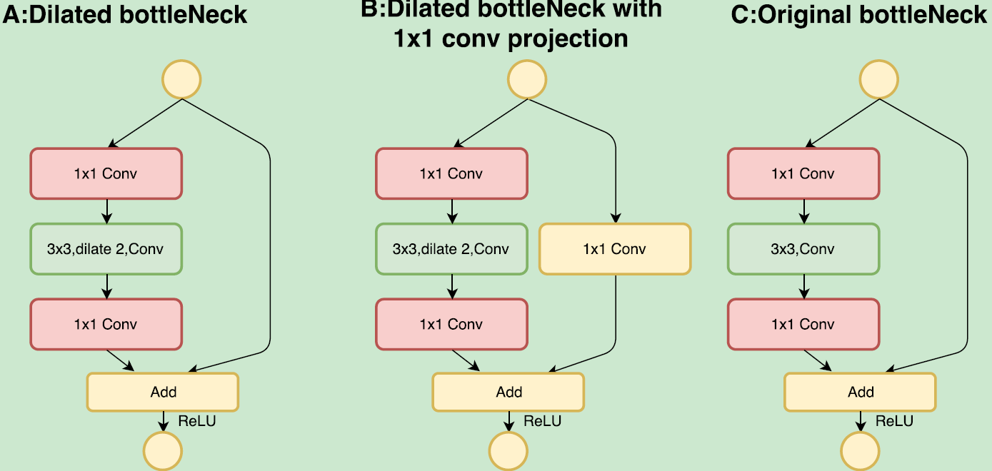
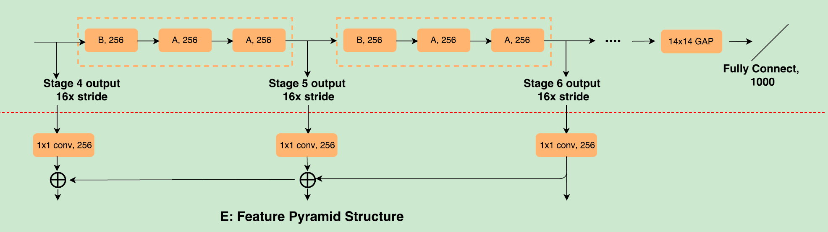

Slide 7
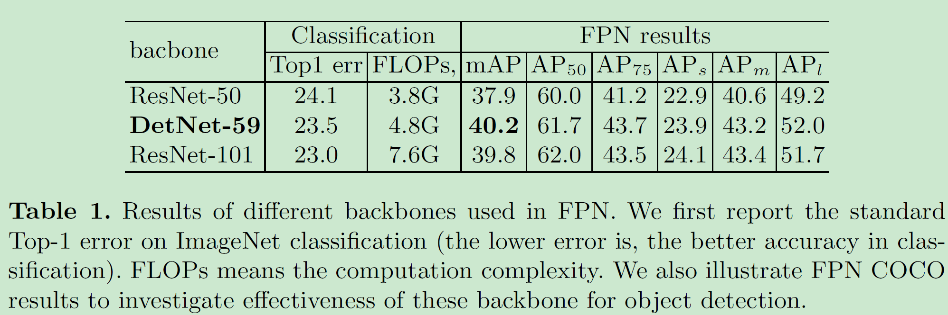

Slide 8
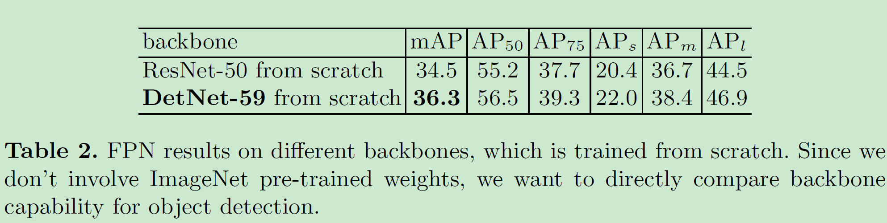

Slide 9
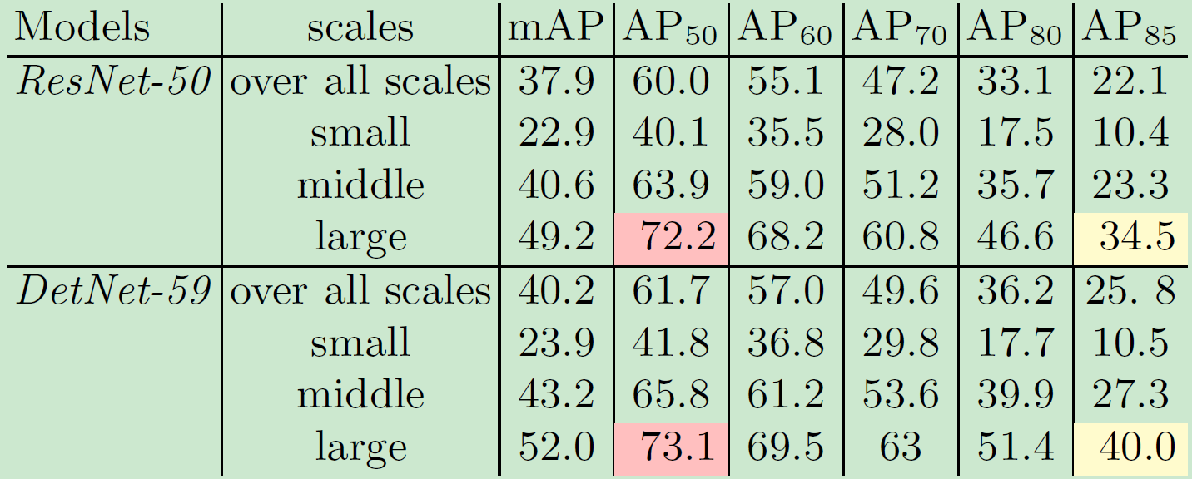
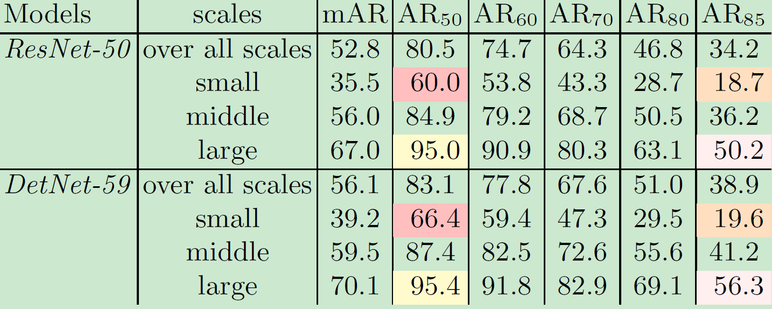

Slide 10
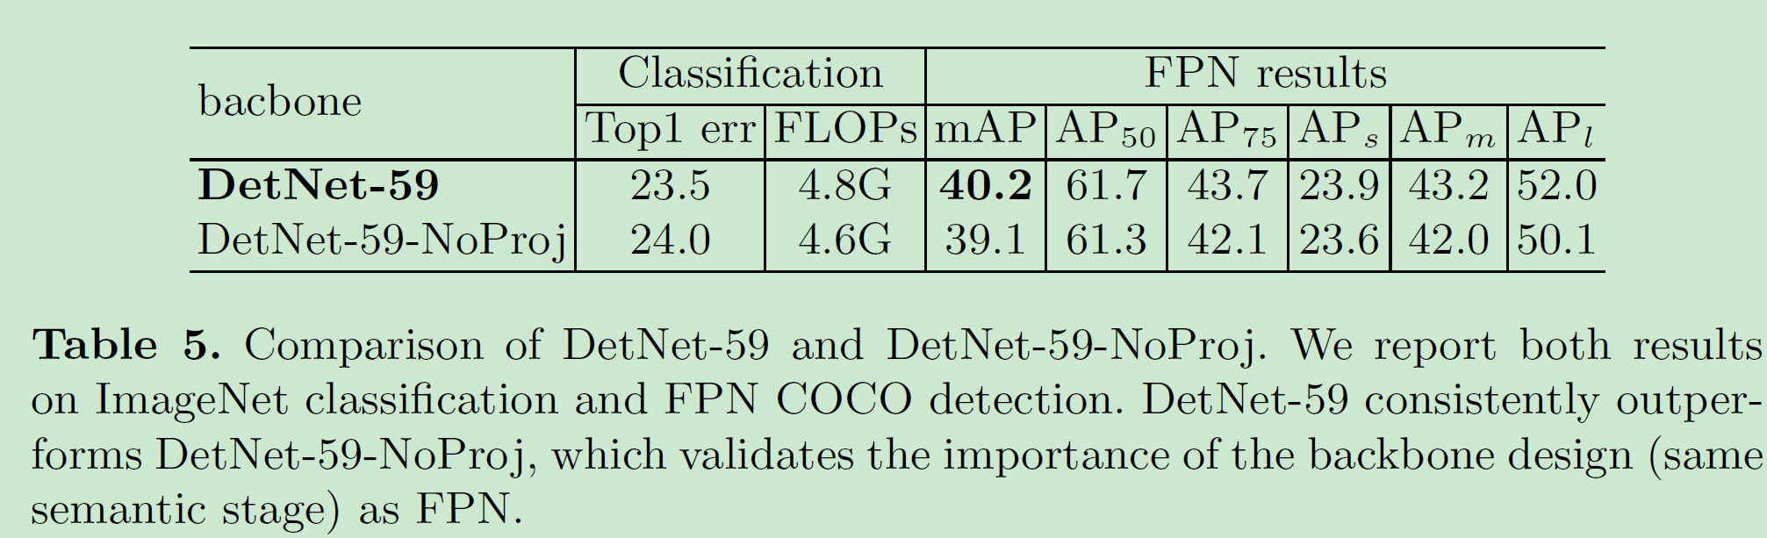
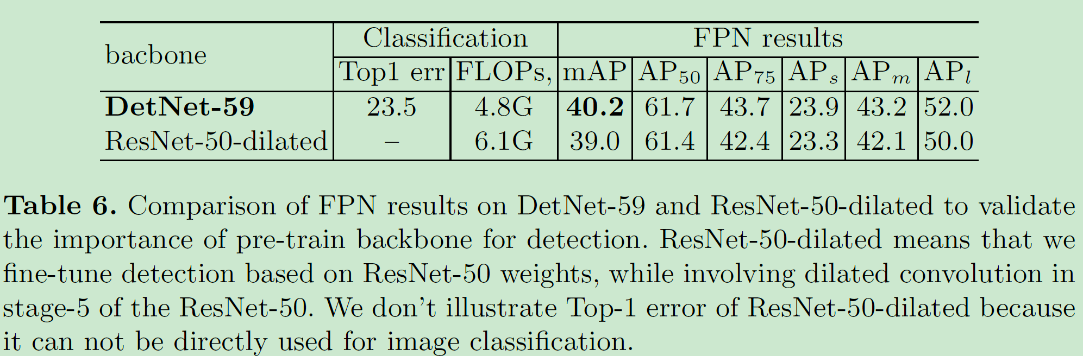

Slide 11
