Slide 1
Temporal Cycle-Consistency Learning
Debidatta Dwibedi, Yusuf Aytar , Jonathan Tompson, Pierre Sermanet, and Andrew Zisserman
Wen Liu
http://openaccess.thecvf.com/content_CVPR_2019/papers/Dwibedi_Temporal_Cycle-Consistency_Learning_CVPR_2019_paper.pdf

Slide 2
Motivation
Finding correspondences across times in multiple videos

Slide 3
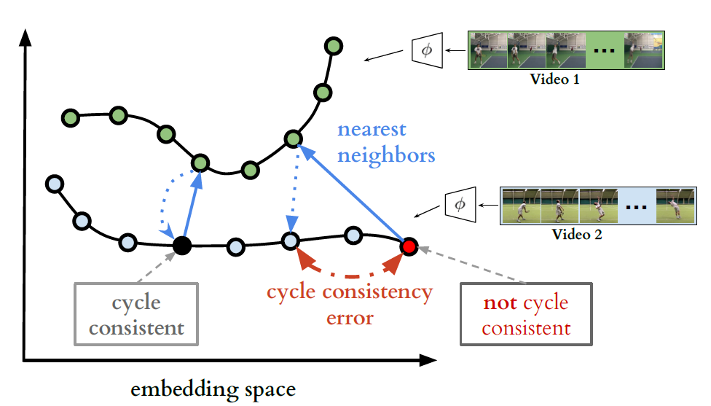
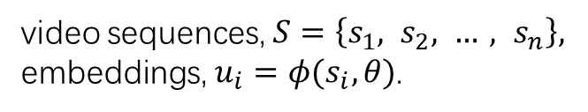
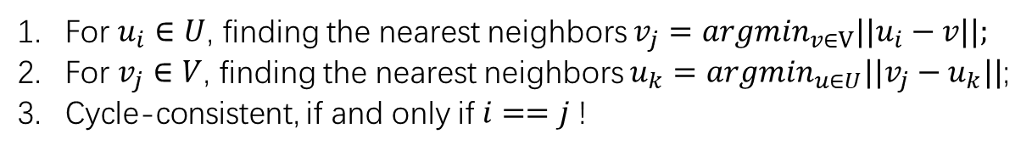
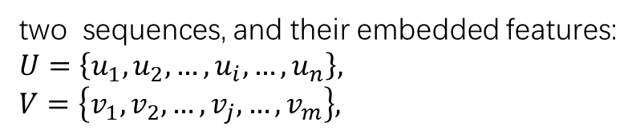
Cycle-Consistent embedding learning
video sequences, $S=\left\{s_{1}, s_{2}, …, s_{n}\right\},$
embeddings, $u_{i}=φ(s_{i}, θ)$.
two sequences, and their embedded features:
$$U=\left\{u_{1}, u_{2}, …,u_{i}, …,u_{n}\right\},$$
$$V=\left\{v_{1}, v_{2}, …, v_{j},…, v_{m}\right\},$$
For $u_{i}∈U$, finding the nearest neighbors $v_{j}=argmin_{v∈V}||u_{i}−v||;$
For $v_{j}∈V$, finding the nearest neighbors $u_{k}=argmin_{u∈U}||v_{j}−u_{k}||$;
Cycle-consistent, if and only if $i==j$!

Slide 4

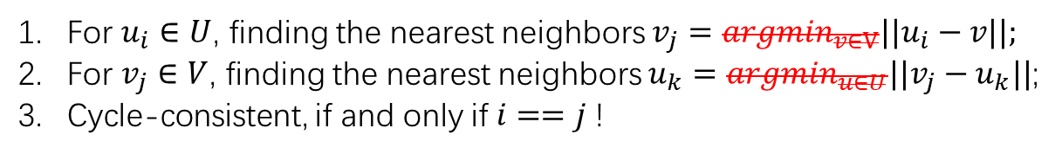
How to minimize?
video sequences, $S=\left\{s_{1}, s_{2}, …, s_{n}\right\},$
embeddings, $u_{i}=φ(s_{i}, θ)$.
two sequences, and their embedded features:
$$U=\left\{u_{1}, u_{2}, …,u_{i}, …,u_{n}\right\},$$
$$V=\left\{v_{1}, v_{2}, …, v_{j},…, v_{m}\right\},$$
For $u_{i}∈U$, finding the nearest neighbors $v_{j}=argmin_{v∈V}||u_{i}−v||;$
For $v_{j}∈V$, finding the nearest neighbors $u_{k}=argmin_{u∈U}||v_{j}−u_{k}||$;
Cycle-consistent, if and only if $i==j$!
$argmin$ is not differentiable

Slide 5
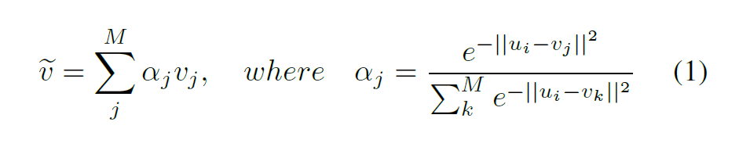
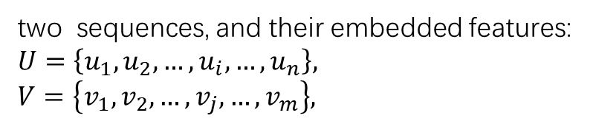
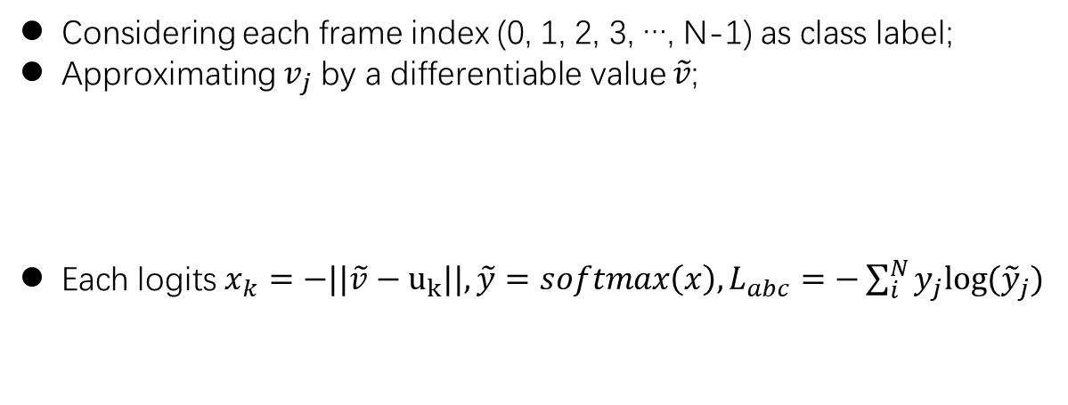
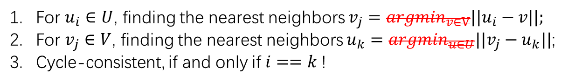
Cycle-back classification
two sequences, and their embedded features:
$$U=\left\{u_{1}, u_{2}, …,u_{i}, …,u_{n}\right\},$$
$$V=\left\{v_{1}, v_{2}, …, v_{j},…, v_{m}\right\},$$
For $u_{i}∈U$, finding the nearest neighbors $v_{j}=argmin_{v∈V}||u_{i}−v||;$
For $v_{j}∈V$, finding the nearest neighbors $u_{k}=argmin_{u∈U}||v_{j}−u_{k}||$;
Cycle-consistent, if and only if $i==k$!
Considering each frame index (0, 1, 2, 3, …, N-1) as class label;
Approximating $v_{j}$ by a differentiable value $\tilde{v}$;
Each logits $x_{k}=−||\tilde{v}−u_{k}||,\tilde{y}=softmax\left(x\right), L_{abc}=−\sum_{i}^{N}{y_{j}log⁡({\tilde{y}}_{j})}$

Slide 6
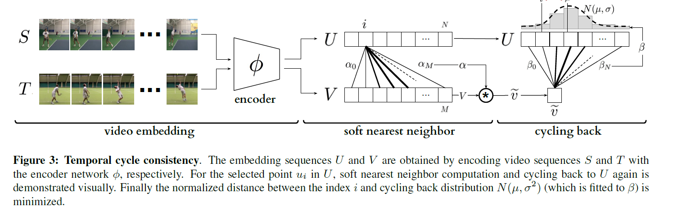
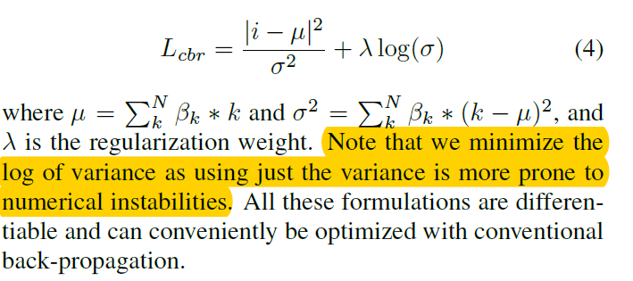
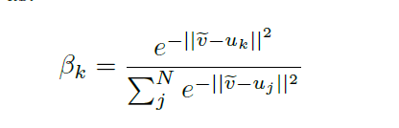
Cycle-back regression

