Slide 1
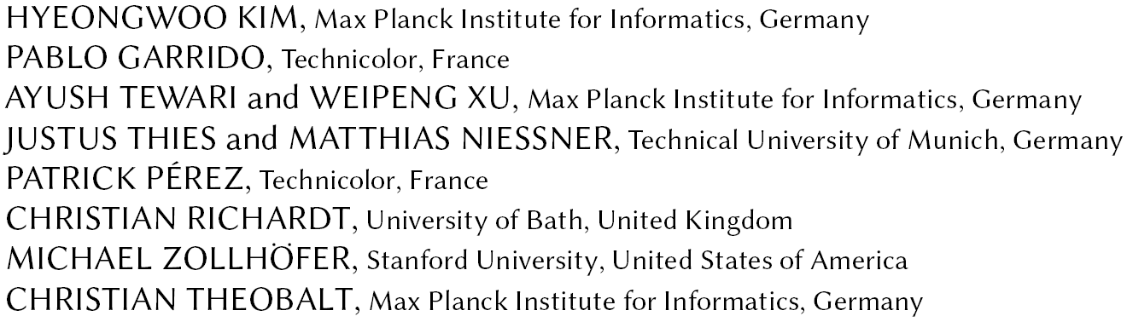
Deep Video Portraits
https://www.youtube.com/watch?v=qc5P2bvfl44
Liu Wen

Slide 2
Whole pipeline
Monocular Face Reconstruction
Illumination
Identity
Pose
Expression
Eyes
Synthetic Conditioning Input
Rendering-to-Video Translation

Slide 3
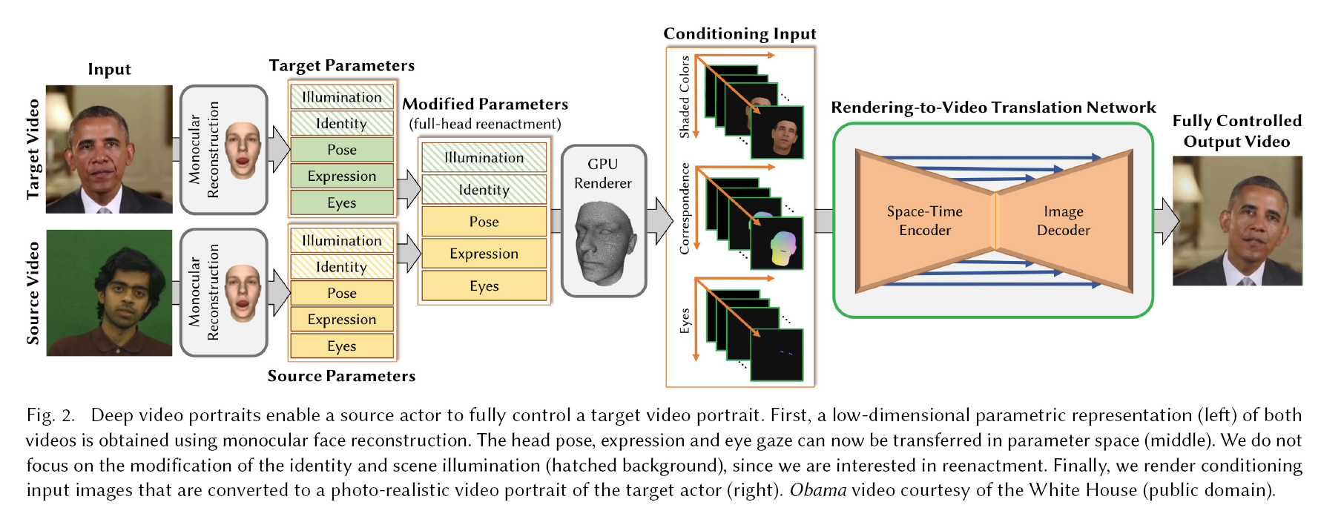
Whole pipeline

Slide 4
Monocular Face Reconstruction

Slide 5
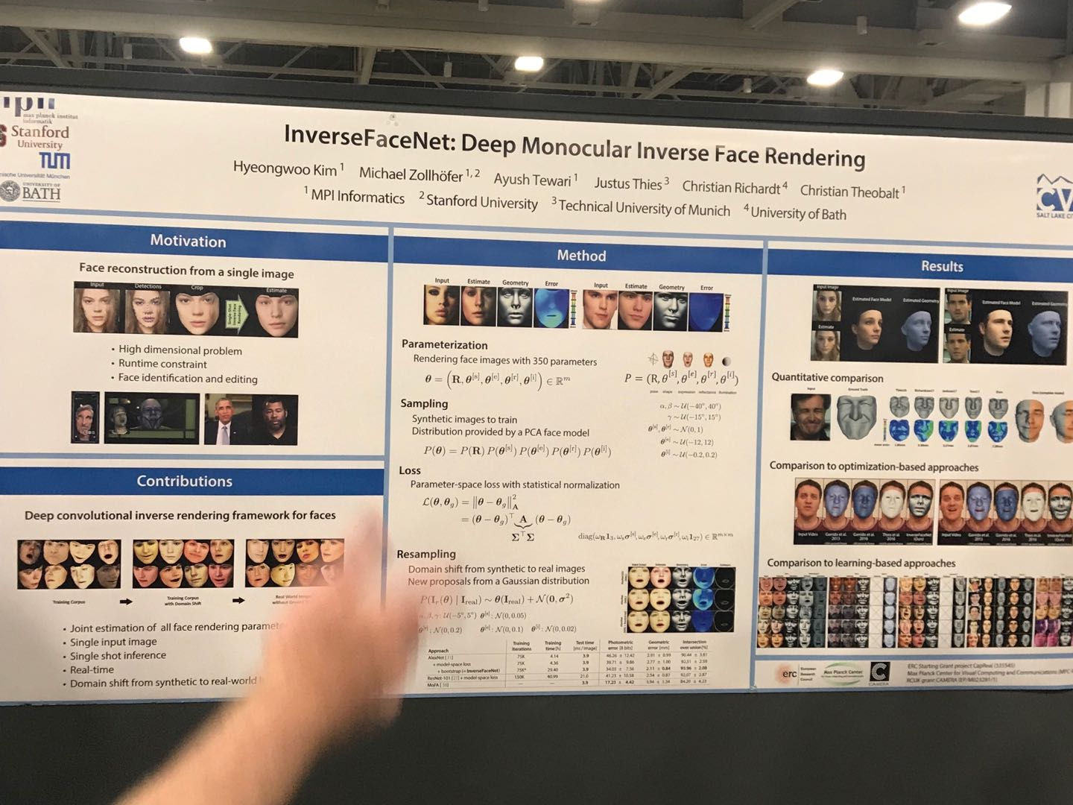

Slide 6
Synthetic Conditioning Input

Slide 7
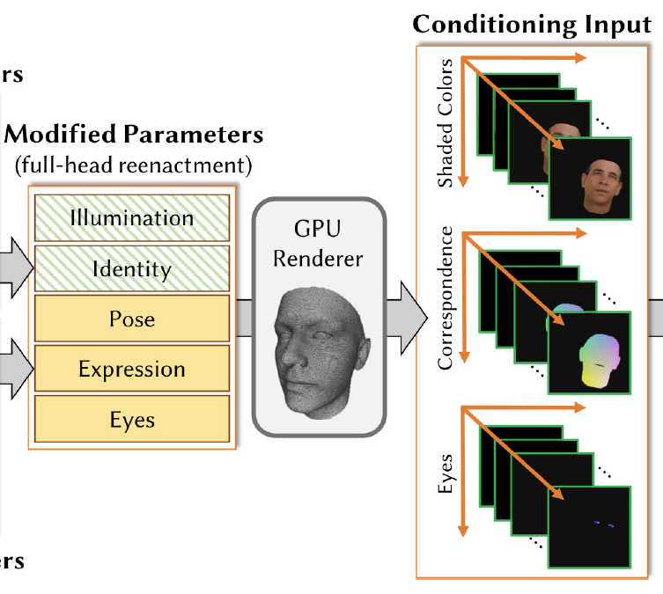

Slide 8
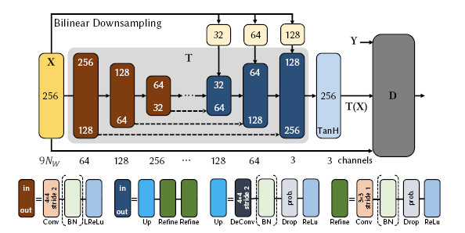
Rendering-to-Video Translation

Slide 9


Training

