Slide 1
VQ-VAE-2
Wen Liu
[1] Neural Discrete Representation Learning, Aaron van den Oord, Oriol Vinyals, Koray Kavukcuoglu, NIPS 2017
[2] Generating Diverse High-Fidelity Images with VQ-VAE-2, Ali Razavi∗, Aäron van den Oord∗, Oriol Vinyals, arxiv 1906.00446

Slide 2
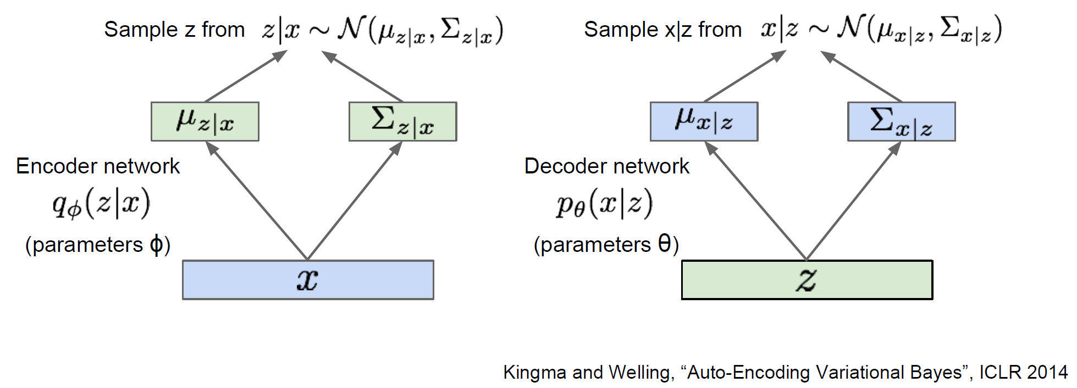

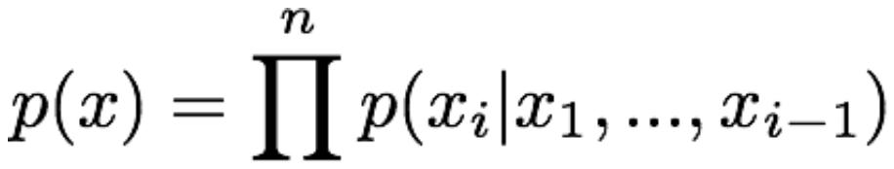
VAE and Pixel CNN
Modeling the data distribution p(x)
VAE:
Pixel RNN (CNN):

Slide 3
VQ-VAE
Posterior distribution p(z|x) is assumed normal distribution with diagonal covariance.
Modeling p(z|x) with Pixel CNN.

Slide 4
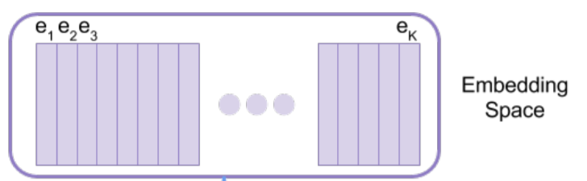
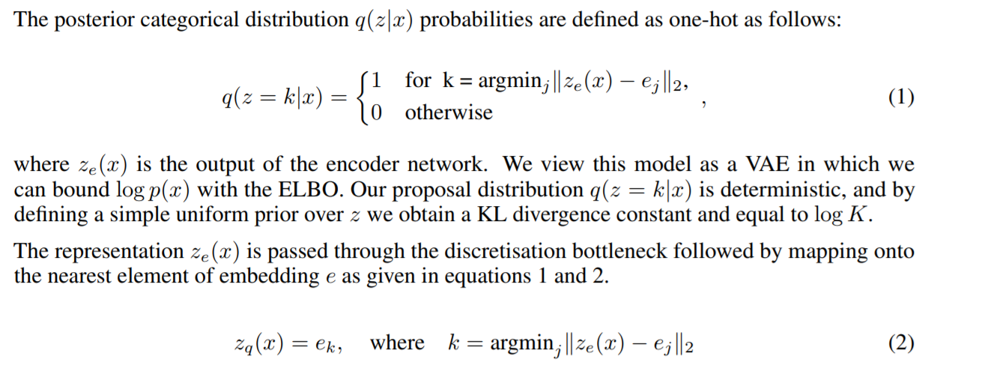

VQ (Vector Quantization)
A latent embedding space $e ∈R^{K×D}$, K is the size of space and D is dimensionality of each latent embedding vector $e_{i}$
[1] Neural Discrete Representation Learning, Aaron van den Oord, Oriol Vinyals, Koray Kavukcuoglu, NIPS 2017

Slide 5
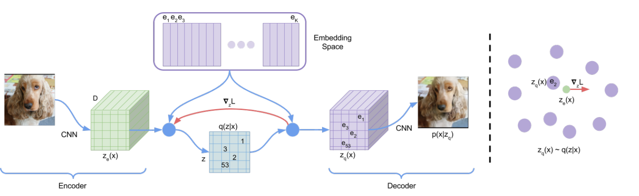
VQ-VAE Framework:
A latent embedding space $e ∈R^{K×D}$, K is the size of space and D is dimensionality of each latent embedding vector $e_{i}$
[1] Neural Discrete Representation Learning, Aaron van den Oord, Oriol Vinyals, Koray Kavukcuoglu, NIPS 2017

Slide 6
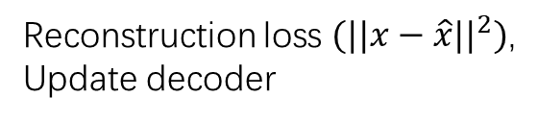
VQ-VAE Loss Function
Reconstruction loss $(||x−\hat{x}||^{2})$,
Update decoder
Update embedding space
Update encoder

Slide 7
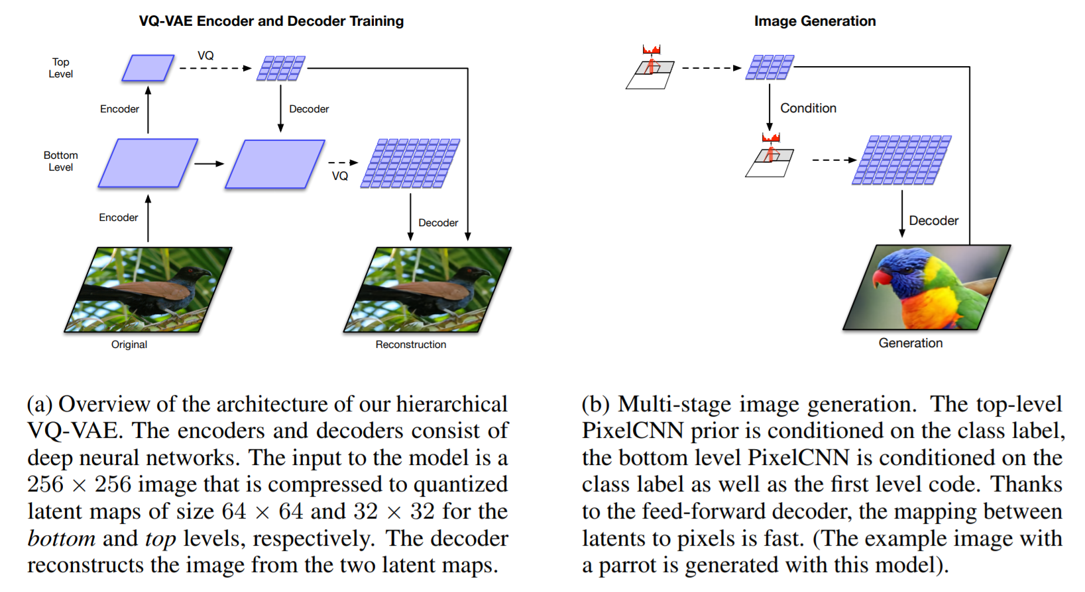
VQ-VAE(-2): Architecture
[2] Generating Diverse High-Fidelity Images with VQ-VAE-2, Ali Razavi∗, Aäron van den Oord∗, Oriol Vinyals, arxiv 1906.00446

Slide 8
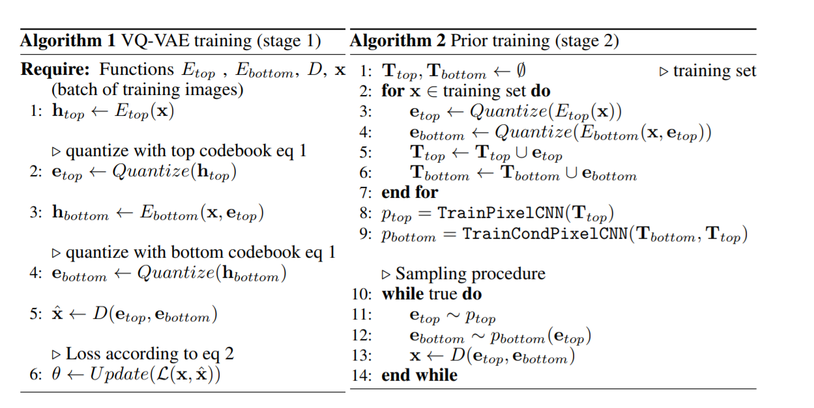
VQ-VAE(-2): Pipeline
[2] Generating Diverse High-Fidelity Images with VQ-VAE-2, Ali Razavi∗, Aäron van den Oord∗, Oriol Vinyals, arxiv 1906.00446

Slide 9
VQ-VAE(-2): results
听说效果比BigGAN还要好
[2] Generating Diverse High-Fidelity Images with VQ-VAE-2, Ali Razavi∗, Aäron van den Oord∗, Oriol Vinyals, arxiv 1906.00446

