Slide 1
Disentangling for VP
Hao Zhang
2020-04-17

Slide 2
The core of VP(video future frame prediction)
What can be predicted ?
What is the output of prediction module ? (next week, no trivial)

Slide 3
The core of VP(video future frame prediction)
What can be predicted ?
What is the output of prediction module ?

Slide 4
Key word
Decomposition
Feature disentangling

Slide 5
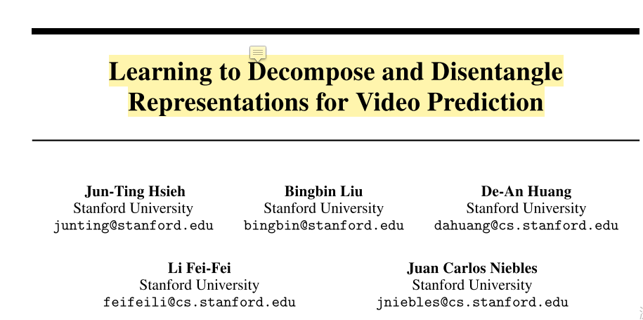
NeuralPS2018

Slide 6
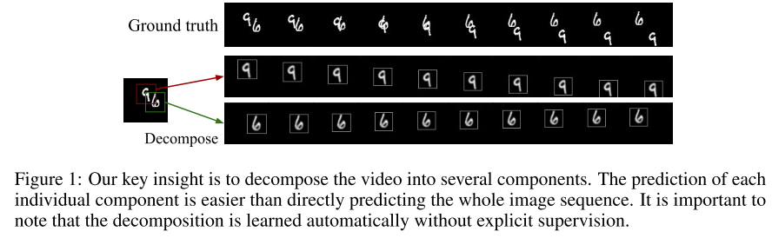

Slide 7
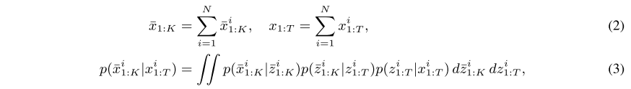

Slide 8
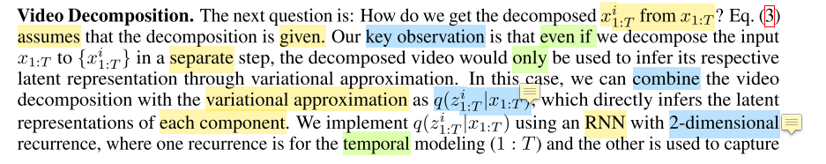
novelty(隐空间做实体分解)

Slide 9
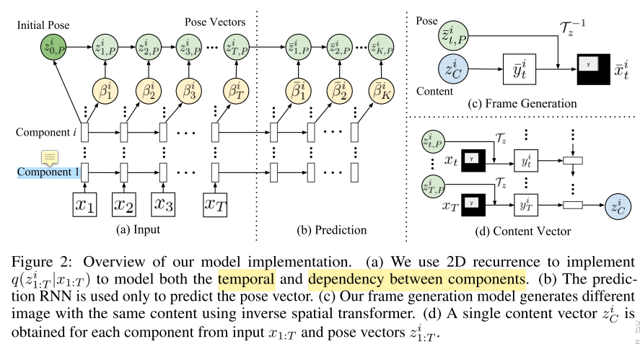

Slide 10
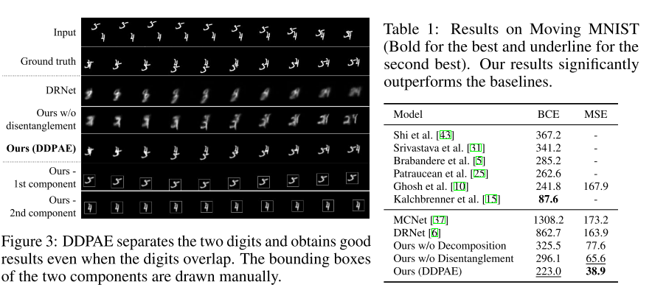

Slide 11
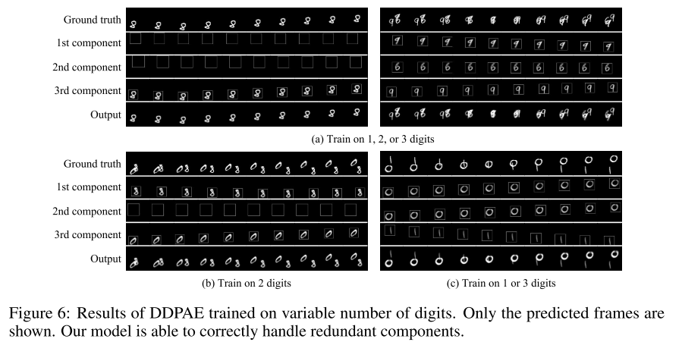

Slide 12
Cons.
the disentangled content feature can be improved
without consider transformation of same appearance (e.g. 1 or 1)
without consider class signal
2-D RNN for modeling the correlation between multi-components

Slide 13
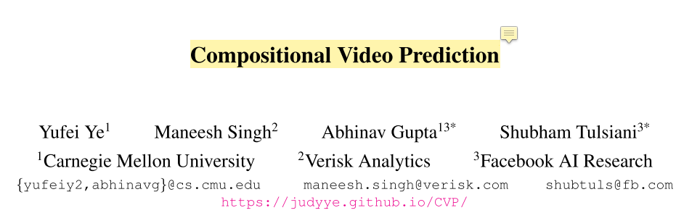
ICCV2019

Slide 14
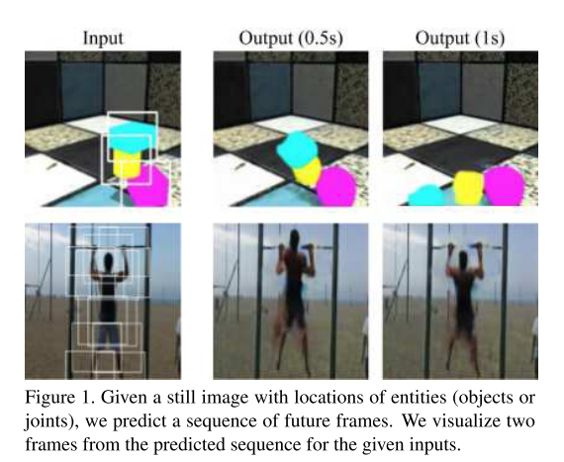

Slide 15
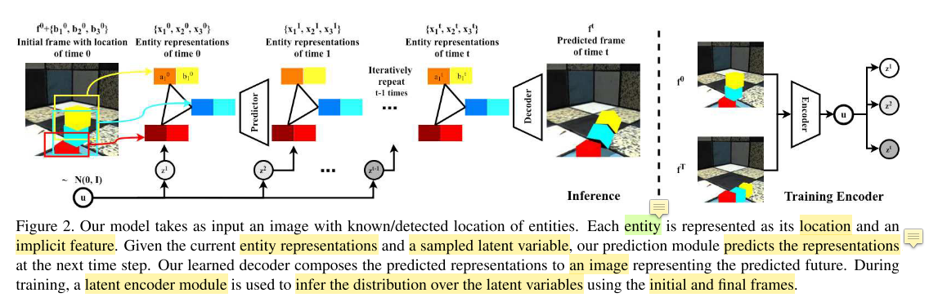

Slide 16
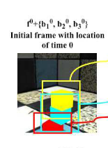
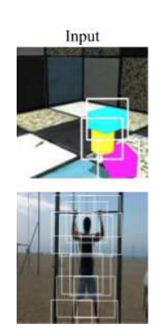
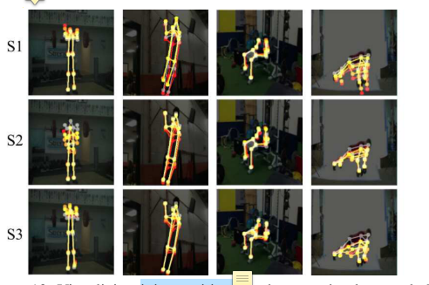
Entity decomposition
Bbox_feature & Bbox_location
keypoints

Slide 17
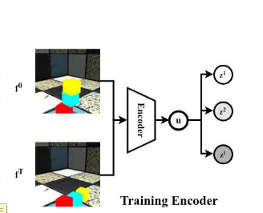
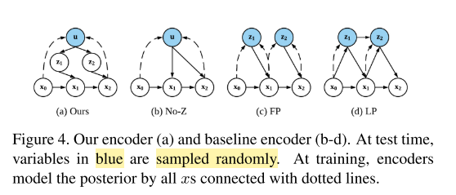
Uncertainty module

Slide 18
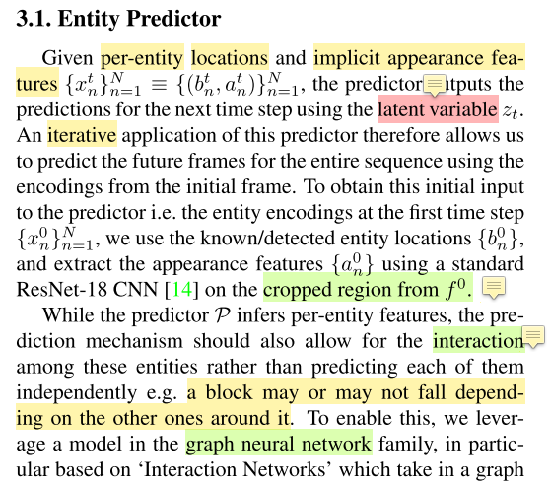
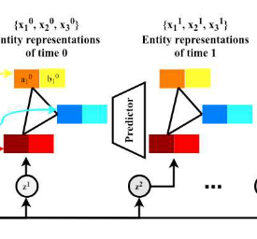
Entity predictor

Slide 19
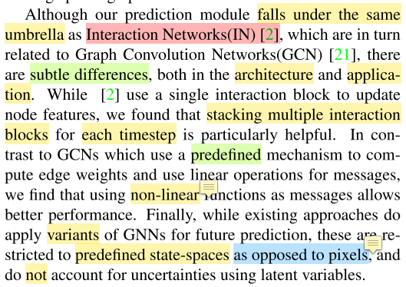
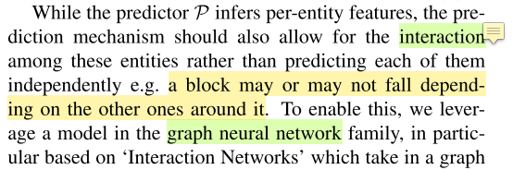
IN to model entities interaction

Slide 20
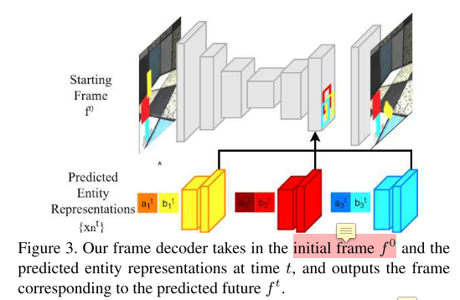
Frame generator

Slide 21
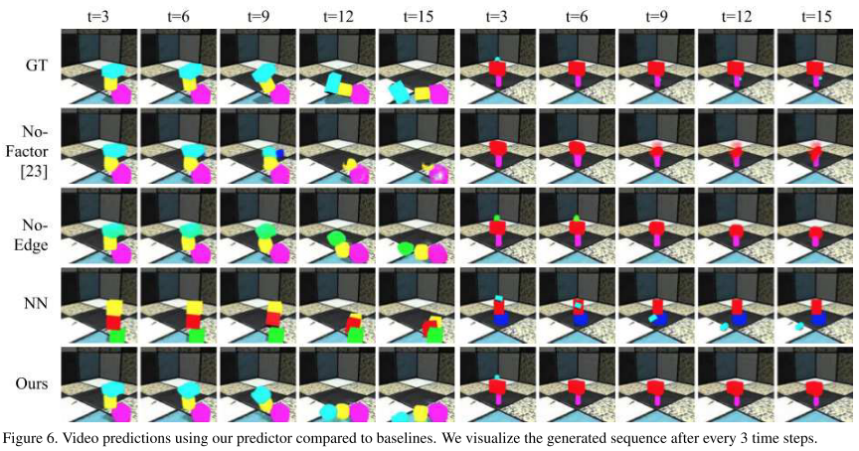
Experiments (Shapestacks)

Slide 22
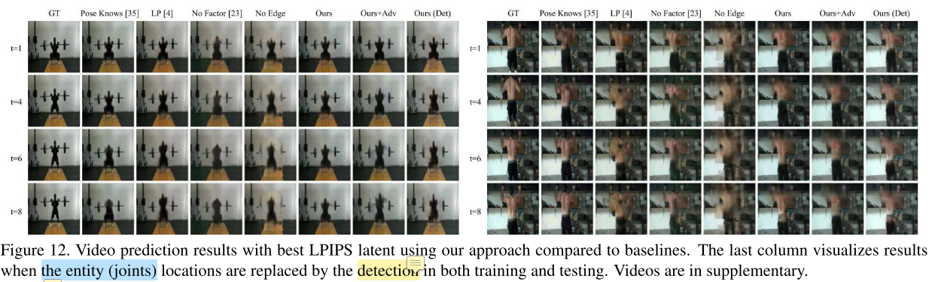
Experiments (Penn Action)

Slide 23
Cons.
Bbox as location signal ? what if instance semantic mask ?
How to represent a entity ?
Uncertainty module ? The solution in this paper is trivial
Entities interaction ?

Slide 24
Q?
What if CVPR2020/ICLR2020 ? (next week).

