Slide 1
ECCV2018
Dongze Lian

Slide 2
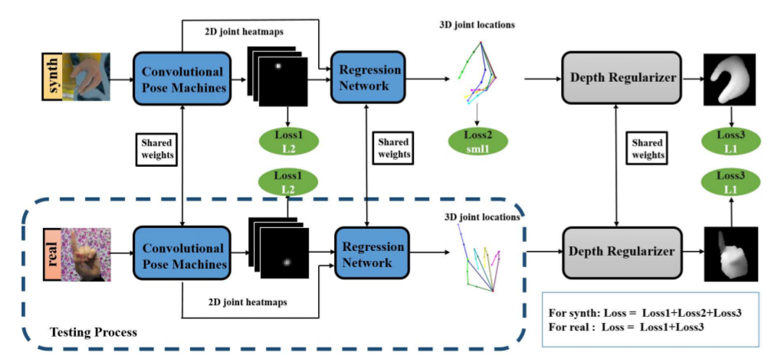
Weakly-supervised 3D Hand Pose Estimation from Monocular RGB Images

Slide 3
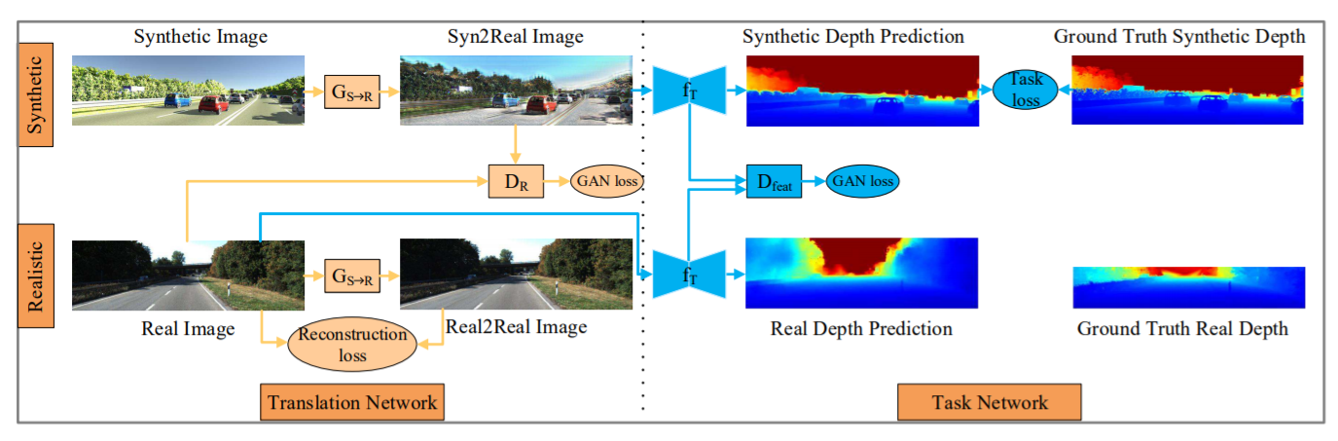
T2Net: Synthetic-to-Realistic Translation for Solving Single-Image Depth Estimation Tasks

Slide 4
Topic
Hot topics:
Detection, Segmentation, Depth estimation, Person-reid, Human pose (Face++, sense time, others)
Multimodal (sound, vision, text, depth, optical flow)
Learning: weakly supervised, unsupervised, semi-supervised learning
3D vision: slam, learning based 3d vision (reconstruction)
Tools: GAN, Reinforcement learning, meta learning

