Slide 1

HW1: LiDAR-based 3D Object Detection
2019170609 정진성
COSE416 (2024 Fall)

Slide 2
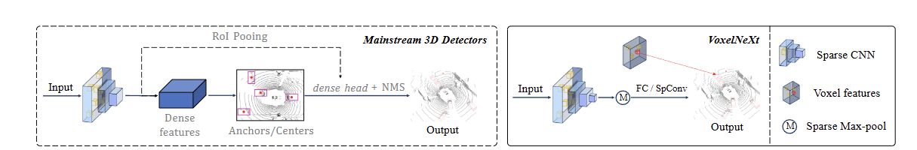
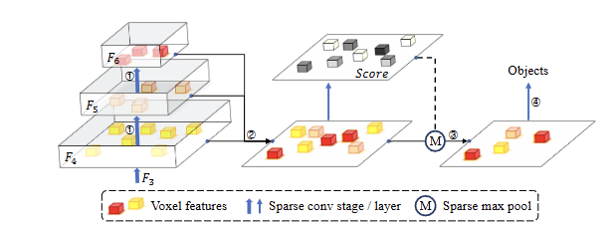
VoxelNeXt - Method
VoxelNeXt : a cutting-edge model that introduces a fully sparse VoxelNet architecture for 3D object detection based on LiDAR
Fully Sparse Convolutional Network: Eliminates the need for dense operations, leading to significant computational savings.
Direct Voxel-Based Prediction: Predicts objects directly from sparse voxel features without relying on anchors or center proxies.
No Need for Non-Maximum Suppression (NMS): Due to its sparse representation, VoxelNeXt can forgo NMS post-processing.
Additional Down-Sampling Layers: Expands the receptive field to capture more contextual information with minimal computational overhead.
Sparse Height Compression: Efficiently compresses the 3D voxel features along the height dimension, converting them into a 2D sparse representation without significant loss of information.
Spatial Voxel Pruning: Reduces the number of voxels by pruning those with lower significance, effectively decreasing the number of computations required in the sparse CNN backbone.

Slide 3
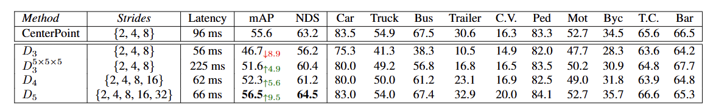
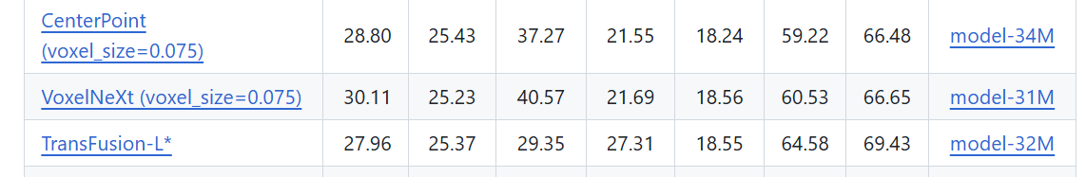

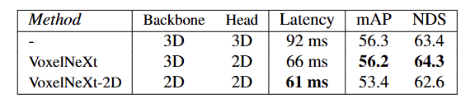
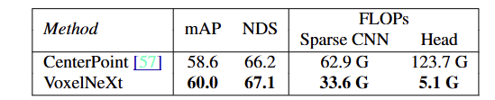
VoxelNeXt - Efficiency and Performance
Computational Efficiency: Achieves lower FLOPs and latency compared to traditional methods like CenterPoint.
Model Size: The pretrained VoxelNeXt model trained with nuSence has a size of approximately 30 MB of parameters, which is efficient for deployment.
Inference Speed: Tested on an RTX 3090 GPU, VoxelNeXt achieves about 20 FPS on batch 1, significantly exceeding the required 6 FPS, making it suitable for real-time applications.

Slide 4
Results
Scenario 1, 2, 3 (High Illumination Environment):
Achieved better detection performance for pedestrians in various postures.
Scenario 4, 5, 6, 7 (Low Illumination Environment):
Observed a decrease in detection performance compared to high illumination conditions.
The model appears to have been primarily trained on data collected similar with high illumination conditions.
Variability in Pedestrian Postures
Pedestrians in unusual postures (e.g., crawling) may not be detected due to limited representation in the training data.
The pretrained model was trained to predict 11 categories, not focusing exclusively on pedestrians.

Slide 5
Improvement ways
Fine-Tuning for only Pedestrian Detection:
Finetunning or fine-tune VoxelNeXt specifically on datasets containing diverse pedestrian postures and various lighting conditions.
Incorporate more samples of low illumination data to improve robustness.
Integration with LiDAR-Based Human Pose Estimation:
Combine methodologies from human pose estimation to enhance the model's ability to detect and recognize pedestrians in different postures.
This integration can help the model learn a wider range of pedestrian shapes and movements.

Slide 6
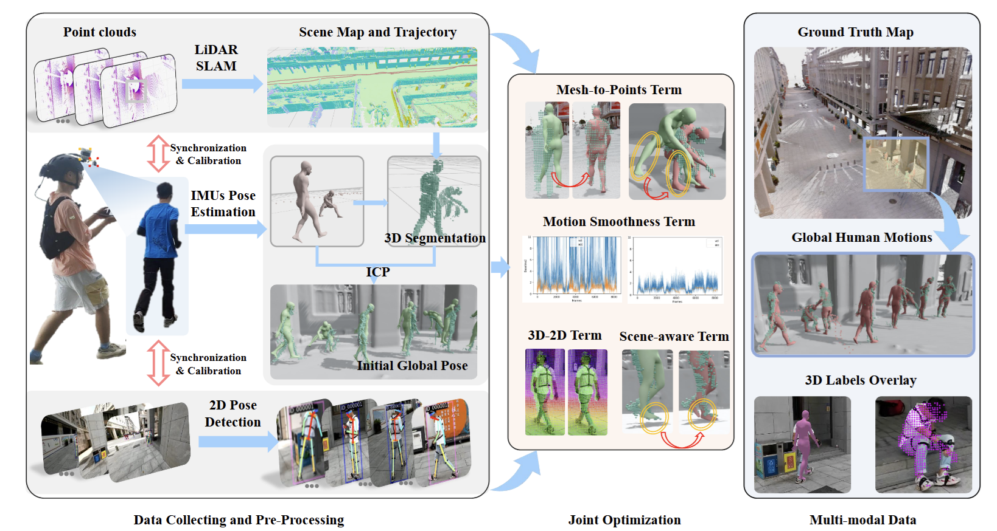
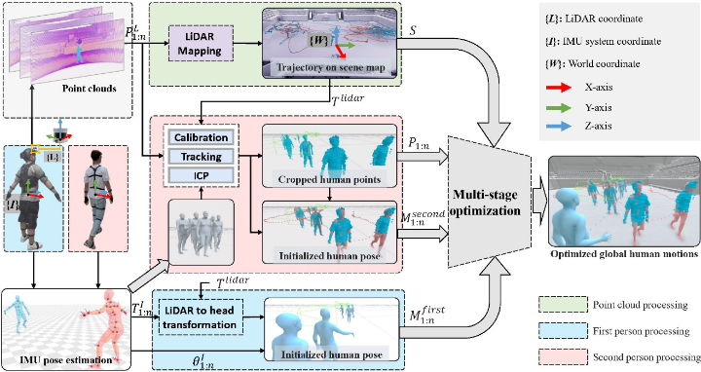
Improvement ways
Integration with LiDAR-Based Human Pose Estimation:
Data to predict not only bounding box but also pose
Predict
Bounding Box Score Pose Estimate .. .. ..
Model that enable realtime estimate

Slide 7
Reference
Chen, Y., Liu, J., Zhang, X., Qi, X., & Jia, J. (2023). VoxelNeXt: Fully Sparse VoxelNet for 3D Object Detection and Tracking. Proceedings of the IEEE/CVF Conference on Computer Vision and Pattern Recognition (CVPR).

Slide 8
Q & A

