Slide 1
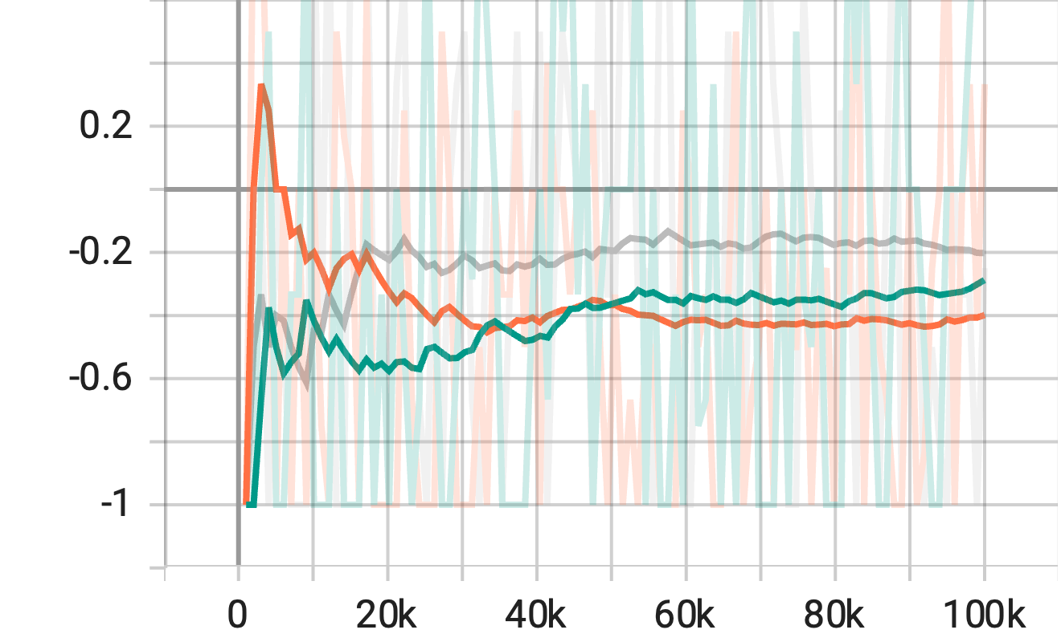
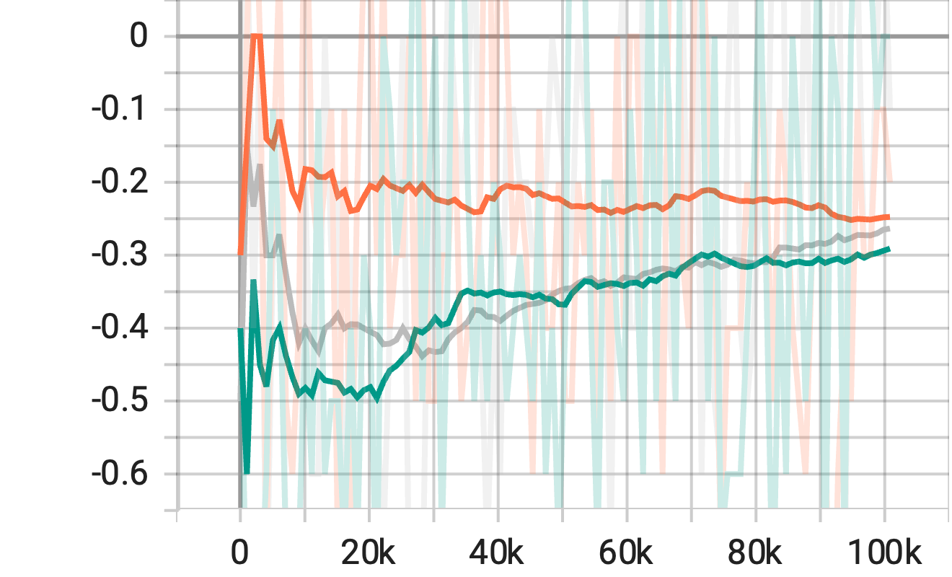
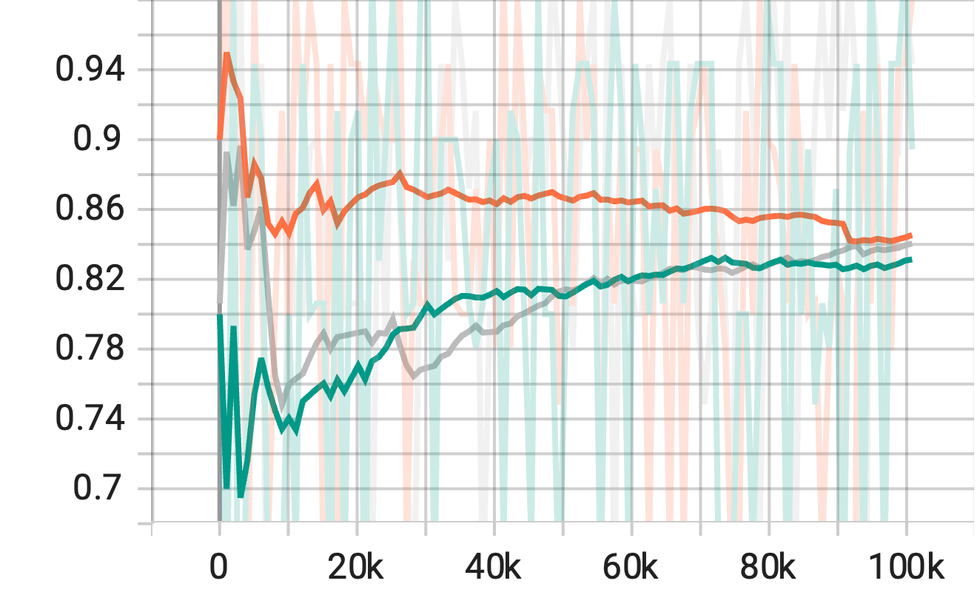
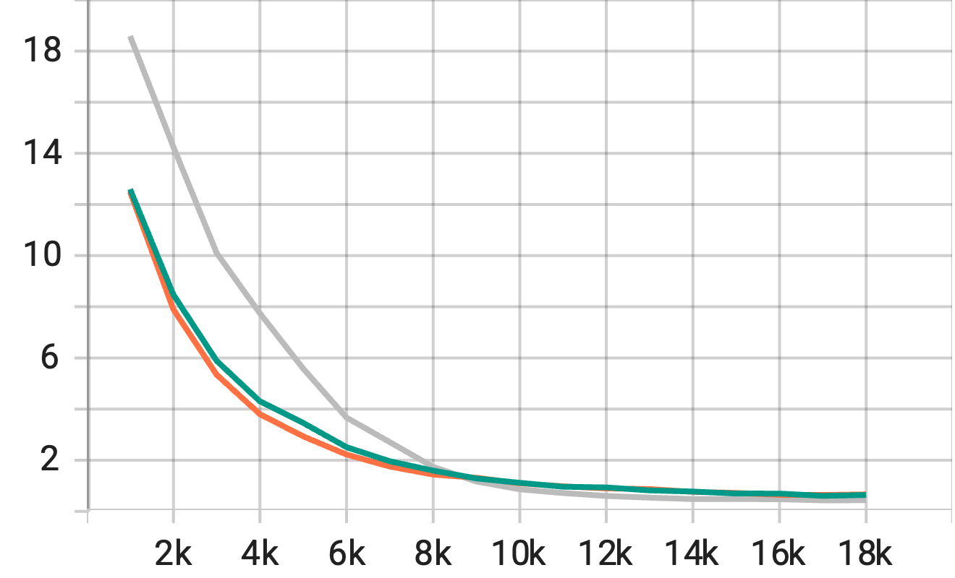
Training Reward
Testing Reward
reward
reward
LSTM
LSTM
GRU
GRU
RNN
RNN
step
step
Testing Reward_std
Loss
reward
reward
LSTM
LSTM
GRU
GRU
RNN
RNN
step
step

