Slide 1
PCE for FOWT

Slide 2
System:
Random Variables:
QoI:

Slide 3
Objective
Build PCE model with quadrature points.
Evaluate 50-year return load and compare with MCS

Slide 4
Quadrature
Find the best model

Slide 5
Quadrature Issues
Theoretically fitting error should decrease with increasing order of basis polynomial. (High order polynomial would lead to over-fitting)

Slide 6
Notes:
These points are selected to assess the accuracy of the surrogate model at interested return period contour

Slide 7
Overfitting

Slide 8
Regression
Vary a lot over different sets of samples

Slide 9
Sample size | 50 | 50 | 100 | 200 | 1000
Fit Error | 0.3338 | 0.3874 | 0.2462 | 0.3795 | 0.444
CV Error | 104979.41 | 28867.63 | 5314.82 | 820.61 | 111.368
 | Quad 56 | Quad 55 | Quad 65 | Quad 75 | Quad 67
Fit Error | 13.420 | 3.055 | 48.812 | 117.649 | 88.0681
CV Error | 2.800 | 2.4497 | 2.4599 | 2.630 | 2.44520
lacks robust performance in many cases

Slide 10
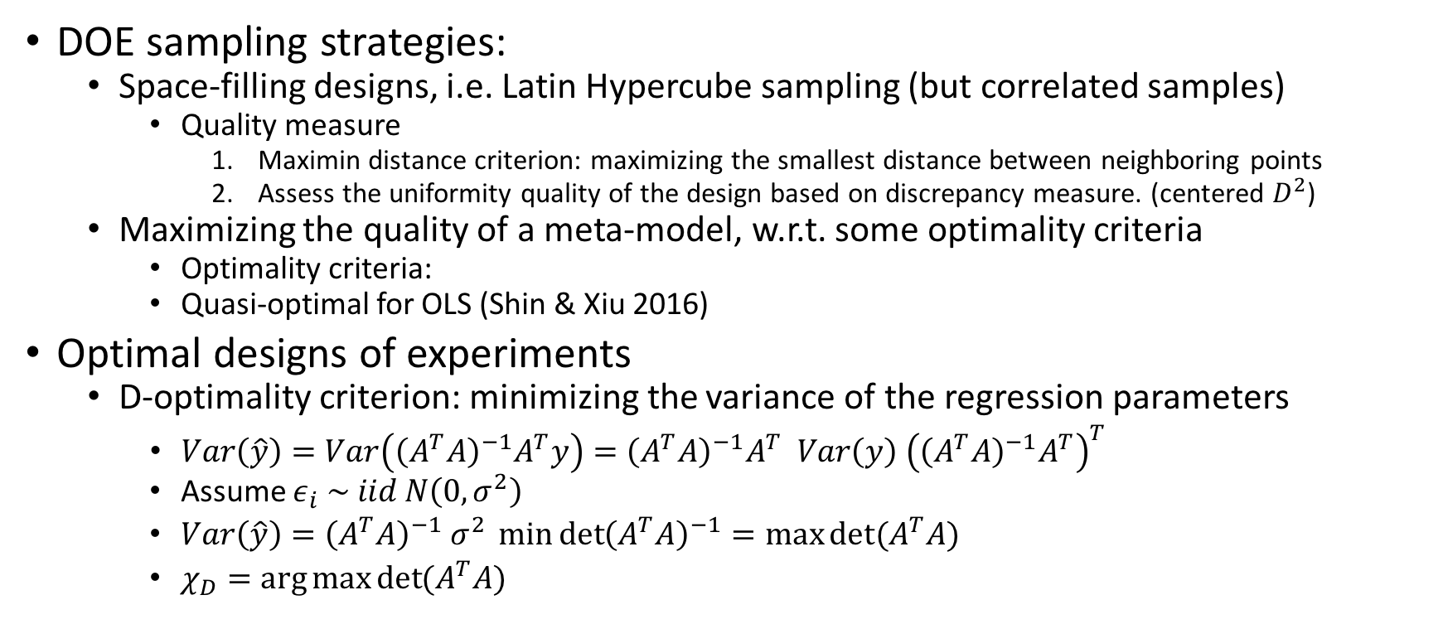
Design of Experiment (DOE)
DOE sampling strategies:
Space-filling designs, i.e. Latin Hypercube sampling (but correlated samples)
Quality measure
Maximin distance criterion: maximizing the smallest distance between neighboring points
Assess the uniformity quality of the design based on discrepancy measure. (centered $D^{2}$)
Maximizing the quality of a meta-model, w.r.t. some optimality criteria
Optimality criteria:
Quasi-optimal for OLS (Shin & Xiu 2016)
Optimal designs of experiments
D-optimality criterion: minimizing the variance of the regression parameters
$Var\left(\hat{y}\right)=Var\left({\left(A^{T}A\right)}^{−1}A^{T}y\right)={\left(A^{T}A\right)}^{−1}A^{T} Var\left(y\right){ \left({\left(A^{T}A\right)}^{−1}A^{T}\right)}^{T}$
Assume $ε_{i} \sim iid N\left(0, σ^{2}\right)$
$Var\left(\hat{y}\right)={\left(A^{T}A\right)}^{−1} σ^{2} \min{{\det\left(A^{T}A\right)}^{−1}=\max{det⁡(A^{T}A)}}$
$χ_{D}=\arg{\max{\det{(A^{T}A)}}}$

Slide 11
S-optimality criterion: minimizing the variance of the regression parameters

Slide 12
The Fisher information is a way of measuring the amount of information that an observable random variable X carries about an unknown parameter θ upon which the probability of X depends

Slide 13
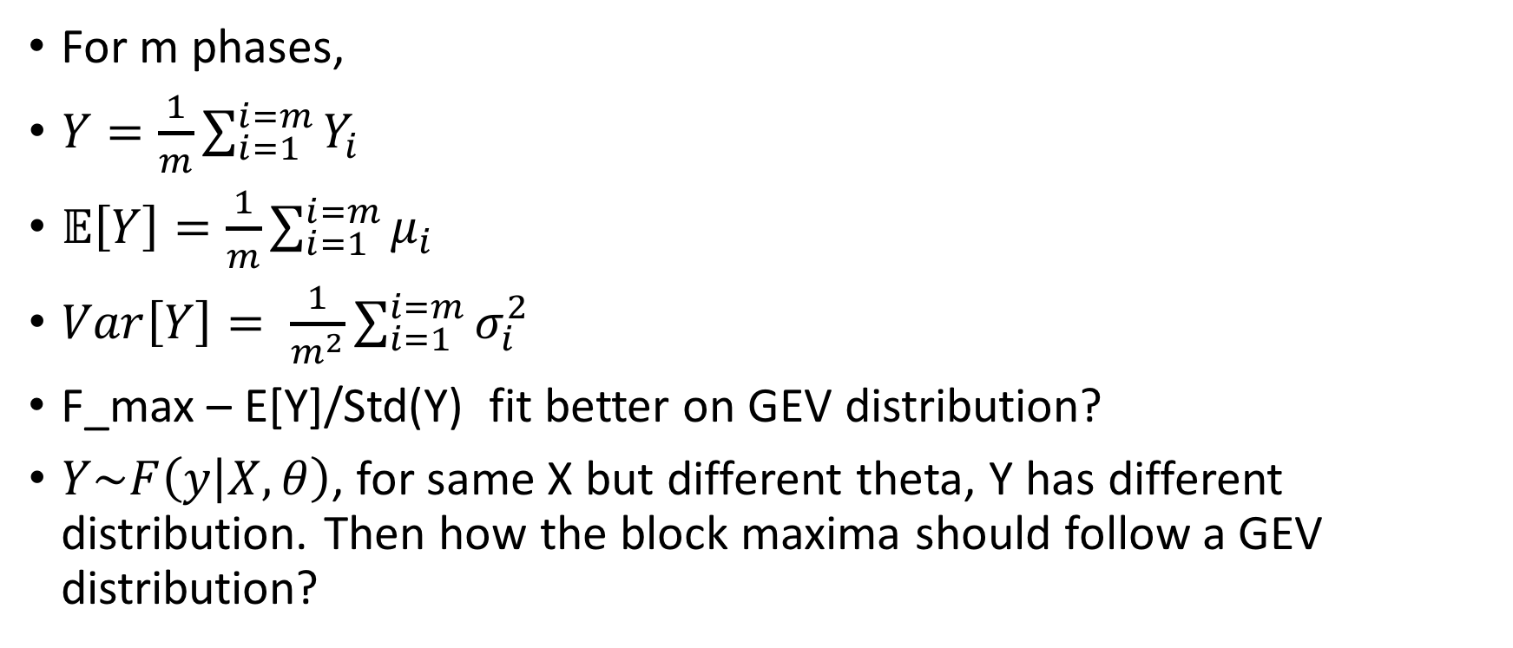
For m phases,
$Y=\frac{1}{m}\sum_{i=1}^{i=m}{Y_{i}}$
$𝔼\left[Y\right]=\frac{1}{m}\sum_{i=1}^{i=m}{μ_{i}}$
$Var\left[Y\right]= \frac{1}{m^{2}}\sum_{i=1}^{i=m}{σ_{i}^{2}}$
F_max – E[Y]/Std(Y) fit better on GEV distribution?
$Y\sim F\left(y | X,θ\right)$, for same X but different theta, Y has different distribution. Then how the block maxima should follow a GEV distribution?

Slide 14
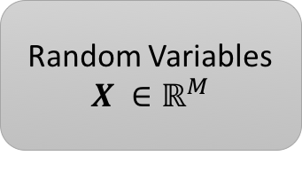
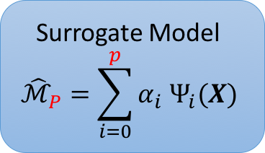
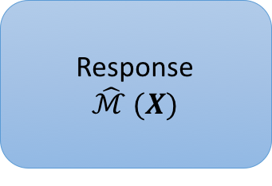
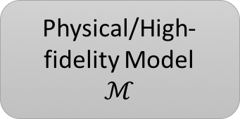
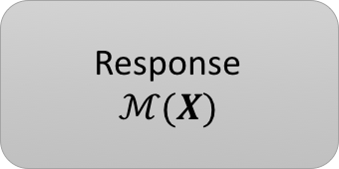
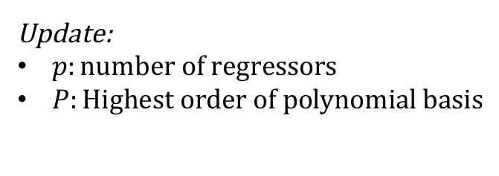
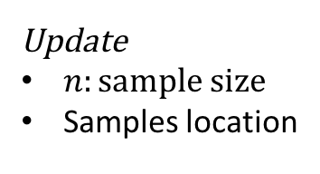
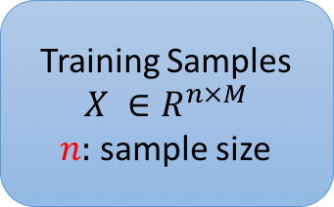
Random Variables
$$X ∈ℝ^{M}$$
Physical/High-fidelity Model
$$ℳ$$
Response
$$ℳ(X)$$
Cross Validation
Design of Experiments
Training Samples
$$X ∈R^{n×M}$$
$n:$ sample size
Surrogate Model
$${\hat{ℳ}}_{P}=\sum_{i=0}^{p}{α_{i} Ψ_{i}(X)}$$
Response
$$\hat{ℳ} (X)$$
Update
$n:sample size$
Samples location
Update:
$p:number of regressors$
$P:Highest order of polynomial basis$

Slide 15
Orthogonal Polynomial space
Random Variables
Projection
Regression
Experimental Design
Quadrature Points
Sample size
Sampling rule
Pseudo random
Latin Hypercube Sampling
Optimal Experimental design
D-optimality
…
Quasi-optimal experimental design
True Model
Surrogate Model
Cross Validation
Surrogate Model

Slide 16
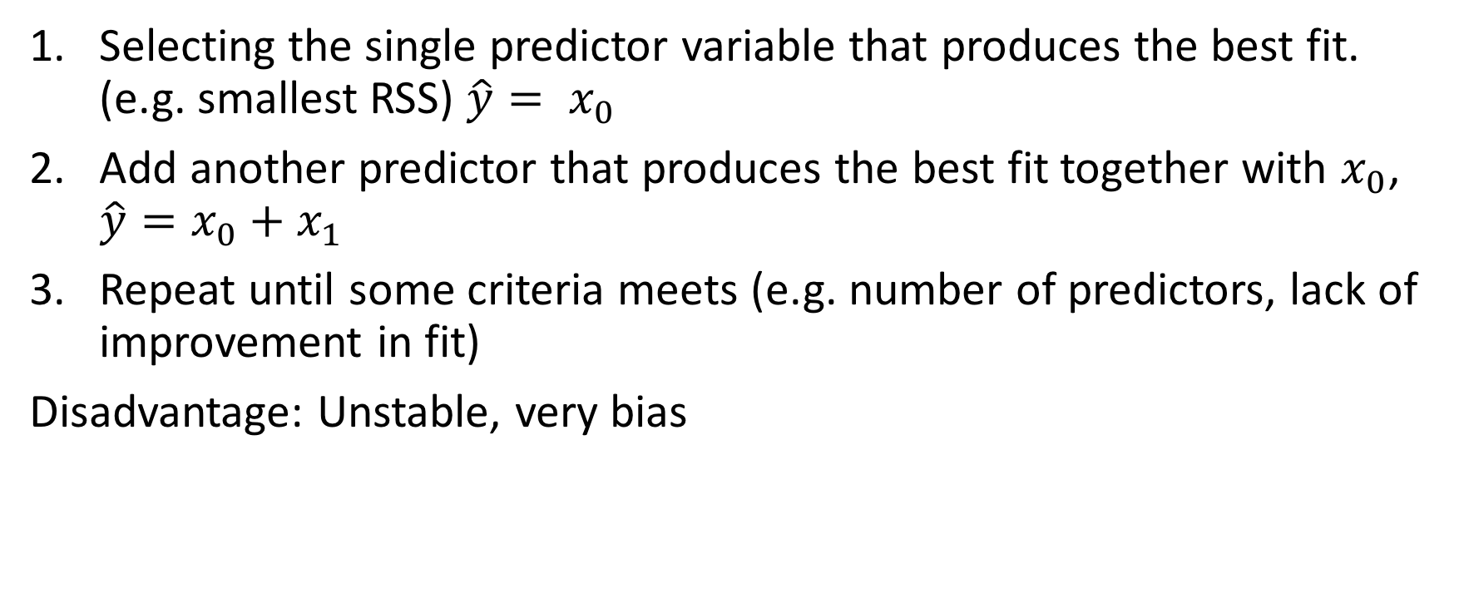
Stepwise regression
Selecting the single predictor variable that produces the best fit. (e.g. smallest RSS) $\hat{y}= x_{0}$
Add another predictor that produces the best fit together with $x_{0}$, $\hat{y}=x_{0}+x_{1}$
Repeat until some criteria meets (e.g. number of predictors, lack of improvement in fit)
Disadvantage: Unstable, very bias

Slide 17
Ridge regression

Slide 18







$$x_{2}$$
$$x_{2}$$
$${\overline{y}}_{2}$$
$$u_{2}$$
$${\hat{μ}}_{0}$$
$${\hat{μ}}_{1}={\hat{μ}}_{0}+{\hat{γ}}_{1}x_{1}$$
$$x_{1}$$

