Slide 1

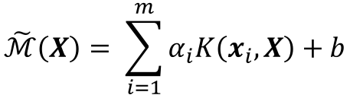
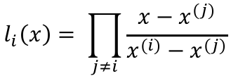

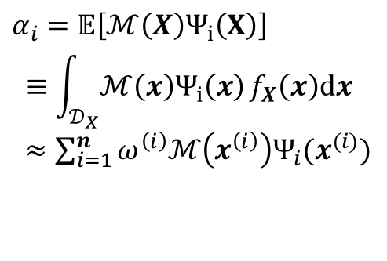
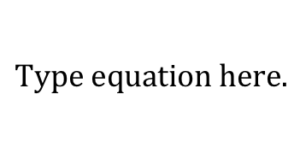

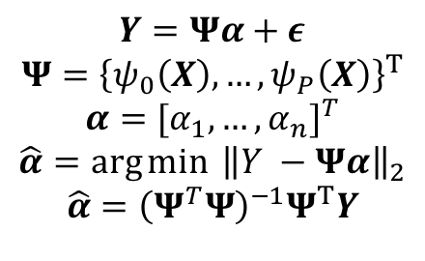
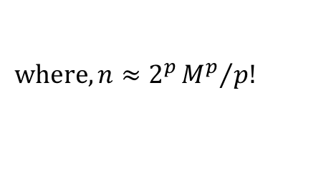

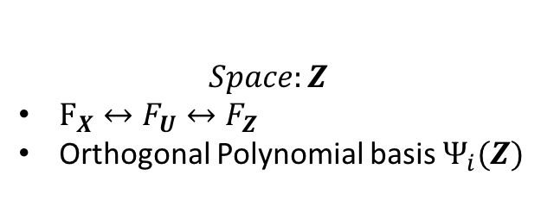
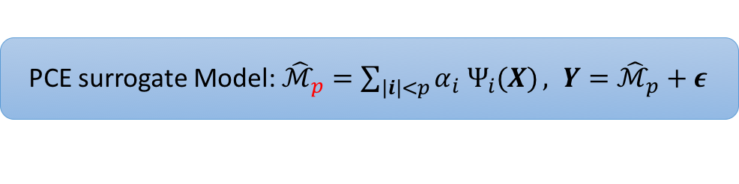


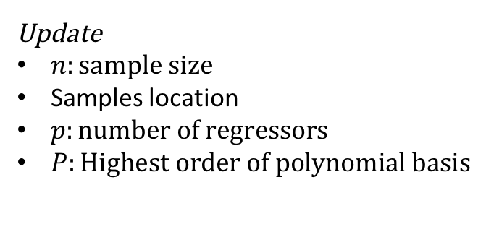
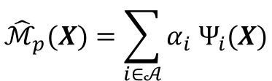
Random Variables
$$Space:Ζ$$
$F_{X}↔F_{U}↔F_{Ζ}$
Orthogonal Polynomial basis $Ψ_{i}(Ζ)$
Phyiscal <-> iid <-> Zeta
Rosenblatt, Nataf, etc…
Experimental Design
Spectral Projection
Regression
Sample size
Sampling rule
Pseudo random
Latin Hypercube Sampling
Optimal Experimental design
D-optimality
…
Quasi-optimal experimental design
Surrogate Models
PCE surrogate Model: ${\hat{ℳ}}_{p}=\sum_{\left|i\right|<p}{α_{i} Ψ_{i}(X)}, Y={\hat{ℳ}}_{p}+ε$
$$<Y,Ψ_{j}>=\sum_{i=0}^{P}{α_{i}<Ψ_{i},Ψ_{j}>}$$
$$α_{i}=\frac{<Y, Ψ_{i}>}{<Ψ_{i}, Ψ_{i}>}$$
$$Y=Xα+ε$$
$X$: design matrix
$$α={[α_{1},…, α_{n}]}^{T}$$
$$\hat{α}=\arg{\min{ {\left\|Y −Xα\right\|}_{2}}}$$
$$\hat{α}={\left(X^{T}X\right)}^{−1}X^{T}Y$$
Cross Validation
Leave one out
K-folder
Selected points
Update
$n:sample size$
Samples location
$p:number of regressors$
$P:Highest order of polynomial basis$
Surrogate Models
Polynomial Chaos Expansion
Support Vector Machine
$$\tilde{ℳ}\left(X\right)= \sum_{i=1}^{m}{α_{i}K\left(x_{i},X\right)+b}$$
$${\hat{ℳ}}_{p}(X)=\sum_{i∈𝒜}{α_{i} Ψ_{i}(X)}$$
$Ψ_{i}$: Multivariate orthogonal polynomial basis
p: Highest order of $Ψ_{i}$
$𝒜$: set of multi-indices
Non-intrusive methods for PCE
Stochastic collocation
Spectral Projection
Regression
$$α_{i}=𝔼\left[ℳ\left(X\right)Ψ_{i}\left(X\right)\right]$$
$$≡\int_{𝒟_{X}}{ℳ\left(x\right)Ψ_{i}\left(x\right)}f_{X}\left(x\right)dx$$
$≈\sum_{i=1}^{n}{ω^{\left(i\right)}ℳ\left(x^{\left(i\right)}\right)Ψ_{i}(x^{(i)})}$
$$Y=Ψα+ε$$
$$Ψ={\left\{ψ_{0}\left(X\right), …,ψ_{P}\left(X\right)\right\}}^{T}$$
$$α={[α_{1},…, α_{n}]}^{T}$$
$$\hat{α}=\arg{\min{ {\left\|Y −Ψα\right\|}_{2}}}$$
$$\hat{α}={\left(Ψ^{T}Ψ\right)}^{−1}Ψ^{T}Y$$
$$l_{i}\left(x\right)= \prod_{j≠i}{\frac{x−x^{(j)}}{x^{(i)}−x^{(j)}}}$$
$${\hat{ℳ}}_{n}\left(X\right)= \sum_{i=1}^{n}{α_{i}l_{i}(X)}$$
$$where, n≈2^{p}{M^{p}}/{p!}$$
$$where, n≈kP, k∈\{2,3\}$$
MCS, LHS,QMC
$$ω^{\left(1\right)}=…=ω^{\left(n\right)}=1/n$$
Tensor/Sparse quadrature
Model selection
Traditional:
Stepwise regression¹
All-subsets regression¹
Ridge regression²
¹: Only variable selection and Unstable
²: Only Coefficients
Modern:
Boosting
Forward stagewise
LASSO
LARS:
LAR + LASSO
LAR + stagewise

Slide 2
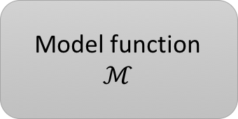
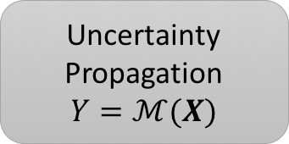
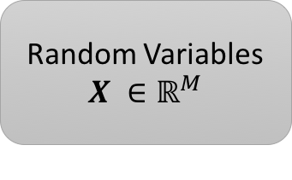
Random Variables
$$X ∈ℝ^{M}$$
Model function
$$ℳ$$
Uncertainty Propagation
$$Y=ℳ(X)$$
Response variability
Sensitivity analysis
Reliability analysis
Distribution analysis
…

