Slide 2




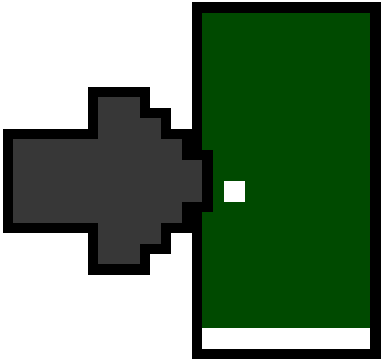

Slide 3



C A R D

