Slide 1
CS188: Distributed Systems Lecture 8
Spring 2019
Ravi Netravali

Slide 2
Today’s agenda
Limitations of primary backup replication
Paxos: another way to implement RSM that overcomes primary backup replication issue

Slide 3
Implementing RSMs
Logical clock based ordering of requests
Cannot serve requests if any one replica is down
Primary-backup replication
Replace primary/backup upon failure

Slide 4
Availability of primary-backup RSM
When is RSM unavailable to serve requests?
Primary failed before syncing with backups
Backup is connected to view service but not primary
View service is down
Summary: replica is down but we may not be able to move to new view

Slide 5
Availability of primary-backup RSM
When is RSM unavailable to serve requests?
Primary failed before syncing with backups
Backup is connected to view service but not primary
View service is down
Summary: replica is down but we may not be able to move to new view
How to…
make RSM tolerant to network partitions?
ensure that operations don’t block even if some machines are unavailable?

Slide 6
Analogy
US Senate needs to pass laws
Senators are often on travel
Common case: not all senators present
How to pass laws successfully?
Goal: ensure that, despite only a subset showing up each day, that if law gets passed, it won’t be overwritten

Slide 7
Analogy
US Senate needs to pass laws
Senators are often on travel
Common case: not all senators present
How to pass laws successfully?
Goal: ensure that, despite only a subset showing up each day, that if law gets passed, it won’t be overwritten

Slide 8
RSM via Consensus
Key idea: apply update only if majority of replicas commit to it
If 2f + 1 replicas, we need f+1 to commit
Tolerate more failures → have more replicas
Why a majority? Why not fewer or more?
Non-zero intersection between majorities: remaining replicas cannot accept some other update

Slide 9
Context for Today’s Lecture
Assumption: replicas start in sync with one another
First challenge: among several concurrent new updates, how to pick next update to apply?
Next challenge: how to apply all updates in a consistent order all replicas

Slide 10
Strawman Approaches
Strawman 1
Every client proposes its value to all replicas
Every replica accepts first proposal received
Value accepted by majority is applied
Problem?

Slide 11
Strawman Approaches
Strawman 1
Every client proposes its value to all replicas
Every replica accepts first proposal received
Value accepted by majority is applied
Problem?
Strawman 2
Every client tags its proposal with sequence number
Every replica collects proposals and accepts one with lowest sequence number
Problem?

Slide 12
Strawman Approaches
Strawman 1
Every client proposes its value to all replicas
Every replica accepts first proposal received
Value accepted by majority is applied
Problem?
Strawman 2
Every client tags its proposal with sequence number
Every replica collects proposals and accepts one with lowest sequence number
Problem?

Slide 13
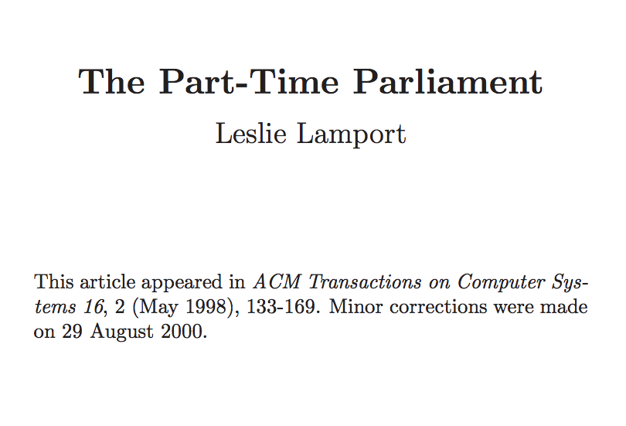
Paxos
Original paper submitted in 1990
Tells mythical story of Greek island of Paxos with “legislators” and “current law” passed through parliamentary voting protocol
Widely used in industry today!

Slide 14
Desirable Properties
Safety
“No bad things happen”
System never reaches an undesirable state
Liveness
“Good things eventually happen”
System makes progress eventually

Slide 15
Desirable Properties
Safety
“No bad things happen”
System never reaches an undesirable state
Liveness
“Good things eventually happen”
System makes progress eventually
Tradeoff between consistency and latency

Slide 16
Desirable Properties of Solution
Safety
Accept a value only if accepted by a majority
Liveness
If any values are proposed, one will eventually be accepted

Slide 17
Desirable Properties of Solution
Safety
Accept a value only if accepted by a majority
Accept a value only if proposed by some client
Liveness
If any values are proposed, one will eventually be accepted
If a value is accepted, all replicas will eventually discover that it was chosen

Slide 18
Roles of a Process
Three conceptual roles
Proposers propose values
Acceptors accept values; chosen if majority accept
Learners learn the outcome (chosen value)
In reality, a process can play any/all roles

Slide 19
Roles of a Process
Three conceptual roles
Proposers propose values
Acceptors accept values; chosen if majority accept
Learners learn the outcome (chosen value)
In reality, a process can play any/all roles
Examples
Roles in bank account example?
Roles in US Senate example?

Slide 20
Roles of a Process
Three conceptual roles
Proposers propose values
Acceptors accept values; chosen if majority accept
Learners learn the outcome (chosen value)
In reality, a process can play any/all roles
Examples
Roles in bank account example?
Roles in US Senate example?

Slide 21
Paxos: Key Ideas
May not be able to come to consensus in a single round
Protocol runs over multiple rounds
Once a value is accepted by a majority, a different value cannot be accepted in a later round

Slide 22
Paxos Overview
Three phases in each round
Prepare Phase
Proposer sends a unique proposal number to all acceptors
Waits to get commitment from majority of acceptors
Accept Phase
Proposer sends proposed value to all acceptors
Waits to get proposal accepted by majority
Learn Phase
Learners discover value accepted by majority

Slide 23
Paxos State
Every acceptor maintains three values:
n_{p} → highest proposal number promised to accept
n_{a} → highest proposal number accepted
v_{a} → value accepted
This state must persist across restarts
Learners can rediscover accepted value (if any) from acceptors

Slide 24
Paxos: Phase 1 (Prepare)
Proposer
Choose unique proposal number n
Send <prepare, n> to all acceptors
Acceptors

Slide 25
Paxos: Phase 1 (Prepare)
Proposer
Choose unique proposal number n
Send <prepare, n> to all acceptors
Acceptors
If n > n_{p}
n_{p} = n ← promise not to accept any new proposal where n’ < n
If no prior proposal accepted → reply with <promise, n, Ø>
Else → reply with <promise, n, (n_{a}, v_{a})>
Else
Reply with <prepare-failed>

Slide 26
Example: Prepare Phase
P1
A1
A2
A3
P2
n=2
n=1
np=_
np=_
np=_
np=2
np=2
np=1

Slide 27
Example: Prepare Phase
P1
A1
A2
A3
P2
n=2
n=1
n=3
np=2
np=2
np=1
np=3
np=3

Slide 28
Paxos: Phase 1 (Prepare)
Proposer
Choose unique proposal number n
Send <prepare, n> to all acceptors
Acceptors
If n > n_{p}
n_{p} = n ← promise not to accept any new proposal where n’ < n
If no prior proposal accepted → reply with <promise, n, Ø>
Else → reply with <promise, n, (n_{a}, v_{a})>
Else
Reply with <prepare-failed>
How to pick a unique proposal number?
Why all? Why not majority?

Slide 29
Paxos: Phase 1 (Prepare)
Proposer
Choose unique proposal number n
Send <prepare, n> to all acceptors
Acceptors
If n > n_{p}
n_{p} = n ← promise not to accept any new proposal where n’ < n
If no prior proposal accepted → reply with <promise, n, Ø>
Else → reply with <promise, n, (n_{a}, v_{a})>
Else
Reply with <prepare-failed>
How to pick a unique proposal number?
Why all? Why not majority?
What else is worth including here?

Slide 30
Paxos: Phase 2 (Accept)
Proposer
Once it has received promises from a majority of acceptors:
v’ = v_{a} returned with highest n_{a}, if exists, else own v
Send <accept, (n, v’)> to acceptors
Acceptors

Slide 31
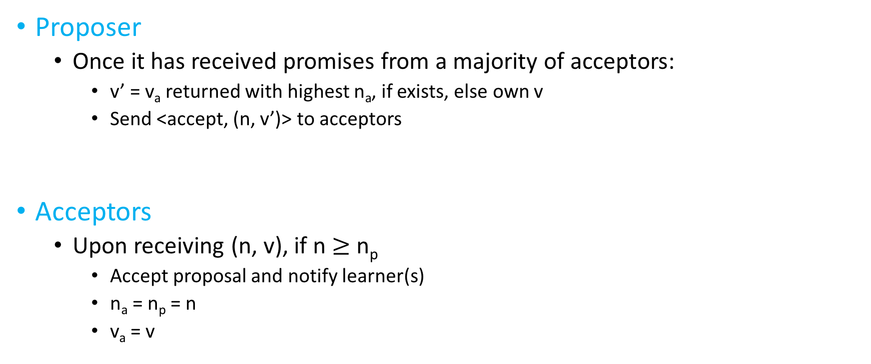
Paxos: Phase 2 (Accept)
Proposer
Once it has received promises from a majority of acceptors:
v’ = v_{a} returned with highest n_{a}, if exists, else own v
Send <accept, (n, v’)> to acceptors
Acceptors
Upon receiving (n, v), if n $≥$ n_{p}
Accept proposal and notify learner(s)
n_{a} = n_{p} = n
v_{a} = v

Slide 32
Paxos: Phase 2 (Accept)
Proposer
Once it has received promises from a majority of acceptors:
v’ = v_{a} returned with highest n_{a}, if exists, else own v
Send <accept, (n, v’)> to acceptors
Acceptors
Upon receiving (n, v), if n $≥$ n_{p}
Accept proposal and notify learner(s)
n_{a} = n_{p} = n
v_{a} = v
When would majority not promise?
Why not stop if v_{a} != v?

Slide 33
Example: Accept Phase
P1 (v1)
A1
A2
A3
P2 (v2)
n=1
n=1
v=v1

Slide 34
Example: Accept Phase
P1 (v1)
A1
A2
A3
P2 (v2)
n=1
n=1
v=v1
n=2
n=2
v=v1

Slide 35
Example: Accept Phase
P1 (v1)
A1
A2
A3
P2 (v2)
n=1
n=1
v=v1
n=2
n=2
v=v1

Slide 36
Example 2: Accept Phase
P1 (v1)
A1
A2
A3
P2 (v2)
n=1
n=1
v=v1
n=2
n=2
v=v2

Slide 37
Example 2: Accept Phase
P1 (v1)
A1
A2
A3
P2 (v2)
n=1
n=1
v=v1
n=2
n=2
v=v2

Slide 38
Example 3: Accept Phase
P1 (v1)
A1
A2
A3
P2 (v2)
n=1
n=1
v=v1
n=2
n=2
v=v1

Slide 39
Next time…
Applying Paxos to RSM

