Slide 1
CS188: Distributed Systems Lecture 10
Spring 2019
Ravi Netravali

Slide 2
Implementing RSMs
Logical clock-based ordering of requests
Cannot serve requests if any one replica is down
Primary-backup replication
Replace primary/backup upon failure
Relies on always available view service
Paxos-based replicated service
Available as long as a majority are up in the same partition

Slide 3
Today’s agenda
Two case studies (locking/coordination services)
Chubby
ZooKeeper

Slide 4
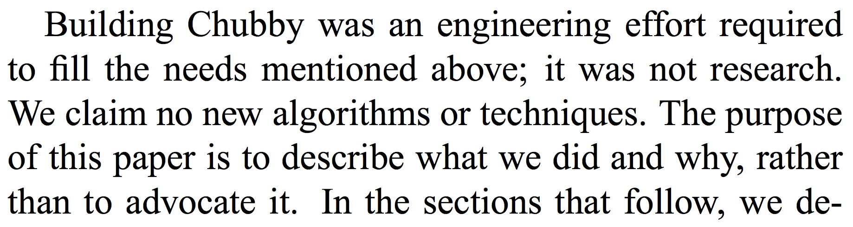
Chubby
Internal service within Google
Highly available coordination service

Slide 5
Chubby
Internal service within Google
Highly available coordination service
Two purposes
Lock service
File system (for small files)

Slide 6
Example: GFS Chunkmaster
x = Open(“/ls/gfs-cell8/chunkmaster")
if (TryAcquire(x) == success) {
// I'm the chunkmaster, tell everyone
SetContents(x, my-address)
} else {
// I'm not the master, find out who is
chunkmaster = GetContents(x)
}

Slide 7
Example: GFS Chunkmaster
x = Open(“/ls/gfs-cell8/chunkmaster")
if (TryAcquire(x) == success) {
// I'm the chunkmaster, tell everyone
SetContents(x, my-address)
} else {
// I'm not the master, find out who is
chunkmaster = GetContents(x)
}

Slide 8
Example: GFS Chunkmaster
x = Open(“/ls/gfs-cell8/chunkmaster")
if (TryAcquire(x) == success) {
// I'm the chunkmaster, tell everyone
SetContents(x, my-address)
} else {
// I'm not the master, find out who is
chunkmaster = GetContents(x)
}

Slide 9
Why this interface?
Why not a library that implements Paxos?

Slide 10
Why this interface?
Why not a library that implements Paxos?
Developers don’t know how to use Paxos
They at least think they know how to use locks!

Slide 11
Why this interface?
Why not a library that implements Paxos?
Developers don’t know how to use Paxos
They at least think they know how to use locks!
Need to export result of coordination outside of system
Example: clients need to discover GFS master

Slide 12
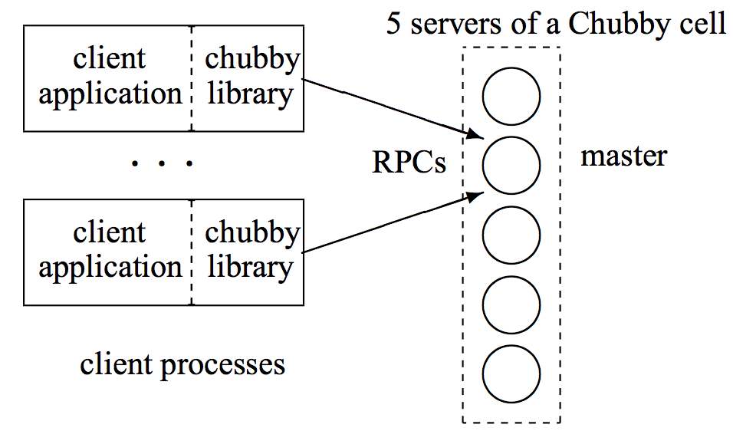
Chubby Design
Replicated service using Paxos to implement fault-tolerant log

Slide 13
Chubby Design
Replicated service using Paxos to implement fault-tolerant log

Slide 14
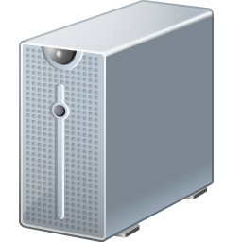
Chubby in Action
Modify file ‘foo’
?
Read file ‘foo’

Slide 15
Reads in Paxos-based RSM
For every key, every replica stores (value, version)
Return latest version out of majority of replicas
V1
V2
V1
V3
Read file ‘foo’
V2

Slide 16
Reads in Paxos-based RSM
For every key, every replica stores (value, version)
Return latest version out of majority of replicas
Read file ‘foo’
V1
V2
V1
V3
Read file ‘foo’
V2
Why do different replicas have different versions?

Slide 17
Reads in Paxos-based RSM
For every key, every replica stores (value, version)
Return latest version out of majority of replicas
Read file ‘foo’
V1
V2
V1
V3
Read file ‘foo’
V2
Why do different replicas have different versions?
Gap between Accept and Learn

Slide 18
Reads in Paxos-based RSM
How to ensure linearizability?
A read must see the effect of all accepted writes
Paxos replicated log: every replica executes command in a slot only after executing commands in all prior slots

Slide 19
Reads in Paxos-based RSM
How to ensure linearizability?
A read must see the effect of all accepted writes
Paxos replicated log: every replica executes command in a slot only after executing commands in all prior slots
Get read accepted to one of the slots in the replicated log

Slide 20
Reads with Paxos
Slots in log
Proposals / ballots

Slide 21
Reads in Paxos-based RSM
How to ensure linearizability?
A read must see the effect of all accepted writes
Get read accepted to one of the slots in the replicated log
Problem: poor performance at scale

Slide 22
Reads/Writes in Chubby
One of the 5 replicas chosen as the master
Clients must submit all reads and writes to the master
How to handle master failure?

Slide 23
Reads/Writes in Chubby
One of the 5 replicas chosen as the master
Clients must submit all reads and writes to the master
How to handle master failure?
Another replica must propose itself as the master
New master must first “catch up”

Slide 24
Reads/Writes in Chubby
One of the 5 replicas chosen as the master
Clients must submit all reads and writes to the master
How to handle master failure?
Another replica must propose itself as the master
New master must first “catch up”
Master is performance bottleneck

Slide 25
Scaling Chubby
Clients cache data they read

Slide 26
Scaling Chubby
Clients cache data they read
Reading from local cache violates linearizability
How to fix this?
Master invalidates cached copies upon update

Slide 27
Scaling Chubby
Clients cache data they read
Reading from local cache violates linearizability
How to fix this?
Master invalidates cached copies upon update
Master must store knowledge of client caches
What if master fails?

Slide 28
Scaling Chubby with Proxies
Proxy
Proxy
Chubby

Slide 29
Handling Client Failures
What if a client acquires a lock and fails?
Client library exchanges keep-alives with master
Lock revoked upon client failure
Problem?
Network partition is not a client failure
Chubby associates lock acquisitions with sequence numbers
Can distinguish operations from previous lock holders

Slide 30
Fixing Lock Issues with Sequence Numbers
Lock service
Replica 1
Client2
Client1
Replica 2
Check with lock service
to confirm lock validity
Replica 3

Slide 31
ZooKeeper
Open source coordination service
Addresses the need for polling in Chubby
Example: if you cannot acquire a lock, you need to retry
Goal in ZooKeeper: wait-free coordination

Slide 32
ZooKeeper: Watch Mechanism
Clients can register to “watch” a file
ZooKeeper notifies the client when the file is updated
Example
Try to acquire a lock by creating a file
If the file already exists, watch for updates
Upon watch notification, try to re-acquire the lock

Slide 33
ZooKeeper: Watch Mechanism
Clients can register to “watch” a file
ZooKeeper notifies the client when the file is updated
Example
Try to acquire a lock by creating a file
If the file already exists, watch for updates
Upon watch notification, try to re-acquire the lock
Problem?
Herd effect

Slide 34
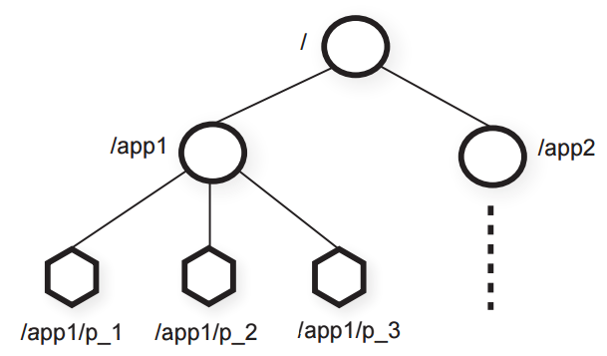
ZooKeeper: Hierarchy

Slide 35
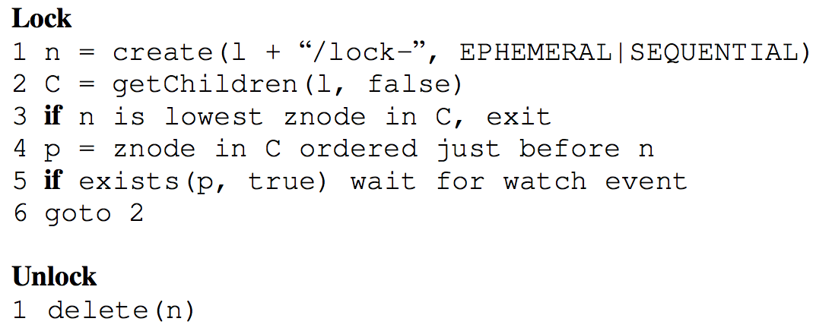
ZooKeeper: Sequencer
lock-1

Slide 36
ZooKeeper: Sequencer
lock-1
lock-2
lock-3

Slide 37
Chubby vs. ZooKeeper
Difference between invalidation (Chubby) and watch (ZooKeeper)?

Slide 38
Chubby vs. ZooKeeper
Difference between invalidation (Chubby) and watch (ZooKeeper)?
Invalidation
Only library receives a notification to update the cache
Watch
Application receives notification
Only application knows what it needs to do

Slide 39
Announcements
Assignment 2
Embrace the freedom in design space
Consider the implications of design decisions
Due 10pm tonight
Assignment 3 posted
Start early
Discussion section this Friday: Paxos

Slide 40
Next time…
Eventually consistent RSM

