Slide 1
CS188: Distributed Systems Lecture 11
Spring 2019
Ravi Netravali

Slide 2
Replicated State Machines
Lamport/vector clock-based RSM
Cannot progress if any replica is unavailable
Primary backup replication
Can replace primary/backup upon failure
Unavailable until failed replica is replaced
Paxos-based RSM
Available as long as majority is in the same partition

Slide 3
Replicated State Machines
Lamport/vector clock-based RSM
Cannot progress if any replica is unavailable
Primary backup replication
Can replace primary/backup upon failure
Unavailable until failed replica is replaced
Paxos-based RSM
Available as long as majority is in the same partition

Slide 4
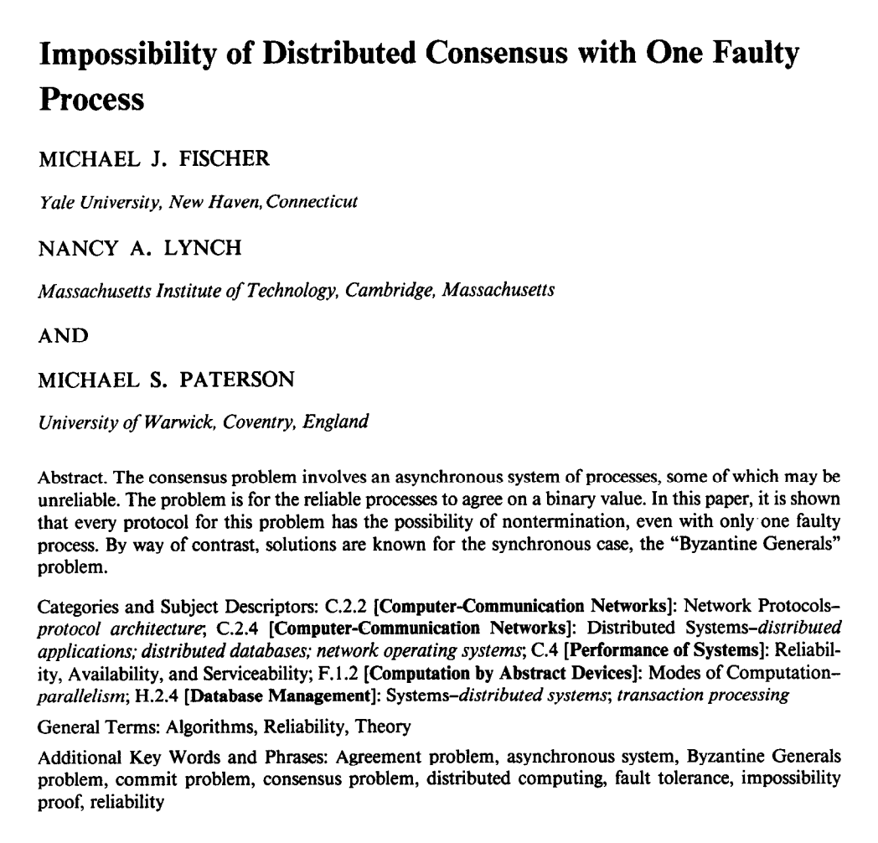
FLP Impossibility Result
In asynchronous model, distributed consensus is impossible if even one process may fail
Holds even for “weak” consensus (i.e., only some process must learn)
Holds even for only two states: 0 and 1

Slide 5
FLP Impossibility Result
Intuition: cannot distinguish from slowness
May not hear from process that has deciding vote
Implication: choose safety or liveness
?
A
B
A
B

Slide 6
FLP Impossibility Result
Intuition: cannot distinguish from slowness
May not hear from process that has deciding vote
Implication: choose safety or liveness
How to get both safety and liveness?
Need failure detectors (partial synchrony)
?
A
B
A
B

Slide 7
FLP Impossibility Result
Intuition: cannot distinguish from slowness
May not hear from process that has deciding vote
Implication: choose safety or liveness
How to get both safety and liveness?
Need failure detectors (partial synchrony)
?
A
B
A
B

Slide 8
CAP Theorem
Pick any two: consistency, availability, and partition-tolerance
In practice, choose between CP and AP
Replica
Replica
Replica
Replica
Replica

Slide 9

CAP Theorem
Pick any two: consistency, availability, and partition-tolerance
In practice, choose between CP and AP
Replica
Replica
Replica
Replica
Replica

Slide 10
CAP Theorem
Pick any two: consistency, availability, and partition-tolerance
In practice, choose between CP and AP
Replica
Replica
Replica
Replica
Replica

Slide 11
PACELC
If partition,
Choose availability vs. consistency
Else,
Choose latency vs. consistency
Unifies two separate tradeoffs that we’ve talked about
R
R
R
R
R

Slide 12
Why should you care?
Werner Vogels, Amazon CTO Job openings in my group What kind of things am I looking for in you? “You know your distributed systems theory: You know about logical time, snapshots, stability, message ordering, but also acid and multi-level transactions. You have heard about the FLP impossibility argument. You know why failure detectors can solve it (but you do not have to remember which one diamond-w was). You have at least once tried to understand Paxos by reading the original paper.”

Slide 13
Impact on Consistency
When a replica receives a read or write, when can it respond without violating linearizability?
If it is in a majority partition

Slide 14
Impact on Consistency
When a replica receives a read or write, when can it respond without violating linearizability?
If it is in a majority partition
If we want any replica to always serve clients:
Can we provide any consistency guarantees?
Examples of such a replicated state machine?

Slide 15
Example Scenario
Shared calendar application running on smartphone
Each entry has time and set of participants
Local copy of calendar on every phone
No master copy
Phone has intermittent connectivity; sync when nearby
Cellular data expensive while roaming
WiFi not available everywhere
Bluetooth has very short range

Slide 16
Format of Updates
Goal: automatic conflict resolution when replicas sync with eachother
What would work?
“10am meeting, 482 EVI, CS188 staff”

Slide 17
Format of Updates
Goal: automatic conflict resolution when replicas sync with eachother
What would work?
“10am meeting, 482 EVI, CS188 staff”
“1 hour meeting at 10am if room and participants are free, else 11am, 482 EVI, CS188 staff”

Slide 18
Example Execution
Node A asks for meeting M1 at 10am, else 11am
Node B asks for meeting M2 at 10am, else 11am
X syncs with A, then B
Y syncs with B, then A

Slide 19
Example Execution
Node A asks for meeting M1 at 10am, else 11am
Node B asks for meeting M2 at 10am, else 11am
X syncs with A, then B
Y syncs with B, then A
X will put meeting M1 at 10am
Y will put meeting M1 at 11am
Replicas can’t apply updates in order received!

Slide 20
Ordering of Updates
All replicas must apply updates in same order
How to achieve consistent ordering despite intermittent connectivity?
Lamport clock!

Slide 21
Ordering of Updates
Recap of Lamport clocks
Every update associated with timestamp of the form (local timestamp T, originating node ID)
a < b if a.T < b.T or (a.T = b.T and a.ID < b.ID)
Updates with timestamps in our example
(701, A): A asks for meeting M1 at 10am, else 11am
(770, B): B asks for meeting M2 at 10am, else 11am

Slide 22
Another Example Execution
(701, A): A asks for meeting M1 at 10am, else 11am
(700, B): Delete meeting M1
B’s clock was slow
Now, delete will be ordered before add
How to prevent this?
Lamport clocks preserve causality

Slide 23
Example Execution
(701, A): A asks for meeting M1 at 10am, else 11am
(770, B): B asks for meeting M2 at 10am, else 11am
Pre-sync database state:
A has M1 at 10am
B has M2 at 10am
After A receives and applies update from B
A has M1 at 10am and M2 at 11am

Slide 24
Example Execution
(701, A): A asks for meeting M1 at 10am, else 11am
(770, B): B asks for meeting M2 at 10am, else 11am
Pre-sync database state:
A has M1 at 10am
B has M2 at 10am
After A receives and applies update from B
A has M1 at 10am and M2 at 11am
How can B apply update from A?
B already has M2 at 10am

Slide 25
Solution: Roll Back and Replay
B needs to “roll back” its state, and rerun operations in correct order
In UI, displayed calendar entries are tentative at first
B’s user saw M2 at 10am, then it moved to 11am

Slide 26
Solution: Roll Back and Replay
B needs to “roll back” its state, and rerun operations in correct order
In UI, displayed calendar entries are tentative at first
B’s user saw M2 at 10am, then it moved to 11am
Takeaways
Need to maintain log of updates
Sync updates between replicas, not state

Slide 27
Quick Syncs
A
B
How to sync without state exchange proportional to size of log?
〈-,10, X〉
〈-,10, X〉
〈-,20, Y〉
〈-,20, Y〉
〈-,30, X〉
〈-,30, X〉
〈-,40, X〉
〈-,40, Y〉

Slide 28
Quick Syncs
A
B
How to sync without state exchange proportional to size of log?
B tells A: highest timestamp for every node
E.g., “X 30, Y 40” ← Version Vector
In response, A sends all of X’s updates after (, 30, X) and all of Y’s updates after (, 40, Y)
〈-,10, X〉
〈-,10, X〉
〈-,20, Y〉
〈-,20, Y〉
〈-,30, X〉
〈-,30, X〉
〈-,40, X〉
〈-,40, Y〉

Slide 29
Quick Syncs
A
B
How to sync without state exchange proportional to size of log?
B tells A: highest timestamp for every node
E.g., “X 30, Y 40” ← Version Vector
In response, A sends all of X’s updates after (, 30, X) and all of Y’s updates after (, 40, Y)
〈-,10, X〉
〈-,10, X〉
〈-,20, Y〉
〈-,20, Y〉
〈-,30, X〉
〈-,30, X〉
〈-,40, X〉
〈-,40, Y〉

Slide 30
Consistency Semantics
Can a calendar entry ever be considered no longer tentative?
Eventual consistency:
If no new updates, all replicas eventually converge to same state

Slide 31
Committing Updates
Implications of ordering updates using timestamp
Never know whether some write from the past may yet reach your node
So all entries in log must be tentative forever
All nodes must store entire log forever
How to mark calendar entries as committed?
How to garbage collect updates to prune the log?

Slide 32
Committing Updates
Update with timestamp (T, ID) is stable if higher timestamp update received from every node
Problem?

Slide 33
Committing Updates
Update with timestamp (T, ID) is stable if higher timestamp update received from every node
Problem?
Disconnected replica prevents others from declaring updates stable
Solution
Pick one of the replicas as the primary
Primary determines order of updates
Desirable properties of primary?

Slide 34
Committing Updates
State at any replica:
Stable state
Log of tentatively ordered updates (order based on Lamport clock timestamps)
Upon sync with primary
Receive updates in order
Apply updates to stable state and prune log

Slide 35
Committing Updates
State at any replica:
Stable state
Log of tentatively ordered updates (order based on Lamport clock timestamps)
Upon sync with primary
Receive updates in order
Apply updates to stable state and prune log
Any constraints on order chosen by primary?
Must respect causality

Slide 36
Consistency vs. Availability
Replica can execute client requests only if in the same partition as majority
Replica
Replica
Replica
Replica
Replica

Slide 37
Consistency vs. Availability
Replica can execute client requests only if in the same partition as majority
What consistency can we offer if we want any replica to always serve client requests?
Replica
Replica
Replica
Replica
Replica

Slide 38
Eventual Consistency
If no new updates, all replicas eventually converge to same state
Apply updates in same order at all replicas in a manner that preserves causal ordering
Use Lamport clocks
Don’t want to wait to apply an update until clock has progressed at all nodes
Apply update immediately; roll back and reapply later

Slide 39
Eventual Consistency
If no new updates, all replicas eventually converge to same state
Apply updates in same order at all replicas in a manner that preserves causal ordering
Use Lamport clocks
Don’t want to wait to apply an update until clock has progressed at all nodes
Apply update immediately; roll back and reapply later

Slide 40
Eventual Consistency
Never know whether some write from the past may yet reach your node
All entries in log must be tentative forever
All nodes must store entire log forever
To commit updates and garbage collect them
Rely on highly available primary to order updates
Order chosen by primary must preserve causality

Slide 41
Consistency Spectrum
Read-after-
write
Eventual
Causal
Sequential
Linearizability
Consistency
Ease of programming
Latency

Slide 42
Consistency Spectrum
Read-after-
write
Eventual
Causal
Sequential
Linearizability
Consistency
Ease of programming
Latency
Availability

Slide 43



Web Services in the Cloud
VM
VM
VM
Storage Service

Slide 44
Example Scenario
Photo sharing web service deployed in AWS
Use Amazon S3 for storage
Photo URL → Image data
Album name → <List of photo URLs>
User name → (# of photos, <List of album names>)

Slide 45
Example Scenario
Photo sharing web service deployed in AWS
Use Amazon S3 for storage
Photo URL → Image data
Album name → <List of photo URLs>
User name → (# of photos, <List of album names>)
Problems application must cope with due to eventually consistent storage system?

Slide 46
Problems with Eventual Consistency
Lack of referential integrity
Total # of photos != sum of # of photos in each album

Slide 47
Problems with Eventual Consistency
Lack of referential integrity
Total # of photos != sum of # of photos in each album
Updates may get lost
Initialize album1 and add photo1
User 1 reads album1’s content and adds photo2
User 2 reads album1’s content and adds photo2
Album1 may eventually have only one photo2
Why is Amazon S3 useful?

Slide 48
Problems with Eventual Consistency
Lack of referential integrity
Total # of photos != sum of # of photos in each album
Updates may get lost
Initialize album1 and add photo1
Read album1’s content and add photo2
Read album1’s content and add photo3
Album1 may eventually have only photo1 and photo3
Why is Amazon S3 useful?
Read-after-write consistency for initial PUT
Most data is write-once

Slide 49
Problems with Eventual Consistency
Lack of referential integrity
Total # of photos != sum of # of photos in each album
Updates may get lost
Initialize album1 and add photo1
Read album1’s content and add photo2
Read album1’s content and add photo3
Album1 may eventually have only photo1 and photo3
Why is Amazon S3 useful?
Read-after-write consistency for initial PUT
Most data is write-once

Slide 50
Consistency at Facebook
0.0004% of reads violate linearizability
Despite system not designed for linearizability!
Implication
Cannot ascertain whether a system offers linearizable consistency via measurements
Must reason about system’s design

Slide 51
Next time…
Impact of eventual consistency

