Slide 1
CS188: Distributed Systems Lecture 16
Spring 2019
Ravi Netravali

Slide 2
Recap: Two-Phase Locking
TC acquires locks on all necessary shards
TC commits transaction if all locks acquired, else aborts
Disjoint transactions can execute concurrently
Transactions with overlap run sequentially
How to increase concurrency?

Slide 3
Improving Concurrency of Transactions
System stores employee → salary mappings
T1: TotalSalary = sum of employee salaries
T2: MedianSalary = median employee salary
Both T1 and T2 require locks for all employees
T1 and T2 must run one after the other
But…no conflict if T1 and T2 run concurrently

Slide 4
Improving Concurrency of Transactions
System stores employee → salary mappings
T1: TotalSalary = sum of employee salaries
T2: MedianSalary = median employee salary
Both T1 and T2 require locks for all employees
T1 and T2 must run one after the other
But…no conflict if T1 and T2 run concurrently
Acquire locks only for data transaction will modify?
T3: increase all employee salaries by 10%

Slide 5
Managing Concurrency
Two-phase locking is pessimistic
Acquire locks assuming conflict will occur
Optimistic concurrency control
Execute transaction assuming no conflict
Verify that no conflict exists before commit

Slide 6
Managing Concurrency
Two-phase locking is pessimistic
Acquire locks assuming conflict will occur
Optimistic concurrency control
Execute transaction assuming no conflict
Verify that no conflict exists before commit

Slide 7
Optimistic Concurrency Control
Read required data and compute results
TC ideally reads from local cache
Verify that no conflicts exist
TC asks relevant partitions whether it is safe to commit
Commit results
Read
Phase
Validate
Phase
Write
Phase

Slide 8
Centralized Validation
TC fetches required data and executes transaction
TC sends transaction to validation server
Validation server evaluates if commit → conflict
If no, ask TC to commit results
If yes, ask TC to re-read and re-execute transaction

Slide 9
Validation
Unsafe set
Safe set
T1: Get x=0, Put x=1
T2: Get x=0, Put y=1
T3: Get y=0, Get x=1
T1: Get x=0, Put x=1
T2: Get y=1, Get x=1
T3: Get y=0, Put y=1
If x=0, y=0, and z=0 initially, how to evaluate if a set of transactions
is safe to execute concurrently?

Slide 10
Validation
Unsafe set
Safe set
T1: Get x=0, Put x=1
T2: Get x=0, Put y=1
T3: Get y=0, Get x=1
T1: Get x=0, Put x=1
T2: Get y=1, Get x=1
T3: Get y=0, Put y=1
If x=0, y=0, and z=0 initially, how to evaluate if a set of transactions
is safe to execute concurrently?

Slide 11
Safe Concurrency: Case 1
T1 completes writes before T2 begins read
Necessary if T1’s write set overlaps with T2’s read set
T₁
T₂

Slide 12
Safe Concurrency: Case 2
T1’s write set disjoint from union of T2’s read set and write set
Example:
T1: TotalSalary = sum of employee salaries
T2: MedianSalary = median employee salary
T₁
T₂

Slide 13
Safe Concurrency: Case 3
T1’s write set disjoint from T2’s read set, and T1 completes write phase before T2’s writes
T₁
T₂

Slide 14
Safe Concurrency: Case 3
T1’s write set disjoint from T2’s read set, and T1 completes write phase before T2’s writes
Example?
T1: TotalSalary = sum of faculty salaries
T2: TotalSalary = sum of graduate student salaries
T₁
T₂

Slide 15
Distributed Validation
TC picks a timestamp based on local clock
TC includes timestamp in reads and writes
Node invalidates prior reads if transaction with following properties arrives before commit:
Lower timestamp
Write set of new transaction intersects with read set of old transaction

Slide 16
Distributed Validation
TC1
Read
P1
Commit
P2
Read
TC2

Slide 17
Fault Tolerance of Two-Phase Locking
More shards → Greater chance that one shard unavailable
TC
Lock
Abort
P1
P2
P3

Slide 18
Transaction Latency
Impact of multi-partition operations on user-perceived latency
Greater the number of shards that transaction touches, the higher the latency
Why?

Slide 19
Transaction Latency
Impact of multi-partition operations on user-perceived latency
Greater the number of shards that transaction touches, the higher the latency
Why?
Transaction latency = max(Per-request latency)
Transaction is slow if response from any one shard is slow

Slide 20
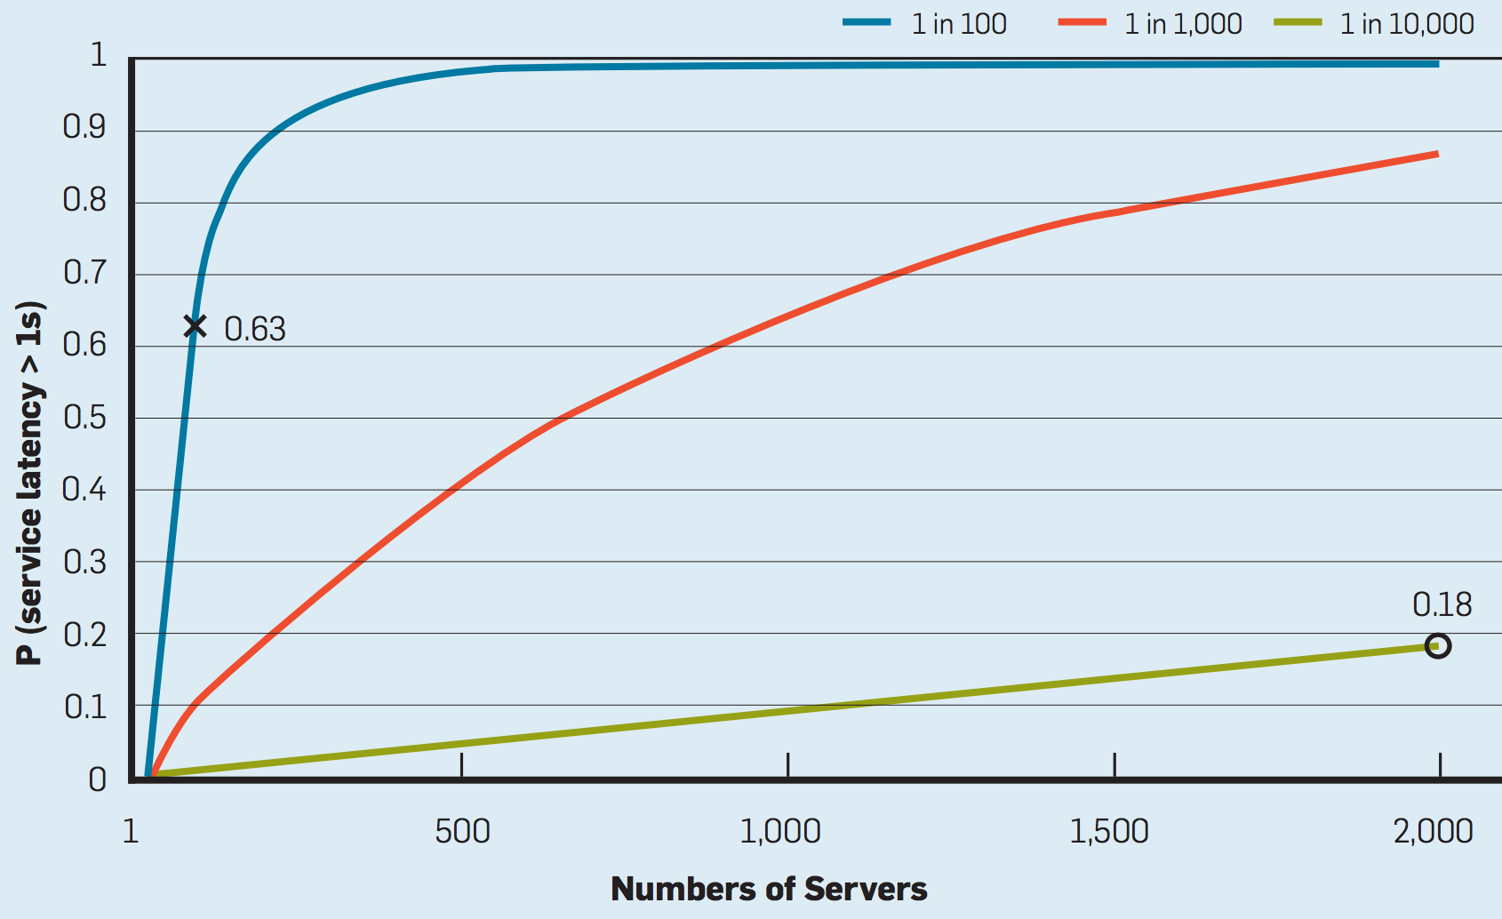
Impact of Tail Latency

Slide 21
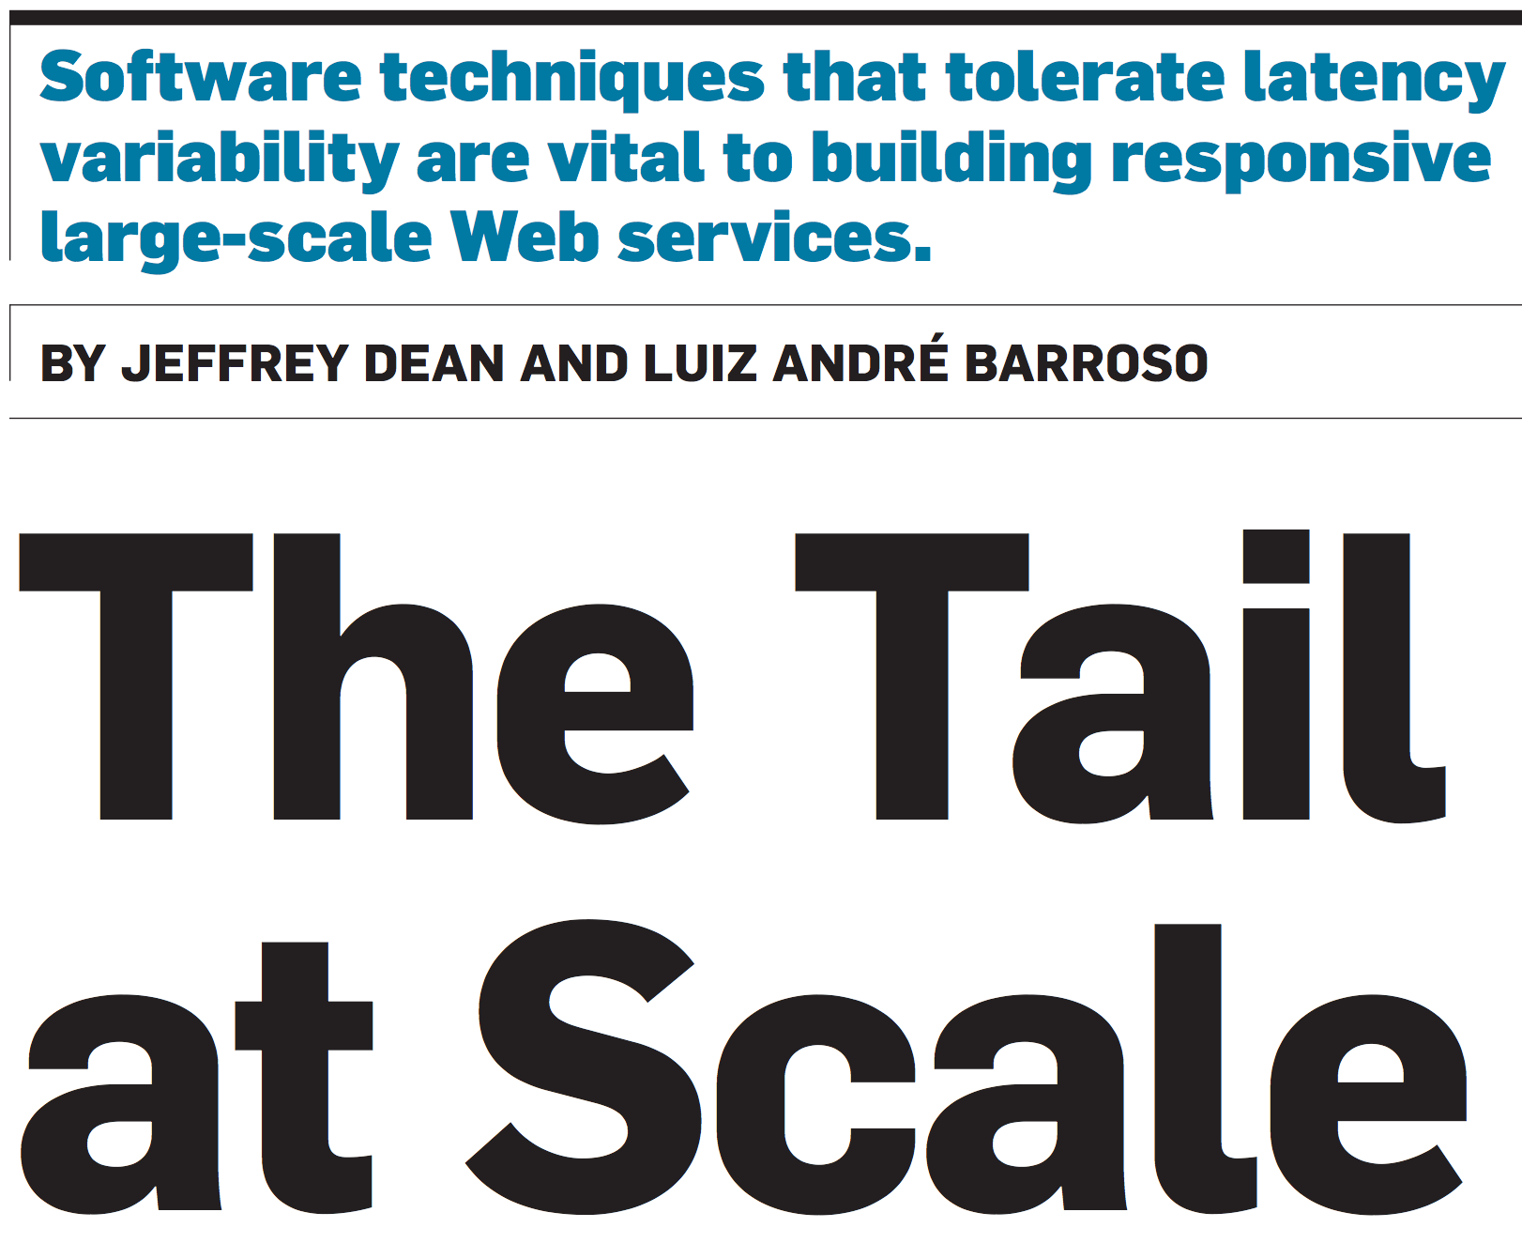

Slide 22
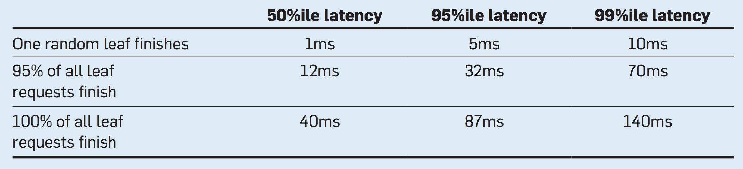
Data from a Service at Google
Root server receives request from user and executes request at many leaf servers
t = 0
Requests
issued
t = 140ms
100% responses
received

Slide 23
Data from a Service at Google
Root server receives request from user and executes request at many leaf servers
t = 0
Requests
issued
t = 10ms
50% responses
received
t = 70ms
95% responses
received
t = 140ms
100% responses
received

Slide 24
Causes for Tail Latency
Why might a server be occasionally slow in responding to a request?

Slide 25
Causes for Tail Latency
Why might a server be occasionally slow in responding to a request?
Infrastructure shared by multiple services
Background work
Energy management

Slide 26
Solution: Add Redundancy
Exploit the fact that every server’s state is replicated
Concurrently send each request to multiple replicas
Take first response
Problem?
Increased load could worsen latencies

Slide 27
Efficient Use of Redundancy
Option 1
Issue request first to any one replica
Issue requests to other replicas after timeout
Increase in load only when first response is slow
Tradeoff between timeout and load
Option 2
Issue requests to all replicas almost simultaneously
Tell every replica to cancel request at other replicas when it responds

Slide 28
Other Solutions for Tail Latency
Selectively increase replication for hot partitions
Detect and put slow machines on probation
Trade off quality of response for latency

Slide 29
Other Solutions for Tail Latency
Selectively increase replication for hot partitions
Detect and put slow machines on probation
Trade off quality of response for latency
Examples?
Google Search, Facebook News Feed

Slide 30
Next time…
Windows Azure Storage
Google Spanner (the following lecture)

