Slide 1
PSXM Shielding: Chi2 vs. Analytical
Method Comparison
J-PARC muon g-2 / EDM — PSXM Magnet Design
Jintian Wang | Mentor: Zejia Lu | Group Meeting, July 29, 2026

Slide 2
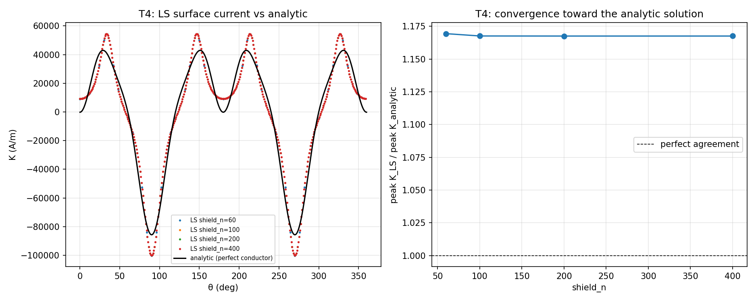
Least-Squares vs. Ideal-Conductor Solution
Chi2 (LS) method
• discrete shield currents that null B on sample rings offset from the shield
Analytical method
• continuous surface current from the multipole expansion, exactly cancels every exterior coil multipole
Result
• LS converges to a stable 1.167× offset above the analytic curve
• shield_n = 60 → 400: ratio 1.169 → 1.166 (flat, not converging to 1.0)
Confirmed independent of sample gap and sampling density
Conclusion
• structural effect of discretizing a continuous shell, not a bug

Slide 3
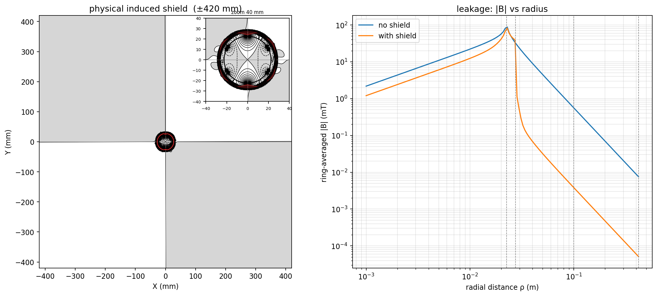
Leakage at 0.419 m (Nearest-Beam Benchmark)
• Physically-induced shield model (real copper, 1 μs pulse)
• Unshielded: ~7 μT at 0.419 m
• With induced shield: ~0.05 μT at 0.419 m
• Suppression: ~140×
• Bounded by real conductivity — the number to quote as a physical estimate

