Slide 1
PSXM - Dipole Shield Radius Optimization
Jintian Wang
University of Oxford

Slide 2
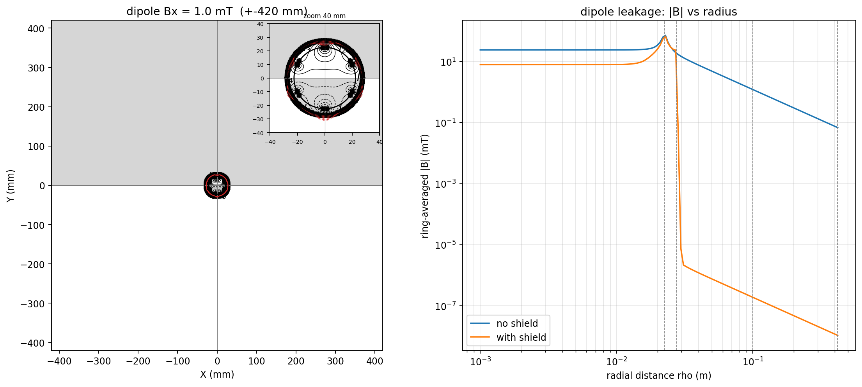
Design Question - Choosing the Shield Radius
Shield radius is a trade-off:
Goal: find the shield radius that still meets the 1 mT dipole target within the 1000 A coil budget.

Slide 3
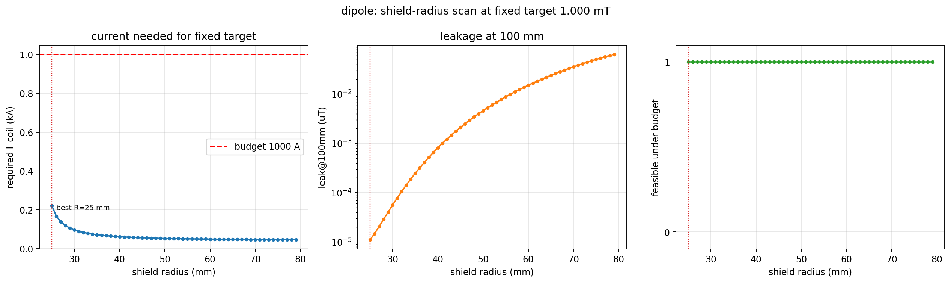
Result - Dipole Shield-Radius Scan
- Swept shield radius 25-79 mm at a 1 mT dipole target, 1000 A budget
- Optimum at the smallest scanned radius: R_sh = 25 mm, required current ~ 222 A
- Required current decreases strictly monotonically with radius
Dipole shield-radius scan (required current, shield current, leakage)

