Slide 1
Responsive Design and Bootstrap
By Jinto MD

Slide 2
Concepts
Responsive Design
Frameworks
Open Source

Slide 3
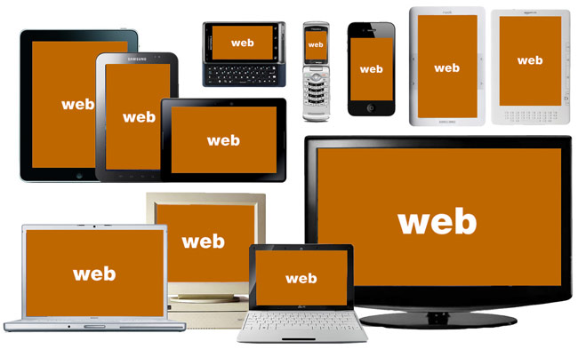
State of Today’s Web
Source: http://bradfrostweb.com/
Notes:
This is the challenge.
How do you design for all of this?
How do you manage the budget (staff, resources)?

Slide 4
51% of US mobile phones are smartphones

Slide 5
What is Responsive Web Design?
An approach to web design that provides an optimal viewing experience across a wide range of devices.
Notes:
First introduced in 2009 by Ethan Marcotte who has also written a book with the same title.

Slide 6
Elements of RWD
Fluid Grid
Resizable Images
Media Queries
Notes:
First introduced in 2009 by Ethan Marcotte who has also written a book with the same title and which I also recommend.
I’ve spent the last two years learning about and really digging into responsive Web design and I’ve gotta say, It is the beginning of a new era in the Web.

Slide 7
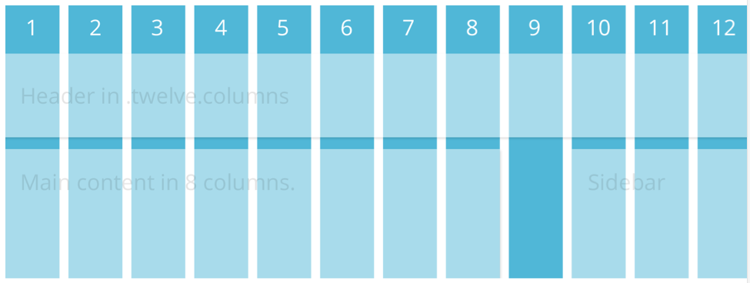
Grids

Slide 8
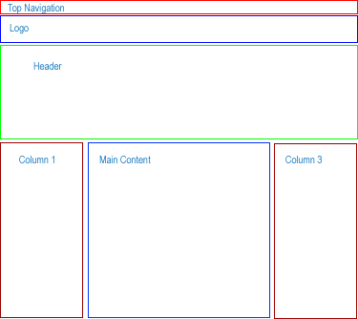
Grids /

Slide 9
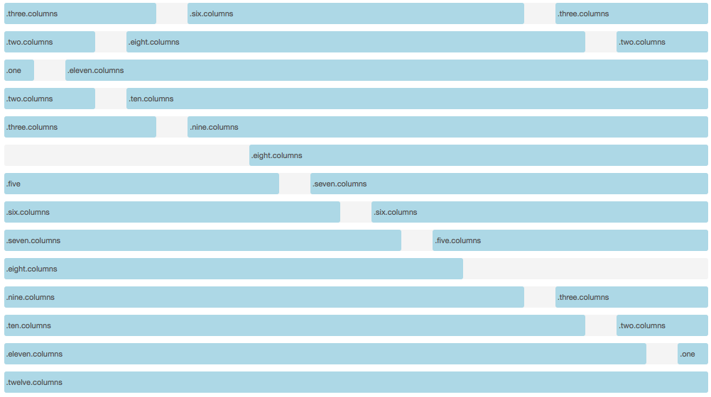
How do grid systems work?
Example based on Foundation Zurb Framework (http://foundation.zurb.com). A 12 column grid system

Slide 10
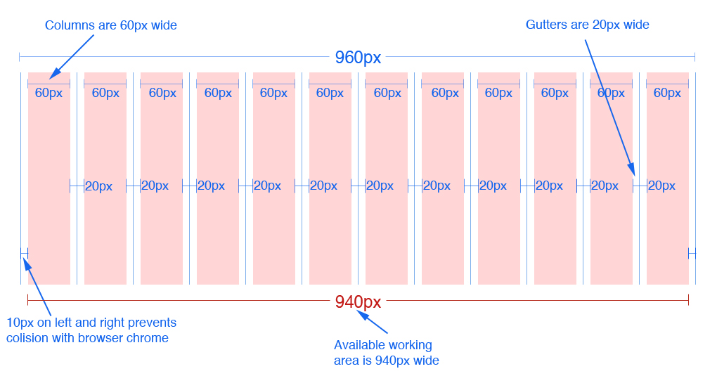
12 column version
12 column version
Source: 960.gs
Notes:
In the 16 column version each column is 40px wide. Everything else remains the same

Slide 11
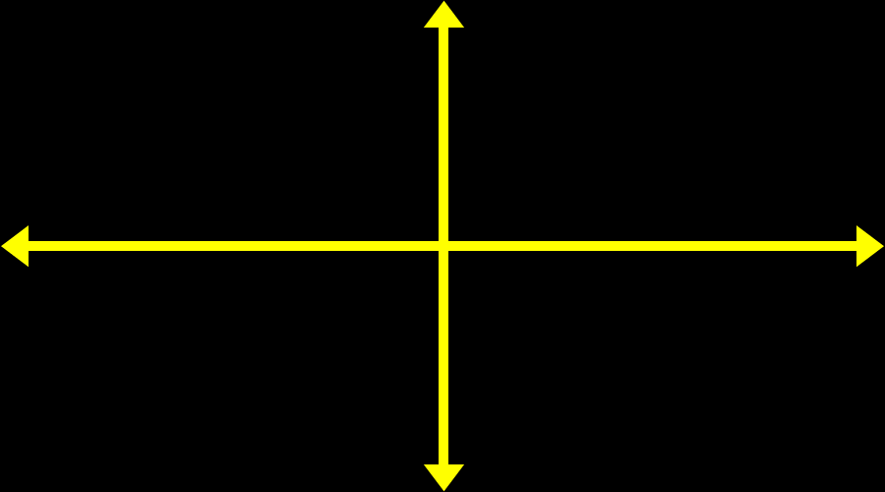
Resizable Images
img {
max-width: 100%;height: auto;}

Slide 12
Media Queries
A CSS3 module that renders web pages based on conditions such as screen resolution
Drafted in 2001 by the W3C
Became a recommended standard in June 2012
:
Notes:
First introduced in 2009 by Ethan Marcotte who has also written a book with the same title and which I also recommend.
I’ve spent the last two years learning about and really digging into responsive Web design and I’ve gotta say, It is the beginning of a new era in the Web.

Slide 13
Common Breakpoints
Label | Layout Width
Smartphones | 480px and below
Portrait Tables | 480px to 768px
Landscape Tablets | 768px to 940px
Default | 940px and up
Large Screens | 1210px and up

Slide 14
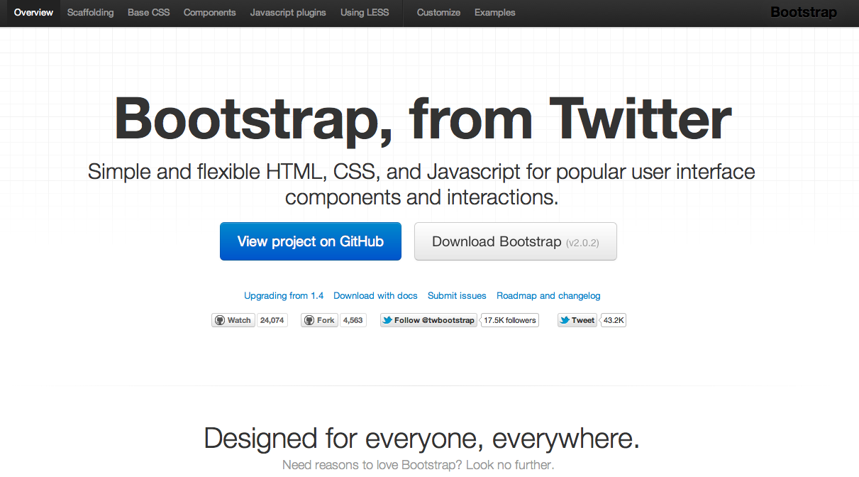
What
http://twitter.github.com/bootstrap/

Slide 15
Twitter Bootstrap
A freely available design framework for websites and web applications
Based upon HTML5, CSS and JavaScript
Supports all major browsers (even IE7!)
Released on GitHub in August 2011

Slide 16
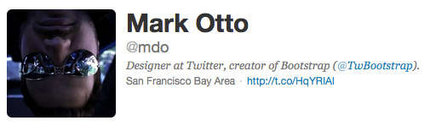
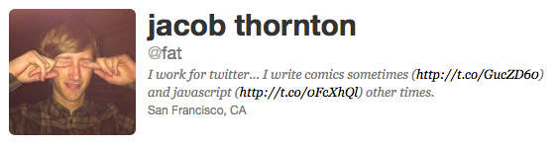
Created By

Slide 17
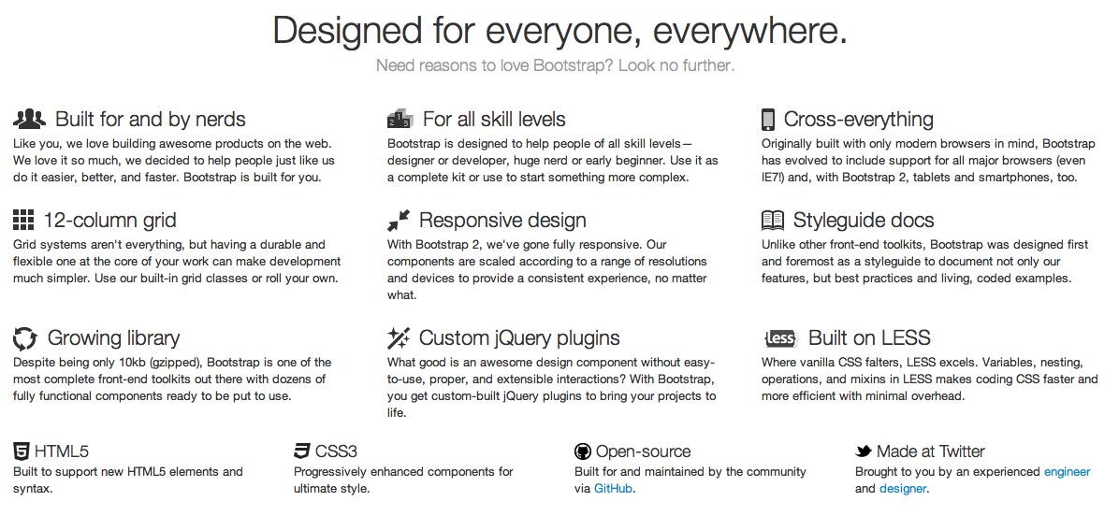
Why
Reason #1: Rich Features

Slide 18
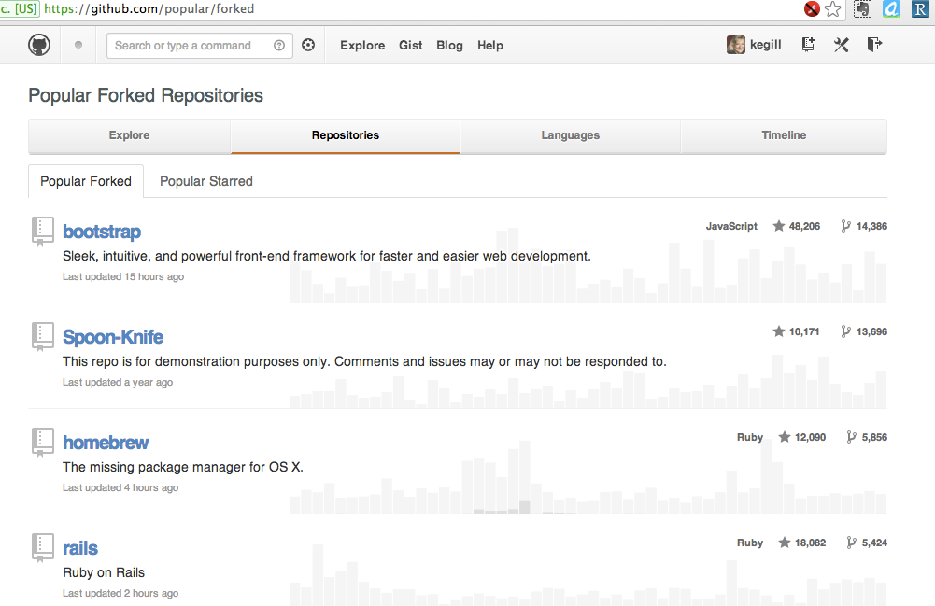
Why
Reason #2: Popularity

Slide 19



Why
Reason #3: Browser Support
Also MSIE and Opera

Slide 20
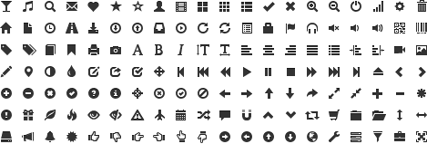
Why
Reason #4: Glyph Icon Set

Slide 21
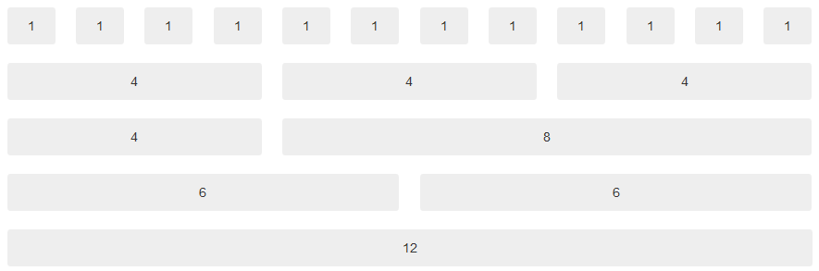
Why
Reason #5: Grid System
Notes:
Bootstrap is using a grid system base on 12 columns.
What is a grid system? A grid system is a way to create a solid foundation to build your project on.
If you want your web application to have a left navigation you could design your HTML using row number 3
If you do not want any navigation and you want your content to be as wide as possible then you could use row number 5
This grid design was popularized by 960 grid system http://960.gs and BluePrint http://www.blueprintcss.org

Slide 22

Why
Reason #6: Components
Buttons:
Tabs:
Pagination:
Alerts:
Progress bar:
Notes:
Here is a list of some of the CSS component available. There are dozens of them available with bootstrap.

Slide 23
Thanks!

