Slide 2
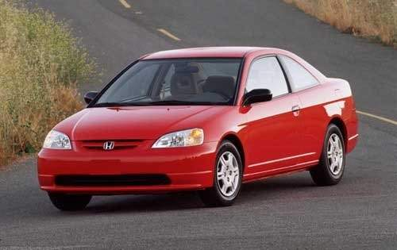
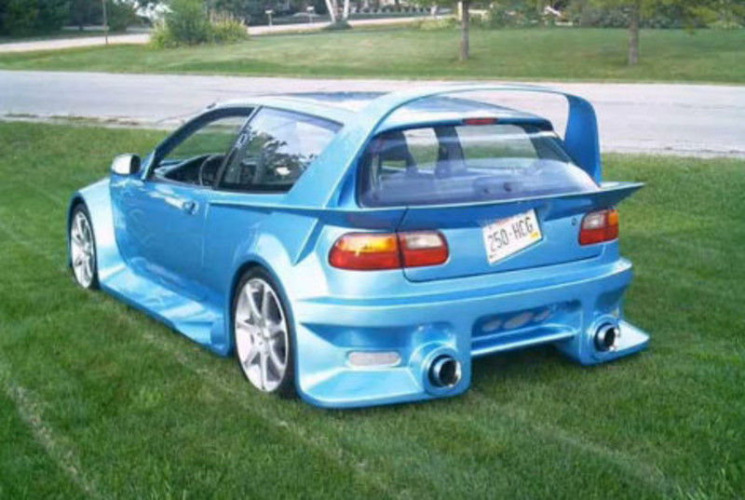
Ribosomes
Rich medium
Minimal medium

Slide 3
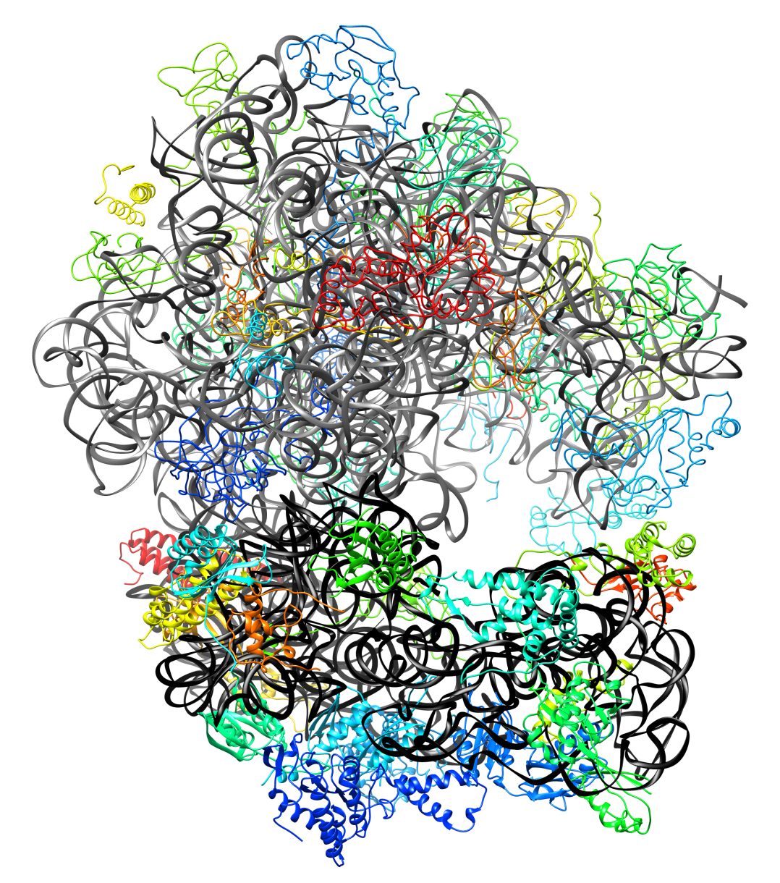
Ribosomal assembly
Reconstitution experiments
Quantitative mass spec experiments

Slide 4
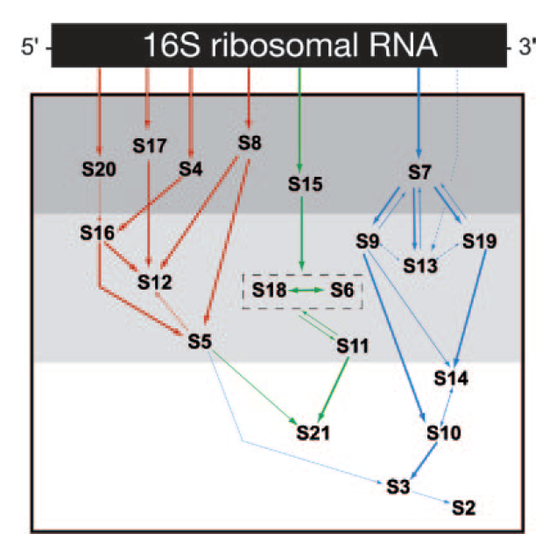
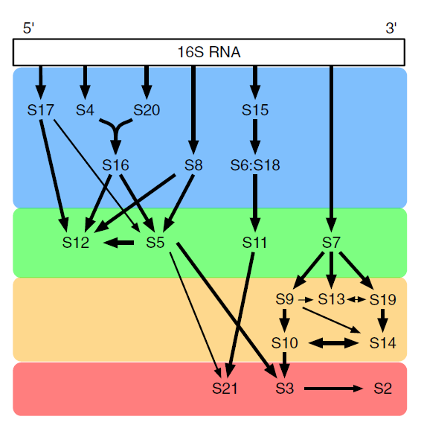
Ribosomes
Reconstitution
Mass spec

Slide 5
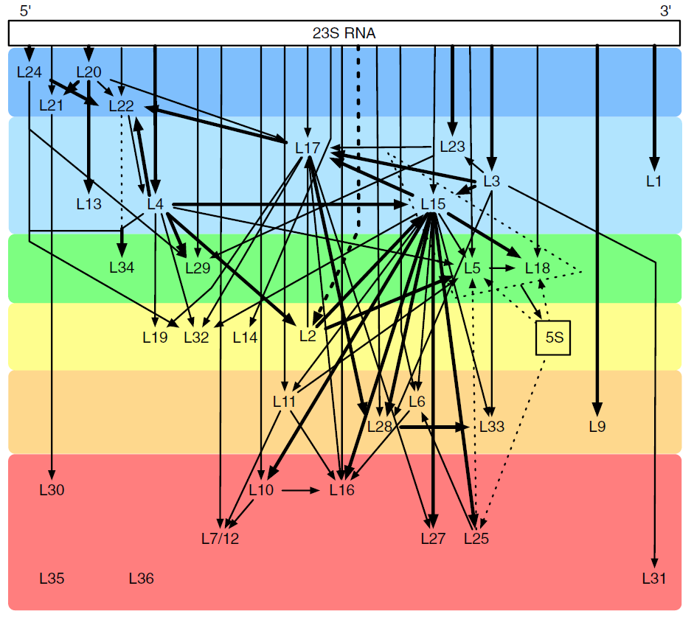
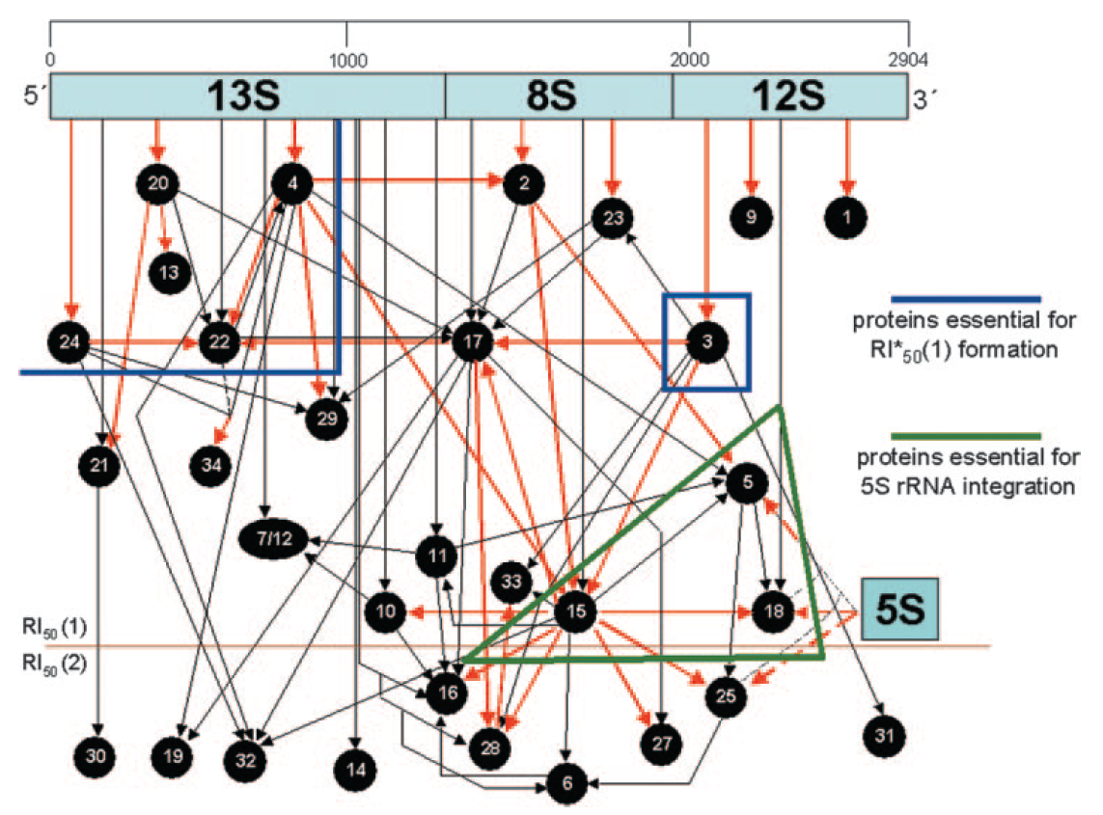

Slide 6
Quant mass spec – part 1
We need information about timing.

Slide 7
[TODO] Look at timing stuff.

Slide 8
rRNA organization
 | Ribosomal parts |  | Regulated by
rrnA | rrsA-ileT-alaT-rrlA-rrfA: 16S, tRNA-Ile, tRNA-Ala, 23S, 5S | ‡ | ppGpp, DksA, Lrp, Fis Sigma70, sigma32
rrnB | rrsB-gltT-rrlB-rrfB 16S, tRNA-glu, 23S, 5S | * | ppGpp, DksA, Lrp, Fis, HNS Sigma70, sigma32
rrnC | rrsC-gltU-rrlC-rrfC 16S, tRNA-glu, 23S, 5S | * | ppGpp, DksA, Lrp, Fis, [H-NS?] Sigma70, sigma32
rrnD | rrsD-ileU-alaU-rrlD-rrfD-thrV-rrfF 16S, tRNA-ile, tRNA-ala, 23S, 5S, tRNA-thr, 5S |  | ppGpp, DksA, [Lrp?], Fis, [H-NS?] Sigma70, sigma32
rrnE | rrsE-gltV-rrlE-rrfE 16S, tRNA-glu, 23S, 5S | * | ppGpp, DksA, [Lrp?], Fis, (PhoP) Sigma70, sigma32
rrnG | rrsG-gltW-rrlG-rrfG 16S, tRNA-glu, 23S, 5S | * | ppGpp, DksA, [Lrp?], Fis, [H-NS?] Sigma70, sigma32
rrnH | rrsH-ileV-alaV-rrlH-rrfH 16S, tRNA-ile, tRNA-ala, 23S, 5S | ‡ | ppGpp, DksA, [Lrp?], Fis, [H-NS?] Sigma70, sigma32
Notes:
The regulated by terms between straight brackets and with question mark have unknown locations but are shown by gene expression analysis. Not sure which technique was used, may be false positive due redundancy?
Between round brackets means predicted regulation.

Slide 9
Type of rRNA regulators
ppGpp: alarmone, stress response
DksA: inhibits RNA-pol, augments ppGpp effect.
Lrp: affects 10-75% genes. Senses richness medium ↔ leucine, “famine” genes (+), “feast” genes (-).
Fis: broad regulator (21% genes), organizes DNA
H-NS: broad effect (5% genes affected), adaptation to stress, histone like
(PhoP: adaptation to low Mg²⁺ environments.)

Slide 10
rRNA knockouts
 | Ribosomal parts |  | Regulated by
rrnA | rrsA-ileT-alaT-rrlA-rrfA: 16S, tRNA-Ile, tRNA-Ala, 23S, 5S | ‡ | ppGpp, DksA, Lrp, Fis Sigma70, sigma32
rrnB | rrsB-gltT-rrlB-rrfB 16S, tRNA-glu, 23S, 5S | * | ppGpp, DksA, Lrp, Fis, HNS Sigma70, sigma32
rrnC | rrsC-gltU-rrlC-rrfC 16S, tRNA-glu, 23S, 5S | * | ppGpp, DksA, Lrp, Fis, [H-NS?] Sigma70, sigma32
rrnD | rrsD-ileU-alaU-rrlD-rrfD-thrV-rrfF 16S, tRNA-ile, tRNA-ala, 23S, 5S, tRNA-thr, 5S |  | ppGpp, DksA, [Lrp?], Fis, [H-NS?] Sigma70, sigma32
rrnE | rrsE-gltV-rrlE-rrfE 16S, tRNA-glu, 23S, 5S | * | ppGpp, DksA, [Lrp?], Fis, (PhoP) Sigma70, sigma32
rrnG | rrsG-gltW-rrlG-rrfG 16S, tRNA-glu, 23S, 5S | * | ppGpp, DksA, [Lrp?], Fis, [H-NS?] Sigma70, sigma32
rrnH | rrsH-ileV-alaV-rrlH-rrfH 16S, tRNA-ile, tRNA-ala, 23S, 5S | ‡ | ppGpp, DksA, [Lrp?], Fis, [H-NS?] Sigma70, sigma32
Note that tRNA molecules are also produced elsewhere
E.g. tRNA-ile has 5 locs, 3 in rRNA operons.
Notes:
The regulated by terms between straight brackets and with question mark have unknown locations but are shown by gene expression analysis. Not sure which technique was used, may be false positive due redundancy?
Between round brackets means predicted regulation.
Circles indicate presence of additional plasmid: ori p15A, aadA(strR,SpcR), trpT, thrV, ileU, aspT, alaU, gltT. [spec confirmed noreen, str unclear, see excel sheet strains.]
Length of the rrnB gene is approx 5479bp, rrnE approx. 5296. (Compare to 711bp of mCherry or 632bp of CRP.)

Slide 11
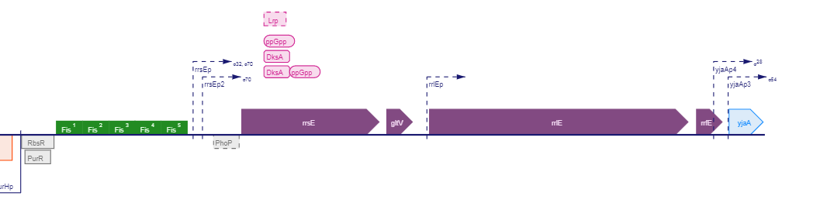
Desired plasmid
P_rrsE
P_rrlE
PrrsE
rrsE-gltV-rrlE-rrfE
RBS
To be added to
Strain ∆rrnEG
(SQ40 or #12340)
mVenus
rrnE, ~5500bp
Low copy nr plasmid
1-5?

Slide 12
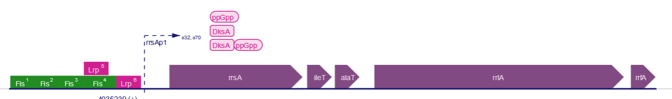
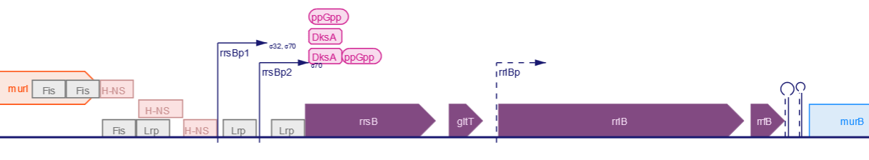

Slide 13
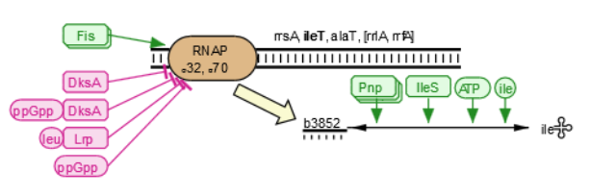
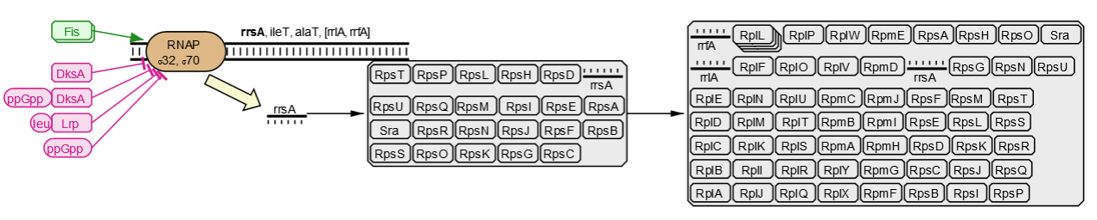
RNA transcripts
rrnA
rrnA

Slide 14

R-protein regulation
 |  | neg | pos |  |  | neg | pos |  |  | neg | pos |  |  | neg | pos
1 | rplA | * |  | 11 | rplK | * |  | 21 | rplU | * | mlrA | 31 | rpmE |  | s32
2 | rplB | *,ArcA | FNR | 12 | rplL | * |  | 22 | rplV | *,ArcA | FNR | 32 | rpmF
3 | rplC | *,ArcA | FNR | 13 | rplM | *+cAMP.CRP+Fis+FNR |  | 23 | rplW | *,ArcA | FNR | 33 | rpmG | *
4 | rplD | *,ArcA | FNR | 14 | rplN | * |  | 24 | rplX | * |  | 34 | rpmH
5 | rplE | * |  | 15 | rplO | * |  | 25 | rplY | * |  | 35 | rpmI | *,NsR
6 | rplF | * |  | 16 | rplP | *,ArcA | FNR | 26 | -- |  |  | 36 | rpmJ | *
7 | rplL | * |  | 17 | rplQ | * |  | 27 | rpmA | * | MlrA
8 | rplN | * |  | 18 | rplR | * |  | 28 | rpmB | *
9 | rplI |  | CRP.cAMP | 19 | rplS | *, FNR |  | 29 | rpmC | *,ArcA | FNR
10 | rplJ | * |  | 20 | rplT | *,FNR,NsrR |  | 30 | rpmD | *

