Slide 1
R Course for Hubrecht Postdocs
Martijn Wehrens & Anna Alemany

Slide 2
Summary of the course
S1: Data types and loops ✅
S2: Matrices and functions ✅
S3: Data Frames, import/export data
S4: Plots
S5: “Sofisticated” applications of our knowledge
S6: Fitting/Clustering/Modeling

Slide 3
Upcoming two hours...
Feedback
Fast recap
Discuss exercices
Lists
DataFrames
Import data
DIY examples

Slide 4
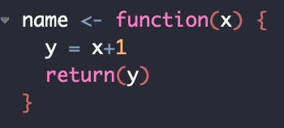

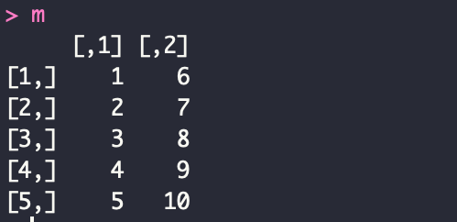
Recap

Slide 5
Lists

Slide 6
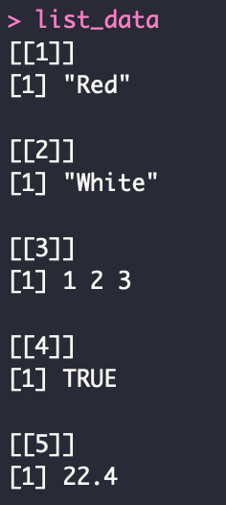
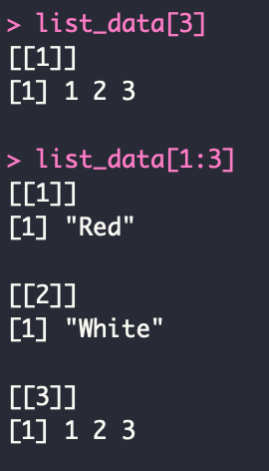
Lists
Object which contains elements of different types
like strings, numbers, vectors, matrix, functions, lists…

Slide 7
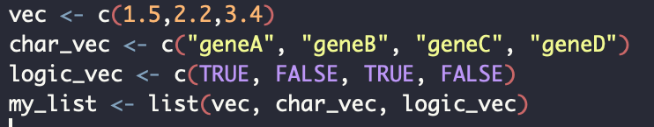
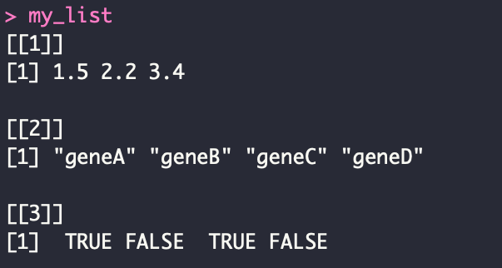
Lists

Slide 8
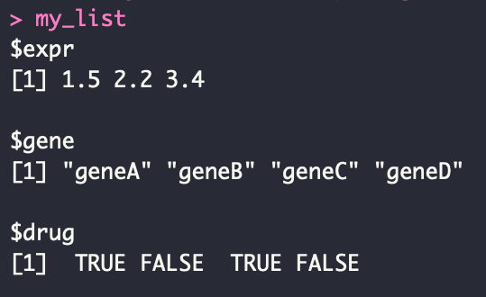
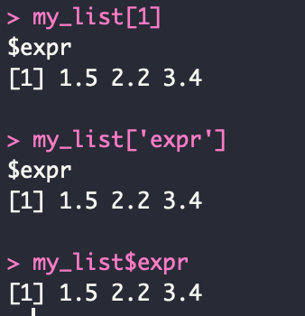
Lists
Notes:
Names!! + different methods to access them

Slide 9
Lists
Notes:
Another way to create a named list.

Slide 10
Data frames

Slide 11
Data frames
A data frame is like a matrix, with a 2D rows/columns structure. However, each column may have a different mode, as in a list.
A lot of files in research can be portrayed as dataframes.
Bed file
Gene expression matrix
Meta data

Slide 12


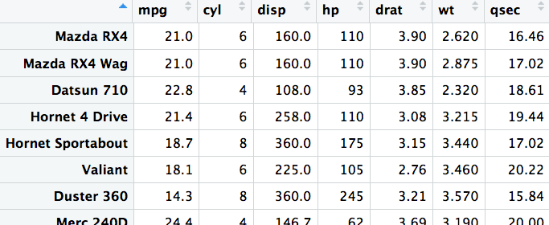
Built-in examples
Notes:
Perhaps point out that you often see that columns correspond to quantities, and rows correspond to measurements/observations. Though for biological data like count matrices this is of course not the case.

Slide 13
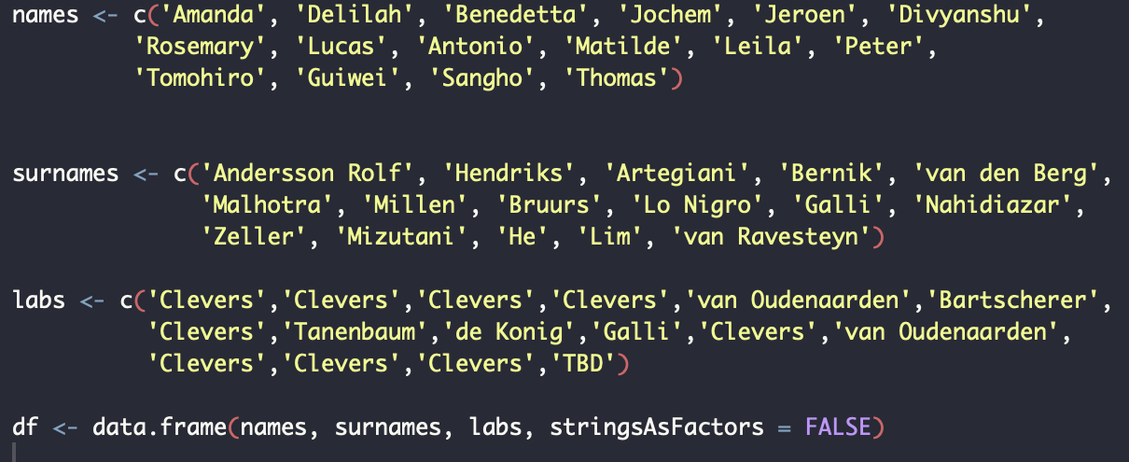
Creating data frames

Slide 14
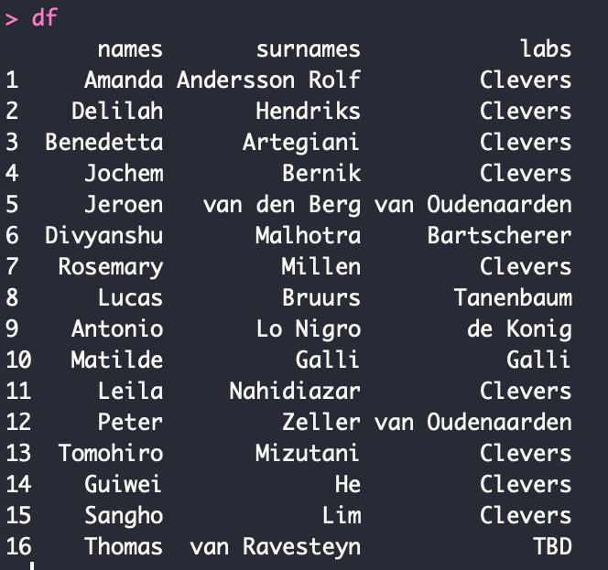
Creating data frames

Slide 15
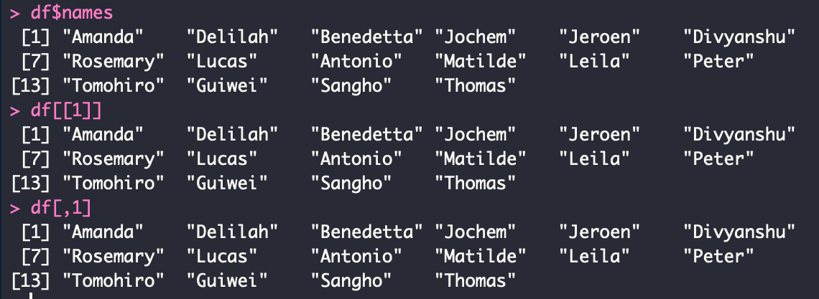
Accessing data frames (columns)
Equivalent options:

Slide 16
Accessing data frames (rows and subsets)
> df[1,]
names surnames labs
1 Amanda Andersson-Rolf Clevers
> df[12,'labs']
[1] van Oudenaarden
> df[12,]$labs
[1] van Oudenaarden
> df[4:10,]
names surnames labs
4 Jochem Bernink Clevers
5 Jeroen van den Berg van Oudenaarden
6 Divyanshu Malhotra X
7 Rosemary Millen X
8 Lucas Bruurs X
9 Antonio Lo Nigro de Konig
10 Matilde Galli Galli
> df[df$labs=='Clevers',]
names surnames labs
1 Amanda Andersson-Rolf Clevers
2 Delilah Hendriks Clevers
3 Benedetta Artegiani Clevers
4 Jochem Bernink Clevers

Slide 17
Adding columns/rows
> df$age <- c(1,2,3,1,2,3,1,2,3,1,2,3,4,5)
> df
names surnames labs age
1 Amanda Andersson-Rolf Clevers 1
2 Delilah Hendriks Clevers 2
3 Benedetta Artegiani Clevers 3
4 Jochem Bernink Clevers 1
5 Jeroen van den Berg van Oudenaarden 2
6 Divyanshu Malhotra X 3
7 Rosemary Millen X 1
8 Lucas Bruurs X 2
9 Antonio Lo Nigro de Konig 3
10 Matilde Galli Galli 1
11 Leila Nahidiazar X 2
12 Peter Zeller van Oudenaarden 3
13 Tomohiro Mizutani X 4
14 Guiwei He X 5

Slide 18
Adding columns/rows
> df[15,] <- list('Anna', 'Alemany', 'van Oudenaarden',5)
> df
names surnames labs age
1 Amanda Andersson-Rolf Clevers 1
2 Delilah Hendriks Clevers 2
3 Benedetta Artegiani Clevers 3
4 Jochem Bernink Clevers 1
5 Jeroen van den Berg van Oudenaarden 2
6 Divyanshu Malhotra X 3
7 Rosemary Millen X 1
8 Lucas Bruurs X 2
9 Antonio Lo Nigro de Konig 3
10 Matilde Galli Galli 1
11 Leila Nahidiazar X 2
12 Peter Zeller van Oudenaarden 3
13 Tomohiro Mizutani X 4
14 Guiwei He X 5
15 Anna Alemany van Oudenaarden 5

Slide 19
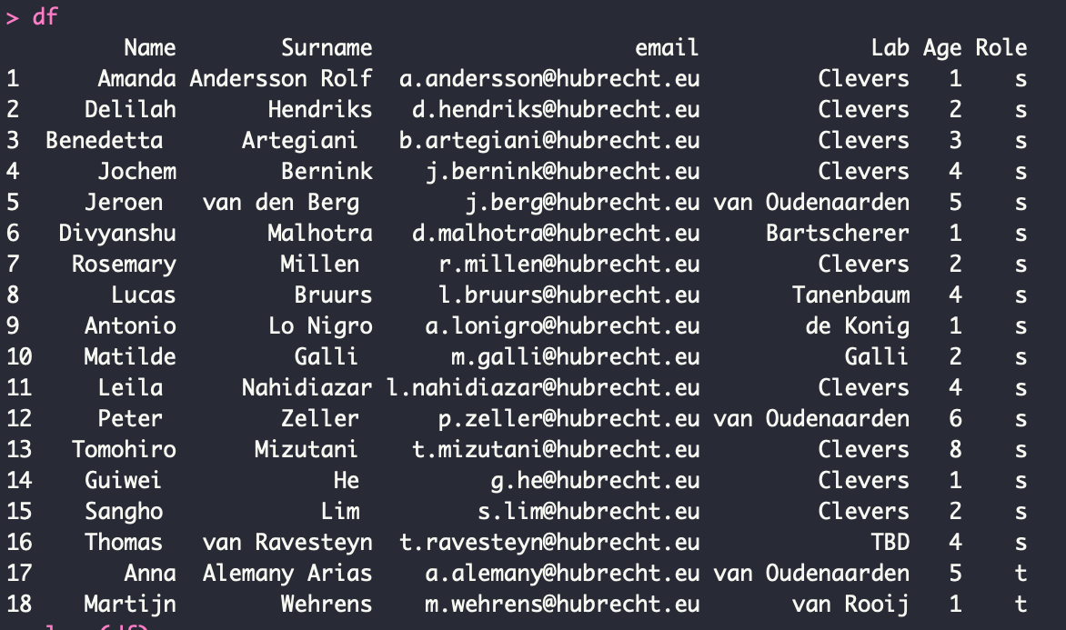
Import data

Slide 20
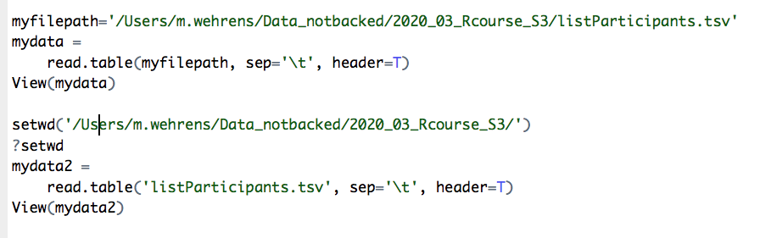

Slide 21
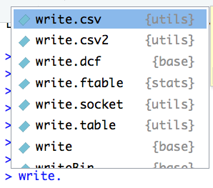
Export data
Notes:
@Anna: put this info here, but made it an animation so you can let it appear

Slide 22


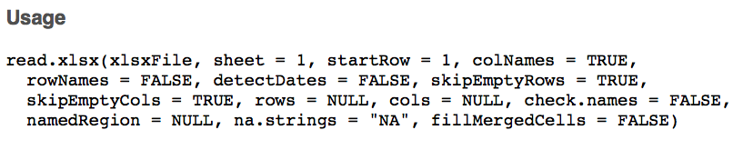



Excel files
or

Slide 23
Final note
The methods presented here all involved data frames;
It is usual to work with those (for our purposes).
You can also ..
.. directly read a plain text file using the functions “file()”, “readLines()” and “close()”. This is a bit more involved (google for examples).
.. read images. (See e.g. https://cran.r-project.org/web/packages/imager/vignettes/gettingstarted.html)
...

Slide 24
PRACTICE!

Slide 25
See you in two weeks ;)

