Slide 1
R Course for Hubrecht Postdocs
Martijn Wehrens & Anna Alemany

Slide 2
Summary of the course
S1: Data types and loops
S2: Matrices and functions
S3: Data Frames, import/export data
S4: Plots
S5: “Sophisticated” applications of our knowledge
S6: Fitting/Clustering/Modeling

Slide 3
Upcoming two hours...
Introduction
Data types
DIY examples
Loops
DIY examples

Slide 4
Disclaimer
Stuff we tell today might not immediately
relate to your own problems.
We’ll work towards that ASAP!

Slide 5
A note in advance: what is an algorithm?
Sequence of instructions
When looking at a problem:
Try to divide it up in multiple smaller problems

Slide 6
A note in advance: programming is precise
The computer is not human
It won’t understand simple mistakes
Variable = "bla'
Variable = 'bla'
Variable = "bla"

Slide 7
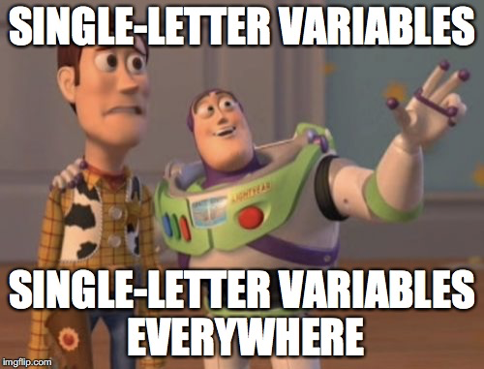
In advance: pro tips to make your code hard to understand
Give parameters unclear one-letter names
e.g. “g” for a parameter that lists gene names instead of “gene_names”
Don’t use comments, particularly not to state the general purpose of your code
e.g. don’t say “in the section below we’ll normalize our gene expression”
Source: “How To Write Unmaintainable Code”, Roedy Green.
Notes:
https://www.se.rit.edu/~tabeec/RIT_441/Resources_files/How%20To%20Write%20Unmaintainable%20Code.pdf

Slide 8
(sarcasm)

Slide 9
A note in advance: interactive versus batch mode
Interactive mode
Execution of R commands in the R console.
Batch mode
Run an R script without needing to manually launch R
Prepare a file with a sequence of R commands and save it as script.R
Go the the terminal and type: .
$ R CMD BATCH script.R

Slide 10
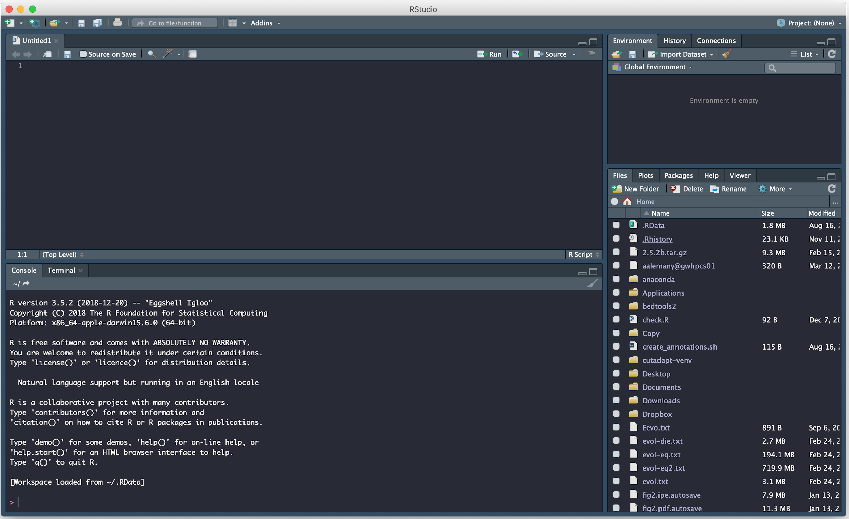
RStudio
Notes:
Console → type single commands
Editor, multiple commands
Interaction between the two
Maybe quickly open Rstudio to talk about the menus on the right

Slide 11
Data types

Slide 12
Character strings
> a <- "hola"
> a
[1] "hola"
> mode(a)
[1] "character"
> a[1]
[1] "hola"
> ?character

Slide 13
String manipulation
> a <- "gene"
> b <- "sample"
> date <- "18-02-2020"
> strsplit(date, split = '-')
[[1]]
[1] "18" "02" "2020"
> nchar(a)
[1] 4
> paste(a, b, sep = '-')
[1] "gene-sample"
> gregexpr('e', a)
[[1]]
[1] 2 4
> substr(b, 2, 4)
[1] "amp"

Slide 14
Numeric variables
> x <- 3
> x
[1] 3
> mode(x)
[1] "numeric"
> x[1]
[1] 3
> ?"numeric"

Slide 15
Numeric operations
> x <- 3
> y <- 5
> sqrt(4*x)
[1] 3.464102
> x**y
[1] 243
> x+y
[1] 8
> x+6
[1] 9
> x*2
[1] 6
> x**3
[1] 27

Slide 16
Logical variables: TRUE/FALSE
> t <- T
> t & t
[1] TRUE
> t & f
[1] FALSE
> f & f
[1] FALSE
> t*t
[1] 1
> t*f
[1] 0
> f*f
[1] 0
> t
[1] TRUE
> f <- F
> f
[1] FALSE
> !f
[1] TRUE

Slide 17
Logical variables: TRUE/FALSE
> t <- T
> t || t
[1] TRUE
> t || f
[1] TRUE
> f || f
[1] FALSE
> t+t
[1] 2
> t+f
[1] 1
> f+f
[1] 0
> t
[1] TRUE
> f <- F
> f
[1] FALSE
> !f
[1] TRUE

Slide 18
VECTORS
Fundamental data type in R.
All elements in a vector must have the same mode.
concatenate
> x <- c(88, 5, 12, 13)
> s <- c('wie','ben','je','?')
> mode(x)
[1] "numeric"
> mode(s)
[1] "character"
> x
[1] 88 5 12 13
> s
[1] "wie" "ben" "je" "?"
> length(x)
[1] 4
> length(s)
[1] 4

Slide 19
Long vectors
> v <- seq(1,100,1)
> v
[1] 1 2 3 4 5 6 7 8 9 10 11 12 13 14 15 16 17 18
[19] 19 20 21 22 23 24 25 26 27 28 29 30 31 32 33 34 35 36
[37] 37 38 39 40 41 42 43 44 45 46 47 48 49 50 51 52 53 54
[55] 55 56 57 58 59 60 61 62 63 64 65 66 67 68 69 70 71 72
[73] 73 74 75 76 77 78 79 80 81 82 83 84 85 86 87 88 89 90
[91] 91 92 93 94 95 96 97 98 99 100
>

Slide 20
Vector indexing
> x <- c(88, 5, 12, 13)
Numbers/Strings are considered one-element vectors.
> x[1]
[1] 88
> y <- 3
> y
[1] 3
> y[1]
[1] 3
> y[2]
[1] NA
> x[2:4]
[1] 5 12 13
> x[c(2,4)]
[1] 5 13
> x[-2]
[1] 88 12 13
> x[c(T,F,T)]
[1] 1 4

Slide 21
Common vector operations
> x <- c(1,2,4)
> y <- c(5,0,-1)
> x > y
[1] FALSE TRUE TRUE
> x + y
[1] 6 2 3
> x == y
[1] FALSE FALSE FALSE
> x - y
[1] -4 2 5
> x[x > y]
[1] 2 4
> y >= 0
[1] TRUE TRUE FALSE
> x * y
[1] 5 0 -4
> c(x,y)
[1] 1 2 4 5 0 -1
> x / y
[1] 0.2 Inf -4.0

Slide 22
Generation of useful vectors
Explore the output of the following instructions:
> 5:8
> 10:1
> seq(from=12, to=30, by=3)
> seq(from=1.1,to=2,length=10)
> rep(8, 4)
> rep(1:3, 2)
> rep(c(15,12,3), each = 2)

Slide 23
Practice
https://docs.google.com/document/d/1RkjW-dHBL9GMgqPOwmPuAUoBVumlAlkB1a7YszekN10/edit?usp=sharing
Notes:
Link to slides: https://docs.google.com/presentation/d/1L8t5IMWqqIhw6F4Wn581mP6jYCF08KMDvo5pB4rJjH4/edit?usp=sharing
Link to exercises: https://docs.google.com/document/d/1RkjW-dHBL9GMgqPOwmPuAUoBVumlAlkB1a7YszekN10/edit?usp=sharing

Slide 24
FOR loops & IF statements

Slide 25
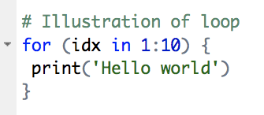
For loop
Notes:
Many things going on; this is editor
Comment
Protected words (“recognized” by R)
“For” will do sth multiple times
Curly brackets
What it expects → Vector, parameter name, keyword “in”

Slide 26
FOR-loop
> for (i in 1:5) {
+ print(i)
+ }
[1] 1
[1] 2
[1] 3
[1] 4
[1] 5
>
> v <- c('hola','hoi','hello','hallo')
> for (s in v) {
+ print(s)
+ }
[1] "hola"
[1] "hoi"
[1] "hello"
[1] "hallo"
>
Notes:
Many things going on here

Slide 27
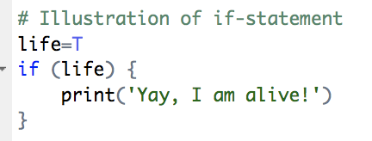
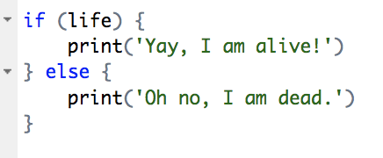
If statement
Notes:
Similar to loop

Slide 28
If statement
> i = 2
> if (i < 1) {
x = 3
} else if (i==2) {
x = 10
} else {
x = -1
}
> i <- 10
> if (i==1) {
x <- 30
} else {
x <- 5
}
> x
[1] 5
> x
[1] 10

Slide 29
Practice!

Slide 30
See you next week :)

