Slide 1
TODO
Send around e-mail and ask everyone to prepare for discussing exercises efficiently https://forms.gle/9JQrqy3GyCgNkU9W9
Also again send around exercises and this powerpoint.
Todo afterwards: send around solutions to exercises.

Slide 2
R Course for Hubrecht Postdocs
Martijn Wehrens & Anna Alemany

Slide 3
Summary of the course
S1: Data types and loops ✅
S2: Matrices and functions
S3: Data Frames, import/export data
S4: Plots
S5: “Sophisticated” applications of our knowledge
S6: Fitting/Clustering/Modeling

Slide 4
Upcoming two hours...
Fast recap 15 mins
Discuss exercises 15 mins
Functions 20 mins
DIY examples 25 mins
Matrices 20 mins
DIY examples 25 mins

Slide 5
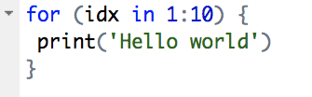
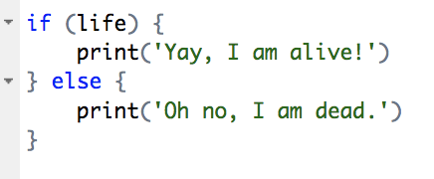
Recap
Place to give a vector
Place to define parameter name
Numbers, strings, logicals
Vectors
Loops
If-statements
Giving R instructions in a prescribed way
Specific words
Specific symbols
Specific order
Place for
code-block
Place for “test” resulting in TRUE or FALSE
Place for
code-block

Slide 6
Functions

Slide 7
Concept of a function
Group of instructions that takes inputs, uses them to compute other values, and returns a result
x_plus_y <- function(x, y) {
z=x+y
return(z)
}
> x_plus_y(3,10)
[1] 13
>
name <- function(input) {
instructions
return(result)
}

Slide 8
Default arguments
Consider a function definition like:
g <- function(x, y = 2, z = TRUE) { ... }
Here, y will be initialized to 2 and z will be set to TRUE unless the user specifies otherwise

Slide 9
Practice!

Slide 10
Matrices

Slide 11
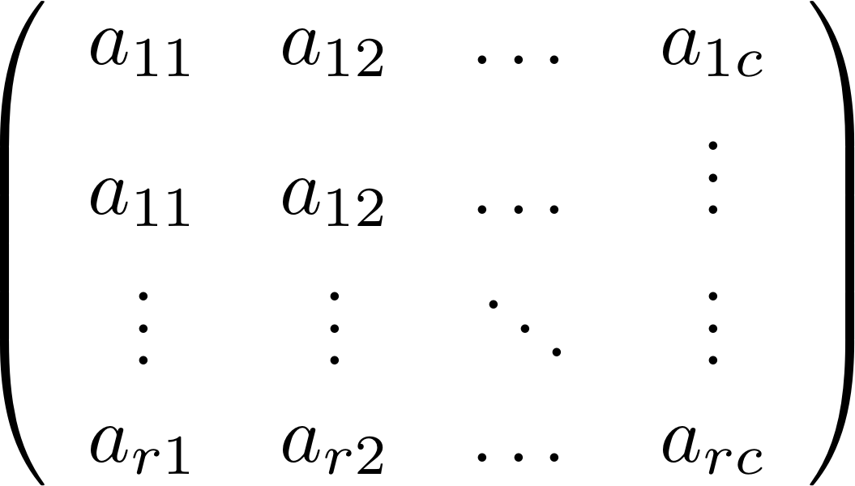
What is the matrix?
In R, a matrix is a vector with two attributes:
Number of rows
Number of columns
Elements {a_ij} can be of any basic mode (e.g. logical, numeric, string, ..).
Notes:
See also: https://adv-r.hadley.nz/vectors-chap.html

Slide 12
Creating matrices
m <- matrix(c(1,2,3,4), nrow = 2, ncol = 2)
> m
[,1] [,2]
[1,] 1 3
[2,] 2 4

Slide 13
Creating matrices
m <- matrix(seq(1,10), nrow = 2)
> m
[,1] [,2] [,3] [,4] [,5]
[1,] 1 3 5 7 9
[2,] 2 4 6 8 10
m <- matrix(seq(1,10), ncol = 2)
> m
[,1] [,2]
[1,] 1 6
[2,] 2 7
[3,] 3 8
[4,] 4 9
[5,] 5 10
m <- matrix(seq(1:10), nrow =5)

Slide 14
Creating matrices
m <- matrix(seq(1:10), ncol = 2, byrow = T)
> m
[,1] [,2]
[1,] 1 2
[2,] 3 4
[3,] 5 6
[4,] 7 8
[5,] 9 10
m <- matrix(seq(1:10), ncol = 2)
> m
[,1] [,2]
[1,] 1 6
[2,] 2 7
[3,] 3 8
[4,] 4 9
[5,] 5 10
> m <- matrix(seq(1:10), nrow =5)

Slide 15
Operations with matrices: linear algebra
> y %*% y # mathematical matrix multiplication
> 3*y # multiplication of matrix by scalar
> y+y # matrix addition (element-wise)
> t(y) # matrix transpose

Slide 16
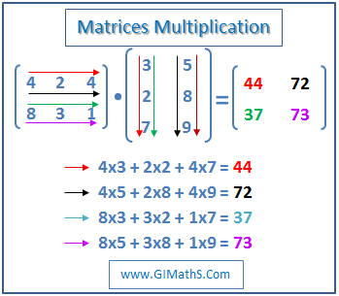
For reference: Matrix multiplication
Elements i,j of result matrix gets filled taking row i of first input “times” column j of second input matrix.
Note that this put some constraints on the dimensions of input matrices.

Slide 17
Matrix indexing
The same operations that we discussed for vectors apply to matrices
> z <- matrix(c(1,2,3,4,1,1,0,0,1,0,1,0), ncol = 3)
> z
[,1] [,2] [,3]
[1,] 1 1 1
[2,] 2 1 0
[3,] 3 0 1
[4,] 4 0 0
> z[,2:3]
> z[2:3, 1:2]

Slide 18
Matrix indexing
Negative subscripts also work
> y <- matrix(1:6, ncol = 2)
> y
[,1] [,2]
[1,] 1 4
[2,] 2 5
[3,] 3 6
> y[-2,]
[,1] [,2]
[1,] 1 4
[2,] 3 6

Slide 19
Assign values to submatrices
> y <- matrix(1:6, nrow = 3)
> y
[,1] [,2]
[1,] 1 4
[2,] 2 5
[3,] 3 6
> y[c(1,3),] <- matrix(c(1,1,8,12), nrow = 2)
> y
[,1] [,2]
[1,] 1 8
[2,] 2 5
[3,] 1 12

Slide 20
Filtering on matrices
> x <- matrix(c(1:3,2:4), ncol = 2)
> x
[,1] [,2]
[1,] 1 2
[2,] 2 3
[3,] 3 4
> x[x>=3] # What is going on here?
> x[x[,2]>=3,] # and here?

Slide 21
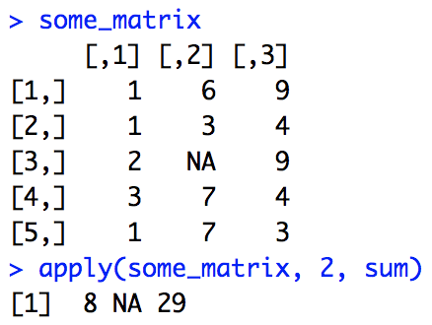
Applying functions to matrix rows and columns
> apply(m, dim, f, fargs)
m is the matrix
dim should equal 1 or 2, and sets if the function is applied to rows or columns, respectively
f is the function to be applied
Fargs are set or arguments to be supplied to the function
> apply(m, 2, mean)
> apply(m, 1, your_function)

Slide 22
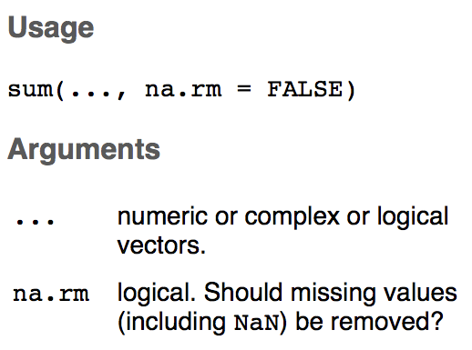
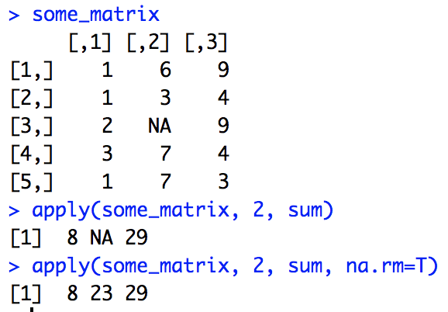

Slide 23
PRACTICE!

Slide 24
See you in two weeks ;)

