Slide 1
Agentic RAG Chatbot for Multi-Format Document QA using Model Context Protocol (MCP)
JINTU VC

Slide 2
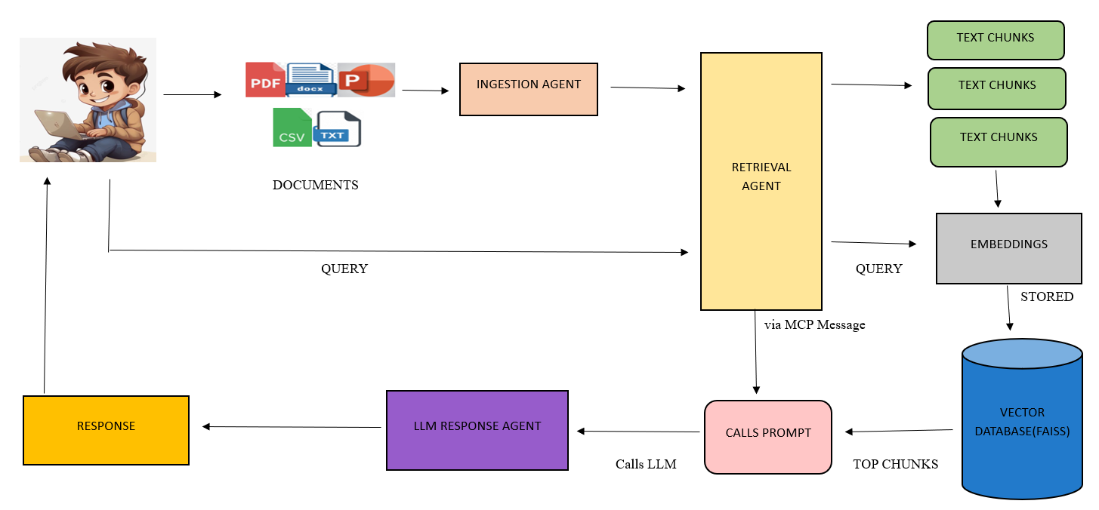
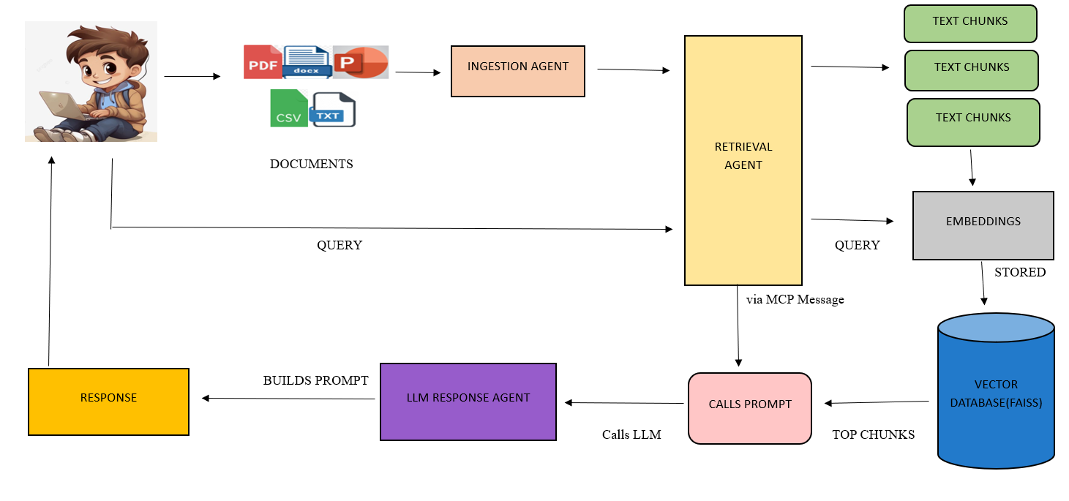
Agent-based architecture with MCP integration

Slide 3
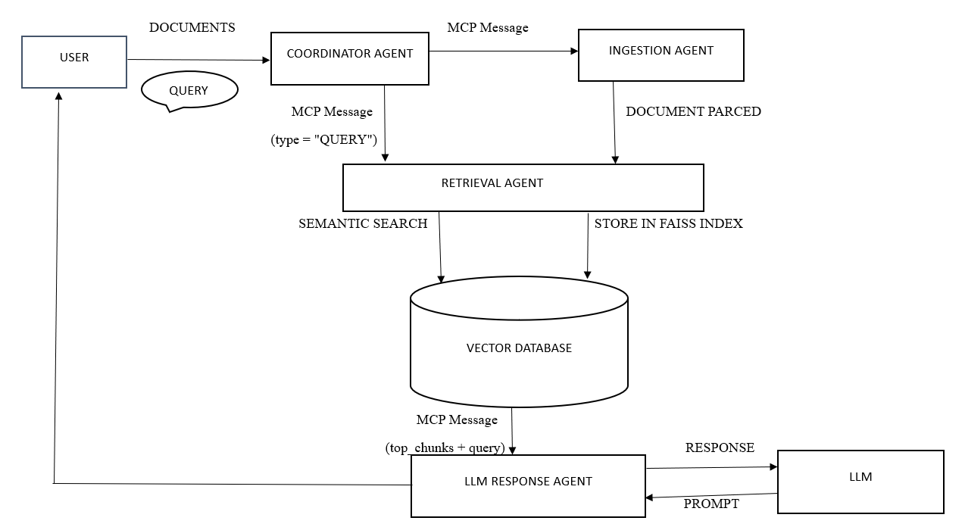
System flow diagram

Slide 4
Tech Stack Used
LLM : OpenAI GPT-3.5-turbo
Embeddings : OpenAIEmbeddings
Vector Store : FAISS
UI Framework: Streamlit
Language : Python

Slide 5
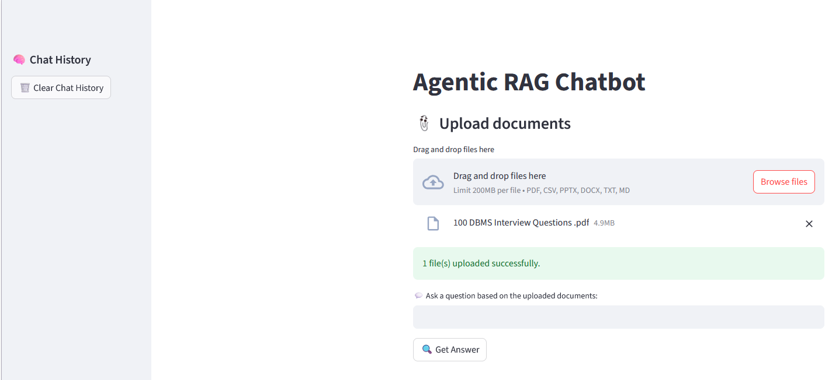
UI Screenshots

Slide 6
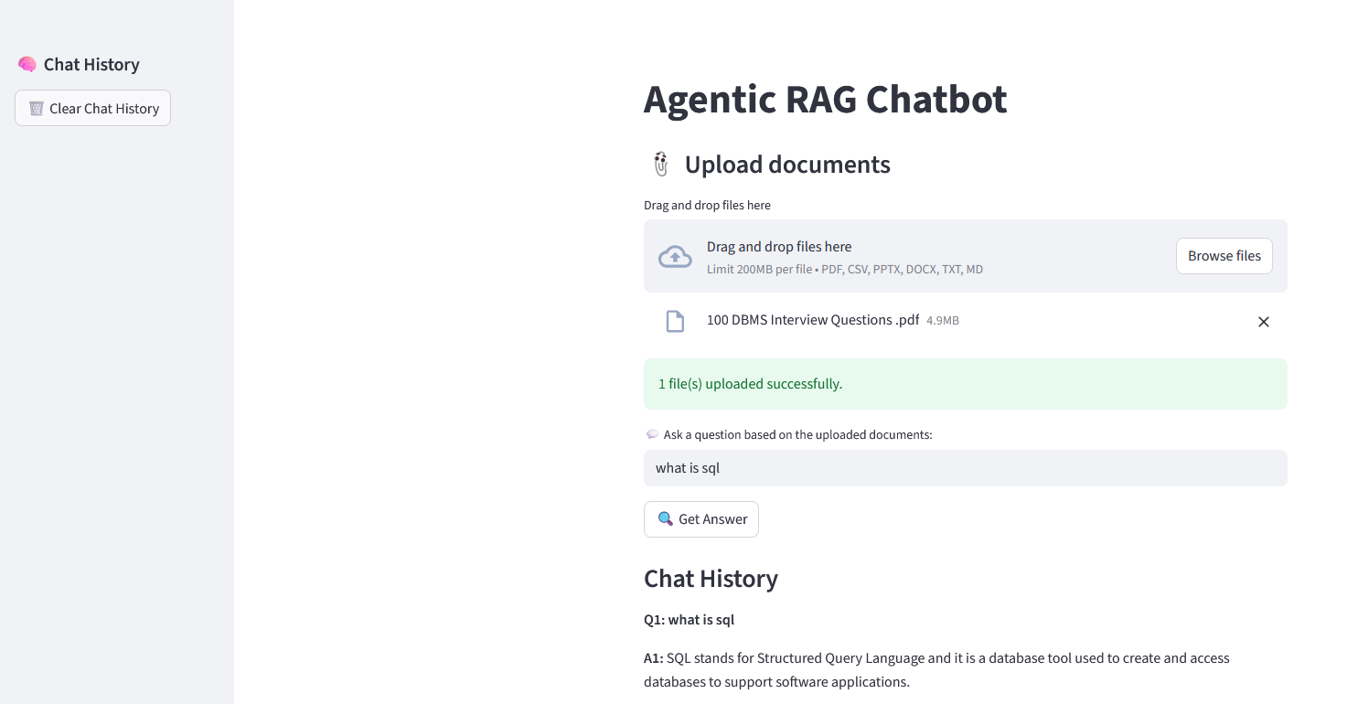
UI Screenshots

Slide 7
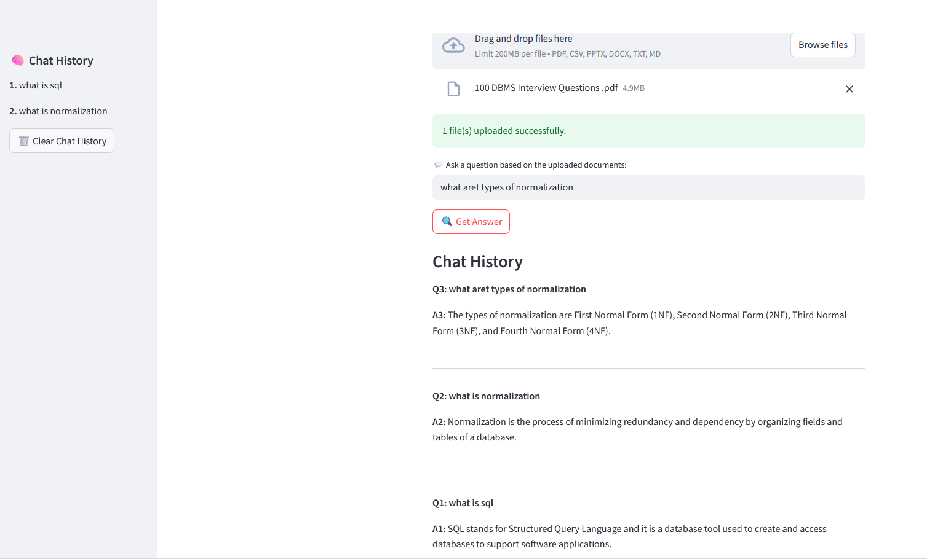
UI Screenshots

Slide 8
Challenges Faced while doing the project
API rate limits
Handling different document formats

