Slide 1
第21章：JUC并发编程
ThreadFactory

Slide 2
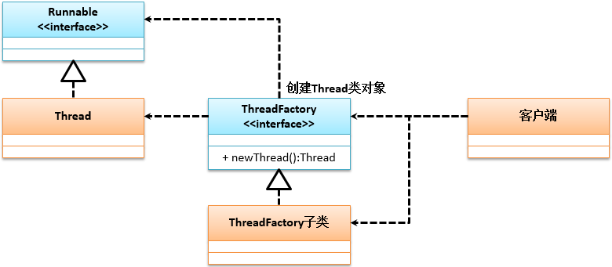
ThreadFactory
负责Thread类实例生成
ThreadFactory接口定义如下：
public interface ThreadFactory {
/**
* 传入Runnable接口实例创建Thread类实例
* @param r Runnable线程核心操作实现
* @return Thread线程类对象
*/
public Thread newThread(Runnable r);
}

Slide 3
范例：使用ThreadFactory创建线程
package cn.mldn.demo; import java.util.concurrent.ThreadFactory; public class JUCDemo { public static void main(String[] args) { Thread thread = DefaultThreadFactory.getInstance().newThread(() -> { System.out.println("多线程执行，" + Thread.currentThread().getName()); }); thread.start(); } } class DefaultThreadFactory implements ThreadFactory {// 定义线程工厂实现类 private static final ThreadFactory INSTANCE = new DefaultThreadFactory() ; private static final String TITLE = "mldn-" ; // 定义线程标记名称 private static int count = 0 ;// 线程个数统计 private DefaultThreadFactory() {} public static ThreadFactory getInstance() { return INSTANCE ; } @Override public Thread newThread(Runnable run) { return new Thread(run,TITLE + count ++); // 获取线程实例 } }

