Slide 1
第22章：NIO编程
异步非阻塞IO通讯模型

Slide 2
AIO
NIO是基于事件驱动模式实现的通讯操作，主要的问题是解决BIO并发访问量高的性能问题，而所有的通讯操作依然通过程序来完成，在进行通讯处理中如果IO操作性能较差也会影响到执行性能，所以从JDK 1.7开始提供有AIO模型，与NIO不同的是，对于当前的IO操作是由操作系统进行IO操作，而应用程序只是调用给定的类库实现读或写的操作调用即可，例如：当有数据流可以读取或写入时，会由操作系统将可操作的流传入到read()或write()方法的缓冲区并发出操作通知，整个的操作完全是异步处理实现的
在进行异步操作时通过CompletionHandler获取的异步执行结果，在Echo案例中数据读取与数据写入都可以编写一个CompletionHandler作为回调操作实现。

Slide 3
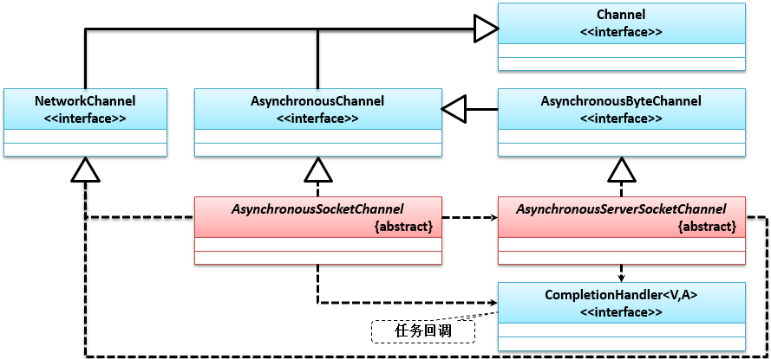
AIO操作结构
Notes:
package cn.mldn.server;
import java.io.IOException;
import java.net.InetSocketAddress;
import java.nio.ByteBuffer;
import java.nio.channels.AsynchronousServerSocketChannel;
import java.nio.channels.AsynchronousSocketChannel;
import java.nio.channels.CompletionHandler;
import java.util.concurrent.CountDownLatch;
class EchoHandler implements CompletionHandler<Integer, ByteBuffer> { // 实现回调处理
private AsynchronousSocketChannel clientChannel; // 客户端对象
private boolean exit = false; // 结束标记
public EchoHandler(AsynchronousSocketChannel clientChannel) {
this.clientChannel = clientChannel;
}
@Override
public void completed(Integer result, ByteBuffer buffer) { // 回调任务
buffer.flip(); // 重置缓冲区
String readMessage = new String(buffer.array(), 0,
buffer.remaining()).trim(); // 接收读取数据
System.err.println("【服务器端读取到数据】" + readMessage); // 信息提示
String resultMessage = "【ECHO】" + readMessage; // 回应信息
if ("exit".equalsIgnoreCase(readMessage)) { // 退出标记
resultMessage = "【EXIT】拜拜，下次再见！"; // 回应内容
this.exit = true; // 退出
}
this.echoWrite(resultMessage); // 消息回应
}
@Override
public void failed(Throwable exp, ByteBuffer buffer) { // 异步处理失败
this.closeClient(); // 关闭连接
}
private void closeClient() {
System.out.println("客户端连接有错误，中断与此客户端的处理！");
try {
this.clientChannel.close(); // 通道关闭
} catch (IOException e) {}
}
private void echoWrite(String result) { // 数据回应
ByteBuffer buffer = ByteBuffer.allocate(100); // 回应缓冲区
buffer.put(result.getBytes()); // 回应处理
buffer.flip(); // 重置缓冲区
this.clientChannel.write(buffer, buffer,
new CompletionHandler<Integer, ByteBuffer>() {
@Override
public void completed(Integer result, ByteBuffer buffer) {
if (buffer.hasRemaining()) { // 有数据
EchoHandler.this.clientChannel.write(
buffer, buffer, this); // 输出
} else {
if (EchoHandler.this.exit == false) { // 继续下一次操作
ByteBuffer readBuffer = ByteBuffer.allocate(100);
EchoHandler.this.clientChannel.read(readBuffer, readBuffer,
new EchoHandler(EchoHandler.this.clientChannel));
}
}
}
@Override
public void failed(Throwable exp, ByteBuffer buffer) {
EchoHandler.this.closeClient(); // 关闭通道
}
});
}
}
class AcceptHandler implements CompletionHandler<AsynchronousSocketChannel, AIOServerThread> {
@Override
public void completed(AsynchronousSocketChannel channel, AIOServerThread aioThread) {
aioThread.getServerChannel().accept(aioThread, this); // 接收连接
ByteBuffer buffer = ByteBuffer.allocate(100); // 接收缓冲区
channel.read(buffer, buffer, new EchoHandler(channel)); // 交由其它异步处理
}
@Override
public void failed(Throwable exp, AIOServerThread aioThread) {
System.out.println("服务器的连接处理失败... ...");
aioThread.getLatch().countDown(); // 解除阻塞状态
}
}
class AIOServerThread implements Runnable { // AIO处理线程
private static final int PORT = 9999; // 监听端口
private CountDownLatch latch = null; // 服务端关闭阻塞
private AsynchronousServerSocketChannel serverChannel = null; // 服务端通道
public AIOServerThread() throws Exception {
this.latch = new CountDownLatch(1); // 服务端阻塞线程数
this.serverChannel = AsynchronousServerSocketChannel.open(); // 异步通道
this.serverChannel.bind(new InetSocketAddress(PORT)); // 绑定端口
System.out.println("服务器启动成功，在" + PORT + "端口上进行监听，等待客户端连接 ... ...");
}
public AsynchronousServerSocketChannel getServerChannel() {
return serverChannel;
}
public CountDownLatch getLatch() {
return latch;
}
@Override
public void run() { // 启动线程
this.serverChannel.accept(this, new AcceptHandler()); // 等待连接
try {
this.latch.await(); // 保持连接
System.err.println("服务器的连接失败，服务器停止运行 ... ...");
} catch (InterruptedException e) {}
}
}
public class AIOEchoServer {
public static void main(String[] args) throws Exception {
new Thread(new AIOServerThread()).start(); // 启动服务器
}
}
package cn.mldn.client;
import java.io.IOException;
import java.net.InetSocketAddress;
import java.nio.ByteBuffer;
import java.nio.channels.AsynchronousSocketChannel;
import java.nio.channels.CompletionHandler;
import java.util.concurrent.CountDownLatch;
import cn.mldn.util.InputUtil;
class ClientReadHandler implements CompletionHandler<Integer, ByteBuffer> {
private CountDownLatch latch; // 线程同步
private AsynchronousSocketChannel clientChannel = null; // 客户端连接
public ClientReadHandler(AsynchronousSocketChannel clientChannel, CountDownLatch latch) {
this.clientChannel = clientChannel;
this.latch = latch;
}
@Override
public void completed(Integer result, ByteBuffer buffer) {
buffer.flip(); // 重置缓冲区
String receiveMessage = new String(buffer.array(),
0, buffer.remaining()); // 读取返回内容
System.err.println(receiveMessage); // 输出回应数据
}
@Override
public void failed(Throwable exp, ByteBuffer buffer) {
System.out.println("对不起，发送出现了问题，该客户端被关闭 ...");
try {
this.clientChannel.close();
} catch (IOException e) {}
this.latch.countDown(); // 接触阻塞状态
}
}
class ClientWriteHandler implements CompletionHandler<Integer, ByteBuffer> {
private CountDownLatch latch;
private AsynchronousSocketChannel clientChannel = null; // 客户端连接
public ClientWriteHandler(AsynchronousSocketChannel clientChannel, CountDownLatch latch) {
this.clientChannel = clientChannel;
this.latch = latch;
}
@Override
public void completed(Integer result, ByteBuffer buffer) {
if (buffer.hasRemaining()) { // 有数据发送
this.clientChannel.write(buffer, buffer, this); // 数据发送
} else { // 需要读取
ByteBuffer readBuffer = ByteBuffer.allocate(100); // 读取数据
this.clientChannel.read(readBuffer, readBuffer, new ClientReadHandler(
this.clientChannel, this.latch)); // 读取回调
}
}
@Override
public void failed(Throwable exp, ByteBuffer buffer) {
System.out.println("对不起，发送出现了问题，该客户端被关闭 ...");
try {
this.clientChannel.close();
} catch (IOException e) {}
this.latch.countDown(); // 解除阻塞状态
}
}
class AIOClientThread implements Runnable { // 客户端线程类
public static final String HOST = "localhost"; // 连接主机
public static final int PORT = 9999; // 绑定端口
private CountDownLatch latch; // 线程锁定
private AsynchronousSocketChannel clientChannel = null; // 客户端连接
public AIOClientThread() throws Exception {
this.clientChannel = AsynchronousSocketChannel.open(); // 客户端Channel
this.clientChannel.connect(new InetSocketAddress(HOST, PORT)); // 进行客户端连接
this.latch = new CountDownLatch(1); // 阻塞处理
}
@Override
public void run() {
try {
this.latch.await(); // 等待处理
this.clientChannel.close(); // 关闭客户端
} catch (Exception e) {}
}
public boolean sendMessge(String msg) { // 实现消息发送
ByteBuffer buffer = ByteBuffer.allocate(100); // 开辟缓冲区
buffer.put(msg.getBytes()); // 保存发送内容
buffer.flip(); // 重设缓冲区
this.clientChannel.write(buffer, buffer, new ClientWriteHandler(
this.clientChannel, this.latch)); // 缓冲区输出
if ("exit".equalsIgnoreCase(msg)) { // 结束指令
return false;
}
return true;
}
}
public class AIOEchoClient {
public static void main(String[] args) throws Exception {
AIOClientThread client = new AIOClientThread();
new Thread(client).start(); // 启动客户端线程
while (client.sendMessge(InputUtil.getString("请输入要发送的消息："))) {
;
}
}
}

