Slide 1
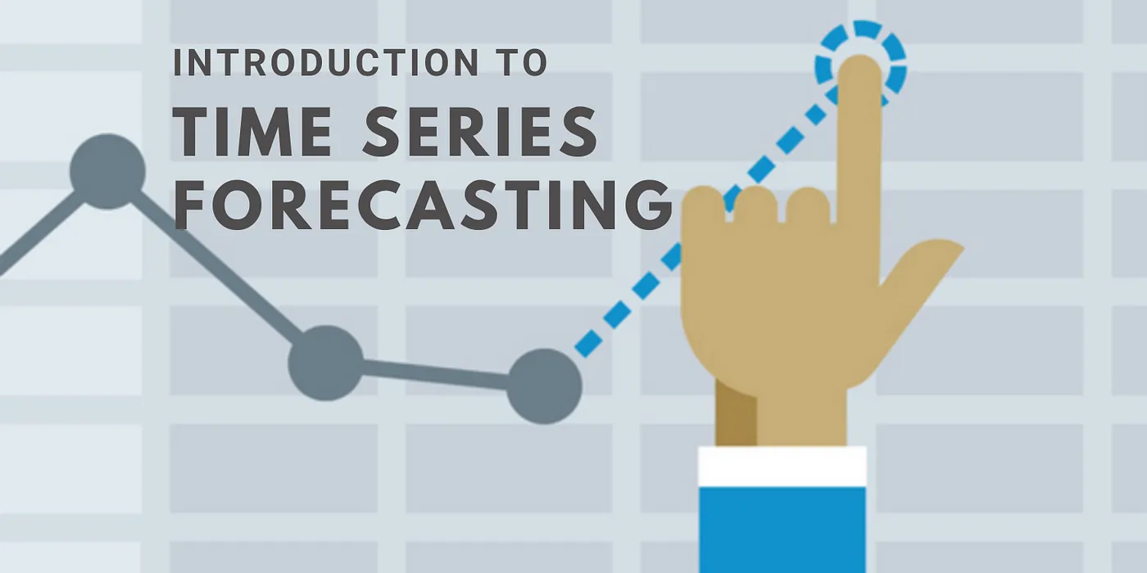
Team members:
- Mr. Rutikesh Hatim
- Mr. Ajinkya Galande
- Ms. Shivani Pawar
- Mr. Laishram Singh
- Mr. Shrikant Katekar
- Mr. Pradeep Hedge

Slide 2
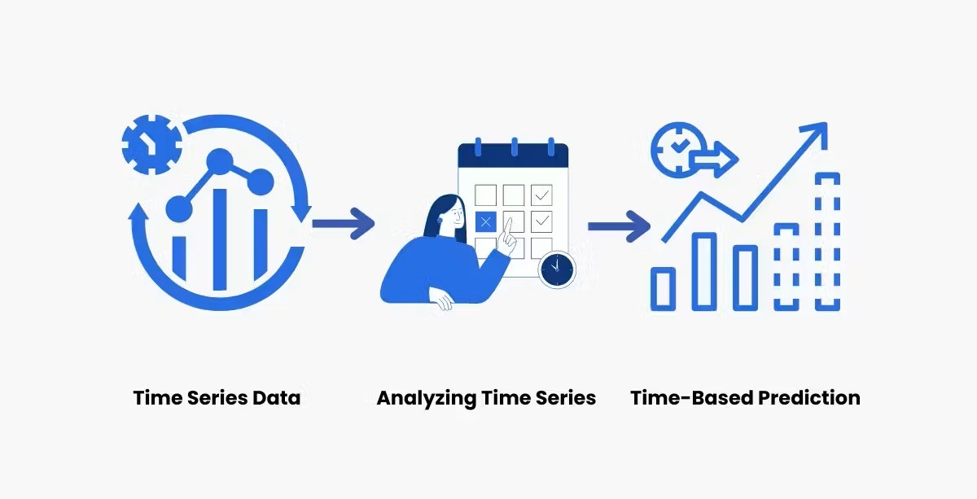
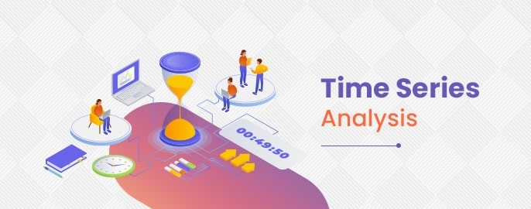
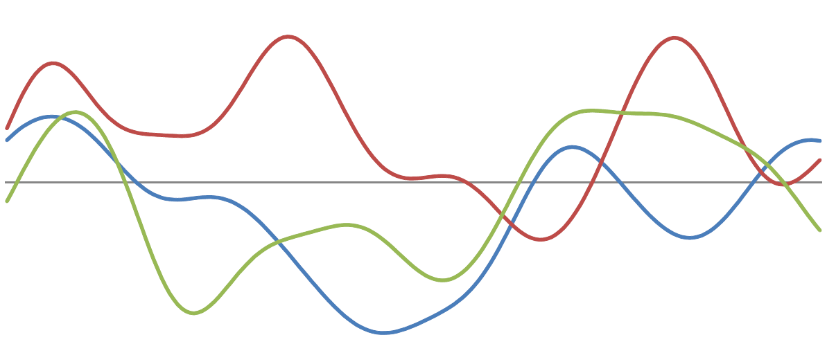
WHAT IS TIME SERIES?
Identifying trends and the tracking of changes over different periods
Building model to predict future values based on previously observed values.
Widely used for non-stationary data, like economic, weather, stock price.

Slide 3

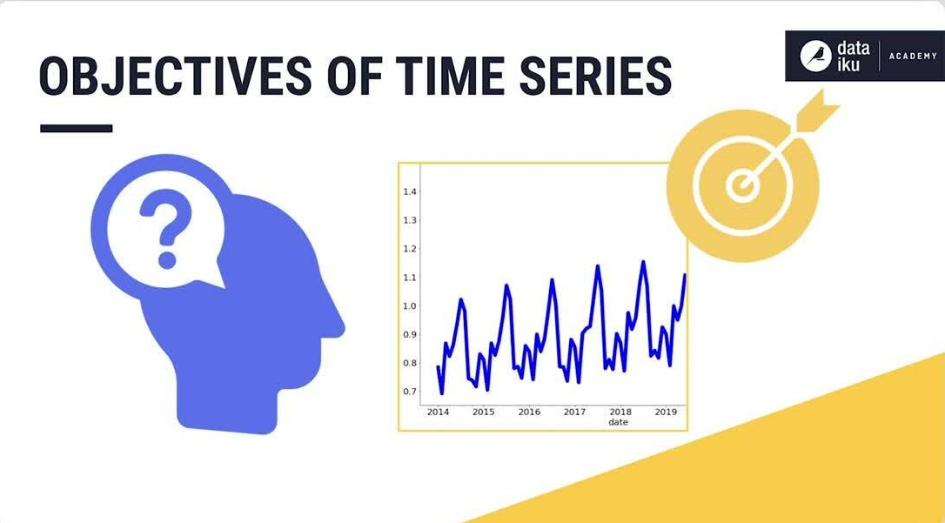
Forecasting Oil Price based on real time data
To build the best model which gives the maximum performance
Understanding the pattern in prices to help the customers and businesses to make smart decisions.

Slide 4
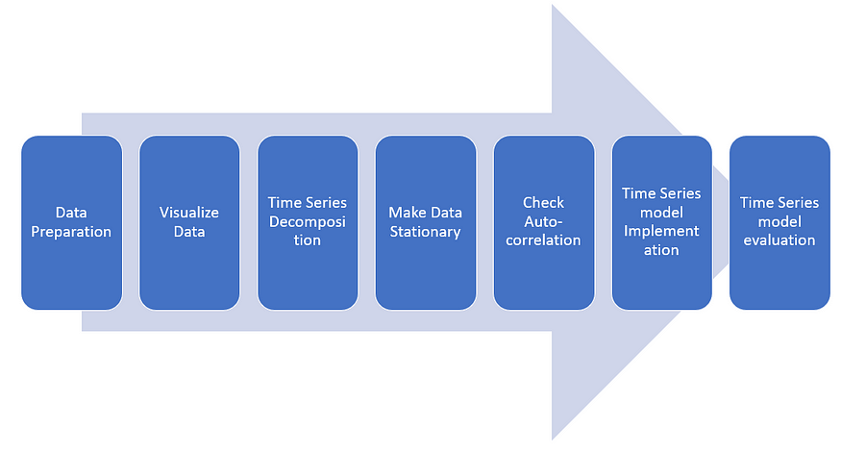
PROJECT ARCHITECTURE

Slide 5
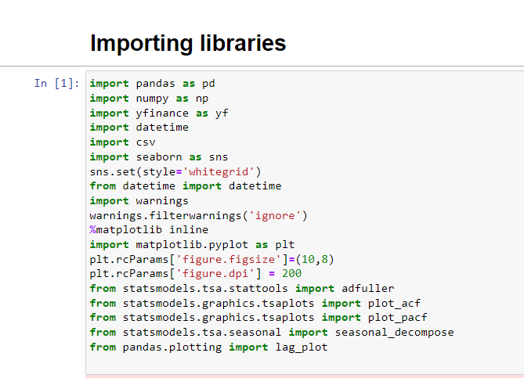
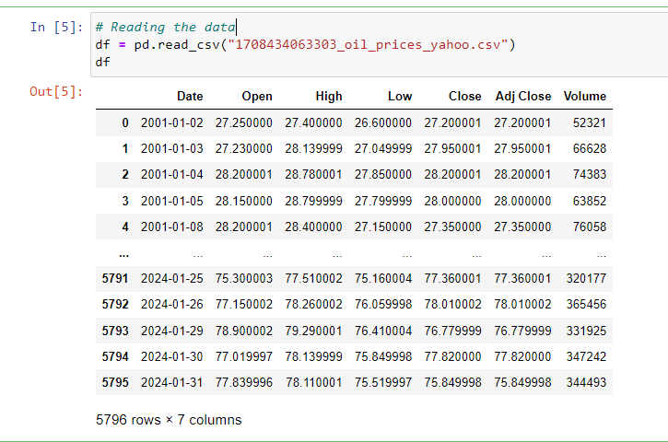
DATASET DETAILS
Imported necessary libraries
There are 7 features which are all of Numerical type.
There are 5796 Rows and 7 Columns

Slide 6
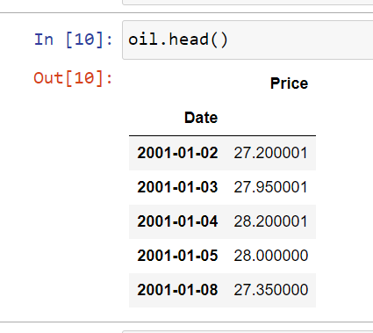
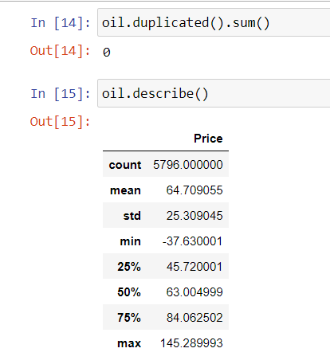
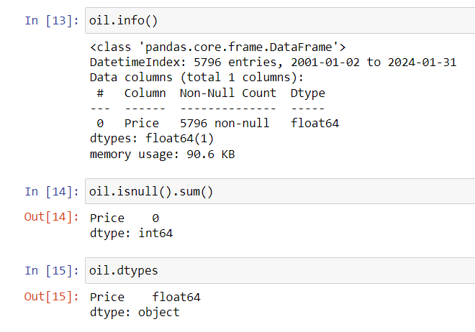
EXPLORATORY DATA ANALYSIS
Column ‘Date’ set to index
No duplicates found
No null values

Slide 7
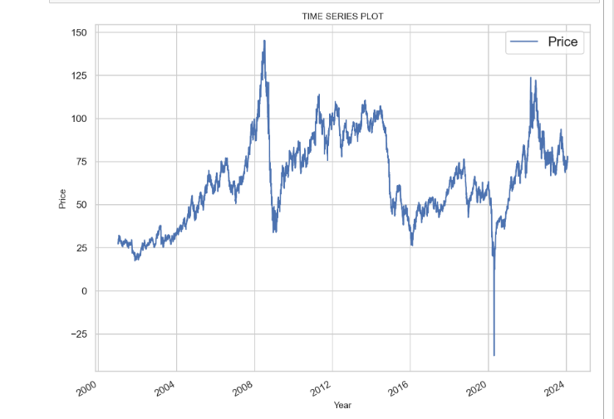
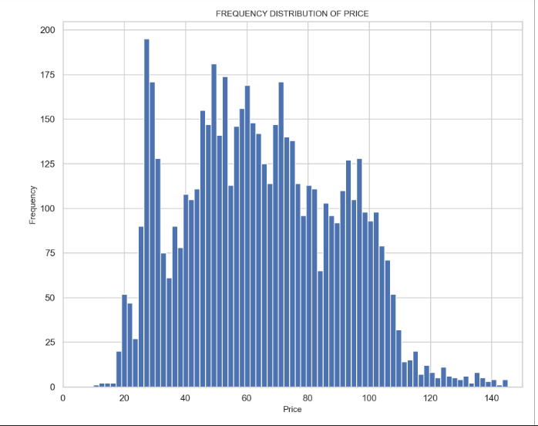
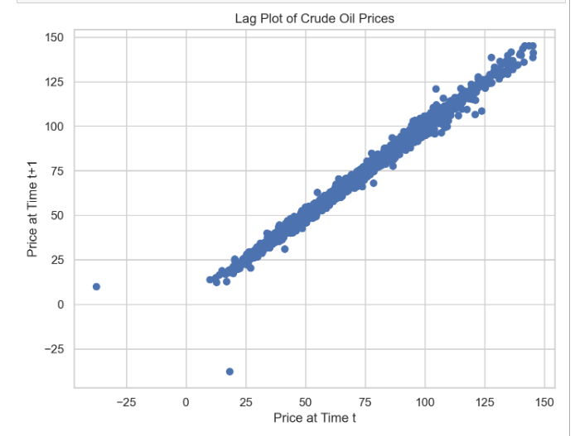
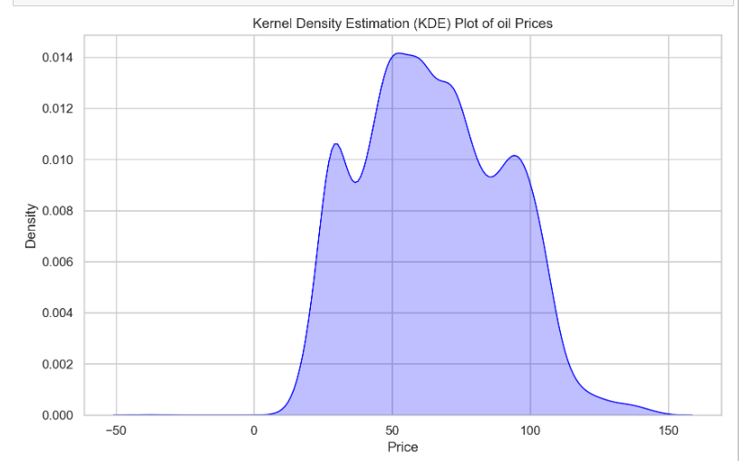
DATA VISUALIZATION
1. ORIGINAL DATA
2. FREQ DIST OF PRICE
3. Lag plot
4. KDE PLOT

Slide 8
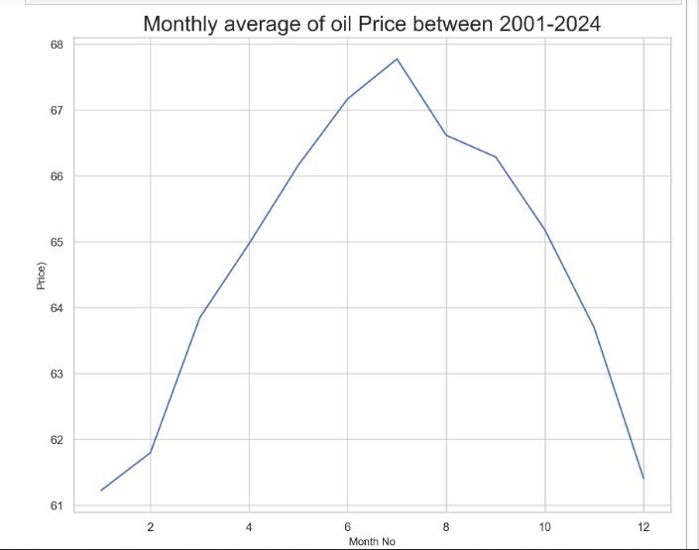
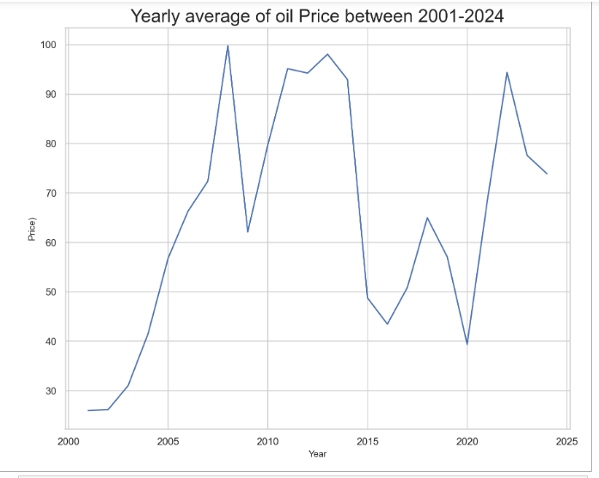
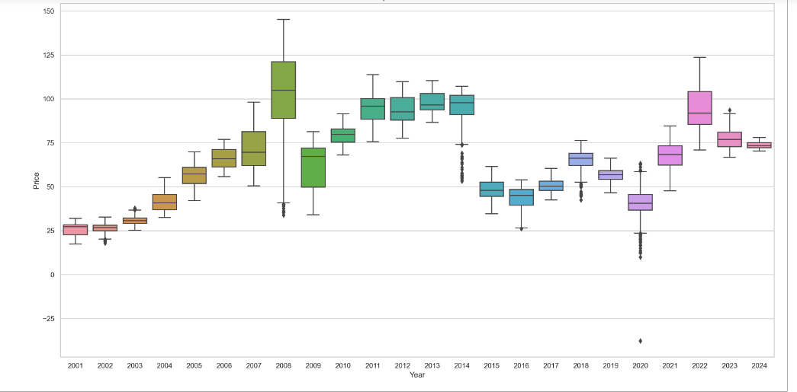
DATA VISUALIZATION 2001- 2024
MONTHLY
YEARLY
BOXPLOT

Slide 9
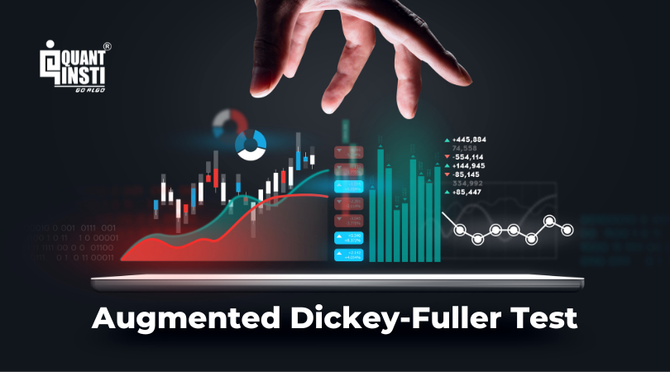
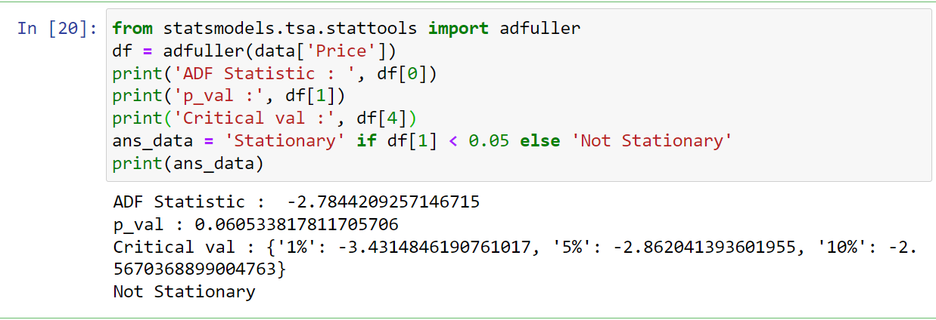
ADF TEST
STATIONARITY TEST

Slide 10
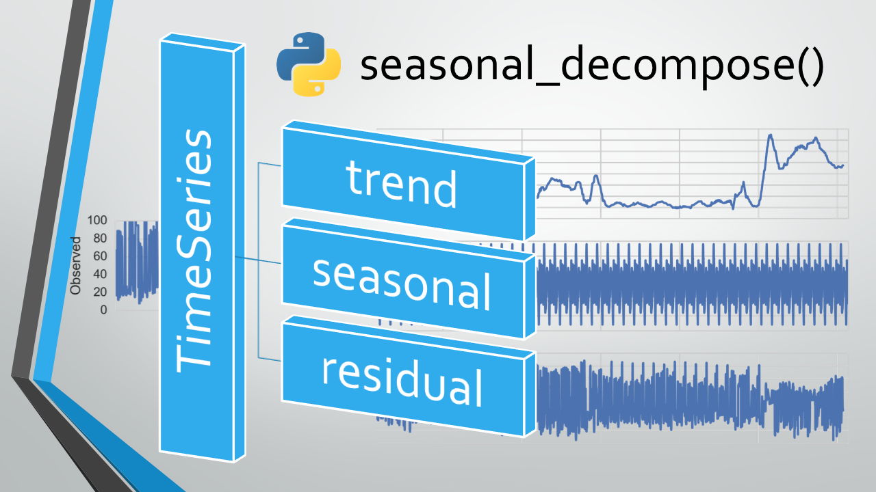
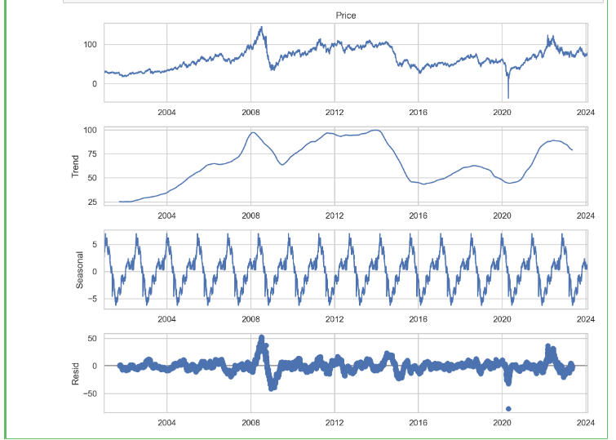

Slide 11

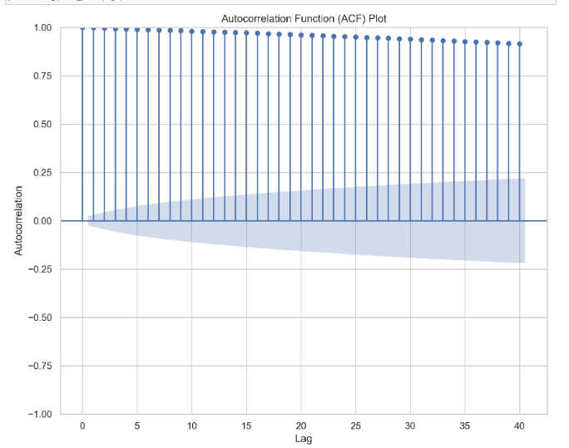
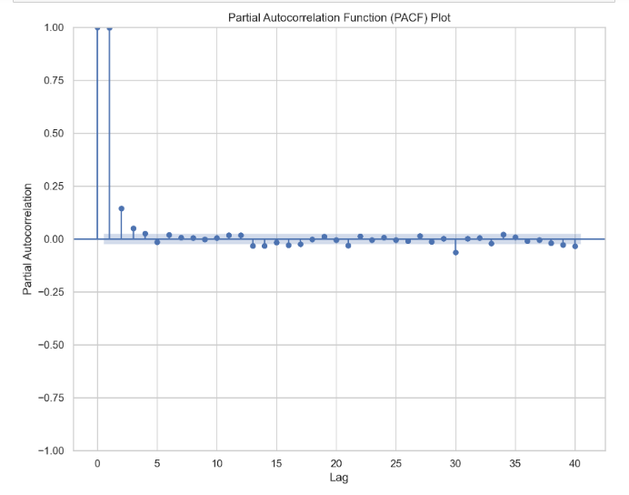
TIME SERIES

Slide 12

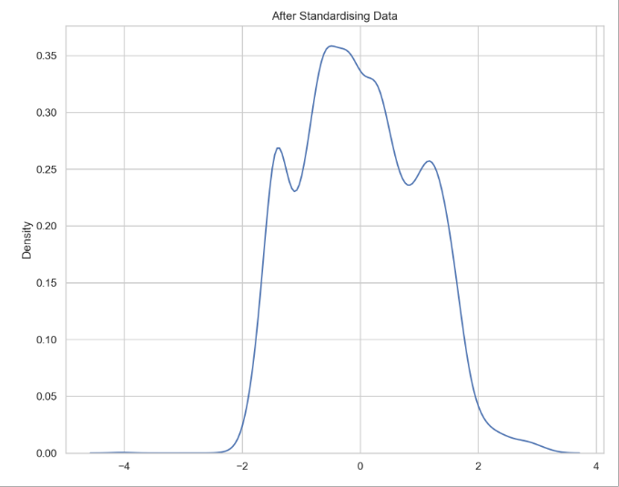
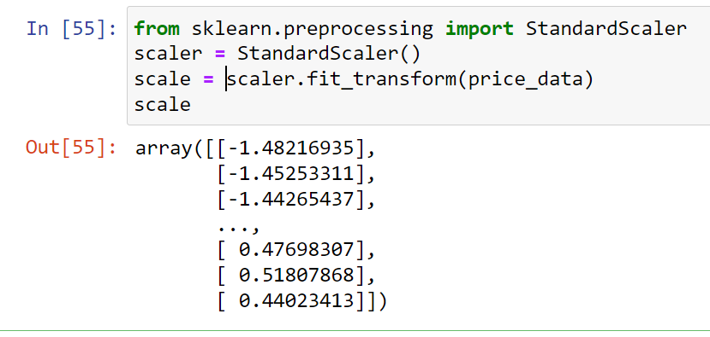
FEATURE SCALING

Slide 13

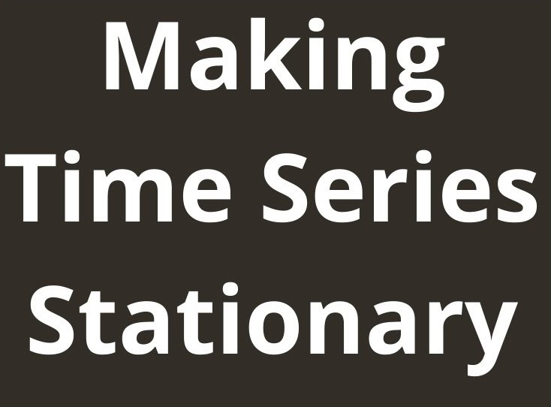
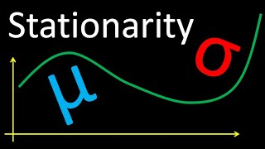
LOG TRANSFORMATION

Slide 14
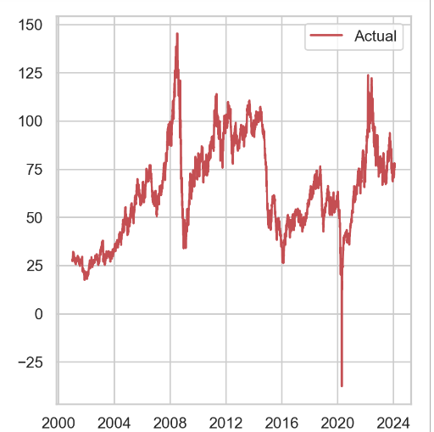
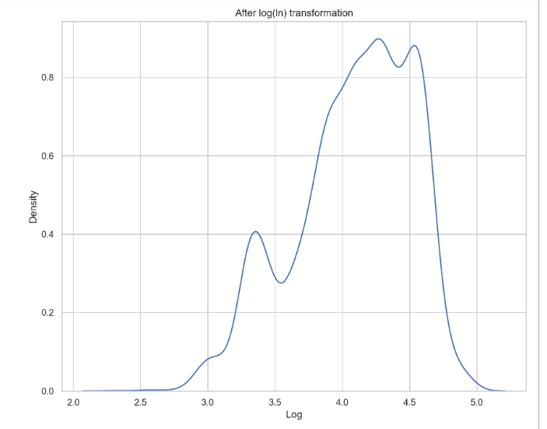
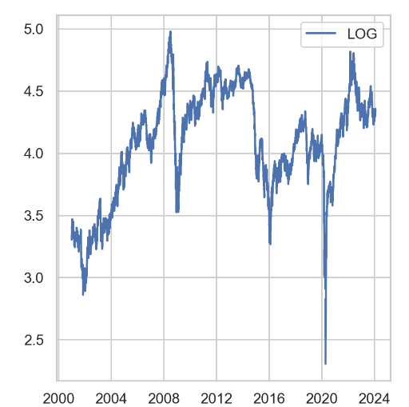
DATA AFTER LOG TRANSFORMATION

Slide 15
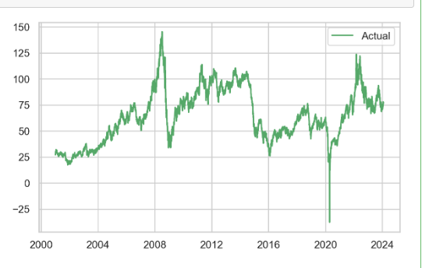
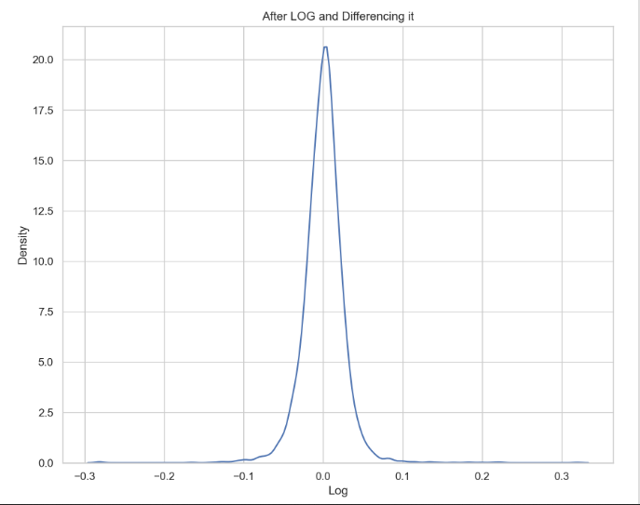
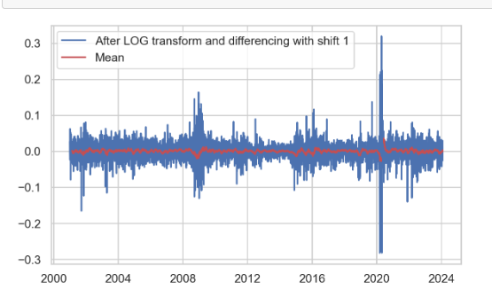
DATA AFTER DIFFERENCING LOG TRANSFORMATION

Slide 16
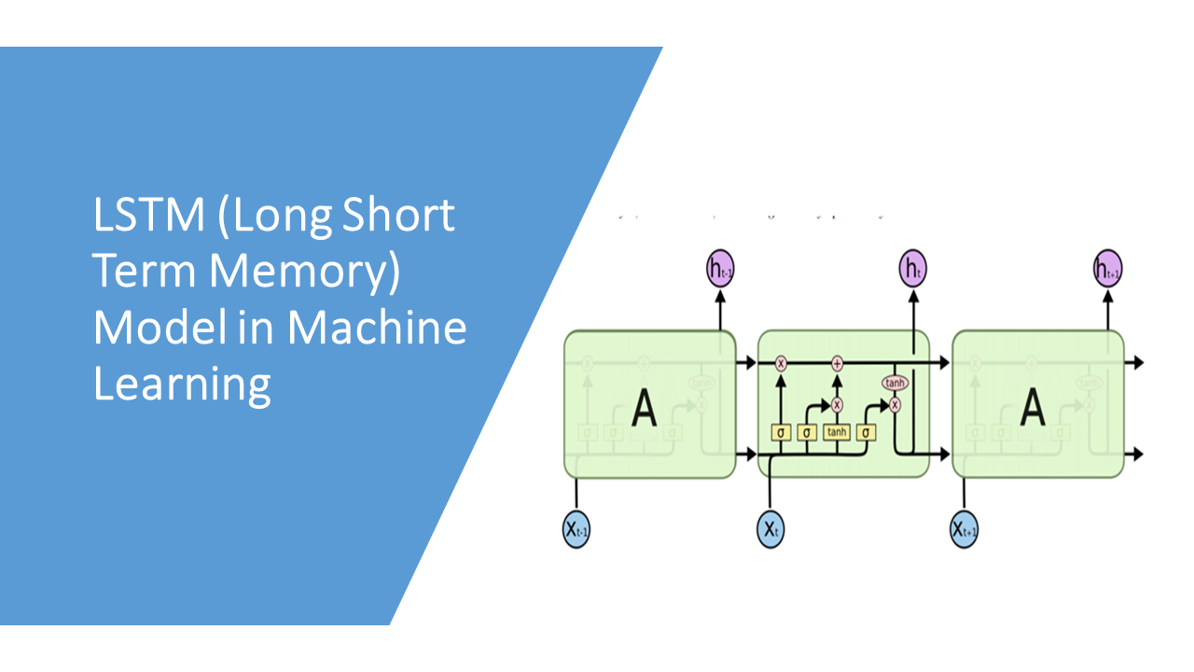
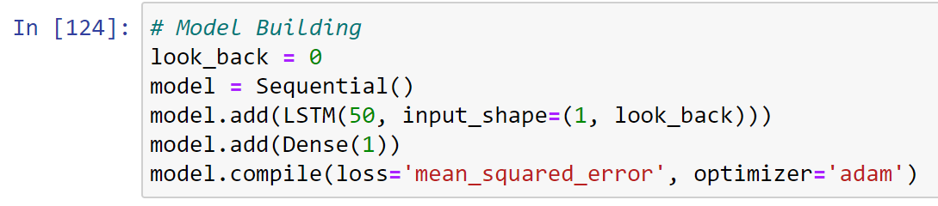
SEQUENTIAL

Slide 17
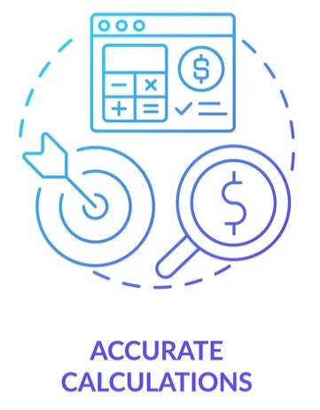
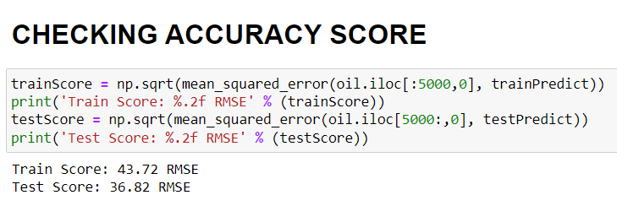
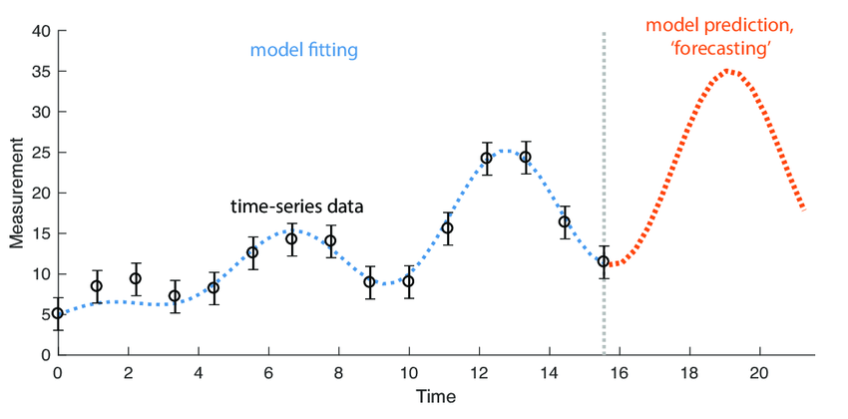

Slide 18
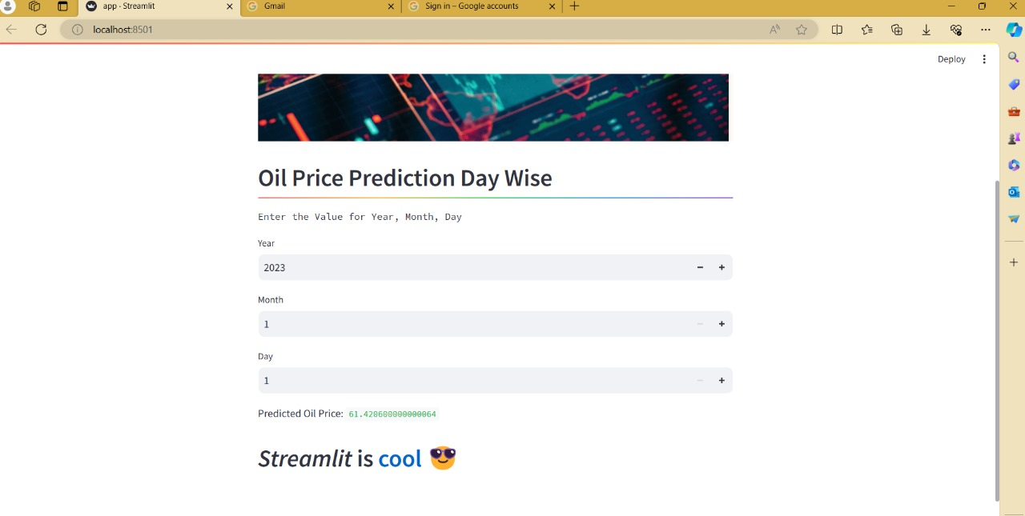
DEPLOYMENT

Slide 19
CHALLENGES FACED
COLLECTING THE DATSET FROM VARIOUS SOURCES
SELECTING THE RIGHT DATASET
CONVERT DATA INTO STANDARD FORMAT
SELECTING THE RIGHT MODEL
MODEL DEPLOYMENT

