Slide 1

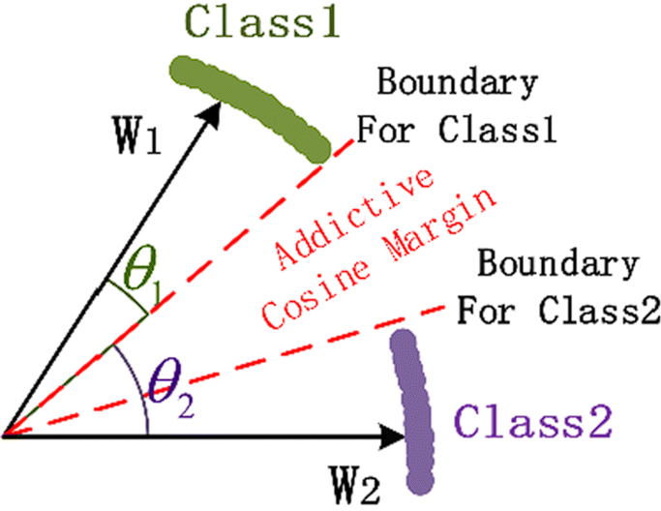
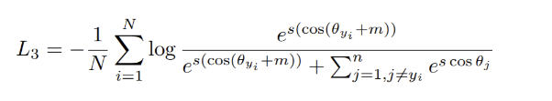
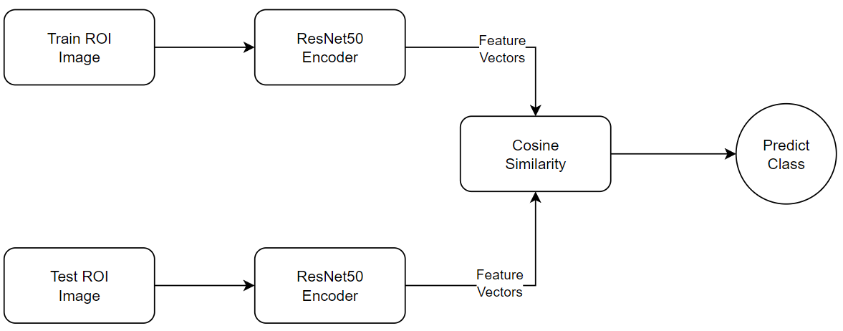
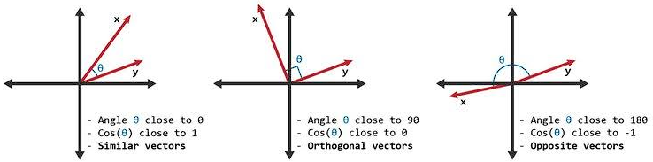
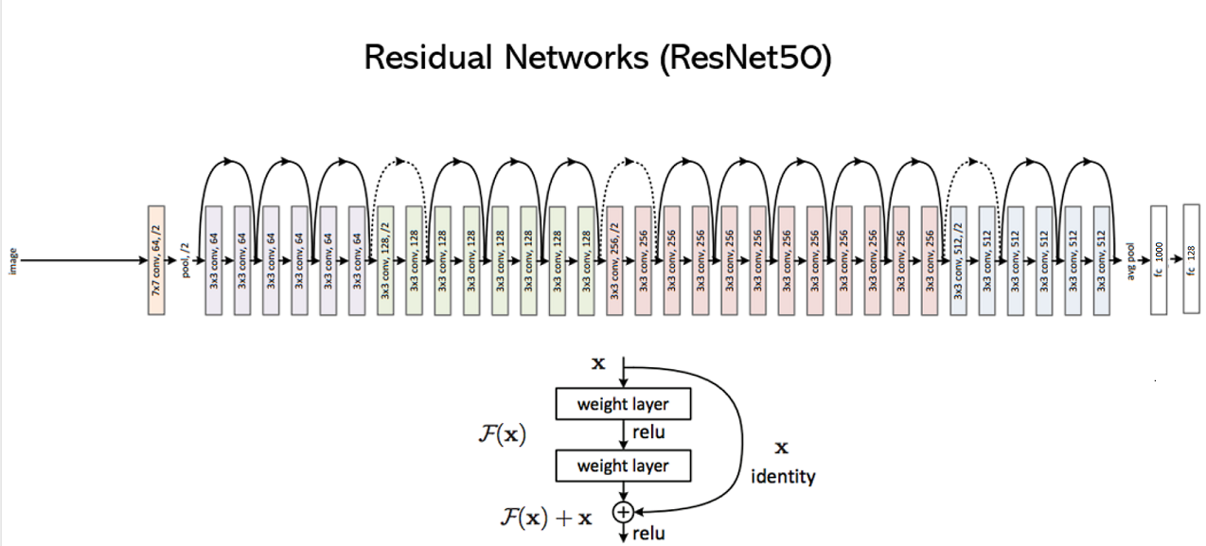
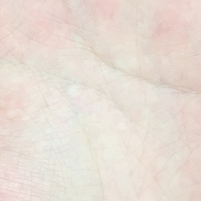
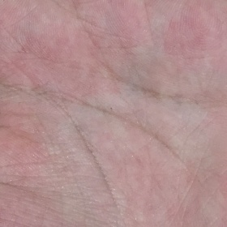
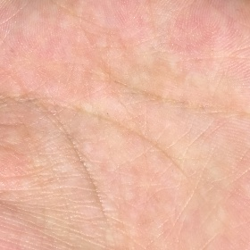
The effect of color on the accuracy of the palmprint recognition network
<Kuo Chih Su, Yueming Zhu, Kang Qi>
Introduction
Biometric Authentication is both unique and structurally complex, which make it hard to be forged.
Compared with fingerprint, palmprint contains more information.
Compared with face, palmprint is less public and more secure.
We build a model to implement the palmprint recognition system. To make the computation easier and can be deployed on mobile device, we are curious about how RGB images input and Grayscale images input influence the accuracy.
Experiment setting:
Pytorch / Colab with CUDA.
Method:
Compare the accuracy of using RGB and Grayscale images.
Loss function: ArcFace loss.
Figure 2. ArcFace Loss Equation
Figure 3. ArcFace Loss
Classifier: Cosine similarity
-Inner product of two 128-dimension vectors
Figure 6. Flow Chart
…
Conclusions
Figure 4. Illustration of cosine similarity
After 60 epochs of training, we got an accuracy of 72.9% on RGB images and 70.99% on Grayscale images. According to the accuracy, we can say color doesn’t influence the model a lot. Using grayscale image can be a good choice for mobile device with limited memory and computation resource.
Approach
Experiments
Encoder: ResNet50
-Input: 224x224 Grayscale image
-Output: 128-dimension feature vector
Ref:
Data Description:
Dataset: XJTU-UP
L01-08 L04-15 L06-05
 | Sample | Ratio
Training set | 3144 | 80%
Testing set | 786 | 20%
Total | 3930 | 100%
Accuracy | Train | Test
RGB | 91.92% | 72.90%
Gray | 90.01% | 70.99%
References
[1] Wan, J., Zhong, D., & Shao, H. (2022). Palmprint recognition system for mobile device based on circle loss. Displays, 73, Article 102214.
[2] P. Poonia and P. K. Ajmera, "Palm-print identification based on deep residual networks," 2021 Fourth International Conference on Computational Intelligence and Communication Technologies (CCICT), Sonepat, India, 2021, pp. 60-63, doi: 10.1109/CCICT53244.2021.00023.
[3] Shao, Huikai & Zhong, Dexing & Du, Xuefeng. (2019). Efficient Deep Palmprint Recognition via Distilled Hashing Coding. 714-723. 10.1109/CVPRW.2019.00098.
Figure 1. ResNet50 Structure
Figure 5. Sample Data

