Slide 1
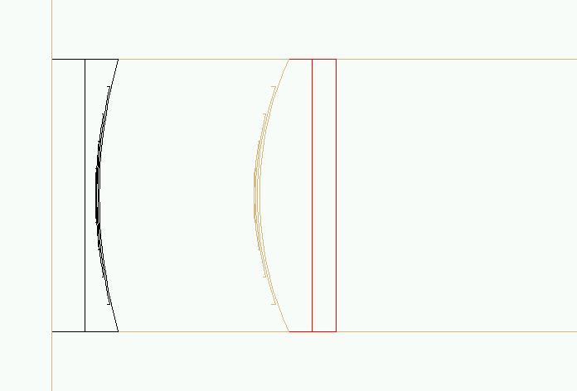
Marcol81 Air NLAK33A Quartz Quartz
Test_barrel3
exbox
air
lens1
lens2
bar
64
61?
90
196
327

Slide 2
Quartz Quartz Quartz Quartz Quartz
iopt=4
exbox
air
lens1
lens2
bar
86
86
89
196
327
Sides of lenses (1+2) are black / reflecting
Quartz Quartz Quartz Quartz Quartz
exbox
air
lens1
lens2
bar
323
322
323
326
327

Slide 3
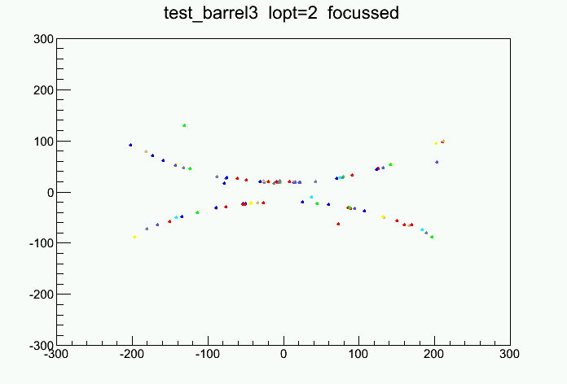
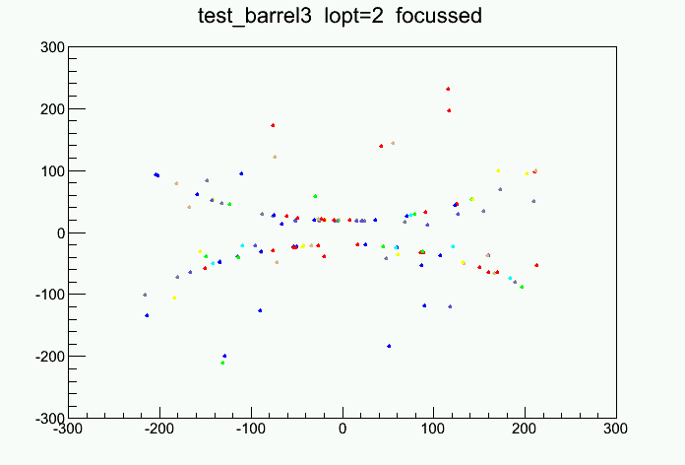
Thick lens
Lenses with non reflecting sides
Lenses with reflecting sides
89 photons
123 photons

Slide 4
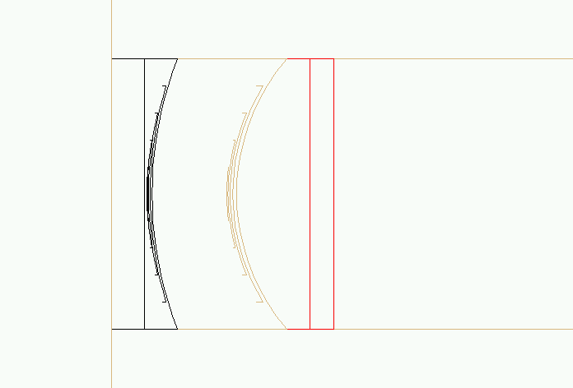
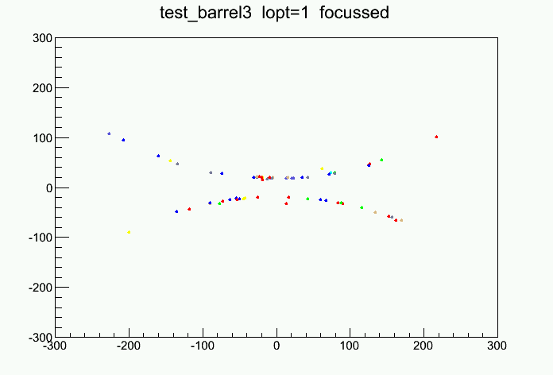
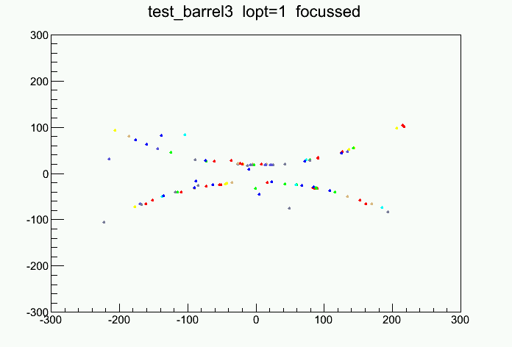
Thin lens
Lenses with non reflecting sides
Lenses with reflecting sides
64 photons
97 photons

Slide 5
Marcol81 Air NLAK33A Quartz Quartz
Lens1:
non reflecting sides
exbox
Lens1
thick
air
lens2
bar
64
61?
90
196
327
exbox
Lens1
thin
air
lens2
bar
64
67
108
181
327

Slide 6
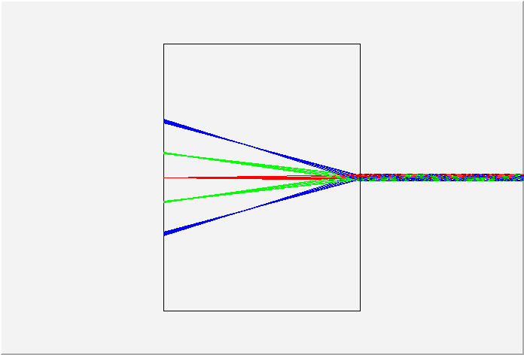
Focussing with a single lens 0,20,40 degree

