Slide 1
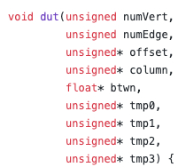
CCC2022 Betweenness
Betweenness​
Betweenness is a graph analysis algorithm. It represents the degree to which nodes stand between each other. For every pair of vertices in a connected graph, there exists at least one shortest path between the vertices such that either the number of edges that the path passes through (for unweighted graphs) or the sum of the weights of the edges (for weighted graphs) is minimized. The betweenness centrality for each vertex is the number of these shortest paths that pass through the vertex.
A reference implementation of the betweenness calculation can be found at:
https://gitenterprise.xilinx.com/qianqiao/ccc2021/blob/main/problems/betweenness/test.cpp#L84
题目
numVert: how many Vertices in the graph
NumEdge: how many edges om the graph
Offset: offset of the csr graph
Column: column of the csr graph
Btwn: the output betweenness for each vertex
评分
将所有的点按照选手计算的betweenness的值从大到小排序
将所有的点按照参考代码计算的betweenness的值从小到大排序
比较上述两个序列从第几个值开始不一样，这个值记为cnt
同时记录程序运行时间 time
最终评分 mark=(cnt^4)/time, 若程序运行时间超过1个小时则不计分

Slide 2
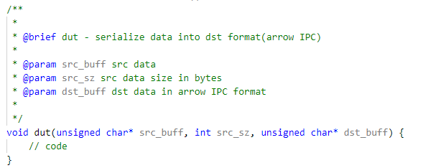
CCC2022 题目
Serialization
The serialization is usually used in the Big Data analysis to convert data into portable structure. It is the process of converting data object into a stream of bytes or binary format that is easy to transmit or store. The target serialized format is Arrow IPC defined in open-sourced Apache Arrow project and can be found in the following link:
https://github.com/apache/arrow/blob/master/docs/source/format/Columnar.rst#serialization-and-interprocess-communication-ipc
评分
正确序列化fix_size数据类型的输入，如int32，记1分；
正确序列化variable_size数据类型的输入，如string，记1分；
正确序列化fix/variable_size混合数据类型的输入， 记1分；
记录运行各类型输入的时间 t_fix，t_var，t_mix；
mark = 1/t_fix + 1/t_var + 1/t_mix。

