Slide 1
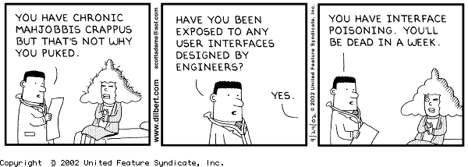
Lecture #01: It’s All About Good Design

Slide 2
This Course is About Good Design
Key Questions for Today’s Class
Q1. Why are you here?
Q2. Why is software hard to design?
Q3. Why does good design matter (a.k.a., why should I care?)
Q4. How can we create better designs?
Q5. How can we learn to be good designers?

Slide 3
Free Writing Exercise (10 min.)
Open up a new document in your word processor of choice.
Write a brief essay that responds to the following writing prompt: Why are you in college, and what does this class on user interface design have to do with it?
Submit your essay by 11:59 p.m. tonight via MS Teams (“Free Writing Exercise”)

Slide 4
Share with your Neighbors (10 minutes)
I will place you in breakout rooms of 4-5 students
Discuss your essays with each other
Identify common themes
I will give you a one-minute warning when time is up

Slide 5
This Course is About Good Design
Key Questions for Today’s Class
Q1. Why are you here?
Q2. Why is software hard to design?
Q3. Why does good design matter (a.k.a., why should I care?)
Q4. How can we create better designs?
Q5. How can we learn to be good designers?

Slide 6
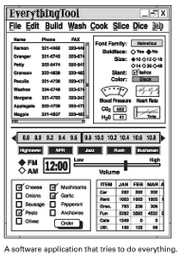
Average UI Has Many Flaws
Difficult to use (poor usability)
Doesn’t support the functionality that people actually need (not useful)
Taken from Johnson, J. (2007). GUI Bloopers 2.0, Second Ed. p. 31.
Notes:
Landauer (1995) did research that showed that average UI has 40 flaws

Slide 7
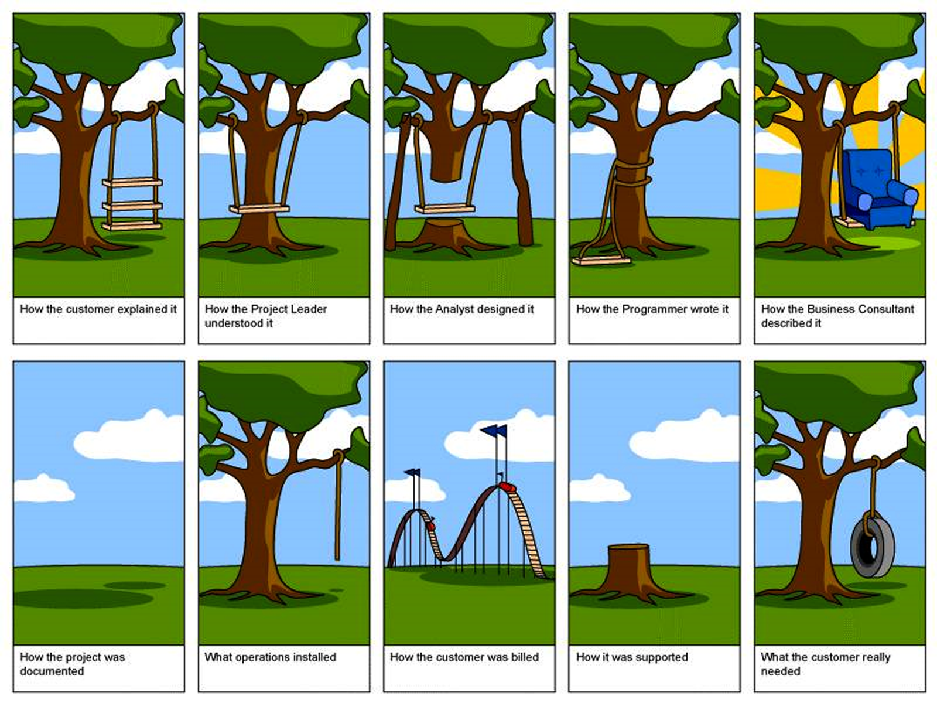
Q1: Why is Software Difficult to Design?
Notes:
Two points:
1. Hard to get requirements right (users don’t know what they need and have hard time communicating needs)
2. Hard to translate requirements into usable and useful software (Designers have hard time building usable and useful software)

Slide 8
More Reasons Software is Difficult to Design
Human behavior is difficult to predict
User interfaces aren’t standardized
Even with modern UI programming tools, UI development is expensive (50+% of overall code on average; see Rosson & Myers, 1992)
Notes:
Human behavior is difficult to predict
No exact prediction methods
Impossible to anticipate all possible conditions of use
User interfaces aren’t standardized
Users must learn each one, at least to some extent
Even with modern UI programming tools, UI development is expensive (50+% of overall code on average; see Rosson & Myers, 1992)

Slide 9
This Course is About Good Design
Key Questions for Today’s Class
Q1. Why are you here?
Q2. Why is software hard to design?
Q3. Why does good design matter (a.k.a., why should I care?)
Q4. How can we create better designs?
Q5. How can we learn to be good designers?

Slide 10
Poorly Designed Software Has Negative Consequences
Decreased sales
Dissatisfied customers/negative perceptions
Poor reviews
Increased need for training
It can even cause death and catastrophes e.g.,
Therac-25 overdoses
Boeing 737 MAX crashes
Three-Mile Island nuclear disaster
________
See Ross, J. (2014). “The Business Value of User Experience.” http://d3.infragistics.com/wp-content/uploads/2015/07/The_Business_Value_of_User_Experience1.pdf.

Slide 11
Share in the Course Google Doc (http://tiny.cc/cpts443)
What software product, piece of technology, or everyday object in the world do you find most annoying or difficult to use?
Have you ever personally experienced suffering or frustration as a result of a using a software product, tech product or everyday object? Elaborate.
We’ll discuss your responses as a class

Slide 12
This Course is About Good Design
Key Questions for Today’s Class
Q1. Why are you here?
Q2. Why is software hard to design?
Q3. Why does good design matter (a.k.a., why should I care?)
Q4. How can we create better designs?
Q5. How can we learn to be good designers?

Slide 13
Design Is Not an Exact Science
Experience + Methodology + Aesthetics = Good Design
Usable Designs
Possible Designs
(The “Design Space”)
Notes:
Key constraints of this design space: People, Tasks, Implementation technology, Design Process.
As engineers, we may not have good graphic design skills or even a good sense of aesthetics, but we can learn a methodology to help us zero in on usable designs.

Slide 14

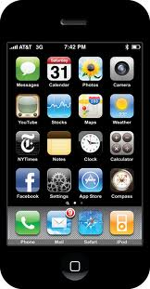

We Need to Approach Design in the Right Way
“Techno-Centric” Development
“Designer-Centric” Development
Notes:
Techno-centric: We have this cool tech. Let’s build something with it!
Designer-centric: I’ll sit in my armchair and imagine what users want and need. I’ll then create a design that I know will work…

Slide 15


Human- or User-Centered Development
Guided by empirical studies with actual users
Users incorporated into the design process early on
Users sometimes even join design team

Slide 16
Human-Computer Interaction is All About Design…
“A discipline concerned with the design, implementation, and evaluation of interactive computer systems for human use”
Interaction design
“Designing interactive products to support people in their everyday and working lives” (Rogers, Sharp & Preece, 2011)
“The design of spaces for human communication and interaction” (Terry Winograd)
Notes:
Highly interdisciplinary field, drawing on CS (software engineering), social sciences (psych, anthro, sociology), engineering (iterative refinement), graphic design

Slide 17
Key Goals of Human-Computer Interaction
To develop and refine theories and principles of human-computer use and human-computer communication
To develop techniques and practices for designing and evaluating humanly-usable software.
Notes:
Research angle and practitioner angle

Slide 18
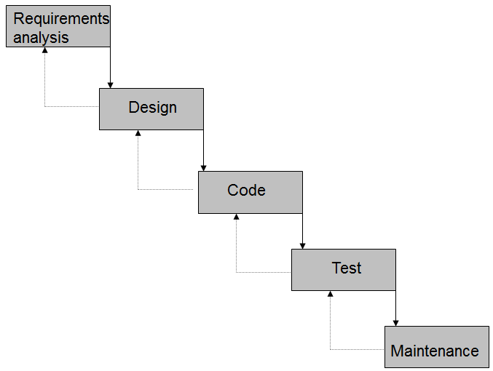
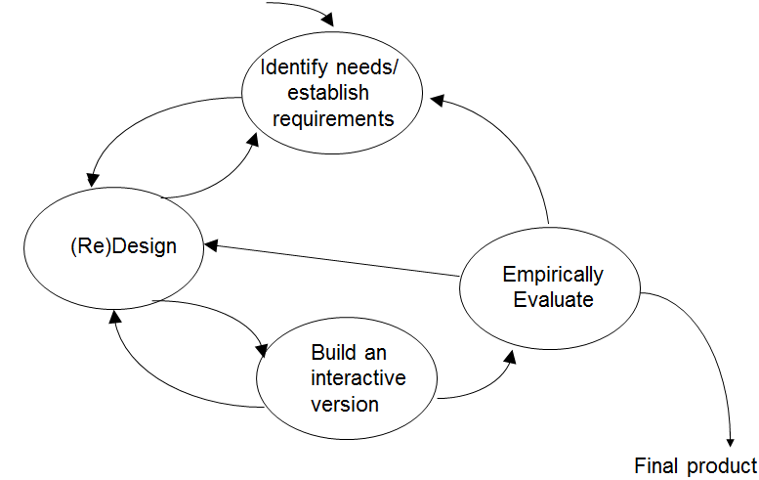
The UCD Design Process Contrasts with the Traditional Waterfall Lifecycle
Waterfall Lifecycle vs. User-Centered Design Process
Notes:
UCD:
Focus early on users and tasks
Requires observation, attention to task environments, and involvement of users
Usability and user experience requirements need to be identified at the beginning of the project
Empirical evaluation is central
Users’ reactions to, and performance with prototypes within actual scenarios of use are observed, recorded, and analyzed
Iteration is essential
UCD is an iterative engineering process in which evaluation leads to re-design and re-evaluation. We know we’re done when our usability requirements are met

Slide 19
Review: Functional Requirements
State what users of your software should be able to accomplish
Always state from perspective of user
Example: “Users must be able to create new appointments”

Slide 20
New: Usability Requirements
Establish human performance goals for your software in observable, measurable terms
Sample human performance metrics:
Number of errors
Task completion time
Safety metrics
Time to learn (learnability)
Memorability (how long remembered, once learned)
Sample usability requirement: “Users must be able to create a new appointment in 20 seconds.”

Slide 21
New: User Experience Requirements
Establish human subjective experience goals in observable, measurable terms
Sample human subjective experience metrics:
ease of use - rewarding
fun - helpful
enjoyable - motivating
entertaining - confident
Sample user experience requirement: “On a scale of 1 to 10, users should rate the system a 9 with respect to ease of use”

Slide 22
This Course is About Good Design
Key Questions for Today’s Class
Q1. Why is software hard to design?
Q2. Why does good design matter (a.k.a., why should I care?)
Q3. How can we create better designs?
Q4. How can we learn to be good designers?

Slide 23
(Poll) How would you react if you were to encounter a problem that’s beyond your current ability?
Extremely positive reaction
Somewhat positive reaction
Neutral reaction
Somewhat negative reaction
Extremely negative reaction
Based on your reaction, what would you do?
Notes:
This is, in fact, an indication of your mindset.

Slide 24
Fixed vs. Growth Mindset (Carol Dweck)
Fixed mindset | Growth mindset
Intelligence can’t be changed | Intelligence can be improved
Avoid challenges | Embrace challenges
Desire to look smart | Desire to learn
Regard effort as pointless | Effort is a path to mastery
Ignore criticism | Use criticism to advantage
Threatened by others’ success | Inspired by others’ success
Notes:
Individuals who learn to work hard and cope with setbacks go further than those who don’t, even if they have “talent” (Michael Jordan is a prime example of an athlete with a growth mindset.)
Organizations that cultivate a fixed mindset remain stagnant, whereas organizations that cultivate a growth mindset continually improve. A classic example is IBM in the 1980s. Employees were trying to be better than each other and maintain status. In 1993, a new CEO, LouGerstner, was stepped in. He had a growth mindset, got rid of the uptight culture, and IBM increased in value by 800%

Slide 25
The Power of “Yet”: How to Promote a Growth Mindset Environment in Class
Present skills as learnable; set achievable goals
Praise learning and perseverance, not intelligence
Give feedback, and propose strategies, that promote learning and improvement
Focus on the value of the learning process, not grades
Design activities that involve cooperative work, rather than competition or individual work
Regard teachers as resources for learning (you still have to do the work!)
see https://youtu.be/kkE1lC4CpIE and http://tinyurl.com/zldbrjq for more
Notes:
What I will try to promote in the classroom

Slide 26
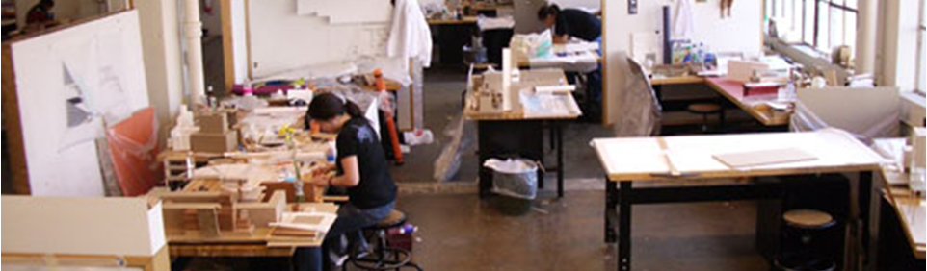
My Philosophy: Learning to be a Good Designer is Within Your Reach!
Design is best learned by doing
Studio pedagogy used in architecture and fine arts education is highly appropriate for learning UI design skills
This class leverages the design studio approach
Notes:
You may not be good at graphic design or drawing, but you can learn to develop a sense for good design and an ability to iteratively zero in on good design through a sound methodology.

Slide 27
This Course is About Good Design
Key Questions for Today’s Class
Q1. Why is software hard to design?
Q2. Why does good design matter (a.k.a., why should I care?)
Q3. How can we create better designs?
Q4. How can we learn to be good designers?
Main questions addressed! Course info to follow…

Slide 28
Teaching Personnel
Instructor:
Dr. Chris Hundhausen (call me “Dr. H”) hundhaus@wsu.edu Office hours: Right after class via Zoom; by appt. via Teams
TAs Ping-Wen Chen (Grading) ping-wen.chen@wsu.edu Office hours: Right after class via Teams
Ziyi Zhang (Grading) ziyi.zhang2@wsu.edu Office hours: MW 1-2 pm and by appt. via Teams
Notes:
Please communicate with us via OSBLE mail.

Slide 29
Learning by Doing in this Course
Interactive lectures (with polls!) provide models of how to apply course concepts and techniques
Studio activities engage you in actual design and critical review
In-class activities provide you with opportunities to practice key skills
Course assignments and projects provide further practice

Slide 30
Course Learning Objectives Focus on Skills for Good Design
By end of course, you should be able to
design and evaluate interactive software by applying appropriate design principles and concepts
employ user-centered design methods
design, conduct, and analyze empirical studies, most notably usability studies
apply analytical methods to the evaluation of interactive software.
communicate about, reason about, and critically review user interface designs through sketching, oral discussions, peer reviews, and well-written documents

Slide 31
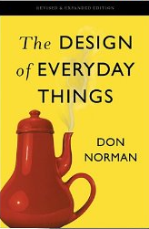
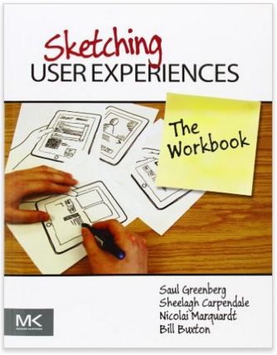
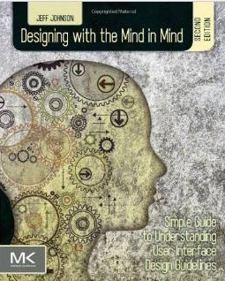
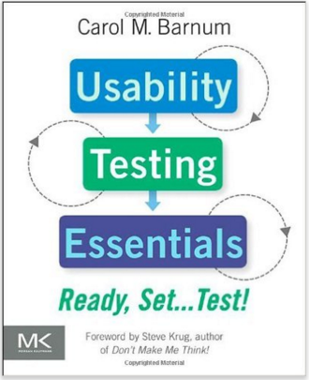
Textbooks Serve as Excellent Starting Points
(R) Norman, D (2013). The Design of Everyday Things (Revised and expanded ed.) New York: Basic Books (ISBN: 978-0465-050659).
(R) Johnson, J. (2014). Designing with the Mind in Mind: Simple Guide to Understanding User Interface Design Rules (3rd ed.). Burlington, MA: Morgan Kaufman (ISBN: 978-0-12-407914-4). Note: 2nd ed also fine!
(R) Barnum, C. (2010). Usability Testing Essentials: Ready, Set…Test! Burlington, MA: Morgan Kaufman (ISBN ISBN-13 978-0-12-375092-1)
(O) Greenberg, S., Carpendale, S., Marquardt, N., & Buxton, B. (2012). Sketching User Experiences: The Workbook. San Francisco: Elsevier. (ISBN: 9780123819598).

Slide 32
Online Presence: Microsoft Teams
Please install desktop and mobile versions to stay connected to the course
It’s the online hub for this course
I post course announcements to General channel
I post assignments to “Assignments” area
I post course materials to “Course Materials” folder
You submit course assignments to “Assignments” area
We complete rubrics in MS Teams to grade your work.
Please consider uploading a profile picture

Slide 33
Some Additional Software and Hardware Will Help
Adobe Reader
A Web Browser
A camera
software capable of generating and reading PDF
Camtasia Studio (for usability study, more on that later)
Microsoft PowerPoint
A software development tool of your choice for the project

Slide 34
This Course Does Not Focus on Programming, but…
For course project, you will implement computer-based prototype
You may implement the prototype using an approach of your choice
Talk to me if you have concerns

Slide 35
Course Grading
All Students:
Participation (10%)
Individual Assignments (20%)
Take-home Midterm Exam (20%)
Team Project (50%)
Grad Students Only:
Graduate Research Assignments (20%)

Slide 36
Some Key Policies (see Syllabus for More)
Except in emergency, please PM TAs and me via MS Teams for fastest response
Assignments and Project Deliverables
Must hand in through MS Teams in .pdf format (unless otherwise stated)
Late policy: SEE EACH ASSIGNMENT PROMPT
Have one week to challenge grade
Will receive graded rubric through MS Teams
Academic dishonesty
No plagiarism! (Must cite all sources, and work you hand in must be your own). Plagiarism violation will result in minimum penalty of “0” on assignment, and maximum penalty of “F” in course.
Group members must contribute equally (you will submit confidential peer review evaluations with each group project deliverable)
Cheating will result in automatic “F” in course

Slide 37
For Next Class…
Make sure you can get into MS Teams course space
Read Johnson intro (if you haven’t already)
Read Norman Chapters 1 and 4
Please look over the syllabus and schedule to get overview of course and deadlines

