Slide 1
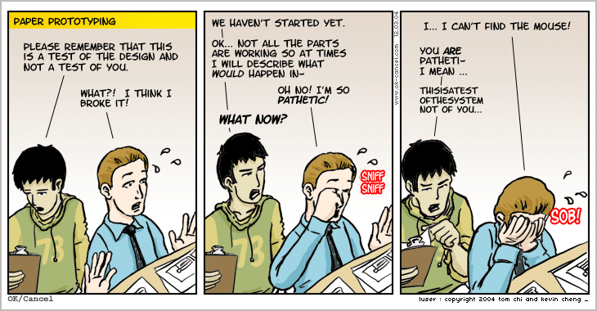
Lecture 16: Prototyping
(Greenberg 5)

Slide 2
Announcements
Midterm exam released today at end of class
  See “Assignments” tab on MS Teams
  Open book, open notes, open internet, but you must cite all sources
  Discussing or working on exam with others is not allowed; your solutions must be your own
  Class canceled on Thursday, March 18!
  Submit DOCX that includes your solution and signed honor pledge by 11:59 pm on Friday, March 19

Slide 3
16-Prototyping
Key topics/questions for this lecture
Intro to Prototyping
Nielsen-Norman Prototyping Video
Participatory Design
Team Design Project Planning

Slide 4
What is a Prototype?
In other fields: a small scale model that communicates design
In interaction design: A model of a user interface, e.g.,
  a series of screen sketches
  a storyboard, i.e. a cartoon-like series of scenes
  a Powerpoint slide show
  a video simulating the use of a system
  a cardboard mock-up
  a piece of software with limited functionality

Slide 5
Why Create a Prototype?
Fundamental tenet of user-centered design: Involve users early and often
A prototype is much easier to create than an actual implementation, and takes far less time
A prototype communicates design and encourages feedback
  A user study with a prototype can provide designers with valuable feedback, even if the prototype isn’t fully functional
  People are more likely to give feedback on “rough, unpolished” sketches (see, e.g., Schumann et al., 1996)

Slide 6
Why Create a Prototype? (cont.)
Designers can get answers to specific research questions regarding a design
  Of several design alternatives, which is better?
  Will a given design work? If not, how can we fix it?
  What will users expect in certain interaction scenarios?
Stakeholders can see, hold, interact with an emerging design before it is fully implemented

Slide 7
What Should We Prototype?
Work flow and tasks
  Screen layouts and information display
  Difficult, controversial areas of design
Prototype should respond to the questions that need answering
  Paper mockup can test feasibility of interface design
  Limited computer-based prototype can address technical feasibility (e.g., response times)

Slide 8
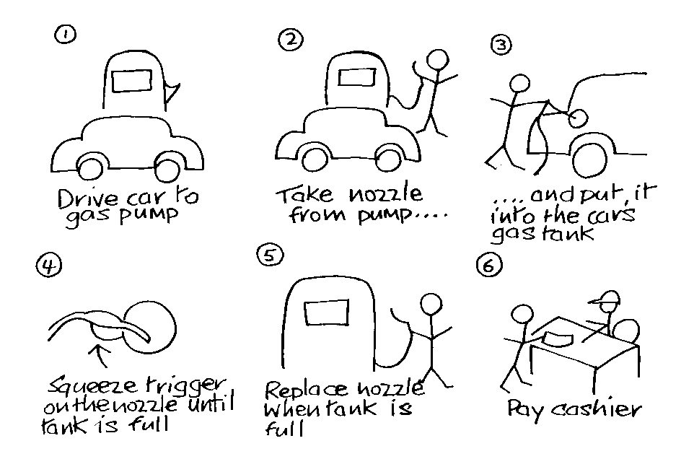
Low Fidelity Prototypes
Use “art supplies”, e.g., Post-it Notes, paper, index cards
Can also be implemented on computer with, e.g., Figma or PowerPoint
Are quick, cheap and easily changed
Example: Storyboards
  Series of sketches representing progression through task
  Supports role-playing; provides context for interaction (as in “wizard-of-oz” study)
ChrisMedia
Artist Song Length Link
C. Wil Rain 3:45 Wil4
Play
Delete
Edit
Goto

Slide 9
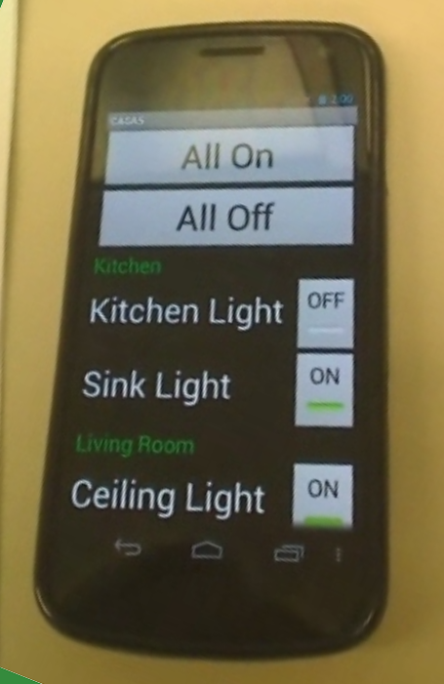
High Fidelity Prototypes
Use materials that users would expect to be used for the final product
Look more like final system than a low-fidelity version
Danger that users will think they have a full system, and then be disappointed
Common high-fidelity prototyping environments (historically) include Adobe Flash, .NET, and PhP

Slide 10
Comparison of Low and High Fidelity Prototypes
Low fidelity | High fidelity
Low development cost Only a rough approximation Facilitator-driven Can help identify requirements No error checking, and may poorly simulate actual navigation and flow Usually thrown away | High development cost Look-and-feel of final product User-driven Can help test final product Can incorporate error-checking, and can give excellent feel for actual navigation and flow Can serve as detailed specification for final implementation

Slide 11
Prototyping Requires Compromise
Implementation compromises: slow response times, unfinished icons, limited functionality
Breadth versus depth: Horizontal versus vertical prototypes
  Horizontal: provide a wide range of functions, but with little detail
  Vertical: provide a lot of detail for only a few functions

Slide 12
Two Different Routes to a Final Product
Evolutionary prototyping
  Lots of effort has gone into prototyping and testing; why waste it?
  Prototype “evolves” into final product
  Evolution must be carefully planned, with quality assurance testing part of the overall process
Throw-away prototyping
  Prototype is used to answer design questions, and then thrown away
  Less need to worry about robustness and quality assurance
  Final product is built from scratch

Slide 13
16-Prototyping
Key topics/questions for this lecture
Intro to Prototyping
Nielsen-Norman Prototyping Video
Participatory Design
Team Design Project Planning

Slide 14
Nielsen/Norman Video on Paper Prototyping
How-to Build Prototypes: 1:58 – 9:55
Demo of Paper Prototype Study: 9:55 ~ 21:20

Slide 15
Tool Support for Prototype Construction
Low fidelity, sketch-based user interface design tools
  SILK and DENIM (Research prototypes)
  WOZ Pro (Evolved out of this class!)
  InVision
  Pencil Project
  Adobe Xd
  See this Medium article for a comparison of 11 tools
HTML/CSS/JavaScript
Object-oriented programming languages and environments
  Java
  Visual Studio .NET
  Python
Notes:
Show publisher low fidelity designs as example

Slide 16
16-Prototyping
Key topics/questions for this lecture
Intro to Prototyping
Nielsen-Norman Prototyping Video
Participatory Design
Team Design Project Planning

Slide 17
Participatory Design
Customers/clients become an active part of design team
Technique developed in Scandinavia in late 1960s and early 1970s
  Arose out of labor unions’ pleas to have say in their working conditions
Walkthroughs with low fidelity prototypes a key component of the design process
  Enable customers to simulate their work practices
  Enable designers to gain key insights into work practices

Slide 18
Aspects of Participatory Design
Finding representatives from the user community? (Interaction may need to be assisted by a facilitator)
Using simple tools such as paper or video scenarios to design cooperatively
Facilitating communication between designers and users about proposed designs
Evaluating prototypes cooperatively

Slide 19
Summary
Prototypes help designers answer questions and get feedback
Different kinds of prototyping are used for different purposes and at different stages of design
Participatory design gives users a place on the design team

Slide 20
16-Prototyping
Key topics/questions for this lecture
Intro to Prototyping
Nielsen-Norman Prototyping Video
Participatory Design
Team Design Project Planning

Slide 21
Team Project Check-In and Planning Breakouts
  Make sure all members listed on your project team are actually on board
  Go over your project idea and identify the 5 core tasks you will focus on
    Logging in and out do not count as tasks!
    You are not “locked in”; core tasks may change
  Let me know if you have any questions about what is required or whether you are on-track
  Make plans to complete TP #1 with your team members. I suggest pairing up and having each pair do a CI

Slide 22
Reminders
Work on take-home midterm
  Released at 11:50 am today
  Due next Thursday, 3/18 at 11:59 p.m. through Teams
  Read instructions carefully!
Work on TP #1, due 3/23 at 11:59 p.m.
Have a GREAT weekend ☺

