Slide 1

21-Heuristic Evaluation (Barnum Ch. 3)
https://planbozchi24.files.wordpress.com/2013/09/he.png

Slide 2
17-Heuristic Evaluation
Key topics/questions for this lecture
Check-In (5 min)
Heuristic evaluation approach (10 min )
Heuristic evaluation example (15 min)
Heuristic evaluation exercise (20 min)
Breakout Room Discussion (15 min)
Wrap-up

Slide 3
Please complete online survey during today’s class
Access survey through “L17 Heuristic-Eval Survey” in MS Teams
Worth participation credit (in addition to Zoom log)
Submit by 12:00 pm today for credit

Slide 4
Early Data Gathering/Exam Check In
Survey 1: How is your early data gathering going?
Survey 2: How is the midterm going?
(Message through Zoom chat): Do you have any questions?

Slide 5
17-Heuristic Evaluation
Key topics/questions for this lecture
Check-In (5 min)
Heuristic evaluation approach (10 min )
Heuristic evaluation example (15 min)
Heuristic evaluation exercise (20 min)
Breakout Room Discussion (15 min)
Wrap-up

Slide 6
What is a “Heuristic”?
Heuristics are a set of principles, or “rules of thumb” used by experts to inspect an interface in search of violations of the heuristics
Examples:
Jakob Nielsen’s “10 Usability Heuristics for User Interface Design“
Shneiderman's "Eight Golden Rules of Interface Design“
Arnie Lund’s “Expert Ratings of Usability Maxims“
Bruce Tognazzini’s “First Principles of Interaction Design“

Slide 7
Heuristic Evaluation
Also known as “expert crit” or “discount evaluation”
Experts evaluate interface with respect to a set of usability principles (“heuristics”)
Heuristics are high-level design principles derived from Nielsen’s (1994) analysis of 249 usability problems
In a previous in-class activity, you were actually performing an informal heuristic evaluation (using Norman’s principles)
Notes:
They are called "heuristics" because they are broad rules of thumb and not specific usability guidelines

Slide 8
Key Heuristics (Jakob Nielsen’s)
Visibility of system status: Is appropriate feedback provided in response to user actions?
Match between system and real world: Is language of user interface understandable to users?
User control and freedom: Can users easily escape from unexpected places? Are undo/redo supported?
Notes:
Encourage students to link these heuristics to concepts/principles we’ve already learned
Examples:
visibility, feedback, signifiers
Natural mappings, transfer effects, standards/norms, conceptual model, perception (priming, biases, context, goals, etc)
Constraints, feedback, gulfs of execution/evaluation

Slide 9
Survey 3 & 4: Pick one the following Norman concepts most related to “Visibility of System Status?” and describe how it’s related
Natural Mapping
Feedback
Signifiers
Conceptual Model
Constraints
Notes:
B or C are best, but discuss

Slide 10
Key Heuristics (cont.) (Jakob Nielsen’s)
Consistency and standards: Can similar actions be performed in similar ways?
Error prevention: Are error-prone conditions eliminated? Are users asked to confirm undoable actions?
Recognition instead of recall: Are objects, actions, and options visible?
Notes:
Note: These heuristics may not be relevant for all interactive products; heuristics must be tailored to specific kinds of products (e.g., websites, on-line communities)
Gulfs of execution and evaluation, memory → consistency easier to remember
Again, gulfs, working memory → don’t make users remember across screens, instructions visible during action, modes.
Visibility, feedback, reading → don’t make users think too much & avoid unfamiliar words, gestalt principles, visual hierarchies to make understanding easier

Slide 11
Survey 5 & 6: Which of the following Norman concepts is most related to “Error Prevention?” How is it related?
Natural Mapping
Feedback
Signifiers
Conceptual Model
Constraints
Notes:
Probably E, but discuss

Slide 12
Key Heuristics (cont.) (Jakob Nielsen’s)
Flexibility and efficiency of use: Are keystroke shortcuts available?
Aesthetic and minimalist design: Is unnecessary or irrelevant information present?
Help users recognize, diagnose, and recover from errors: Are error messages understandable and helpful?
Help and documentation: Is help provided? Can it be easily searched for relevant information?
Notes:
Note: These heuristics may not be relevant for all interactive products; heuristics must be tailored to specific kinds of products (e.g., websites, on-line communities)
7. Emotional processing → finding the right balance, not too easy not too hard, allow for expert modes
8. working memory → don’t make users remember across screens, instructions visible during action, modes, recognition vs recall, perception → contrast/system 1, target size appropriate
9. feedback, perception → don’t’ make users read too much, avoid unfamiliar words
10. visibility, same perception, transfer effect

Slide 13
Survey 7 & 8: Which of the following Johnson concepts is most related to “Aesthetic and Minimalist Design?” How is it related?
“Understand users’ goals”
“Avoid ambiguity”
“Be consistent”
“Minimize text”
“Impose visual structure”
Notes:
Probably E, but discuss

Slide 14
Step 1 of Heuristic Evaluation: Briefing Session
Expert evaluators (usually 3) meet to discuss what they are supposed to do
Evaluators introduced to the system being evaluated (if they are unfamiliar with system)
Evaluators agree on a description of target user(s)
Evaluators may be given
Personas
Scenarios
Tasks

Slide 15

Step 2 of Heuristic Evaluation: Evaluation period
Period during which evaluators independently inspect the product.
Usually 1-2 hours
Usually two passes are done:
first pass gives overall feel for flow of interface
second pass focuses on specific interface elements
Experts often choose specific tasks/user groups to focus evaluation
http://www.experienceux.co.uk/faqs/what-is-an-expert-review/

Slide 16
Step 3 of Heuristic Evaluation: Debriefing Session
Experts come together to discuss their findings, to prioritize problems, and to suggest solutions
Severity codes are used to indicate how likely issues are to impact user experience
Severity 1: “Showstopper” (Must be fixed)
Severity 2: “Major problem” (Must be fixed)
Severity 3: “Minor problem” (Should be fixed, but lower priority)
Severity 4: “Cosmetic issue” (Fix only if time allows)
Notes:
Aggregate the usability issues, severity and descriptions
NOTE: depending on where you look at for examples of heuristic evaluation you MAY see a different severity scale… make sure all evaluators understand the scale you’re using!

Slide 17
Suggested Heuristic Evaluation Table
Description of Issue | Severity | Relevant Heuristic(s)

Slide 18
Heuristic evaluation bottom line
According to Bailey (2001):
Only about 33% of problems found through heuristic evaluation are real usability problems
About 43% of the problems identified through heuristic evaluation are not problems at all (false alarms)
Bottom line: "For every true usability problem identified, there will be a little over one false alarm, and about one half of a missed problem."
Notes:
So it’s not perfect, but it DOES/CAN uncover usability problems

Slide 19
17-Heuristic Evaluation
Key topics/questions for this lecture
Check-In (5 min)
Heuristic evaluation approach (10 min )
Heuristic evaluation example (15 min)
Heuristic evaluation exercise (20 min)
Breakout Room Discussion (15 min)
Wrap-up

Slide 20
Evaluating Scratch: Briefing Session
Briefing Session
Target users: 8-16 year-old learners, all ages
For sharper focus, assume we are an instructor using Scratch for a course
For even sharper focus, could assume specific scenarios:
Instructor trying to demonstrate actions in the system
https://scratch.mit.edu/
Notes:
While it can be easier to apply a H.E. by considering specific scenarios, the typical procedure does not require this. You can just look at screens and apply the heuristics without a specific task context.

Slide 21
Evaluating Scratch: Evaluation period
Pass 1: Get familiar with system
Log on and poke around
Pass 2: Walk through specific scenarios or tasks
Create a new animation
Create animation on 2 sprites
Adding a new backdrop
Essentially “walk the system”
Notes:
Pass 1: Look at initial screen. Explore conceptual model to try to understand it. Anticipate potential difficulties and use heuristics to justify them.
Pass 2: Walk through some specific scenarios. For example, think of programming tasks to perform and then try to perform them. Try to pretend you aer seeing the system for the first time.
For this, let’s actually just poke around and see what we find first…
Go to https://scratch.mit.edu/ (or have it pre-loaded)
Click ‘Create’
Look at sidebar menu and explore options
Apply heuristics:
Visibility of system status: We jump right into the creation mode with a default sprite, will users know what to do next? Will they understand it’s ‘ready’ ? What about knowing how to ‘start’ the scripts? What about the ‘nothing visible is happening’ state?
Match between system and real world: What would be vocabulary in terms of which an instructor would think about such a system? What about the target audience (8-16 year olds)? Some words familiar, some not
User control and freedom: Can users easily escape from an unwanted page? For example, switching between modes or tutorials
Consistency and standards: delete → scissors, maybe okay for novice users, what about people used to trash can for delete and scissors for cut?
Error prevention: (good, blocks look like they fit together, can’t fit pieces together if they shouldn’t be fit → puzzle shapes, hex shapes, doesn’t require all parts to be working to run)
Recognition rather than recall: (good, use of familiar words (some))
Aesthetic and minimalist design:
Help users recognize, diagnose, and recover from errors:
Help and documentation: (good, not an issue→ prominent tutorial/help pane)

Slide 22
Heuristic Evaluation of Scratch
Description of Issue | Severity | Relevant Heuristic(s)
Notes:
Users may not notice they can scroll down for more programming options, despite the presence of a color-coded map.

Slide 23
Another Example of Heuristic Evaluation
Heuristic Evaluation of HolidayInn.com.cn
In the Barnum text, page 73

Slide 24
17-Heuristic Evaluation
Key topics/questions for this lecture
Early Data Gathering (5 min)
Heuristic evaluation approach (10 min )
Heuristic evaluation example (15 min)
Heuristic evaluation exercise (20 min)
Breakout Room Discussion (15 min)
Wrap-up

Slide 25
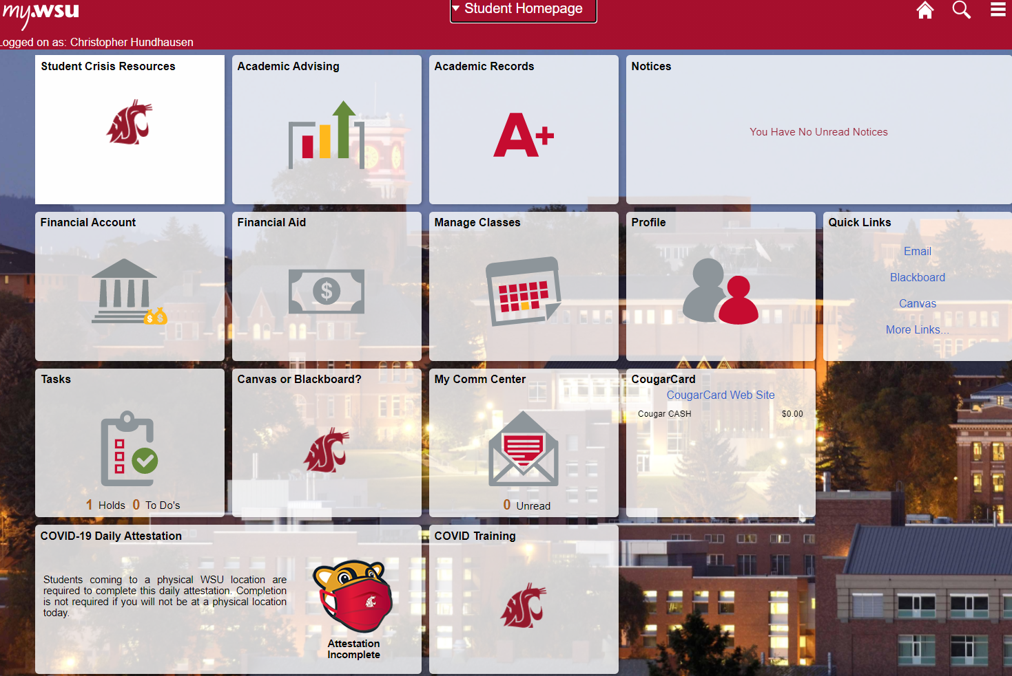
Individual Exercise: Heuristic Evaluation (20 min)
Evaluate https://my.wsu.edu
Focus on three tasks
Do COVID attestation
Change multi-factor authentication method
Order transcript
Document at least three issues by filling in survey
When time is up, I’ll place you into breakout rooms to discuss results

Slide 26
17-Heuristic Evaluation
Key topics/questions for this lecture
Early Data Gathering Check-In (5 min)
Heuristic evaluation approach (10 min )
Heuristic evaluation example (15 min)
Heuristic evaluation exercise (20 min)
Breakout Rooms (15 min)
Wrap-up

Slide 27
Breakout Room Discussion (15 minutes)
Share the issues you identified. Look for common issues. Write down the issues that at least two of you identified in your “Breakout.docx”
Do you think the problems you found are real? Why or why not?
How does this approach compare with the cognivite walkthrough? Which do you prefer?

Slide 28
17-Heuristic Evaluation
Key topics/questions for this lecture
Early Data Gathering Check-In (5 min)
Heuristic evaluation approach (10 min )
Heuristic evaluation example (15 min)
Heuristic evaluation exercise (20 min)
Breakout Rooms (15 min)
Wrap-up

Slide 29
Looking Ahead…
University holiday on Wednesday
No class on Thursday
Take-home Midterm due by 11:59 p.m. on Friday 3/19
TP 1 (Early Data Gathering) due by 11:59 pm on 3/23
Team evaluation for TP 1 due by 11:59PM on 3/24

