Slide 1
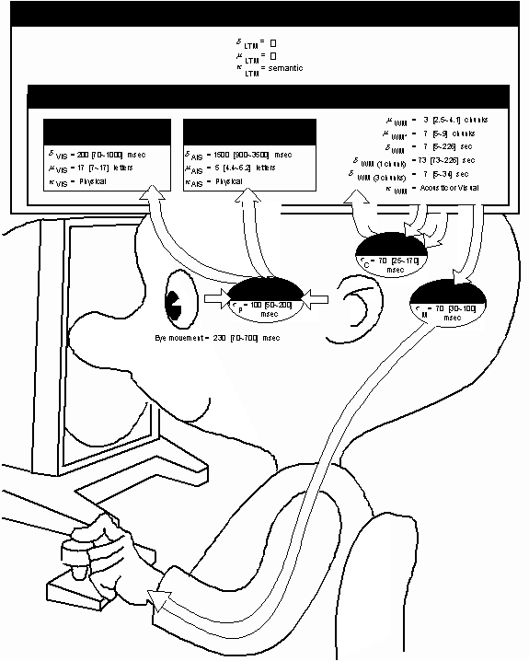
19-GOMS & KLM (KLM Supplement)

Slide 2
On the Model Human Processor that is foundational to GOMS/KLM
“Our purpose…is to convey a version of the existing psychological science base in a form suitable for analyzing human-computer interaction. To be practical to use and easy to grasp, the description must necessarily be an oversimplification of the complex and untidy state of present knowledge…Our tack…is to organize the discussion around a simple model…[of the] human mind [as] an information-processing system.”
--Card, Moran, & Newell, pp. 23-25

Slide 3
19-GOMS & KLM
Key topics/questions for this lecture
Evaluation approaches
The Model Human Processor
Predictive models: GOMS & KLM
IA #5 (Extra Credit): KLM Study

Slide 4
Key Evaluation Approaches
Analytical evaluation
Field study
Controlled experiment
Usability testing
Formative vs. Summative

Slide 5
Approach 1: Analytical Evaluation
Heuristic evaluation
Cognitive Walkthrough
User Modeling
Notes:
Heuristic evaluation: Experts apply their knowledge of typical users, often guided by heuristics, to predict usability problems.
Cognitive walkthrough: Experts walk through core tasks and ask directed questions to uncover usability problems.
User modeling: Model user behavior using detailed knowledge of tasks, coupled with theoretically-based predictions of human performance
A key feature of predictive evaluation is that users need not be present
Relatively quick & inexpensive
practical method not guaranteed to be optimal or perfect, but sufficient for the immediate goals. Where finding an optimal solution is impossible or impractical, heuristic methods can be used to speed up the process of finding a satisfactory solution. Heuristics can be mental shortcuts that ease the cognitive load of making a decision. Examples of this method include using a rule of thumb, an educated guess, an intuitive judgment, guesstimate, stereotyping, profiling, or common sense.

Slide 6

Approach 2: Field Studies
https://blinkux.com/wp-content/uploads/2014/09/DSCF3113%C2%A9mark_gsellman.jpg
Notes:
Use of any ethnographic field technique (observation, interviews, etc.) to study users in naturalistic settings
Aim is to understand what users do naturally and how technology impacts them
We use these in early design to establish requirements
As an evaluation approach, we can use field studies to evaluate prototypes in their actual situations of use (in situ)

Slide 7
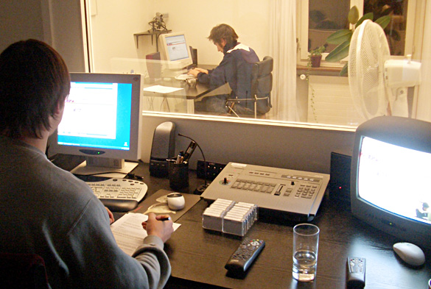
Approach 3: Usability Testing
http://magazin.unic.com/wp-content/uploads/2011/06/SBB_Usability-Testing.jpg
Notes:
Involves recording typical users’ performance on typical tasks in controlled settings (the “lab”)
As the users perform tasks, they are watched & recorded on video
Data are used to calculate performance times, identify errors and interface problems, to help explain why the users did what they did, and to gauge progress w.r.t. usability goals.
User satisfaction questionnaires & interviews are often used afterwards to elicit users’ opinions, and to measure progress w.r.t. user experience goals.

Slide 8
Complete Today’s Survey Questions Online
Go to MS Teams “Assignment” tab
Locate “L19 GOMS KLM” assignment
Open online survey and follow along
Submit by end of class today for participation credit

Slide 9
Survey Question 1
Early tests of printed scenarios and user guides are an example of
Formative evaluation
Summative evaluation
Notes:
Formative evaluation → used to verify evolving design
Summative evaluation used to verify final design

Slide 10
Survey Question 2
Evaluation that does not involve end users is known as
Formative evaluation
Summative evaluation
Analytical evaluation
Usability evaluation
Notes:
C. Analytical evaluation → Uses expert knowledge and theoretically-based predictions of human performance to analyze designs.

Slide 11
Survey Question 3
A type of lab study in which many aspects of the study are tightly regulated is a
Beta test
Usability study
Contextual inquiry
Ethnographic study
None of the above
Notes:
B. Usability study → often recorded, given set tasks, performance calculated, and given specific user experience questions.

Slide 12
Survey Question 4
The Olympic Messaging System used in the 1984 Olympic Games underwent a field-test at an international event shortly before the Olympic games. This was an example of
Formative evaluation
Usability testing
Summative evaluation
Analytic evaluation
Notes:
C. Summative evaluation → the field test was used to verify final design before the live use.

Slide 13
Comparison of usability, field, and analytical approaches
 | Usability testing | Field studies | Analytical
Users | Perform tasks | Act in natural setting | Are not involved
Location | Controlled setting | Natural setting | Anywhere
When | When prototype is available | Early on | When prototype is available
Data Collected | Primarily quantitative | Primarily qualitative | Problems
Feedback Obtained | Measures and errors | Descriptions | Problems
Type | Applied | Naturalistic | Expert

Slide 14
19-GOMS & KLM
Key topics/questions for this lecture
Evaluation approaches
The Model Human Processor
Predictive models: GOMS & KLM
IA #5: KLM Study

Slide 15
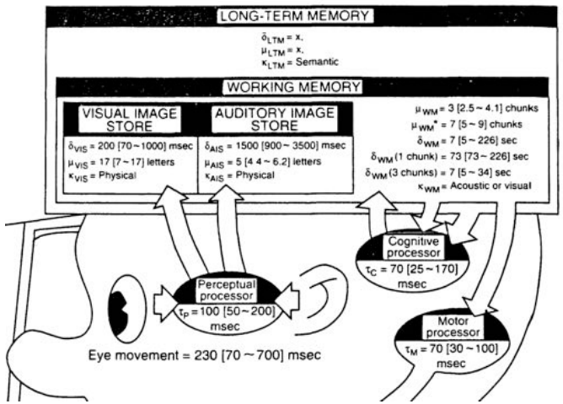
Model Human Processor (MHP) (Card, Moran & Newell, 1983)
https://www.wikipendium.no/TDT4137_Cognitive_Architectures
Notes:
most influential model of human processing
Three interacting subsystems
Cognitive, perceptual & motor
Each with processor & memory
described by parameters such as capacity, cycle time
Capable of serial & parallel processing

Slide 16
MHP Principles and Parameters
10 Principles of operation
Describe subsystem behavior under certain conditions
e.g. Fitts’s Law, Power Law of Practice
Processors have
cycle time (τ)
Memories have
storage capacity (μ)
decay time of an item (δ)
info code type (κ)
physical, acoustic, visual & semantic
Parameters based on empirical studies of word processing tasks
Notes:
Fitt’s Law: time to target acquisition
Power law of practice: time to perform task

Slide 17
Example: Perceptual Subsystem Parameters
Processor
cycle time (τ) = 100 msec
Visual Image Store
storage capacity (μ) = 17 letters
decay time of an item (δ) = 200 msec
info code type (κ) = physical
physical properties of visual stimulus, e.g., intensity, color, curvature, length
Notes:
It may take you (on average) 100ms to perceive something
Let’s say it’s a visual object (a word!)
You may perceive up to 17 letters
You will then retain those characters in your visual image store for 200ms on average (up to 1000ms → 1 second)
Along with it’s physical code type, i.e., …

Slide 18
Model Human Processor (MHP) (Card, Moran & Newell, 1983)
https://www.wikipendium.no/TDT4137_Cognitive_Architectures
Notes:
What might happen from there?
VIS → WM → handled by your cognitive processor, then if necessary, you may even push some action to your motor processor,
e.g., maybe you were correcting a sentence or maybe you were deciding which object to pick up
Each one of those perceptions, analyses, and reactions have an empirically based time/count associated with it!

Slide 19
19-GOMS & KLM
Key topics/questions for this lecture
Evaluation approaches
The Model Human Processor
Predictive models: GOMS & KLM
IA #5: KLM Study

Slide 20

Prediction Without Users
Notes:
Predictive (User) Modeling provides specific performance predictions without testing users
Good when user testing isn’t feasible
Idea is to construct a rough model of the user based on what is known about the limits of human performance
We’ll consider two well-known models: GOMS and its “daughter,” the Keystroke Level Model

Slide 21
GOMS Overview
Proposed by Card, Moran, & Newell (1983)
Models cognitive processes that take place as users interact with systems (text processing was original focus)
Uses “model human processor” to predict performance of tasks in user interface

Slide 22
GOMS in More Detail (CMN-GOMS)
Goals: what the user wants to achieve
Operators: the cognitive processes and physical actions available to achieve those goals
Methods: Learned procedures for accomplishing goals (routinized operators)
Selection rules: Determine which method to use in cases in which more than one is available at a given point
Notes:
Card, Moran and Newell GOMS
GOMS models goal-directed user interaction
GOMS is based on a careful task analysis, leading to identification of G, O, M, and S

Slide 23
GOMS: Simple Example
Goal: Obtain list of web pages containing keyword “squirrel”
Method 1: URL field
Step 1: Recall “squirrel” is keyword for search
Step 2: Recall presence of URL field in browser
Step 3: Accomplish goal by typing “squirrel” into text field and hitting return
Step 4: Return with goal accomplished
Method 2: Google main page
Step 1: Recall “squirrel” is keyword for search
Step 2: Recall “google.com” is URL of Google main page
Step 3: Locate URL field in web browser
Step 4: Type “google.com” into URL field and hit return
Step 5: Type “squirrel” into search field on Google main page and hit return
Step 6: Return with goal accomplished

Slide 24
GOMS: Simple Example (cont.)
Operators used:
Move cursor to text field
Click mouse
Depress keyboard key
Selection rules
If aware of URL field, type keyword directly into URL field
If unaware of URL field, first navigate to Google home page, then type keyword into text field

Slide 25
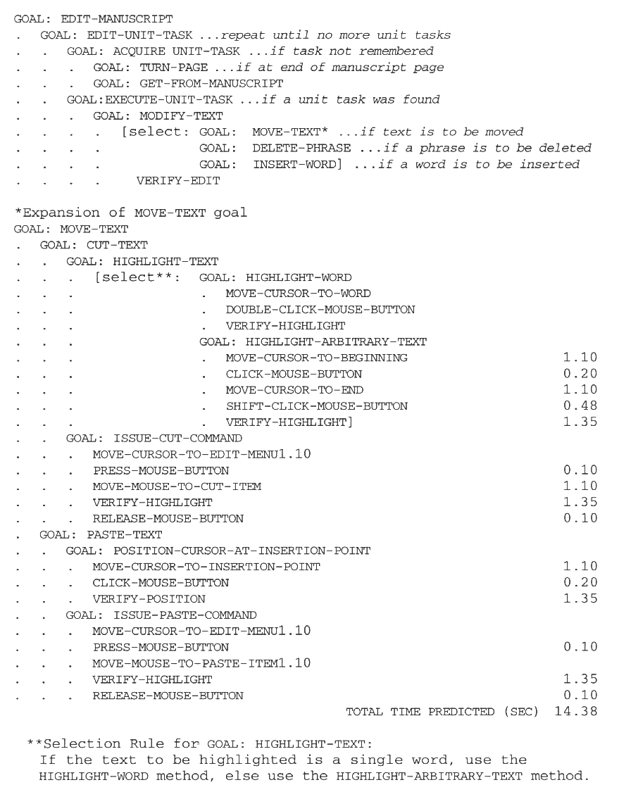
More Complex Text-Editing Example
Notes:
This illustrates the hierarchical nature of the model: Goals can have subgoals and sub-subgoals. Each operator has an empirically-derived time.

Slide 26
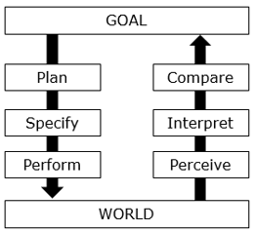
Survey Question 5: Where is GOMS/KLM situated within Seven Stages of Action model?
A
F
B
E
C
D
Notes:
C → because it is in the actual performing of the tasks (and the timing of those actions!)

Slide 27
What are the limitations or weaknesses of the GOMS model?
Does not provide directions for task analysis (hard to determine appropriate granularity)
Only models serial (instead of parallel) perceptual processing, contrary to MHP
Only one active goal at a time
Assumes error-free expert performance
- Can’t handle fatigue or learning
- Does not account for problem solving or evaluation, as does Norman’s Action Cycle
Notes:
Does not provide directions for task analysis (hard to determine appropriate granularity)
Only models serial (instead of parallel) perceptual processing, contrary to MHP
Only one active goal at a time
Assumes error-free expert performance
Can’t handle fatigue or learning
Does not account for problem solving or evaluation, as does Norman’s Action Cycle

Slide 28
Keystroke Level Model (KLM)
A finer grained “daughter” to GOMS developed by Card, Moran, & Newell (1983)
Looks at specific user actions, without consideration of overall goals (no hierarchical decomposition of tasks)
Based on Card, Moran, & Newell’s empirically-derived times for basic human operations (e.g., keystrokes, homing)
See L19-KLM.pdf on MS Teams for a highly-readable, detailed treatment of the Keystroke Level Model

Slide 29
KLM Operators
A single keystroke (K): 0.28 sec
ctrl key counts as separate keystroke
Pointing at target (P): 1.10 sec
Mouse click (B): 0.1 for “mouse down,” and 0.1 for “mouse up”)
Homing: 0.40 sec.
Mental preparation (M): 0.6 – 1.35 sec.; use 1.2 sec on average
Wait for system (W): t (variable)
Notes:
These are suggested timings → note the timing ranges in the supplemental documents

Slide 30
KLM Example 1
Formula for predicting task time: T_{exec} = T_{K} + T_{P} + T_{B} + T_{H} + T_{M} + T_{W}
Example:
Task: Use URL bar to obtain list of web pages with keyword “squirrel”:
Point at URL bar: T_{P} = 1.10 sec
Click in URL bar: T_{BB} = 0.20 sec
Home to keyboard: T_{H} = 0.40 sec
Mentally prepare for typing: T_{M} = 1.20 sec
Type in “squirrel”: T_{K} = 8 * 0.28 sec
Type return key: T_{K} = 0.28 sec
Wait for system response: T_{w} = 0.5 sec (estimated)
Total: 5.92 sec
Notes:
Note: Assume here that hand is already on mouse, so no initial homing is necessary
Timing of execution equals timing for keystrokes + pointing to the target + mouse clicks (up and down) + homing time + mental preparation time + waiting for the system.

Slide 31
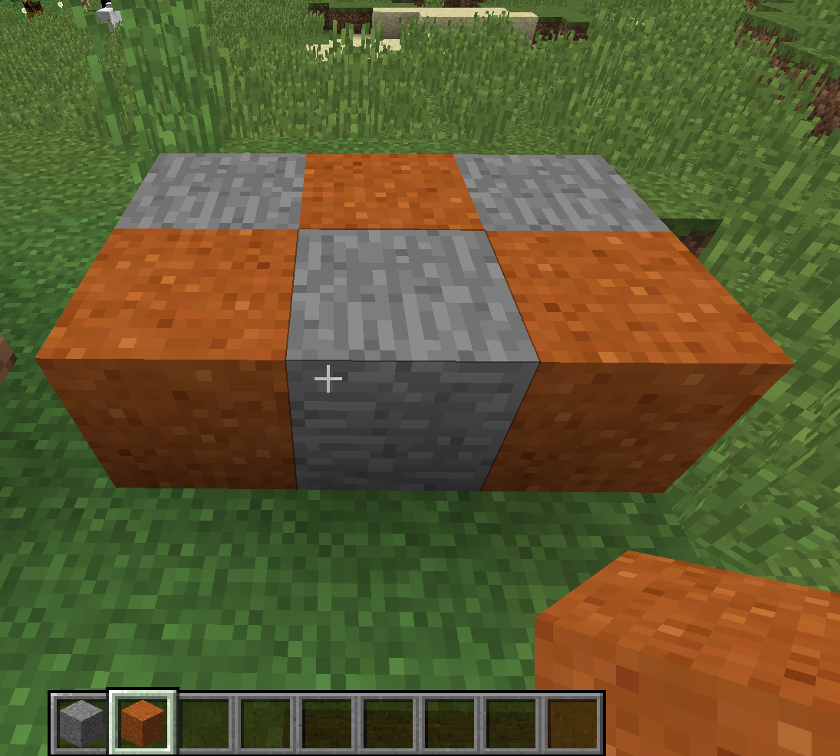
KLM example 6-block Minecraft task
Build alternating 6-block struct
Crosshair moves with mouse
Right click to place block at crosshair position
Numeric keys select block color (1 = gray, 2 = orange)
Notes:
How might we form a keystroke level model for the task of creating this 6 block configuration?
Open up KLM Model Minecraft.xlsx once we get started with model

Slide 32
Minecraft 6-block task: a possible KLM Model
Task Step | Operator | Time
Type “1” | K | 0.28
Home to Mouse | H | 0.4
Right click | BB | 0.2
Point to next square | P | 1.1
Home to keyboard | H | 0.4
Type “2” | K | 0.28
Home to mouse | H | 0.4
Right click | BB | 0.2
Point to next square | P | 1.1
Home to keyboard | H | 0.4
Type “1” | K | 0.28
…

Slide 33
Survey Question 6
In order to predict human performance, predictive models need to know
what specific task is to be performed
How long it typically takes a person to do components of a task
the specific user who will perform the task
A & B
A & C
Notes:
A, B, possibly C if you want a scenario with, e.g., a ‘slow’ user.

Slide 34
Survey Question 7
A key limitation of the GOMS and KLM models is that
They assume error-free performance
They cannot account for serial human processing
they do not produce actual time predictions
More than one of the above
None of the above
Notes:
A

Slide 35
Advantages of GOMS/KLM to Analyze Task Performance
No working prototype needed; interface must be specified at level of task sequences, not interface elements
No users are required; in Card, Moran, & Newell (1983) predicted expert performance with 80% accuracy

Slide 36
Disadvantages of Using GOMS/KLM to Analyze Task Performance
Models do not account for learning or fatigue (expert performance assumed)
Models do not account for human errors! (assumed to be a “wash,” but in practice, can be substantial part of task times, especially in non-expert performance)
In KLM, knowing where to place mental preparation times can be difficult
No guidelines provided by GOMS for appropriate level of granularity
GOMS and KLM cannot handle parallel processing

Slide 37
Summary
Formative evaluation used to verify evolving design; summative evaluation used to verify final design
Three general evaluation paradigms: usability studies, field studies, analytical evaluation
User modeling leverages past empirical studies of limits of human info processing in order to make concrete predictions regarding goal-directed human performance

Slide 38
19-GOMS & KLM
Key topics/questions for this lecture
Evaluation approaches
The Model Human Processor
Predictive models: GOMS & KLM
IA #5 (extra credit): KLM Study

Slide 39
IA#5: User modeling OPTIONAL → worth up to 2% extra credit
Given a specific word processing task:
model the task and obtain predictions using KLM
Recruit three participants to use your procedure to perform the tasks error-free while you time them
Build a table of your results
Discuss your results relative to predictions
SEE ASSIGNMENT FOR FULL DETAILS
Due on 3/30 at 11:59 p.m.

Slide 40
In Class Assignment: Create a KLM
Task to model → “Submit the “KLM Model Spreadsheet.xlsx to the ‘L19 In-Class assignment’ on MS Teams”
Starting Assumptions:
You have already downloaded and completed the spreadsheet (available as an attachment to the above assignment) to your computer
You are already logged in to MS Teams in your browser and are currently viewing the “Assignments” tab
Your hands are on the keyboard.

Slide 41
Each Student Must Submit a Completed “KLM Model-Spreadsheet”
“Task Model” tab
Identify each task and task step
Associate a KLM operator with each step
Operator time will auto-populate
“Data” tab
Time you and your teammates performing 3 error free task completion runs.
Fill in your timings in Participant columns
Spreadsheet auto-calculates percent error!
Work on this in breakout rooms in remainder of class

Slide 42

Percent Error Formula (Built in to spreadsheet)

Slide 43
Announcements
Submit “L19 GOMS KLM” suvey for participation credit by 1 p.m. today
Submit “L19 In-Class Assignment” t for participation credit by 11:59 p.m. tonight
TP #1 (Early Data Gathering) due tonight at 11:59 pm
TP#2a due 4/6; TP #2b due 4/13

