Slide 1
Prediction of Boston House Price
Presenters: Jinyi Shang
Yu Cao
Chaohui Li

Slide 2
Contents
Part 01
Introduction
Part 05
Neuron Network
Part 02
Dataset Description
Part 06
Ensemble method
Part 03
Data Preprocessing
Part 07
Summary
Part 04
Linear Regression
Part 08
Q&A

Slide 3
PART 01
Introduction

Slide 4
Introduction
The house value is related to many factors. So our project will focus on solving the problem of predicting house price for house buyers and sellers.
The data is collected from Boston. There are total 506 entries and 13 features.

Slide 5
PART 02
Dataset Description

Slide 6
Dataset Description
# | Column | Description | Non-Null Count | Dtype
0 | CRIM | Crime rate per capita in towns | 486 non-null | float64
1 | ZN | Proportion of residential land | 486 non-null | float64
2 | INDUS | Proportion of non-commercial land in urban areas | 486 non-null | float64
3 | CHAS | Charles River Dummy Variable | 486 non-null | float64
4 | NOX | Environmental protection index | 506 non-null | float64
5 | RM | Number of rooms per house | 506 non-null | float64
6 | AGE | Proportion of self-occupied units built before 1940 | 486 non-null | float64
7 | DIS | Weighted distance from Boston’s five employment centers | 506 non-null | float64
8 | RAD | Convenience Index to Highway | 506 non-null | int64
9 | TAX | Real estate tax rate per US$10,100 | 506 non-null | int64
10 | PTRATIO | Teacher-student ratio in towns | 506 non-null | float64
11 | B | Proportion of blacks in towns | 506 non-null | float64
12 | LSTAT | Proportion of landlords belonging to the lower income class | 486 non-null | float64
13 | MEDV | Median of house price of self-occupied house | 506 non-null | float64

Slide 7
Dataset Description
 | CRIM | ZN | INDUS | CHAS | NOX | RM | AGE
count | 486 | 486 | 486 | 486 | 506 | 506 | 486
mean | 3.612 | 11.212 | 11.084 | 0.070 | 0.555 | 6.285 | 68.519
std | 8.720 | 23.389 | 6.836 | 0.255 | 0.116 | 0.703 | 28.000
min | 0.006 | 0.000 | 0.460 | 0.000 | 0.385 | 3.561 | 2.900
median | 0.254 | 0.000 | 9.690 | 0.000 | 0.538 | 6.209 | 76.800
max | 88.976 | 100.000 | 27.740 | 1.000 | 0.871 | 8.780 | 100.000
 | DIS | RAD | TAX | PTRATIO | B | LSTAT | MEDV
count | 506 | 506 | 506 | 506 | 506 | 486 | 506
mean | 3.795 | 9.549 | 408.237 | 18.456 | 356.674 | 12.715 | 22.533
std | 2.106 | 8.707 | 168.537 | 2.165 | 91.295 | 7.1561 | 9.197
min | 1.130 | 1.000 | 187.000 | 12.600 | 0.320 | 1.730 | 5.000
median | 3.207 | 5.000 | 330.000 | 19.050 | 391.440 | 11.430 | 21.200
max | 12.127 | 24.000 | 711.000 | 22.000 | 396.900 | 37.970 | 50.000

Slide 8
PART 03
Data Preprocessing

Slide 9
Data Preprocessing
Missing Values
The numbers of missing values for every feature:
CRIM | ZN | INDUS | CHAS | NOX | RM | AGE
TRUE | TRUE | TRUE | TRUE | FALSE | FALSE | TRUE
20 | 20 | 20 | 20 | 0 | 0 | 20
DIS | RAD | TAX | PTRATIO | B | LSTAT | MEDV
FALSE | FALSE | FALSE | FALSE | FALSE | TRUE | FALSE
0 | 0 | 0 | 0 | 0 | 20 | 0

Slide 10
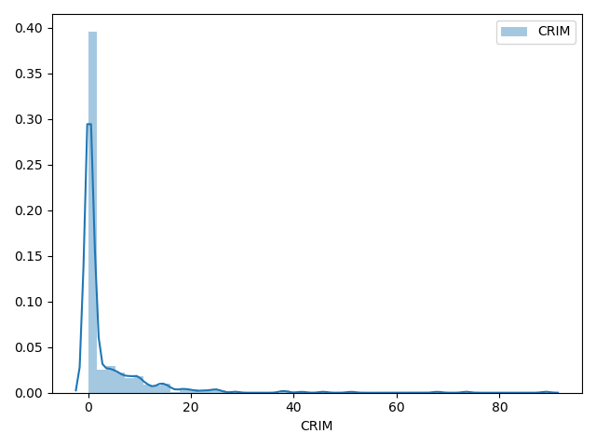
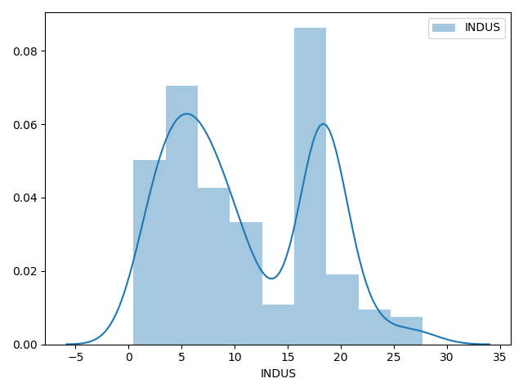
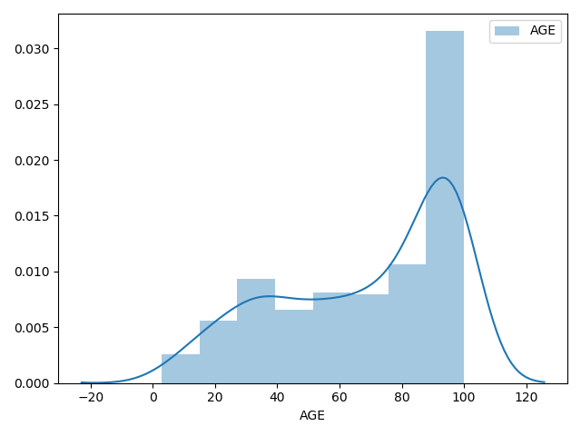
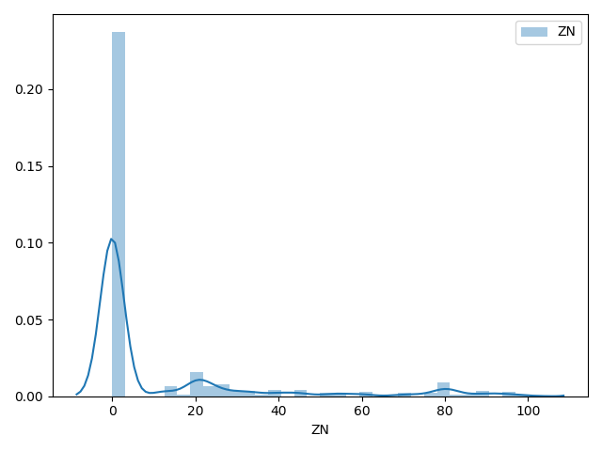
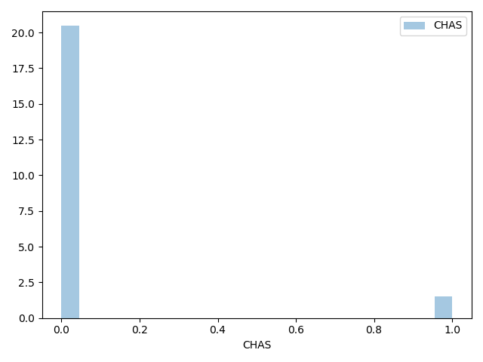
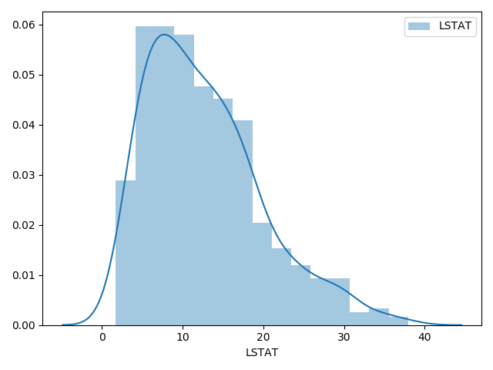
Data Preprocessing
Missing Values
The distribution for features that exist missing values:

Slide 11
Data Preprocessing
Missing Values
Three kinds of filling strategies:
imp1 = SimpleImputer(missing_values=np.nan, strategy='median') imp2 = SimpleImputer(missing_values=np.nan, strategy='mean') imp3 = SimpleImputer(missing_values=np.nan, strategy='most_frequent')
df = boston_housing.copy() imp1.fit(np.array(df['CRIM']).reshape(-1, 1)) df['CRIM'] = imp1.transform(np.array(boston_housing['CRIM']).reshape(-1, 1)) imp1.fit(np.array(df['ZN']).reshape(-1, 1)) df['ZN'] = imp1.transform(np.array(boston_housing['ZN']).reshape(-1, 1)) imp2.fit(np.array(df['INDUS']).reshape(-1, 1)) df['INDUS'] = imp2.transform(np.array(boston_housing['INDUS']).reshape(-1, 1)) imp3.fit(np.array(df['CHAS']).reshape(-1, 1)) df['CHAS'] = imp3.transform(np.array(boston_housing['CHAS']).reshape(-1, 1)) imp1.fit(np.array(df['AGE']).reshape(-1, 1)) df['AGE'] = imp2.transform(np.array(boston_housing['AGE']).reshape(-1, 1)) imp1.fit(np.array(df['LSTAT']).reshape(-1, 1)) df['LSTAT'] = imp1.transform(np.array(boston_housing['LSTAT']).reshape(-1, 1))

Slide 12
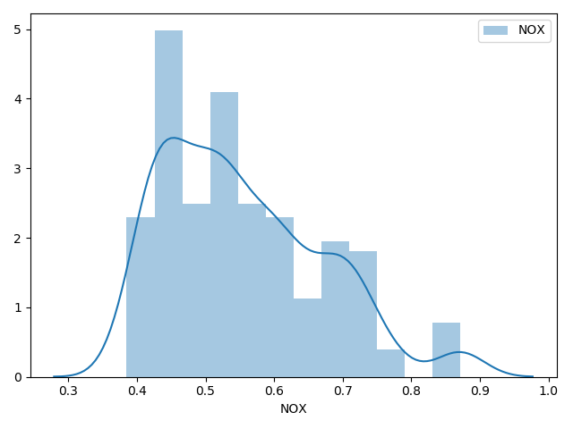
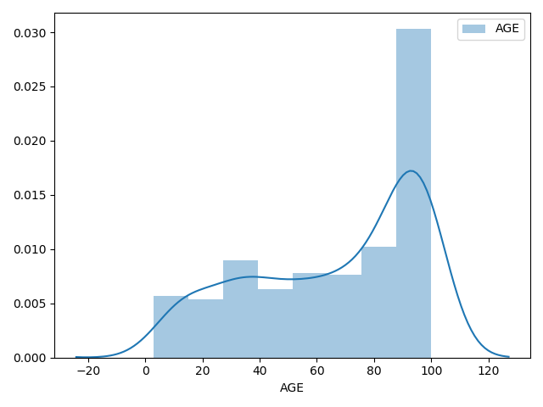
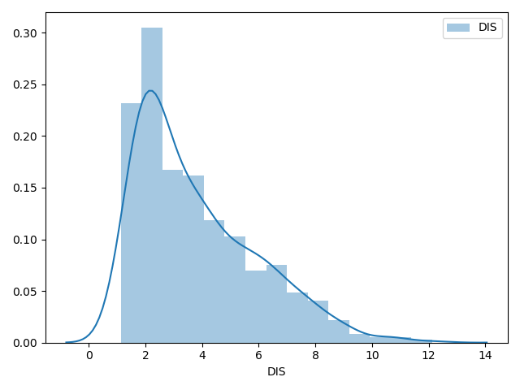
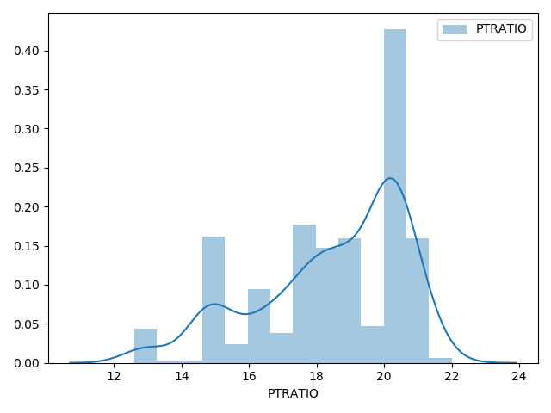
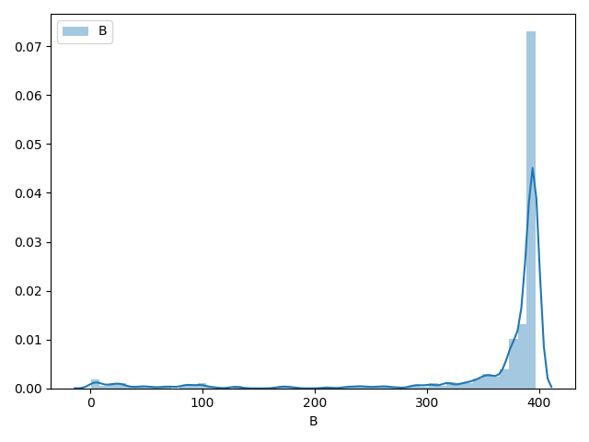
Data Preprocessing
Transformation and Standardization
Non-linear transformation

Slide 13
Data Preprocessing
Transformation and Standardization
pt = preprocessing.PowerTransformer() features_pt = pt.fit_transform(features)
method=‘box-cox’
method=‘yeo-johnson’
Standardize=True
Box-Cox requires input data to be strictly positive.
Yeo-Johnson supports both positive and negative data.

Slide 14
Data Preprocessing
Feature Significance Test
sklearn.feature_selection.SelectKBest(score_func, k)
score_func: k:
For regression: f_regression, mutual_info_regression k=int or “all”
f_test, _ = f_regression(features_pt, price) mi = mutual_info_regression(features_pt, price) new = SelectKBest(f_regression, k='all') new.fit_transform(features_pt, price) print('p_values of features are:', new.pvalues_) plt.figure(figsize=(15, 5)) for i in range(len(cols)): plt.scatter(features_pt[:, i], price, edgecolors='black', s=20) plt.xlabel("{}".format(cols[i]), fontsize=14) plt.title("F-test={:.2f}, MI={:.2f}, p_value={:.2f}".format(f_test[i], mi[i], new.pvalues_[i])) plt.show()

Slide 15
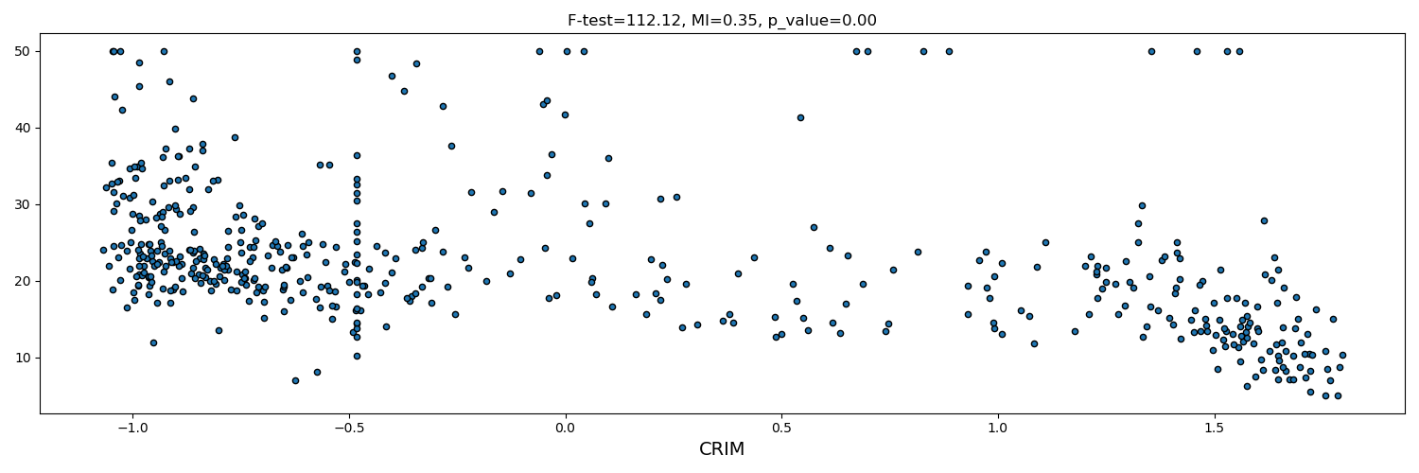
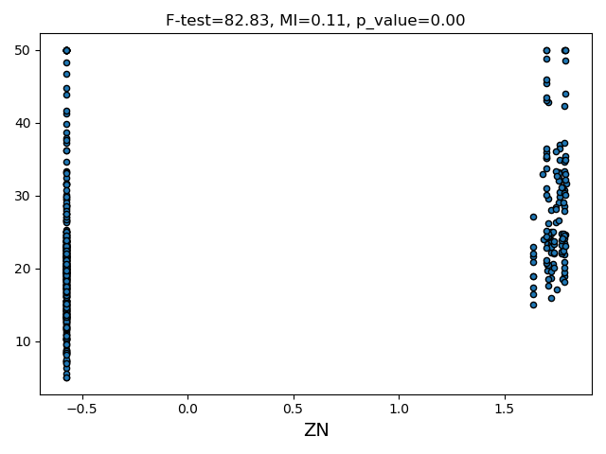
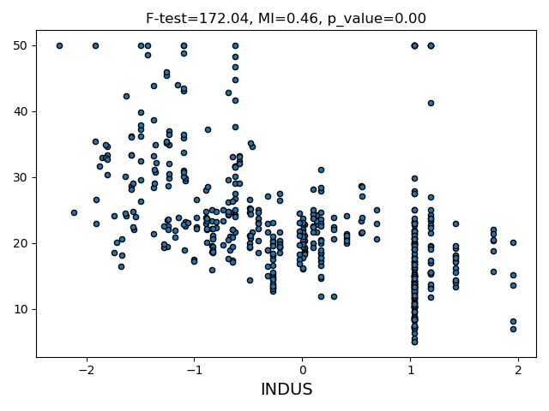
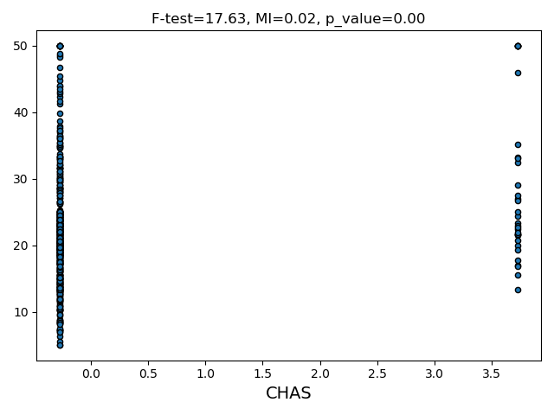
Data Preprocessing
Feature Significance Test

Slide 16
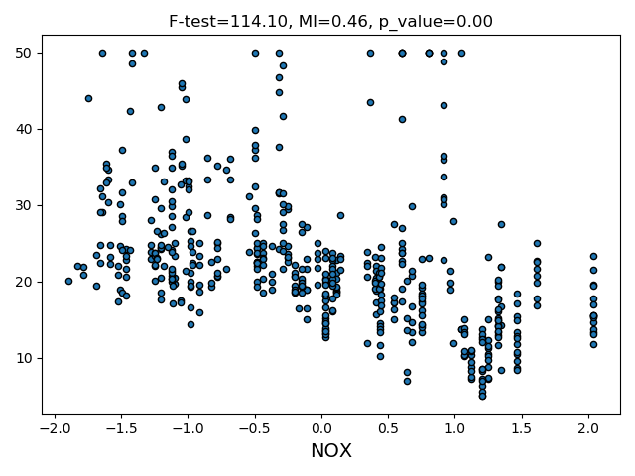
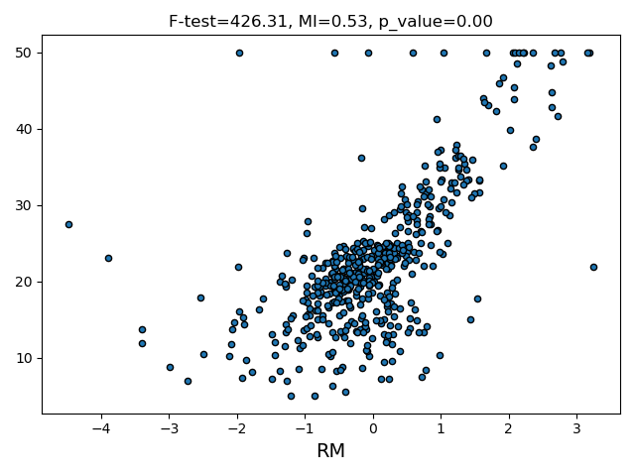
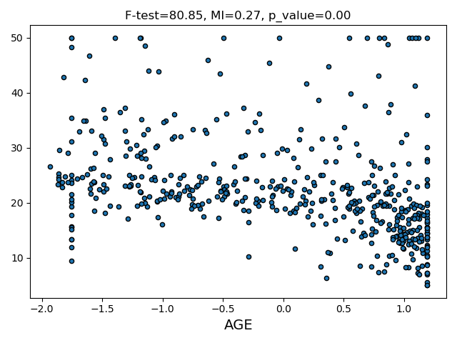
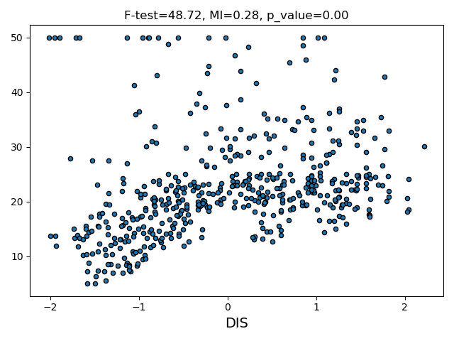
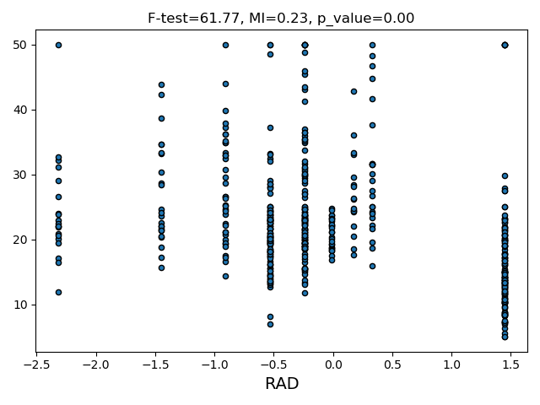
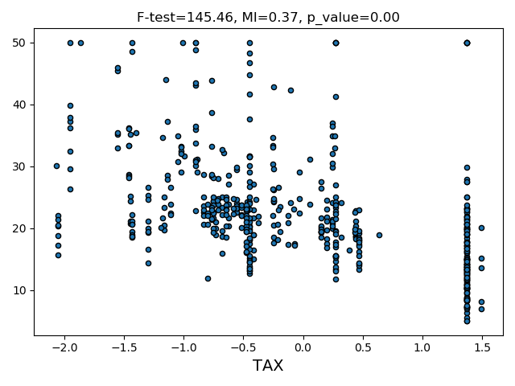
Data Preprocessing
Feature Significance Test

Slide 17
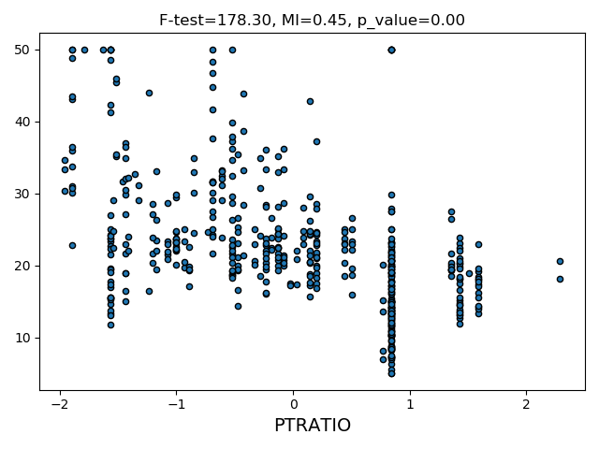
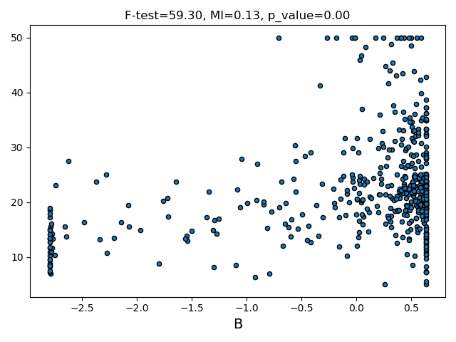
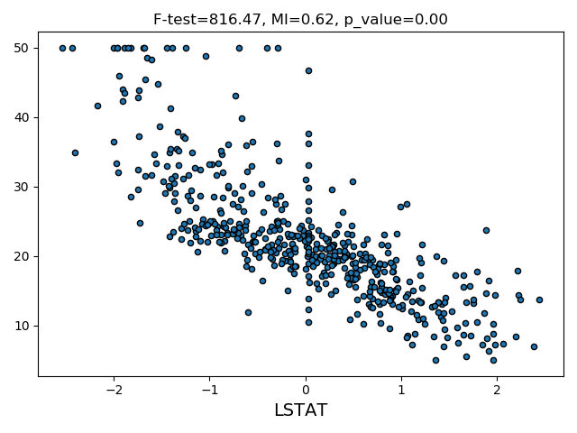
Data Preprocessing
Feature Significance Test
summary of p_value
CRIM | ZN | INDUS | CHAS | NOX | RM | AGE
8.59E-24 | 2.08E-18 | 5.06E-34 | 3.17E-05 | 3.79E-24 | 4.33E-69 | 4.92E-18
DIS | RAD | TAX | PTRATIO | B | LSTAT
9.35E-12 | 2.35E-14 | 1.32E-29 | 4.91E-35 | 7.22E-14 | 1.75E-107

Slide 18
PART 04
Linear Regression

Slide 19
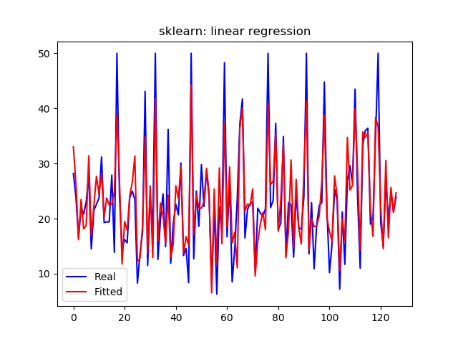
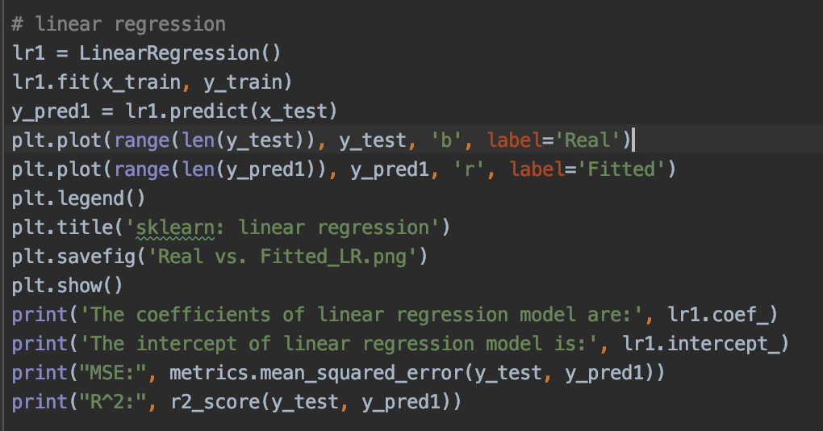
Results
MSE & R²:
MSE: 20.239 R²: 0.796
Real vs. Fitted

Slide 20
PART 05
Neural Network

Slide 21
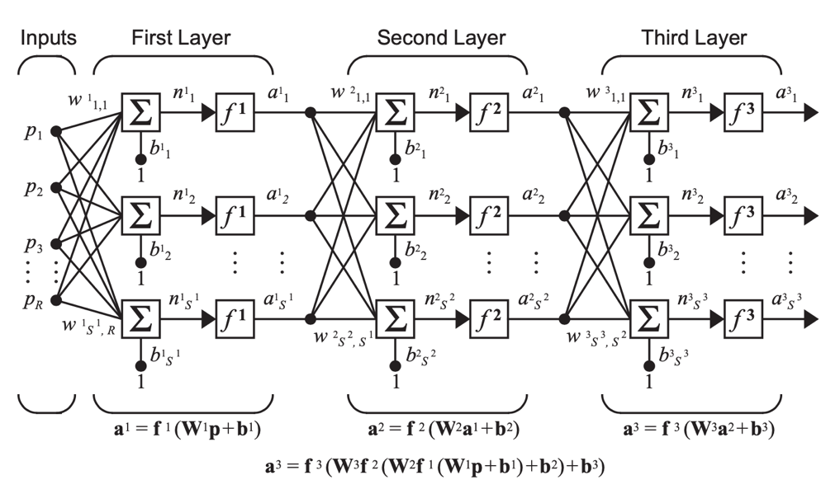


Neural Network
Neural Networks are a set of algorithms,
modeled loosely on the human brain.
Three-Layer Network
Net Input
Neuron Output

Slide 22
Parameters
Model：
MLPRegressor()
Parameters：
activation | activation function for the hidden layer
solver | the solver for weight optimization
batch_size | size of minibatches for stochastic optimizers
max_iter | the maximum number of iterations
early_stopping | whether to stop when validation score is not improving

Slide 23
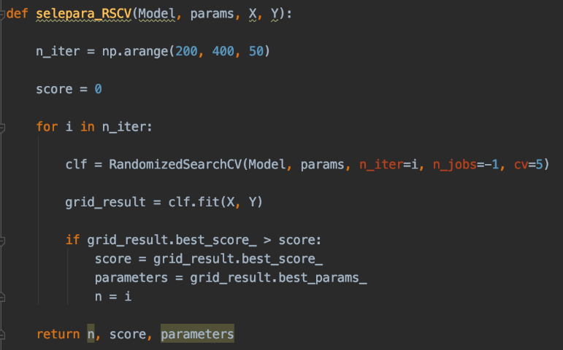
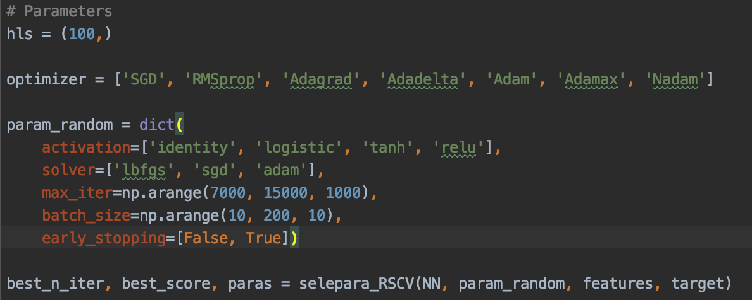
CV
RandomizedSearchCV:
grid search for parameters by randomly sampling in the parameter space
Its search ability depends on the set ‘n_iter’ parameter.
Best Parameters:
Parameters | activation | solver | batch_size | max_iter | early_stopping
Value | relu | sgd | 70 | 11000 | True

Slide 24
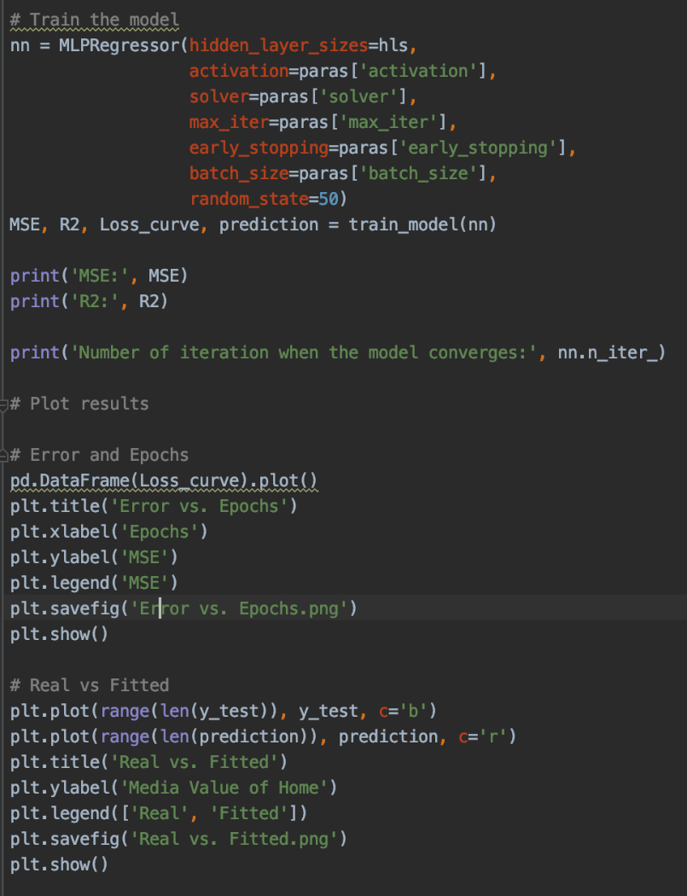
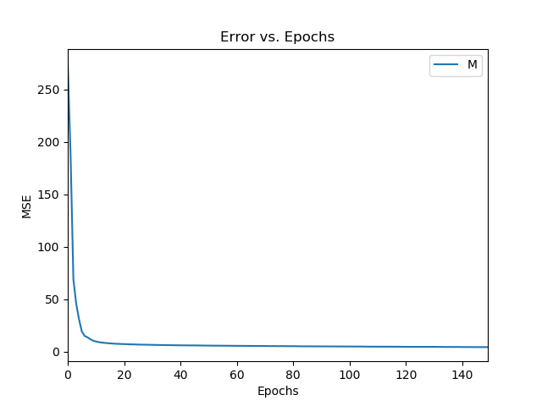
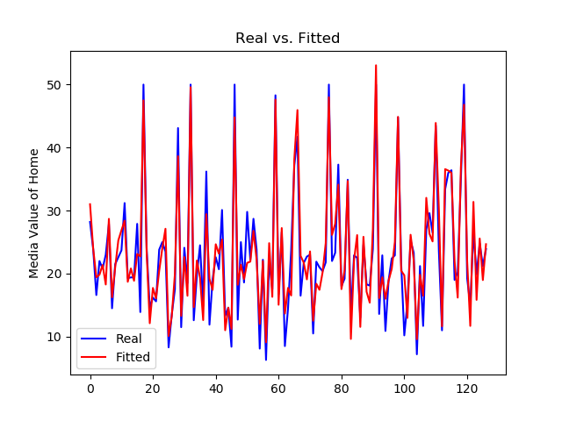
Results
MSE & R²:
MSE: 10.352. R²: 0.896
Error vs. Epochs
Real vs. Fitted

Slide 25
PART 04
Ensemble method

Slide 26
Ensemble method
Reason:
Data size
Bad generalization

Slide 27
Ensemble method
Bagging
random forest
01
Boosing
adaboost, Gradient boosting
02

Slide 28
Ensemble method
01
Random forest
How to improve the ability of generalization?
Resampling technique(Bootstrap)
Randomly select subfeature

Slide 29
Ensemble method
Bootstrap:
data set D : m samples,
randomly take a sample from D with replacement into set D'
data set D':m samples.

Slide 30
Ensemble method
Randomly select subfeature
Traditional: k of features
information gain
RF : subfeature set

Slide 31

Ensemble method
RF Performance:

Slide 32
Ensemble method
02
Gradient boosting
All of data
Estimator
weight value

Slide 33



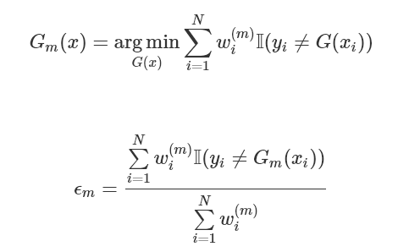


Given dataset:
and base estimator
initialize weight
train G(x):
Adaboost
calculate error rate
final model:
update parameter

Slide 34
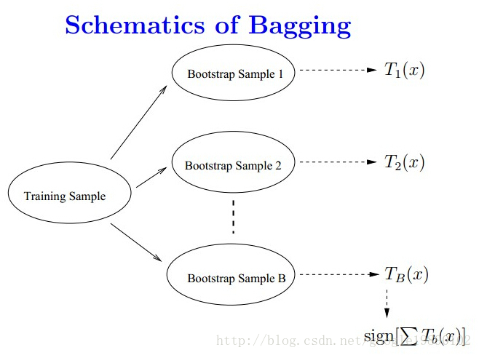
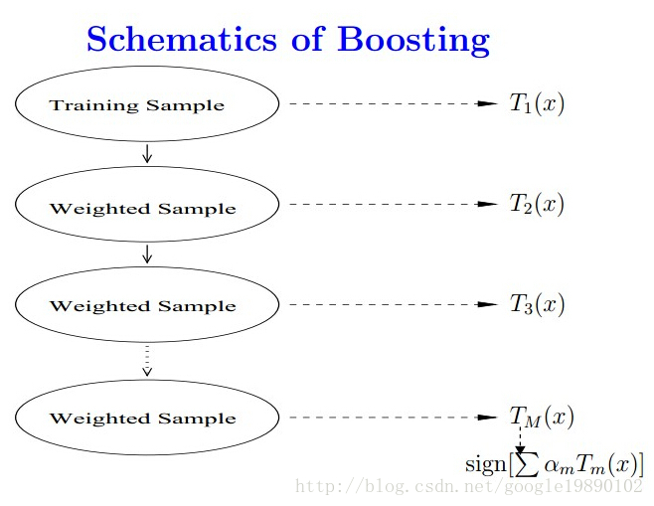
Schematics

Slide 35

Ensemble method
GB Performance:

Slide 36
PART 07
Summary

Slide 37
Model | MSE | R square
Linear regression | 20.239 | 0.796
Neural network | 10.352 | 0.896
Random forest | 9.376 | 0.905
Gradient boosting | 9.126 | 0.907
Ensemble method is better.

Slide 38
PART 08
Q&A

