Slide 1
Probabilistic Robotics:
Motion Model/EKF Localization
Advanced Mobile Robotics
Dr. Jizhong Xiao
Department of Electrical Engineering
CUNY City College
jxiao@ccny.cuny.edu

Slide 2
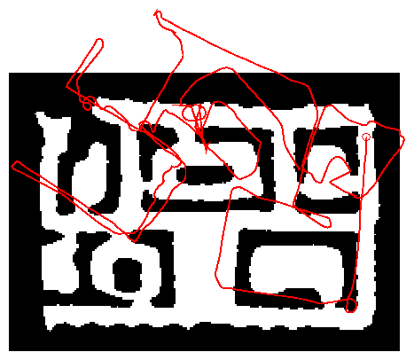
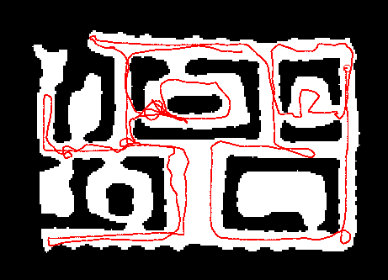
Robot Motion
Robot motion is inherently uncertain.
How can we model this uncertainty?

Slide 3
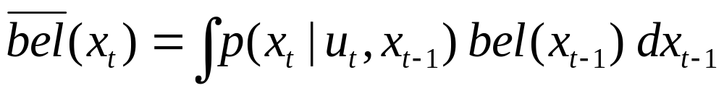
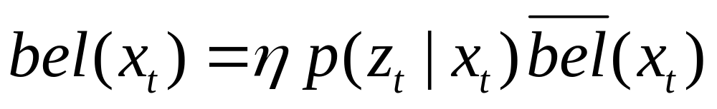
Bayes Filter Revisit
Prediction (Action)
Correction (Measurement)

Slide 4
Probabilistic Motion Models
To implement the Bayes Filter, we need the transition model p(x_{t} | x_{t-1}, u).
The term p(x_{t} | x_{t-1}, u) specifies a posterior probability, that action u carries the robot from x_{t-1} to x_{t}.
In this section we will specify, how
p(x_{t} | x_{t-1}, u) can be modeled based on the motion equations.

Slide 5
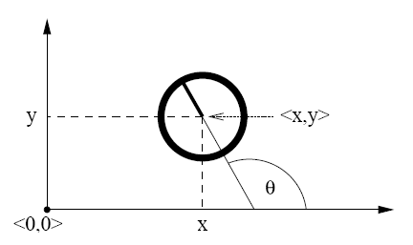
Coordinate Systems
In general the configuration of a robot can be described by six parameters.
Three-dimensional cartesian coordinates plus three Euler angles pitch, roll, and tilt.
Throughout this section, we consider robots operating on a planar surface.
The state space of such systems is three-dimensional (x, y, θ).

Slide 6
Typical Motion Models
In practice, one often finds two types of motion models:
  Odometry-based
  Velocity-based (dead reckoning)
Odometry-based models are used when systems are equipped with wheel encoders.
Velocity-based models have to be applied when no wheel encoders are given.
They calculate the new pose based on the velocities and the time elapsed.

Slide 7
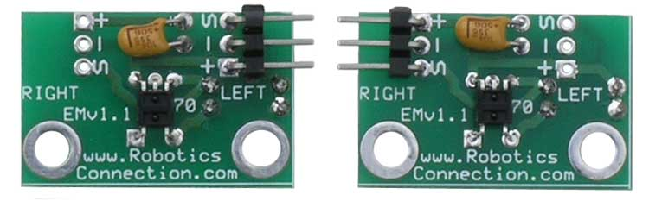
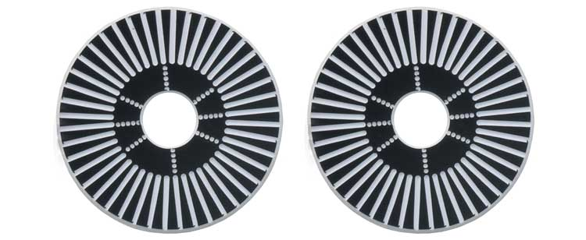
Example Wheel Encoders
These modules require +5V and GND to power them, and provide a 0 to 5V output. They provide +5V output when they "see" white, and a 0V output when they "see" black.
These disks are manufactured out of high quality laminated color plastic to offer a very crisp black to white transition. This enables a wheel encoder sensor to easily see the transitions.
Source: http://www.active-robots.com/

Slide 8
Dead Reckoning
Derived from “deduced reckoning.”
Mathematical procedure for determining the present location of a vehicle.
Achieved by calculating the current pose of the vehicle based on its velocities and the time elapsed.
Odometry tends to be more accurate than velocity model,
But, Odometry is only available after executing a motion command, cannot be used for motion planning

Slide 9
Reasons for Motion Errors
different wheel
diameters
ideal case
bump
carpet
and many more …

Slide 10
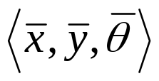
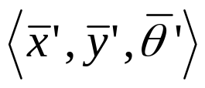
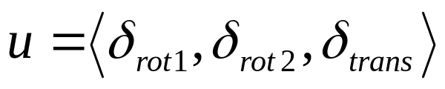
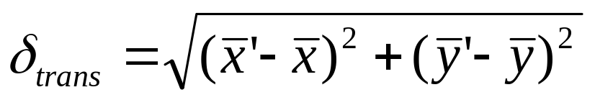
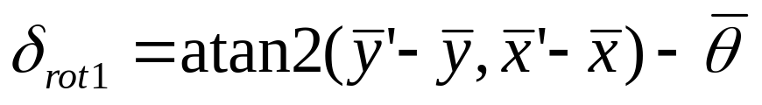
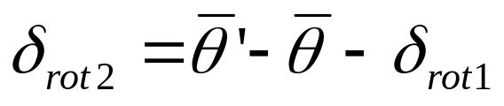
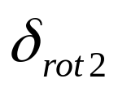
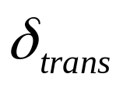

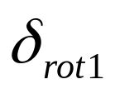
Odometry Model
Robot moves from to .
Odometry information .
Relative motion information, “rotation” → “translation” → “rotation”

Slide 11
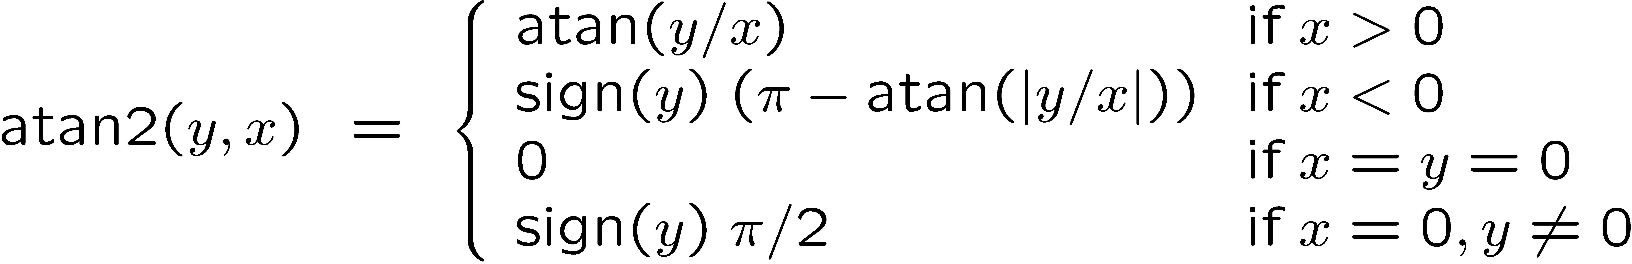
The atan2 Function
Extends the inverse tangent and correctly copes with the signs of x and y.

Slide 12
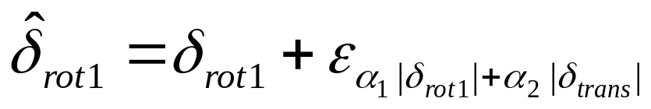
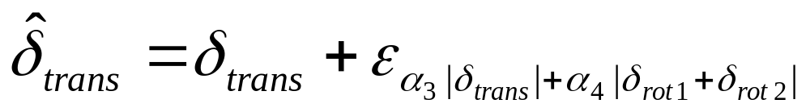
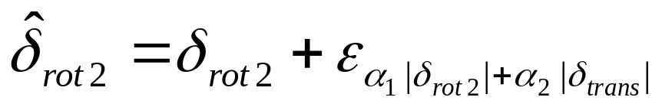
Noise Model for Odometry
The measured motion is given by the true motion corrupted with independent noise.

Slide 13
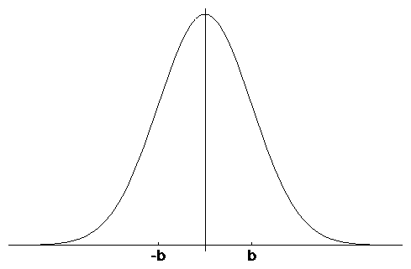
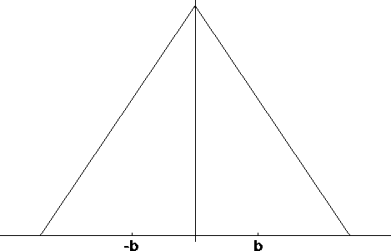
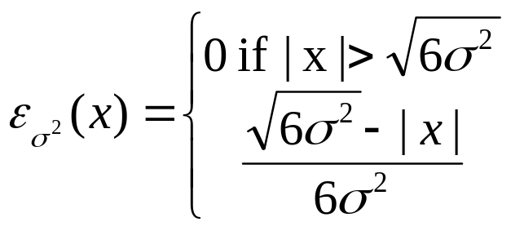
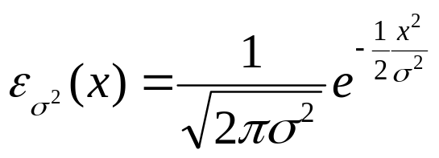
Typical Distributions for Probabilistic Motion Models
Normal distribution
Triangular distribution

Slide 14
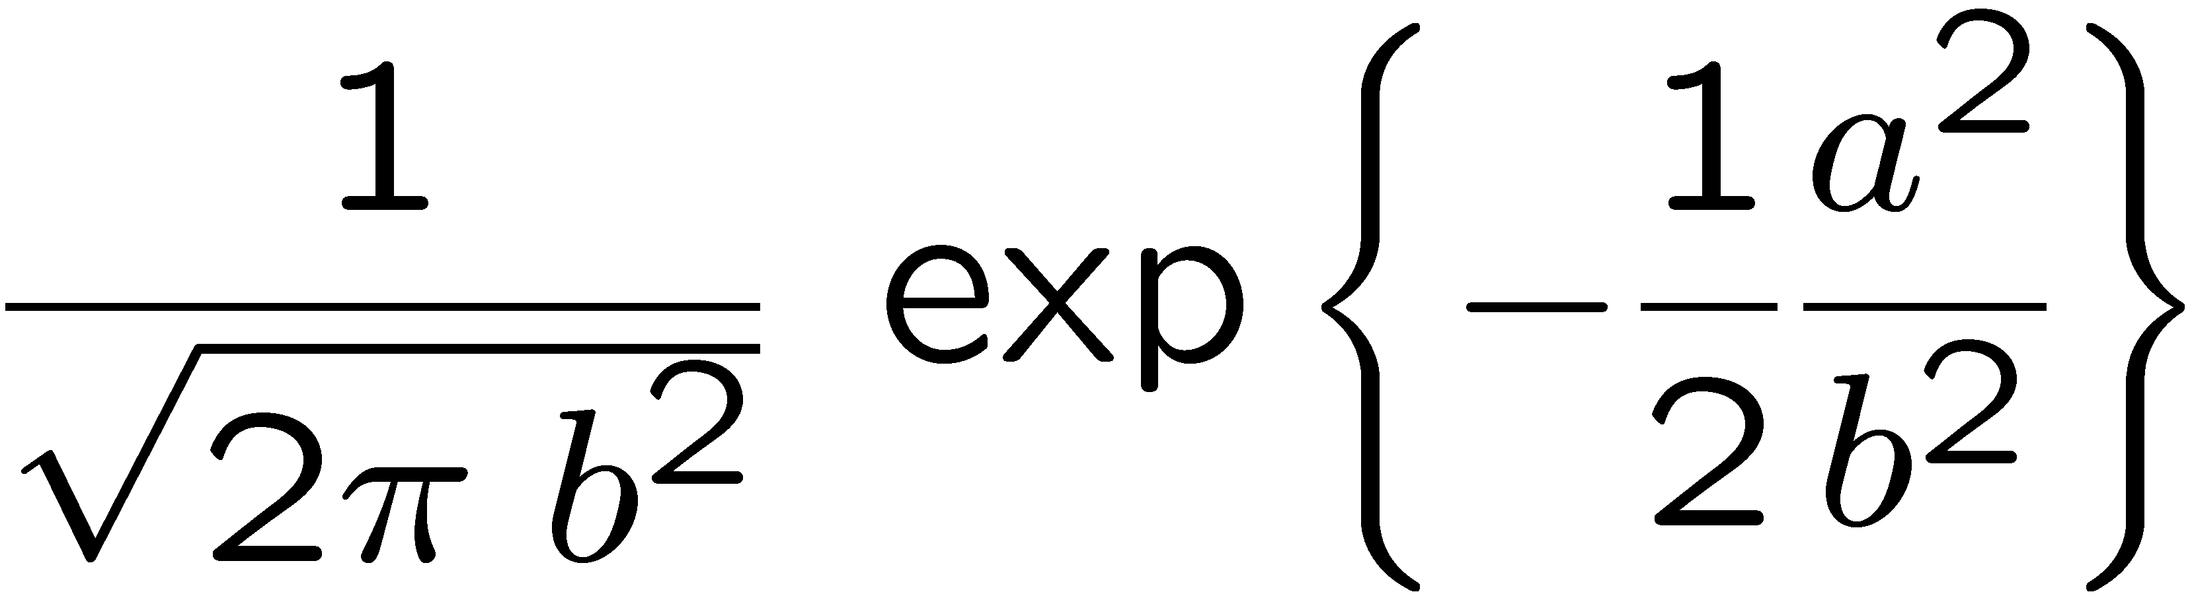
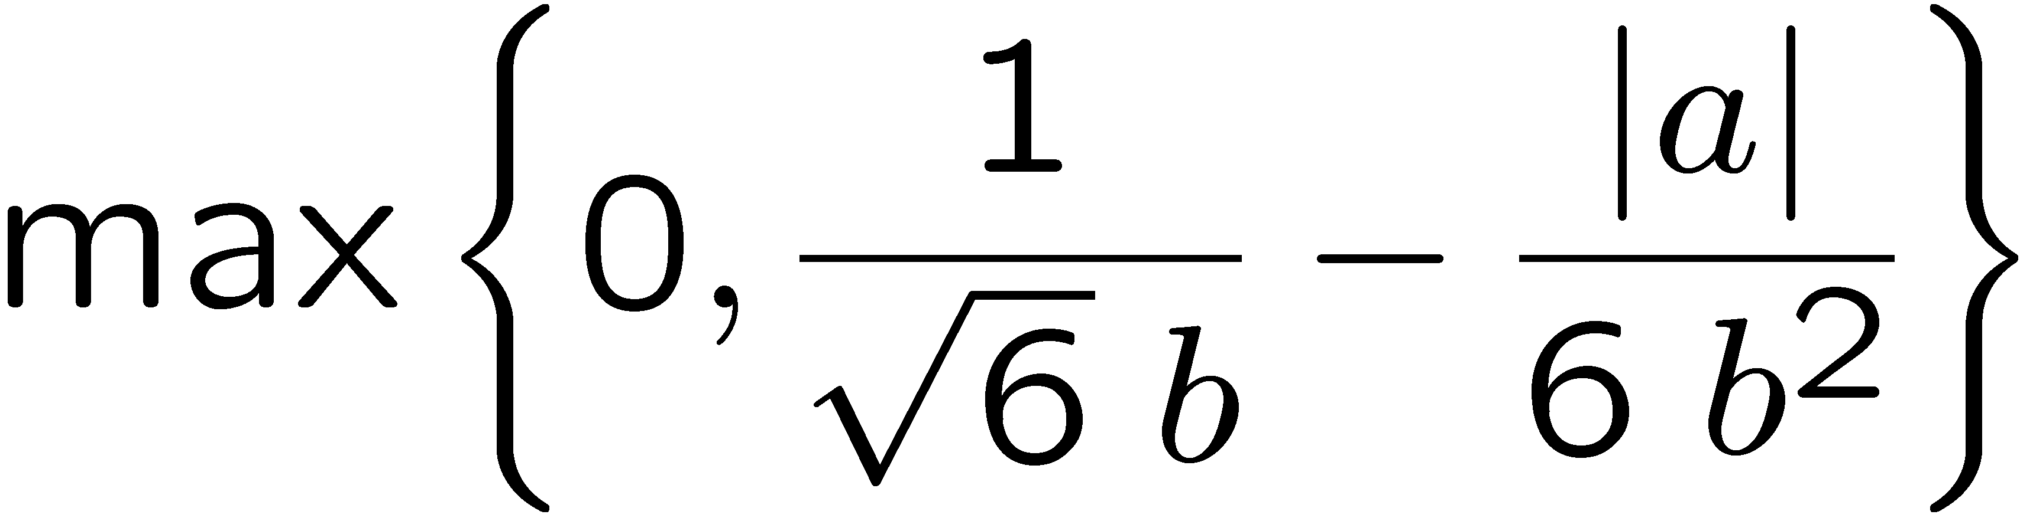
Calculating the Probability (zero-centered)
For a normal distribution
For a triangular distribution
Algorithm prob_normal_distribution(a, b):
return
Algorithm prob_triangular_distribution(a,b):
return

Slide 15
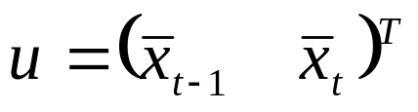

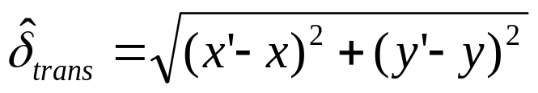

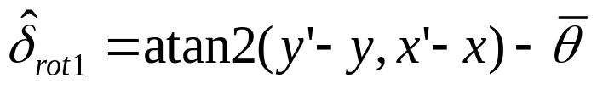
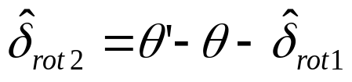
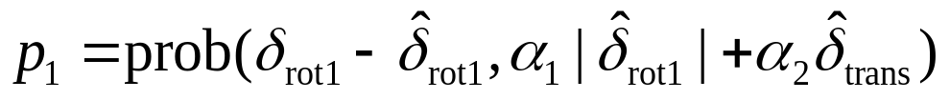
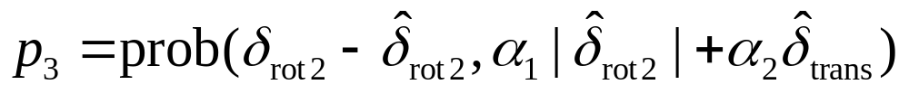


Calculating the Posterior
Given x_{t}, x_{t-1}, and u
An initial pose X_{t-1}
A hypothesized final pose X_{t}
A pair of poses u obtained from odometry
Algorithm motion_model_odometry (x_{t}, x_{t-1}, u)
return p₁ · p₂ · p₃
odometry values (u)
values of interest (x_{t-1}, x_{t})
Implements an error distribution over a with zero mean and standard deviation b

Slide 16
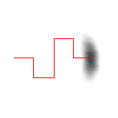

Application
Repeated application of the sensor model for short movements.
Typical banana-shaped distributions obtained for 2d-projection of 3d posterior.
p(x_{t}| u, x_{t-1})
x’
x’
u
u
Posterior distributions of the robot’s pose upon executing the motion command illustrated by the solid line. The darker a location, the more likely it is.

Slide 17
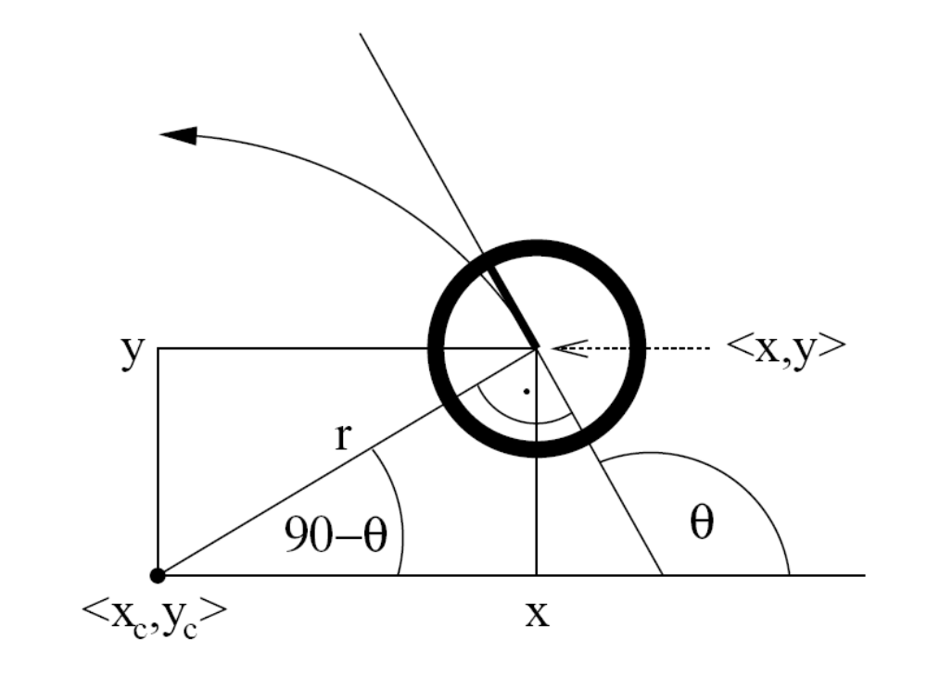
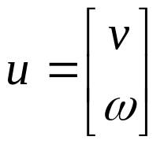
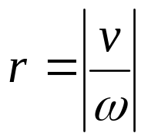
Velocity-Based Model
Rotation radius
control

Slide 18

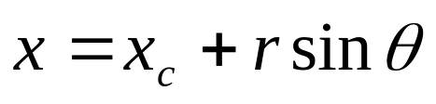
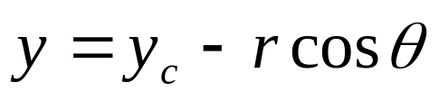

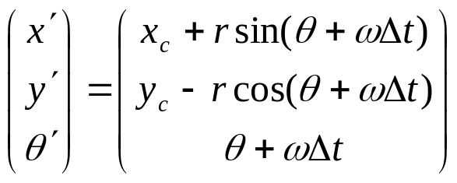
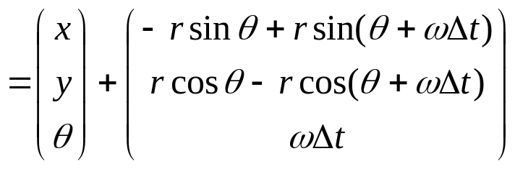
Equation for the Velocity Model
Instantaneous center of curvature (ICC) at (x_{c} , y_{c})
Initial pose
Keeping constant speed, after ∆t time interval, ideal robot will be at
Corrected, θ-90

Slide 19
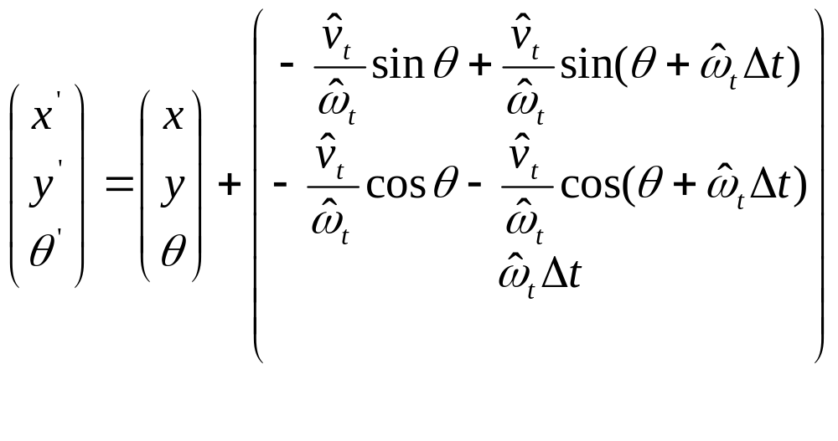





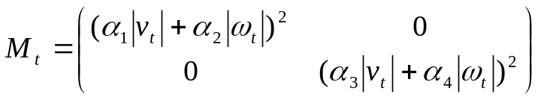
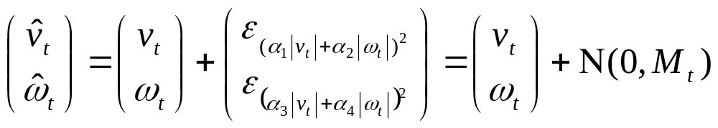

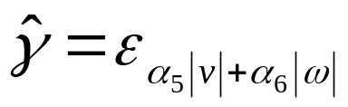

Velocity-based Motion Model
With and are the state vectors at time t-1 and t respectively
The true motion is described by a translation velocity and a rotational velocity
Motion Control with additive Gaussian noise
Circular motion assumption leads to degeneracy ,
2 noise variables v and w ➔ 3D pose
Assume robot rotates when arrives at its final pose

Slide 20
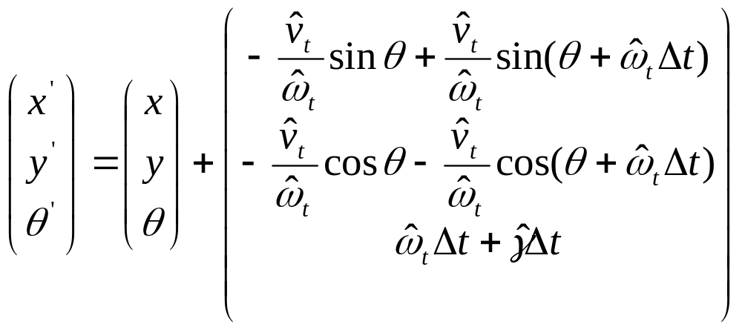
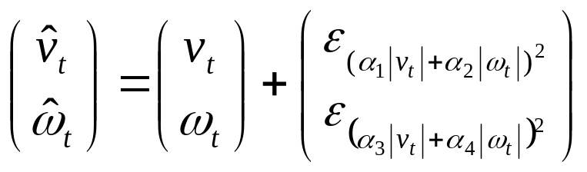
Velocity-based Motion Model
Motion Model:
α₁ to α₄ are robot-specific error parameters determining the velocity control noise
α₅ and α₆ are robot-specific error parameters determining the standard deviation of the additional rotational noise

Slide 21

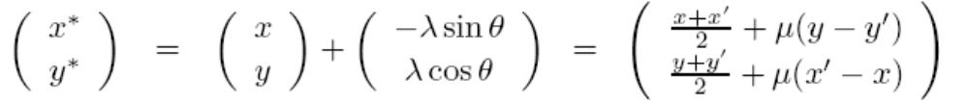
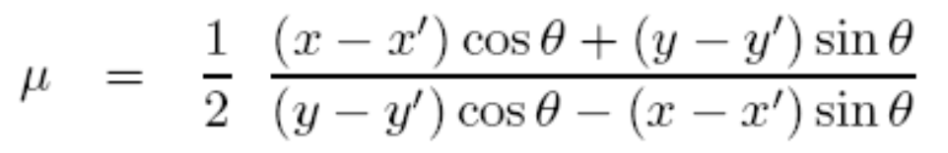
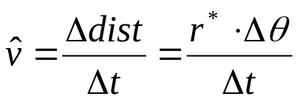
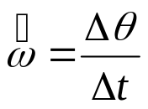

Probabilistic Motion Model
How to compute ?
Move with a fixed velocity during ∆t resulting in a circular trajectory from
to
Center of circle:
with
Radius of the circle:
Change of heading direction:
(angle of the final rotation)

Slide 22


Posterior Probability for Velocity Model
Center of circle
Radius of the circle
Change of heading direction
Motion error: v_{err} ,w_{err} and

Slide 23






Examples (velocity based)

Slide 24






Map-Consistent Motion Model
≠
Obstacle grown by robot radius
Map free estimate of motion model
“consistency” of pose in the map
“=0” when placed in an occupied cell
Approximation:

Slide 25
Summary
We discussed motion models for odometry-based and velocity-based systems
We discussed ways to calculate the posterior probability p(x| x’, u).
Typically the calculations are done in fixed time intervals Δt.
In practice, the parameters of the models have to be learned.
We also discussed an extended motion model that takes the map into account.

Slide 26

Localization, Where am I?
Given
  Map of the environment.
  Sequence of measurements/motions.
Wanted
  Estimate of the robot’s position.
Problem classes
  Position tracking (initial robot pose is known)
  Global localization (initial robot pose is unknown)
  Kidnapped robot problem (recovery)

Slide 27

Markov Localization
Markov Localization: The straightforward application of Bayes filters to the localization problem

Slide 28
Bayes Filter Revisit
Prediction (Action)
Correction (Measurement)

Slide 29


EKF Linearization
First Order Taylor Expansion
Prediction:
Correction:

Slide 30












EKF Algorithm
Extended_Kalman_filter( μ_{t-1}, Σ_{t-1}, u_{t}, z_{t}):
Prediction:
Correction:
Return μ_{t}, Σ_{t}

Slide 31




EKF_localization ( μ_{t-1}, Σ_{t-1}, u_{t}, z_{t}, m):
Prediction:
Jacobian of g w.r.t location
Jacobian of g w.r.t control
Motion noise covariance
Matrix from the control
Predicted mean
Predicted covariance

Slide 32
Velocity-based Motion Model
With and are the state vectors at time t-1 and t respectively
The true motion is described by a translation velocity and a rotational velocity
Motion Control with additive Gaussian noise

Slide 33



Velocity-based Motion Model
Motion Model:

Slide 34




Velocity-based Motion Model
Derivative of g along x’ dimension, w.r.t. x at
Jacobian of g w.r.t location

Slide 35


Velocity-based Motion Model
Mapping between the motion noise in control space to the motion noise in state space
Jacobian of g w.r.t control
Derivative of g w.r.t. the motion parameters, evaluated at and

Slide 36







EKF_localization ( μ_{t-1}, Σ_{t-1}, u_{t}, z_{t}, m):
Correction:
Predicted measurement mean
Jacobian of h w.r.t location
Pred. measurement covariance
Kalman gain
Updated mean
Updated covariance

Slide 37






Feature-Based Measurement Model
Jacobian of h w.r.t location
Is the landmark that corresponds to the measurement of

Slide 38

EKF Localization with known correspondences

Slide 39

EKF Localization with unknown correspondences
Maximum likelihood estimator

Slide 40




EKF Prediction Step

Slide 41




EKF Observation Prediction Step

Slide 42


EKF Correction Step

Slide 43


Estimation Sequence (1)

Slide 44


Estimation Sequence (2)

Slide 45

Comparison to Ground Truth

Slide 46
UKF Localization
Given
  Map of the environment.
  Sequence of measurements/motions.
Wanted
  Estimate of the robot’s position.
UKF localization

Slide 47



Unscented Transform
Sigma points Weights
Pass sigma points through nonlinear function
For n-dimensional Gaussian
λ is scaling parameter that determine how far the sigma points are spread from the mean
If the distribution is an exact Gaussian, β=2 is the optimal choice.
Recover mean and covariance

Slide 48






UKF_localization ( μ_{t-1}, Σ_{t-1}, u_{t}, z_{t}, m):
Prediction:
Motion noise
Measurement noise
Augmented state mean
Augmented covariance
Sigma points
Prediction of sigma points
Predicted mean
Predicted covariance

Slide 49







UKF_localization ( μ_{t-1}, Σ_{t-1}, u_{t}, z_{t}, m):
Correction:
Measurement sigma points
Predicted measurement mean
Pred. measurement covariance
Cross-covariance
Kalman gain
Updated mean
Updated covariance

Slide 50




UKF Prediction Step

Slide 51




UKF Observation Prediction Step

Slide 52


UKF Correction Step

Slide 53
EKF Correction Step

Slide 54

Estimation Sequence
EKF PF UKF

Slide 55
Estimation Sequence
EKF UKF

Slide 56


Prediction Quality
EKF UKF

Slide 57

Kalman Filter-based System
[Arras et al. 98]:
  Laser range-finder and vision
  High precision (<1cm accuracy)
[Courtesy of Kai Arras]

Slide 58




Multi- hypothesis
Tracking

Slide 59
Localization With MHT
Belief is represented by multiple hypotheses
Each hypothesis is tracked by a Kalman filter
Additional problems:
  Data association: Which observation corresponds to which hypothesis?
  Hypothesis management: When to add / delete hypotheses?
Huge body of literature on target tracking, motion correspondence etc.

Slide 60



MHT: Implemented System (1)
Hypotheses are extracted from Laser Range Finder (LRF) scans
Each hypothesis has probability of being the correct one:
Hypothesis probability is computed using Bayes’ rule
Hypotheses with low probability are deleted.
New candidates are extracted from LRF scans.
[Jensfelt et al. ’00]

Slide 61


MHT: Implemented System (2)
Courtesy of P. Jensfelt and S. Kristensen

Slide 62


MHT: Implemented System (3)
Example run
# hypotheses
P(H_{best})
Map and trajectory
#hypotheses vs. time
Courtesy of P. Jensfelt and S. Kristensen

Slide 63

Thank You

