Slide 1
실험 2. LED ON/OFF 해보기

Slide 2
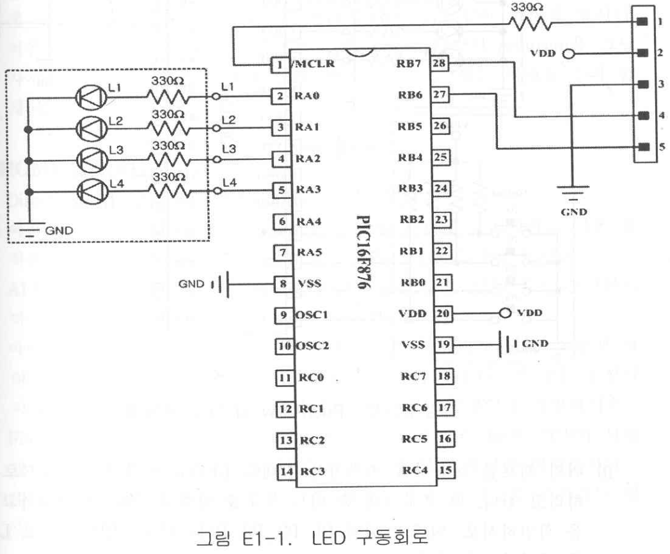
EX2-1.asm (1/2)

Slide 3
EX2-1.asm (2/2)
PROCESSOR 16F876A
INCLUDE <P16F876A.INC>
; MAIN PROGRAM
ORG 0000
BSF STATUS, RP0 ; BANK를 1로 변경함
MOVLW B'00000000'
MOVWF TRISA
MOVLW B'00001111'
MOVWF TRISC
MOVLW B’00000111’ ; PORTA를 DIGITAL I/O로 사용
MOVWF ADCON1
BCF STATUS, RP0 ; BANK를 0으로 변경
MOVLW 00H
MOVWF PORTA ; PORTA 초기화
LOOP INCF PORTA, F ; PORTA를 1씩 증가시킴
GOTO LOOP
END

Slide 4
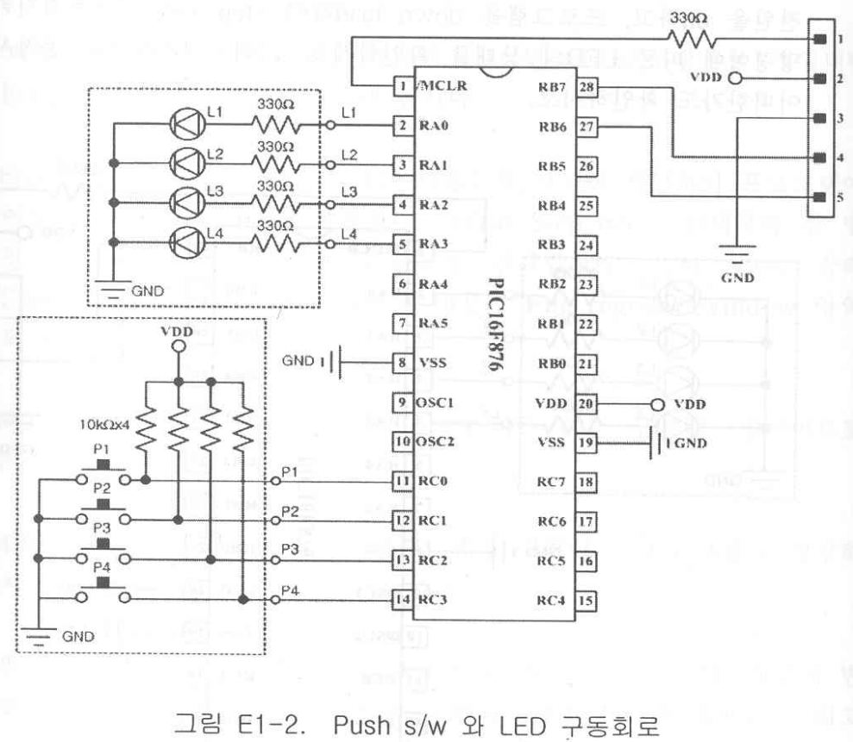
EX2-2.asm, EX2-3.asm

Slide 5
EX2-2.asm
PROCESSOR 16F876A
INCLUDE <P16F876A.INC>
ORG 0000
BSF STATUS, RP0
MOVLW B'00000000'
MOVWF TRISA
MOVLW B'00001111'
MOVWF TRISC
MOVLW B'00000111'
MOVWF ADCON1
BCF STATUS, RP0
LOOP
MOVF PORTC, W
MOVWF PORTA
GOTO LOOP
END

Slide 6
EX2-3.asm
PROCESSOR 16F876A
INCLUDE <P16F876A.INC>
ORG 0000
BSF STATUS, RP0
MOVLW B'00000000'
MOVWF TRISA
MOVLW B'00001111'
MOVWF TRISC
MOVLW B'00000111'
MOVWF ADCON1
BCF STATUS, RP0
LOOP
COMF PORTC, W
MOVWF PORTA
GOTO LOOP
END

