Slide 1
Physics-Inspired Upsampling for Cloth Simulation in Games
Jiong Chen
November 18, 2015

Slide 2

Challenges
Current games are complex pieces of software
Rendering, animation, AI, gameplay, HCI, networking…
Time budget for cloth: 1ms

Slide 3
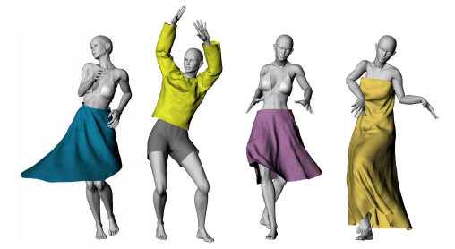
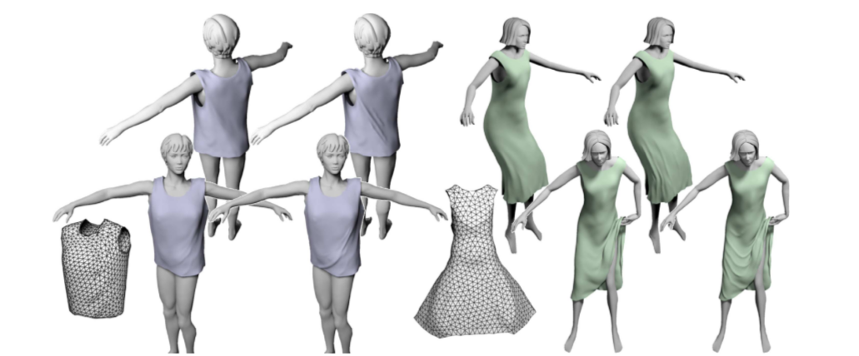
Wrinkle Synthesis
Add high-resolution detail to coarse simulations
Advanced nonlinear operators [Feng et al. 2010; Rohmer et al.2010]
Simplified fine-scale physics [Müller and Chentanez 2010]
Comprehensive databases of example shapes [Wang et al. 2010]

