Slide 1
Physics-Inspired Upsampling for Cloth Simulation in Games
Jiong Chen
November 18, 2015

Slide 2
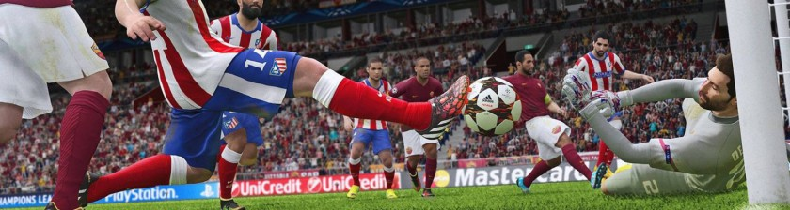
Overview
Current games are complex pieces of software
Rendering, animation, AI, gameplay, HCI, networking…
Time budget for cloth: 1ms -> Coarse Meshes
Notes:
While the computing power of modern GPUs is sufficient to simulate high-resolution meshes in real-time, many games choose to spend the majority of their GPU budgets on rendering. In the future we can expect more powerful hardware, however, light-weight solutions will always be important for the increasingly popular, low-power, mobile devices.

Slide 3
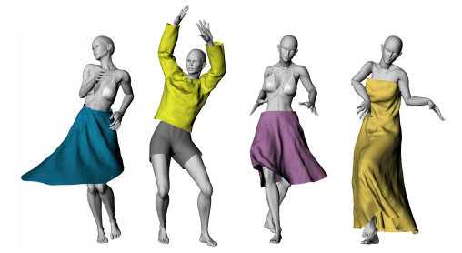
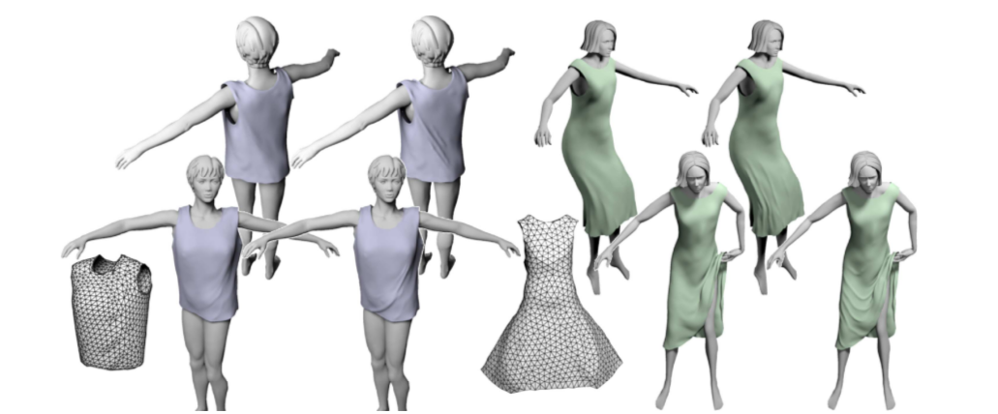
Wrinkle Synthesis
Add high-resolution detail to coarse simulations
Advanced nonlinear operators [Feng et al. 2010; Rohmer et al.2010]
Simplified fine-scale physics [Müller and Chentanez 2010]
Comprehensive databases of example shapes [Wang et al. 2010]

Slide 4
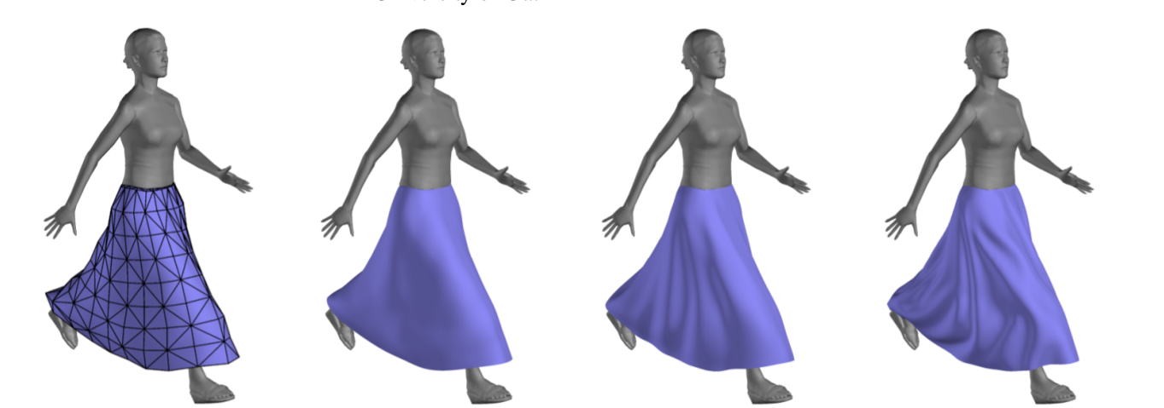
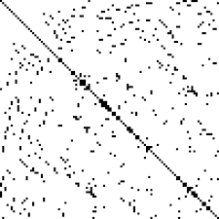
Key Words
Data driven
Linear upsampling operators
Dense upsampling matrices
Context specific
Mid-scale details
Limited generality but rich interactivity
Notes:
This trade-off is justified because in games interaction possibilities are often limited by design (e.g., the flag will not be removed from the pole and a skirt will always be attached at the waist). At the same time, we allow for rich interactivity in the chosen subspace (e.g., changing wind velocity or applying unexpected motions).

Slide 5
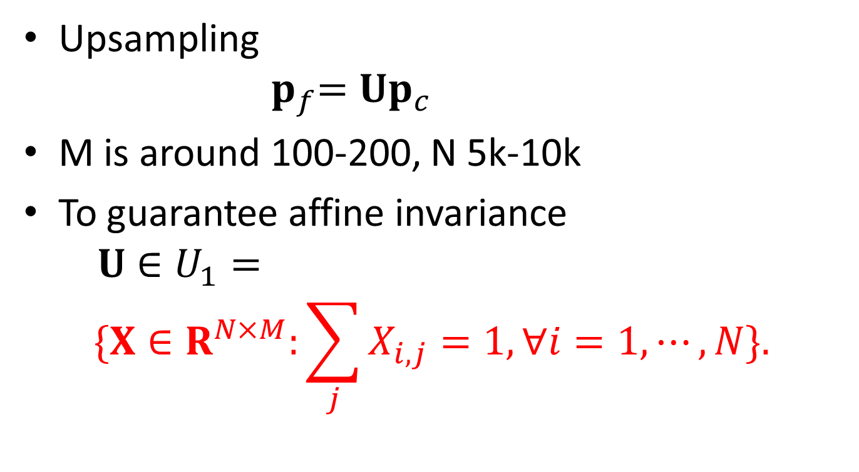
Learning Upsampling Operators
3
M
3
Upsampling
$${ p}_{f}=Up_{c}$$
M is around 100-200, N 5k-10k
To guarantee affine invariance
$$U∈U_{1}=$$
$$\{X∈R^{N×M}:\sum_{j}{X_{i,j}=1, ∀i=1,⋯, N\}. }$$
.
M
N
=
N

Slide 6
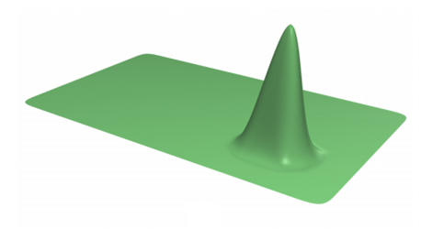
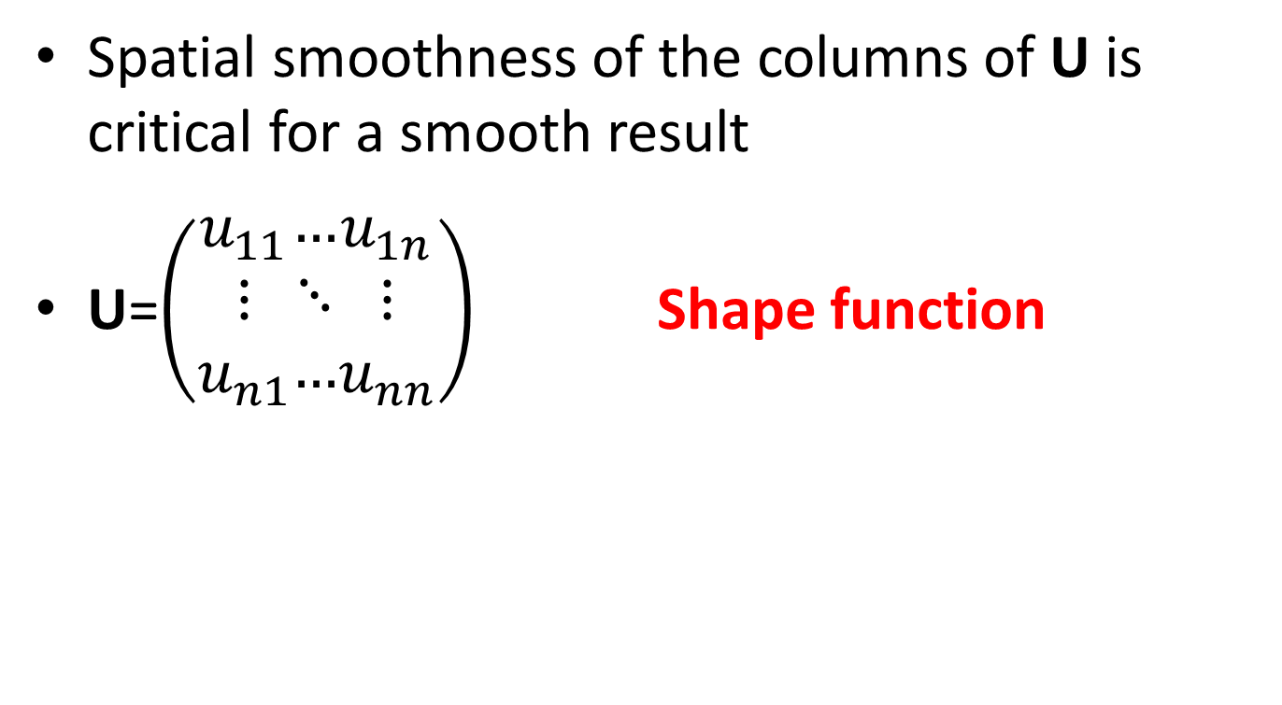
Learning Upsampling Operators
Spatial smoothness of the columns of U is critical for a smooth result
U=$\left(\begin{aligned}u_{11} \\ ⋮ \\ u_{n1}\end{aligned}\begin{aligned}… \\ ⋱ \\ …\end{aligned}\begin{aligned}u_{1n} \\ ⋮ \\ u_{nn}\end{aligned}\right)$ Shape function
Loop subdivision
Notes:
to visualize them we use a flat rectangular mesh. For example, one of the shape functions of a Loop subdivision matrix is shown in Figure 3a.

Slide 7
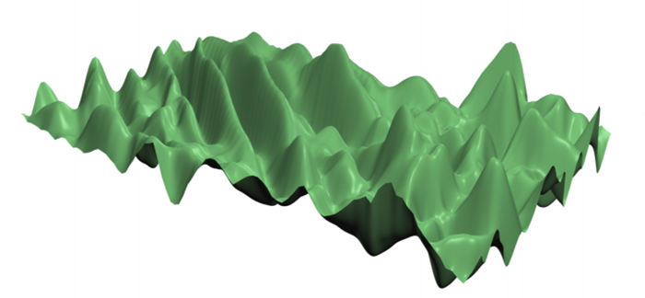
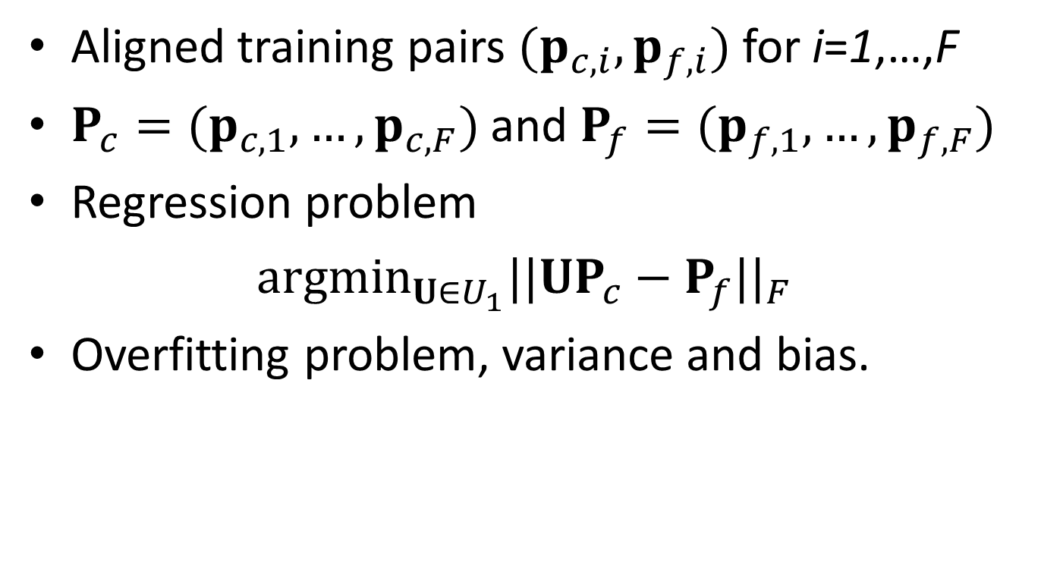
Data Term
Aligned training pairs $(p_{c,i},p_{f,i})$ for i=1,…,F
$P_{c}=(p_{c,1},…,p_{c,F})$ and $P_{f}=(p_{f,1},…,p_{f,F})$
Regression problem
${argmin}_{U∈U_{1}}||UP_{c}−P_{f}||_{F}$
Overfitting problem, variance and bias.
Notes:
However, even with enough training data so that Pc is numerically well conditioned (i.e., an overconstrained problem), this approach often results in shape functions that overfit, as can be seen in Figure 3b. While optimally reconstructing the input data, even a small perturbation away from the training frames can lead to very non-smooth results.
The model is too complex and the data is not enough.
Training data has noise, so that training data and testing data has different distribution
Solution: restrict the learning of machine

Slide 8
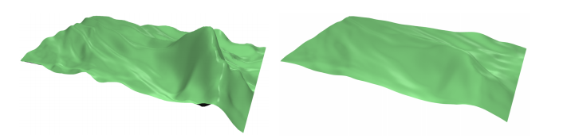
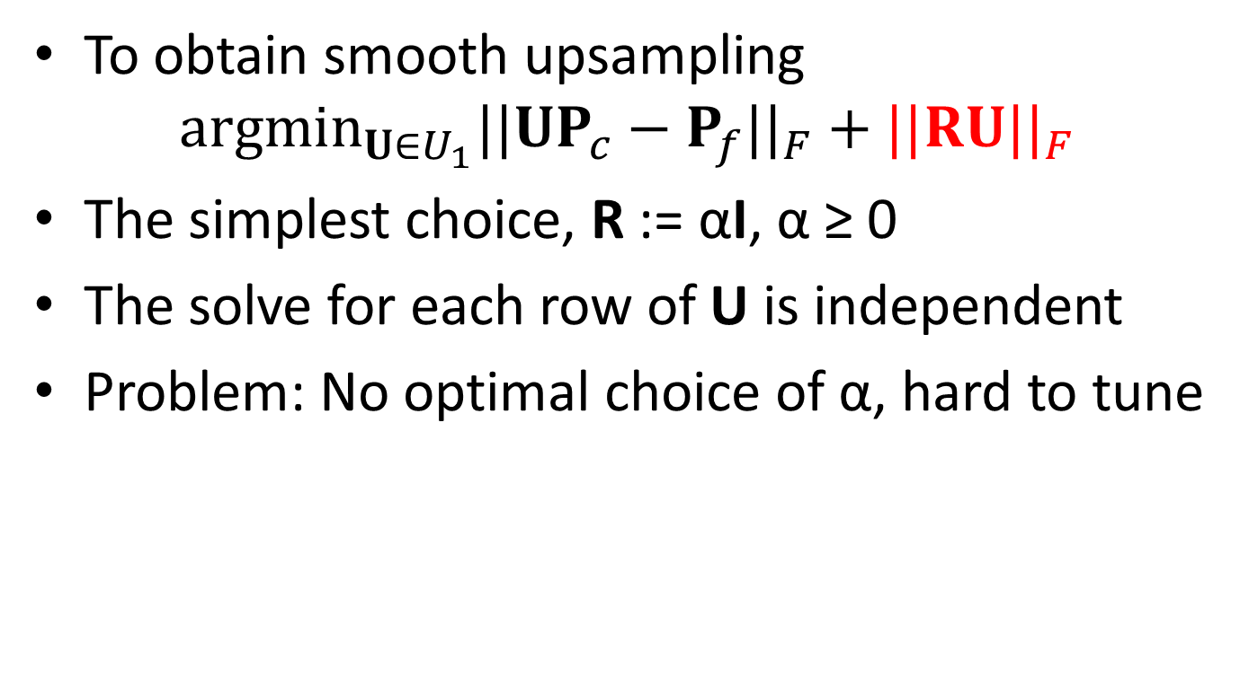
Harmonic Regularization
To obtain smooth upsampling
$${argmin}_{U∈U_{1}}||UP_{c}−P_{f}||_{F}+||RU||_{F}$$
The simplest choice, R := αI, α ≥ 0
The solve for each row of U is independent
Problem: No optimal choice of α, hard to tune
α=1
α=2
Notes:
We also experimented with a L1-norm of the regularization term (sum of absolute values) instead of the Frobenius norm. The absolute values metric produces sparse, but, unfortunately, not very smooth shape functions. Also, the required optimization routines are much more complex.
for small α, the noisy high frequencies are not damped enough, and larger values of α quickly begin to suppress the desirable low frequencies.

Slide 9
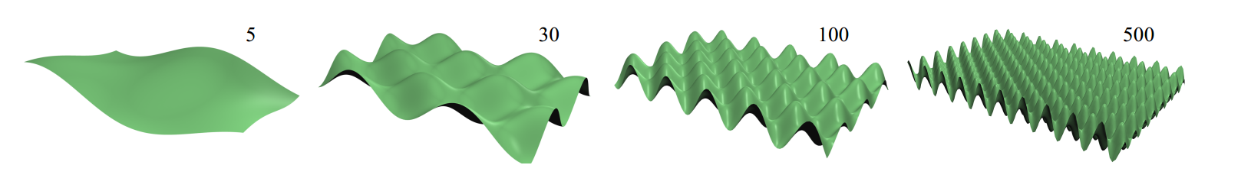

Harmonic Regularization
Another choice, R = αL, L := ${\sqrt{V}}^{−1}$C ${\sqrt{V}}^{−1}$
Spatial dependencies, N$×$M unkowns, not sparse
Not prevent overfitting in low frequencies
Harmonic regularization: $L=QΛQ^{T}$
$$||αLU||=α||LU||=α||QΛQ^{T}U||=α||ΛQ^{T}U||$$
$$||UP_{c}−P_{f}||=||Q^{T}UP_{c}−Q^{T}P_{f}||$$
$\hat{U}=Q^{T}U$
$$argmin_{\hat{U}∈Q^{T}(U_{1})}||\hat{U}P_{c}−Q^{T}P_{f}||+α||Λ\hat{U}||$$
$$U=Q\hat{U}$$
Notes:
which is prohibitively expensive for user tuning with different training datasets and regularization parameters (note that the system matrix depends on both Pf and α).

Slide 10
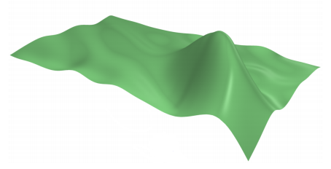

Harmonic Regularization
Low frequency harmonics ⬄ small eigenvalue
$αΛ→Γ, with γ_{n}=a{\left(1+b\left(\frac{n−1}{N}\right)\right)}^{c}$
$n=1,…,N and a,b,c≥0$
a=0.8, b=10, c=4
Notes:
the singular values corresponding to low-order harmonics are very small and therefore these modes are not regularized enough.

Slide 11
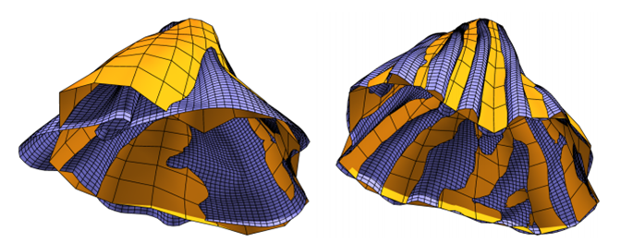
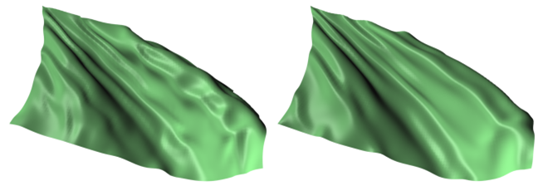

Tracking
Good training data is crucial, $(p_{c,i},p_{f,i})$
Need tracking constraints for alignment
$$Tp_{f}=TBp_{c}$$
B: barycentric interpolation operator
T: test function. Spatial? Freqency?
T as low-pass filter here
$$T=\left[\begin{aligned}q_{1}^{T} \\ ⋮ \\ q_{t}^{T}\end{aligned}\right]$$
Compare similarity in the row space of T
[Bergou et al. 2007]
Notes:
Even with carefully selected mesh independent simulation parameters, the two simulations will behave differently because the finer one can represent higher frequencies; these small differences (along with numerical errors) accumulate over time and can cause the two simulations to bifurcate to different states.

Slide 12


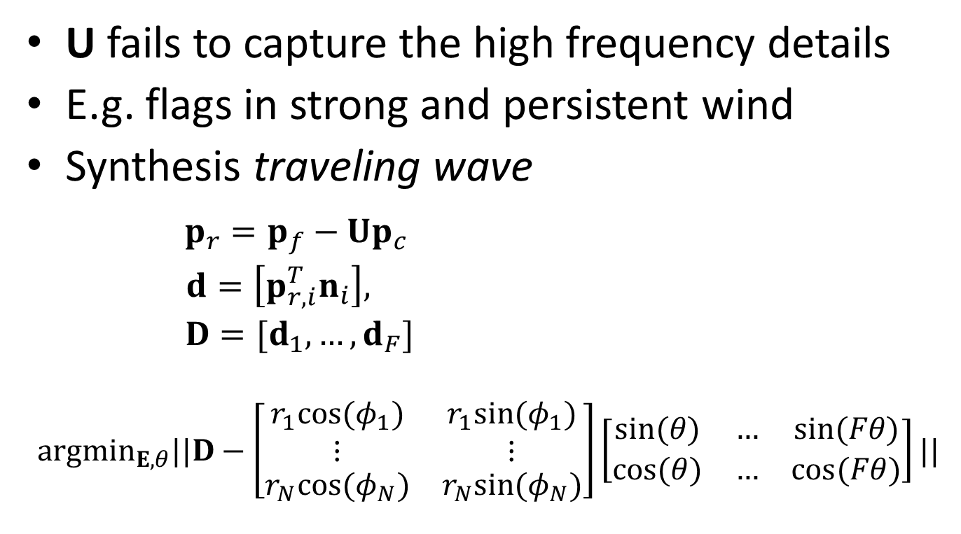
Adding Oscillatory Modes
U fails to capture the high frequency details
E.g. flags in strong and persistent wind
Synthesis traveling wave
$p_{r}=p_{f}−Up_{c}$
$d=\left[p_{r,i}^{T}n_{i}\right],$
$D=[d_{1},…,d_{F}]$
$$argmin_{E,θ}||D−\left[\begin{matrix}\begin{aligned}r_{1}cos⁡(φ_{1}) \\ ⋮\end{aligned} & \begin{aligned}r_{1}sin⁡(φ_{1}) \\ ⋮\end{aligned} \\ r_{N}cos⁡(φ_{N}) & r_{N}sin⁡(φ_{N})\end{matrix}\right]\left[\begin{matrix}sin⁡(θ) & … & sin⁡(Fθ) \\ cos⁡(θ) & … & cos⁡(Fθ)\end{matrix}\right]||$$
E
Ω(ϴ)
Runtime: ${Up}_{c}+diag\left(E\left[\begin{matrix}\sin\left(rθ\right) \\ \cos\left(rθ\right)\end{matrix}\right]\right)n$

Slide 13
Results

Slide 14
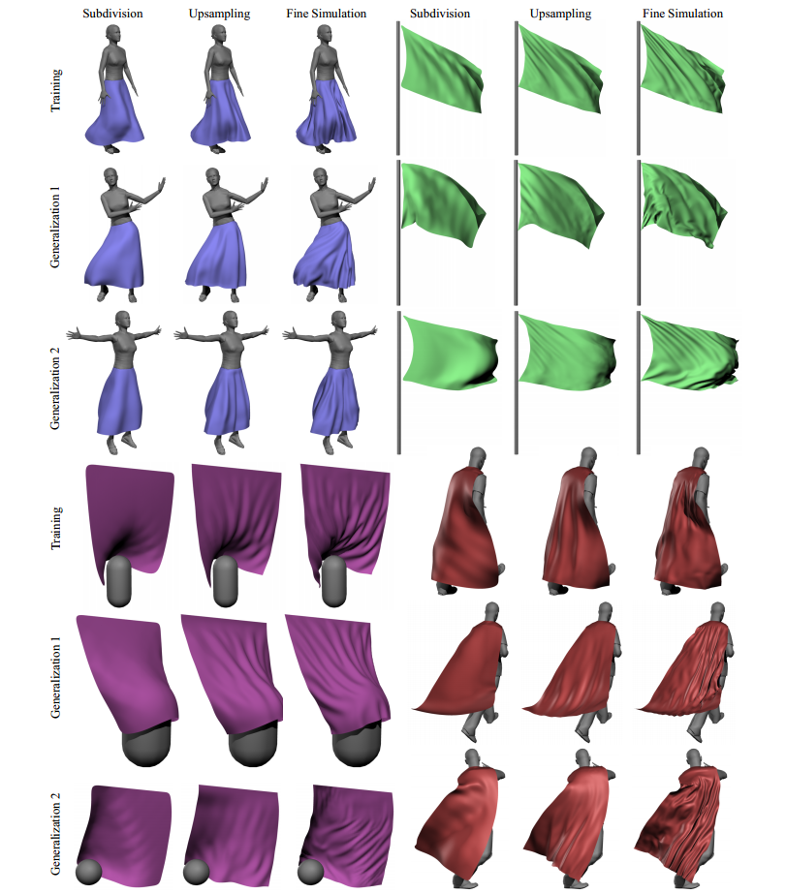

Slide 15
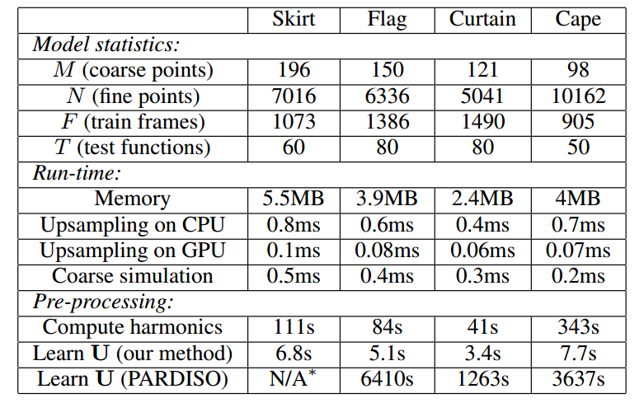
Results: Performance
Notes:
Bullet: single thread, CPU, 30ms on skirt

Slide 16
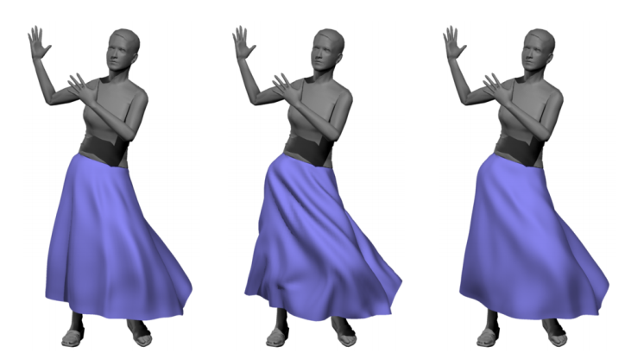
Results: Generalization
The upsampling operators can be applied to motions quite different from the training data
Limitations
Upsampled by walking data
Dancing simulation
Retrained result
Notes:
This limitation can be addressed by constructing a new operator U for the dance animation, see Figure 10 (right). An interesting extension would be to learn multiple versions of U and blend between them at run-time

Slide 17
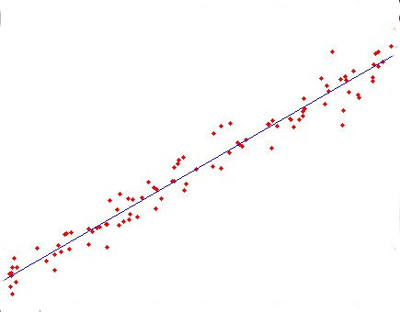
Conclusion
Fitting a nonlinear map using a linear one.
Non-physical subdivision & non-linear deformers.
Compress and sparsify the upsampling operators.
Add previous states of the coarse mesh to the regression.

Slide 18
Thanks!

