Slide 1
Use Analog Input to control Seven-segment Display

Slide 2
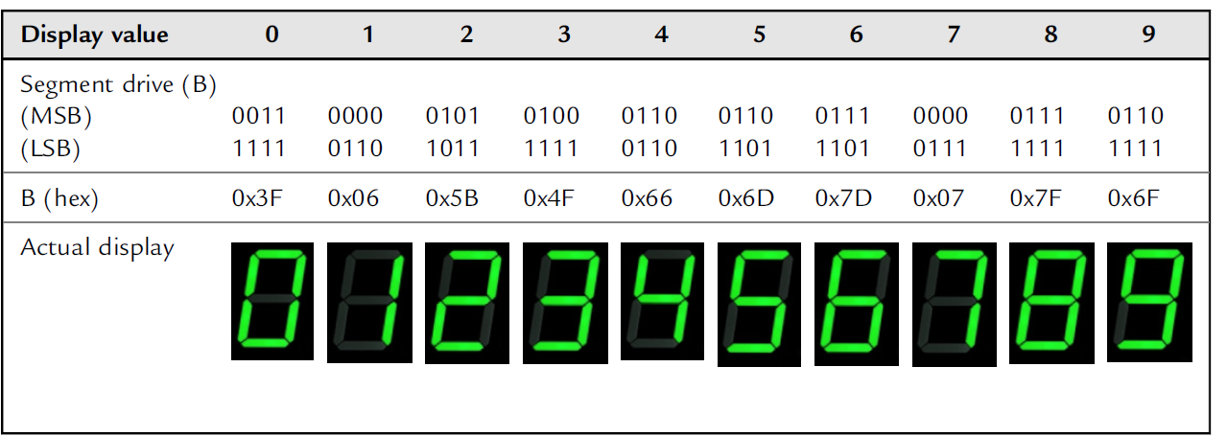
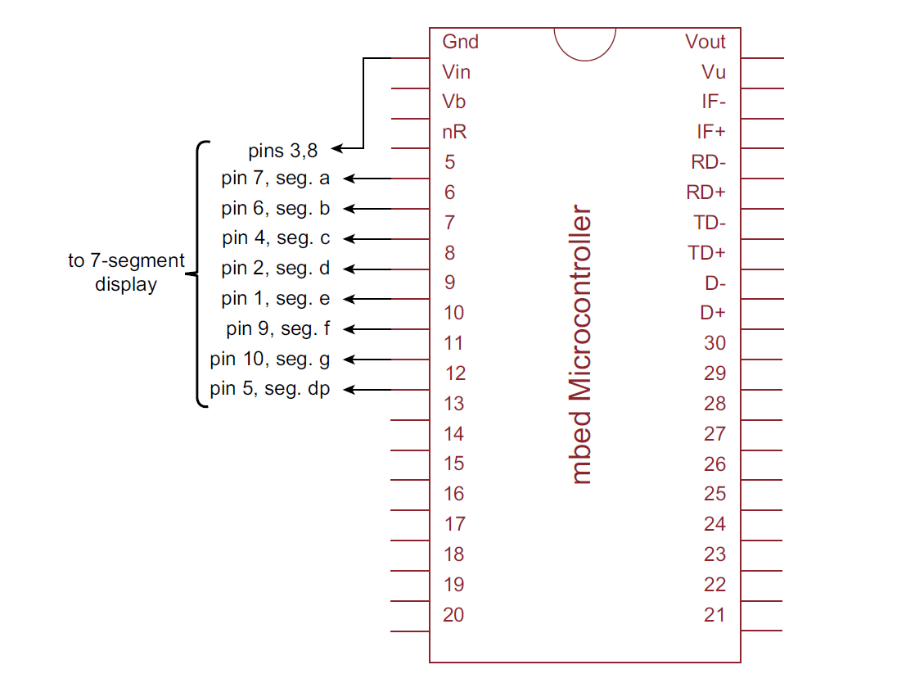
Seven segment driven by digit output

Slide 3
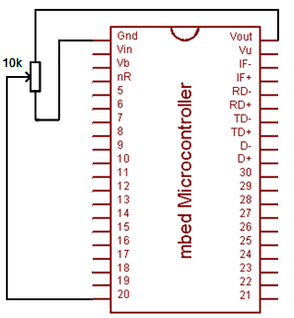
Potentiometer analog ouput to mbed pin 20

Slide 4
Code
#include "mbed.h"
BusOut display(p5,p6,p7,p8,p9,p10,p11,p12); // segments a,b,c,d,e,f,g,dp
AnalogIn Ain(p20); //input from Potentiometer
float ADCdata;
Serial pc(USBTX,USBRX);
//0, 1, 2, 3, 4, 5, 6, 7, 8, 9, .
char ssd[]={0x3F, 0x06, 0x5B, 0x4F, 0x66, 0x6D, 0x7D, 0x07, 0x7F, 0x6F, 0x80};
int main() {
pc.baud(115200);
pc.printf("ADC Data Values... \n\r");
while (1) {
ADCdata=Ain; //read
pc.printf("%f \n\r",ADCdata);
ADCdata = ADCdata>1?1: ADCdata;
display = ssd[(int)(ADCdata*10)]; //write
wait (1);
}
}

Slide 5
